Slide 1
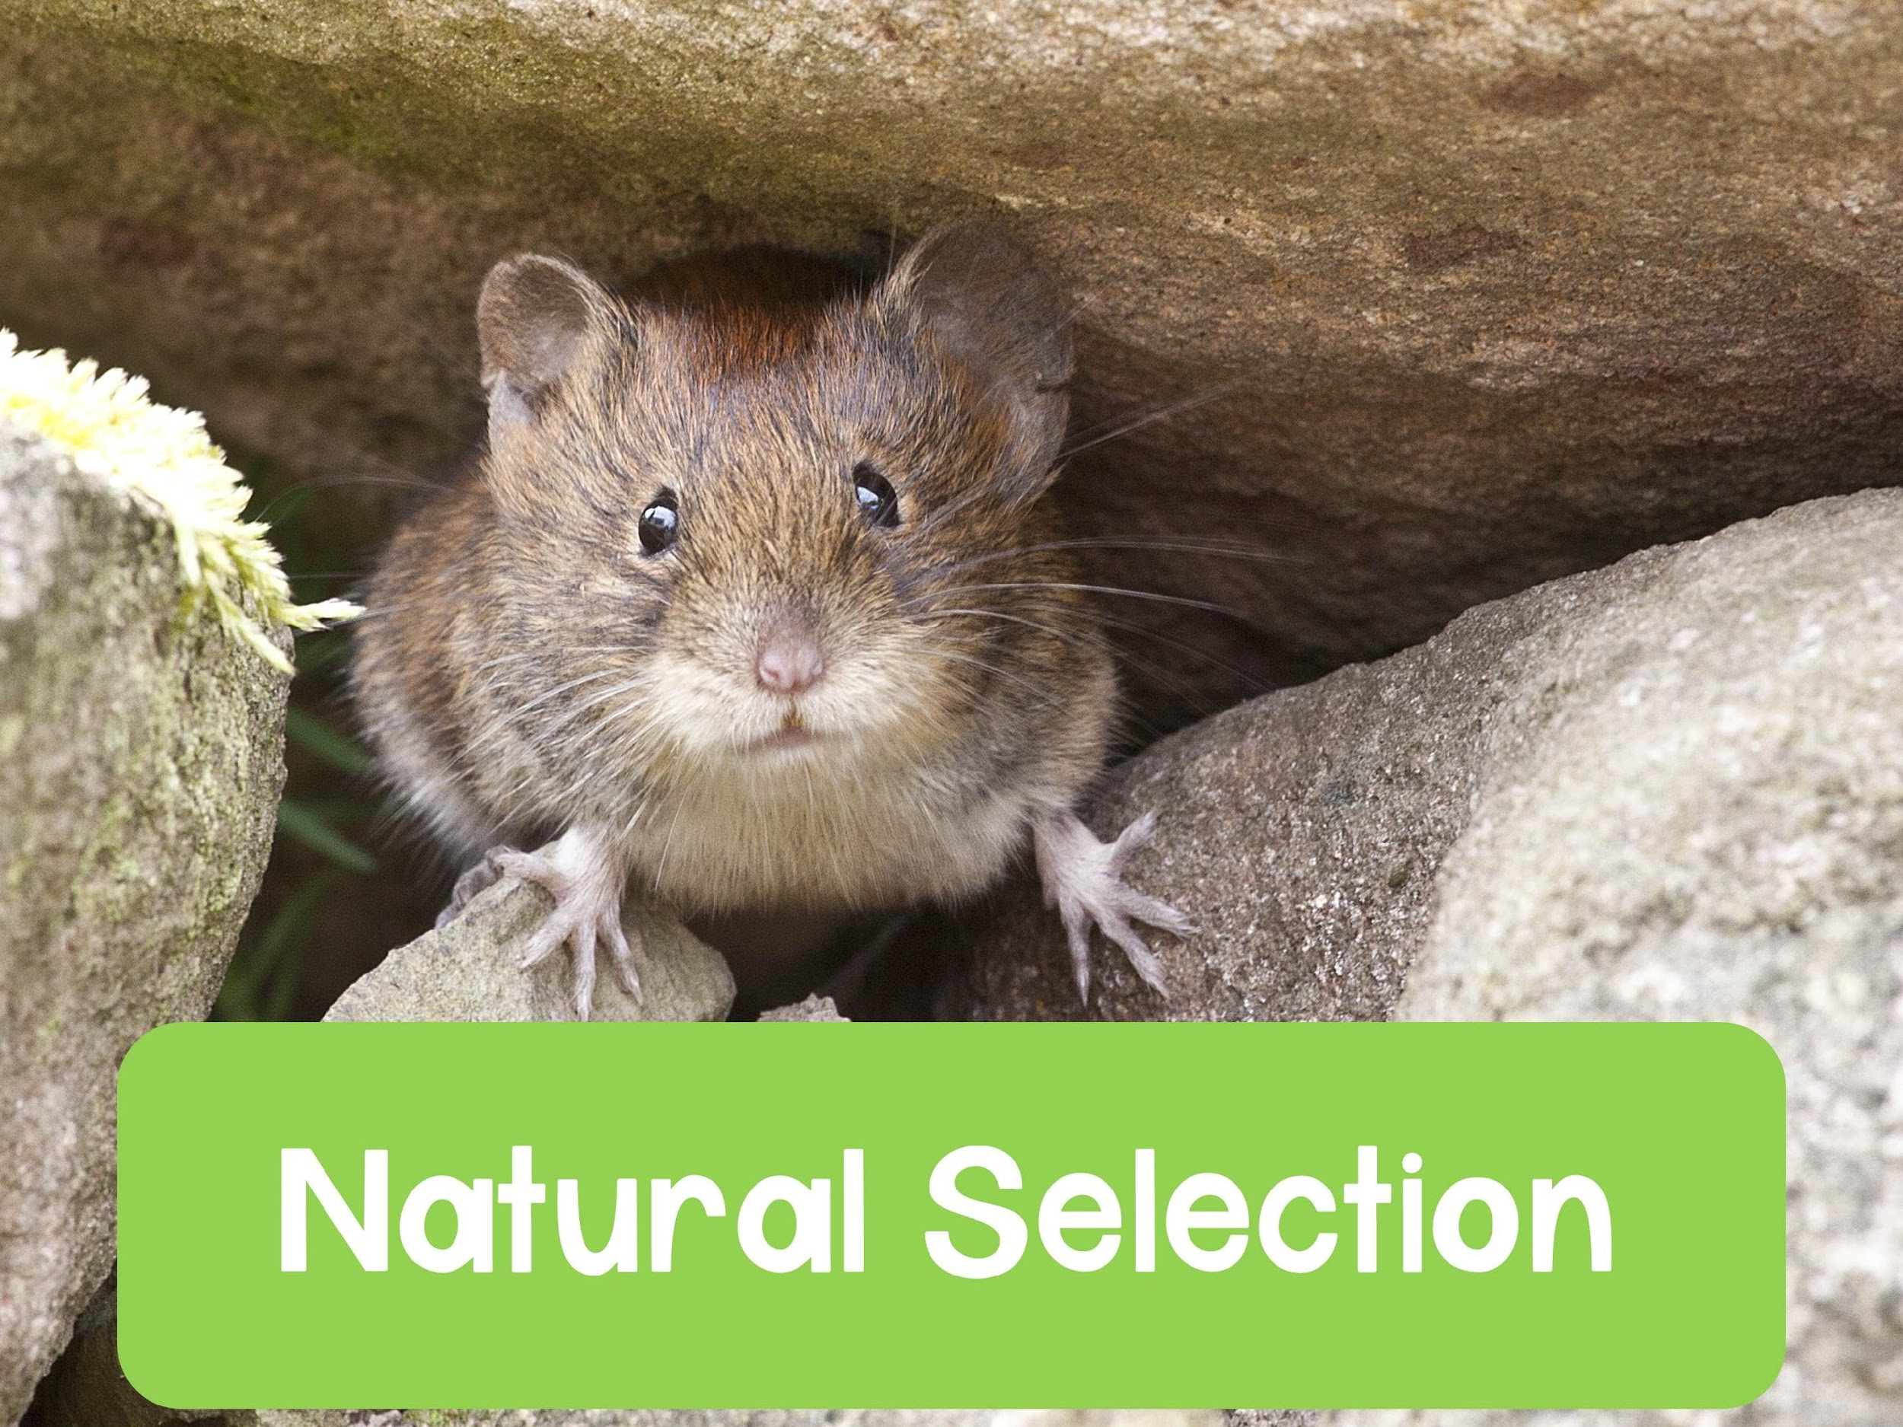

Slide 2
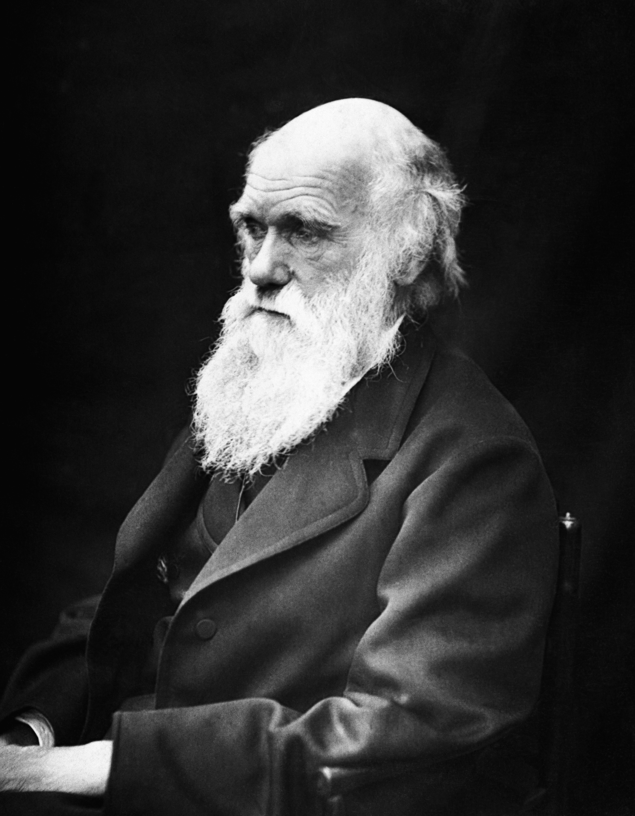
“It may be said that natural selection is daily and hourly scrutinizing, throughout the world, every variation, even the slightest; rejecting that which is bad, preserving and adding up all that is good; silently and insensibly working, whenever and wherever opportunity offers, at the
improvement of each organic being in relation to its organic and inorganic conditions of life. We see nothing of these slow changes in progress, until the hand of time has marked the long lapse of ages, and then so imperfect is our view into long past geological ages, that we only see that the forms of life are now different from what they formerly were.”
-- Charles Darwin On the Origin of Species
Notes:
I love to start the unit off with this quote. To me this is one of the most beautiful quotes from On the Origin of Species, written by Charles Darwin. It perfectly summarizes his ideas of natural selection. I like to have students get into pairs and discuss what this quote means in terms of the unit.

Slide 3
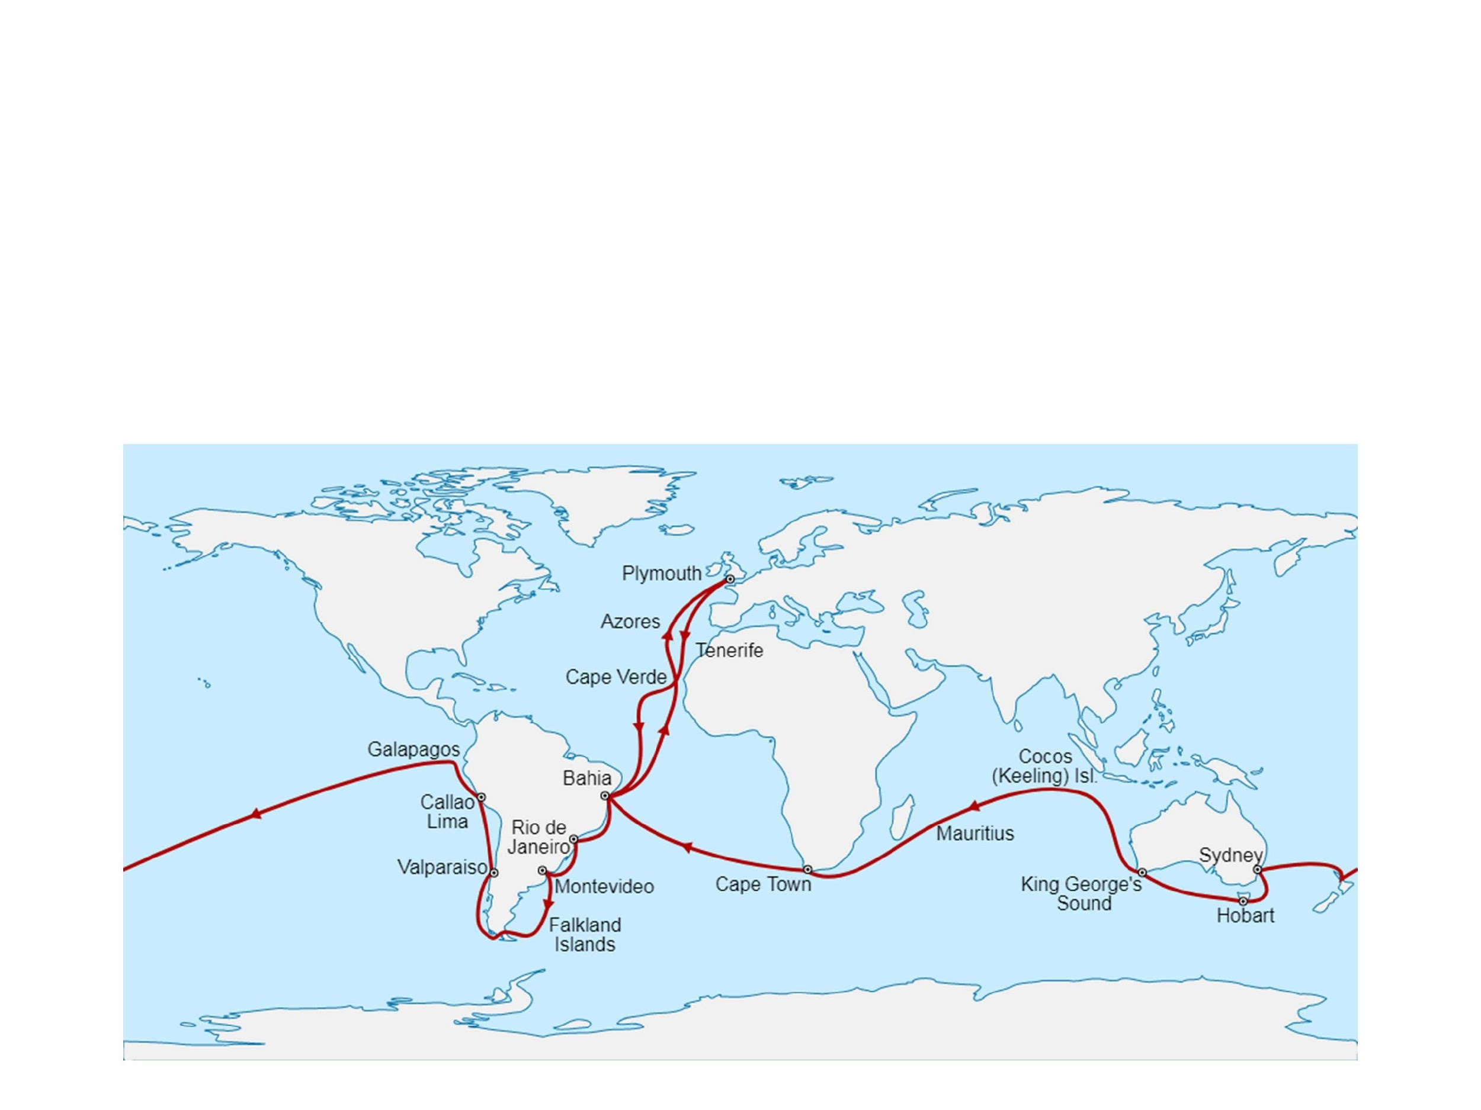
Charles Darwin
English naturalist
Most notable research was done at the Galapagos Islands
Notes:
The Galapagos islands are near the equator and about 900 km west of South America

Slide 4
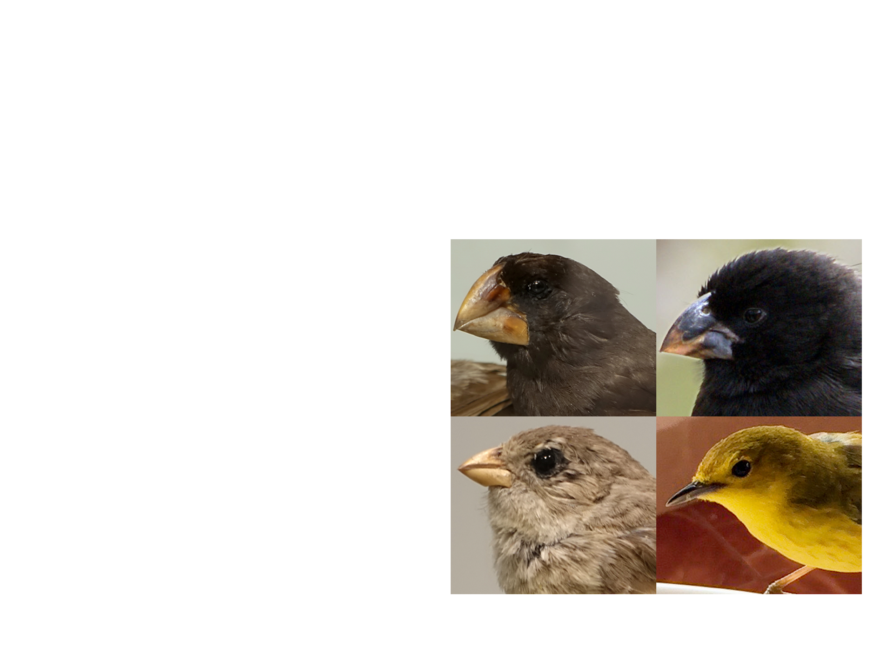
Charles Darwin’s Research
Darwin was interested in biogeography
  The geographic distribution of species
Darwin’s hypothesis:
  Organisms left South America and colonized the Galapagos Islands where they then diversified and gave rise to new species
  Darwin was specifically interested in finches

Slide 5
True or False?
Before we delve into the theories of natural selection and descent with modification, let’s play a game of true or false.
Game Play:
You will be given a total of FOUR statements. You and a partner must decide if the statement is true or false. Once you choose, you must then try to justify your logic.
Notes:
My students usually get pretty into this when we play. I don’t make them take notes, but many students choose to. So it’s up to you! Some of the logic is on the longer side, so I have them try to summarize it in their own words if they do take notes. I like to do this because it really nips misconceptions in the bud! So many students come into class with misconceptions, and I do NOT want them to carry them through the unit. These are the top 4 misconceptions I’ve encountered with students. If you have more than add them here!

Slide 6
Statement 1
Natural selection gives organisms what they need to survive
  FALSE: natural selection has no knowledge of what organisms “need.” Natural selection simply acts on genetic variations that lead to survival and reproduction

Slide 7
Statement 2
Natural selection acts for the good of a species
  FALSE: Natural selection has no intentions. It only acts on traits that lead to survival and reproduction.
    Just because a trait leads to survival doesn’t mean it’s good for the species.
    For example, let’s say we have a species of predators that have a trait that makes them the BEST predator, over time they will eat all of their prey! If they run out of a food source, they will starve and die!

Slide 8
Statement 3
Natural selection is a process involving organisms trying to adapt to their surroundings
  FALSE: Natural selection acts on random mutations that have lead to a genetic variation in the population.
  Organisms cannot close their eyes and cross their fingers and make a wish to adapt
Notes:
I like to give an example of beetles living in a forest. Let’s say in the beetle population we have two colors: green and brown. The brown color is due to a random mutation. If the forest is lush green, the green beetles will have a better chance of survival because they blend in. But now, let’s say a fire in the forest has left the foliage brown. NOW the brown beetles will have a better chance of survival because THEY can blend in. At no time were the beatles successfully closing their eyes and crossing their “fingers” wishing to be the color that would allow them to survive!

Slide 9
Statement 4
“Survival of the fittest” is a common phrase you may have heard. The term “fittest” refers to the organisms in a population that are the strongest, healthiest, and fastest.
  FALSE: the fittest organism simply refers to the organism that (you guessed it) can survive and reproduce
    For example, sickle cell anemia is a trait that leads to protection against malaria. But individuals with sickle cell anemia would not be classified as healthy

Slide 10
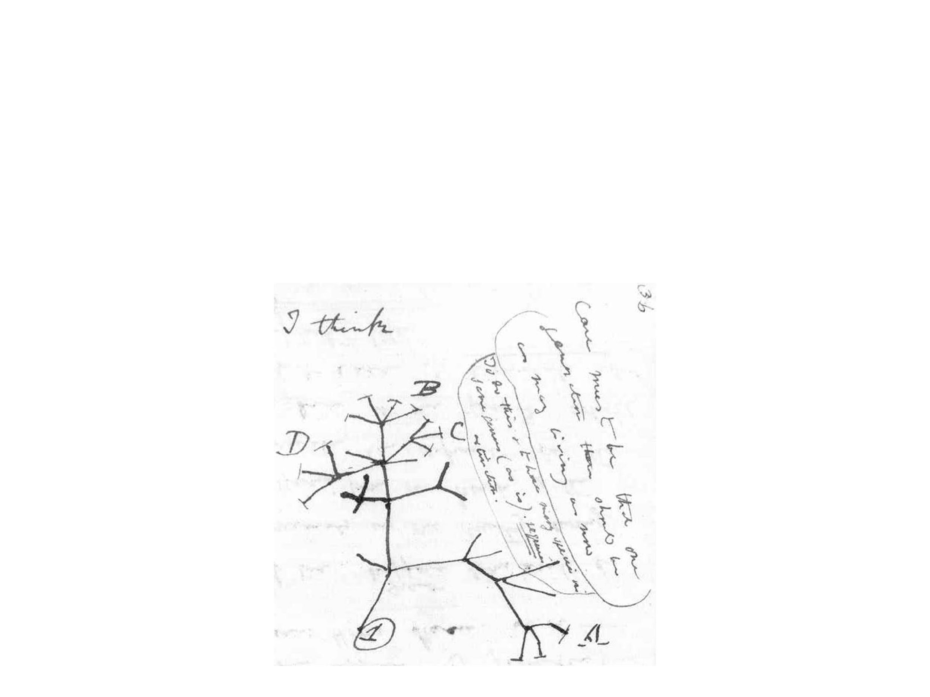
Evolution
During his studies, Darwin proposed the idea of descent with modification, which is now our modern definition of evolution
Notes:
It’s important to note that Darwin was influenced by previous scientists and their work. He did not come up with all of his ideas on his own. For example, he was influenced by paleontologists who studied fossils. and researchers like Carolus Linnaeus (who classified organisms and grouped them by similarity). He also did not use the term evolution, he used descent with modification to describe his observations.

Slide 11
Evolution
Evolution: change in the genetic makeup of a population over time; descent with modification
Heritable traits change from generation to generation
  To explain the pattern of descent with modification (evolution) he observed, Darwin proposed the idea of natural selection

Slide 12
Natural Selection
Natural selection: A process in which individuals that have certain traits tend to survive and reproduce at higher rates than other individuals because of those traits
  Natural selection acts on phenotypic variations in populations
    Some phenotypes will increase or decrease an organism’s fitness (ability to survive and reproduce)
      Measured by reproductive success
    Environments can change, causing selective pressures to populations
Notes:
Favorable refers to an organism’s ability to survive and reproduce

Slide 13
Natural Selection
The theory of natural selection is based on two main observations that Darwin made:
Traits are heritable
More offspring are produced than can survive
Notes:
Favorable refers to an organism’s ability to survive and reproduce

Slide 14
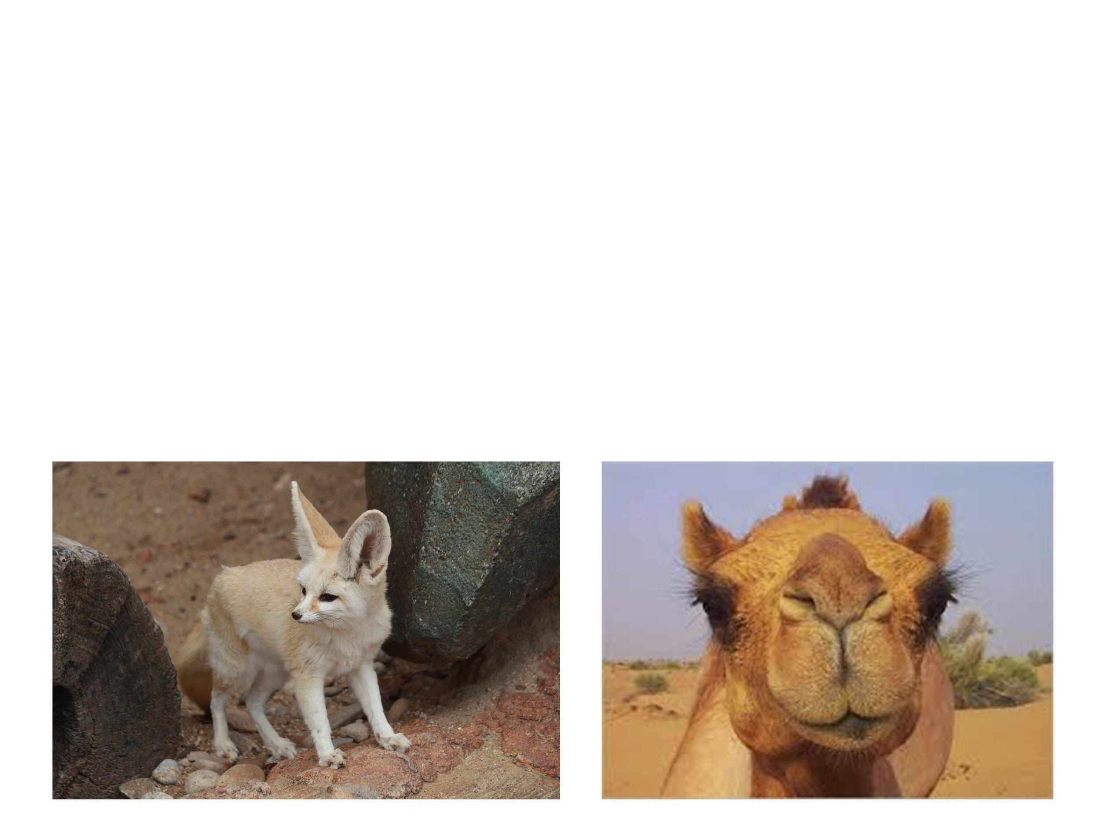
Natural Selection
1. Traits are heritable
Characteristics can be passed from parent to offspring
Adaptations: inherited characteristics of organisms that enhance their survival and reproduction
Notes:
Favorable refers to an organism’s ability to survive and reproduce. Examples: desert foxes have large ears that help in temperature regulation. Long eyelashes in camels help prevent sand from getting in their eyes and helps shield their eyes from the sun

Slide 15
Natural Selection
2. More offspring are produced than can survive
This leads to competition for limited resources, which results in differential survival
      The traits that lead to survival (“favorable” traits) will accumulate in the population
        Populations evolve, NOT individuals
Notes:
Favorable refers to an organism’s ability to survive and reproduce

Slide 16
Artificial Selection
At the time, Darwin was worried about other scientists supporting his work. So he compelled them by comparing natural selection to artificial selection
  Artificial selection: the selective breeding of domesticated plants and animals to encourage the occurrence of desirable traits
Notes:
Scientists were well aware of the practice of artificial selection, so Darwin argued that a similar process happens IN nature BY nature

Slide 17
Natural vs Artificial Selection
Natural Selection
Artificial Selection
Nature “selects” traits that are better suited for survival and reproduction
Humans select traits that are desirable
Domestication of plants and animals
Note: Both can lead to evolutionary change in the organism, but natural selection occurs in nature without the influence of humans

Slide 18
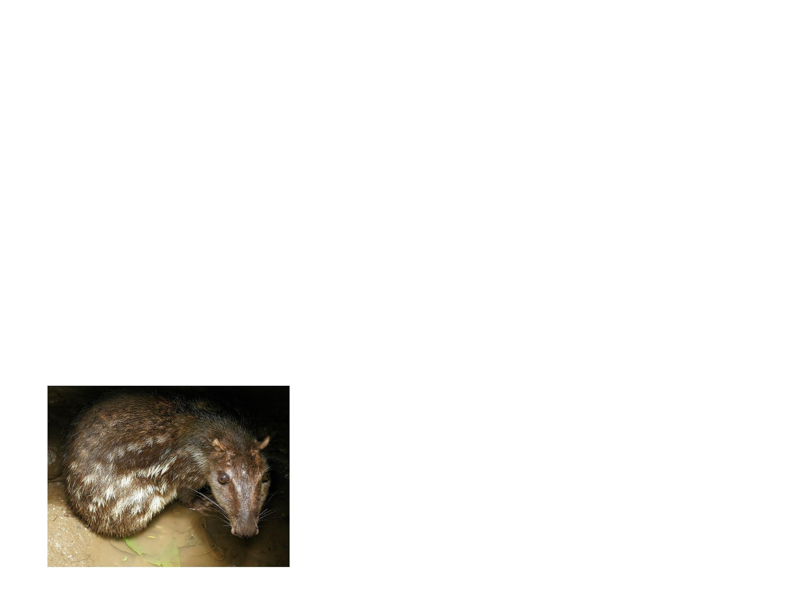
Practice Problem
A population of pacas, a nocturnal rodent, live in South America. Their diet consists of leaves, flowers, and fruits that have fallen from taller trees. A recent fire has wiped out much of the food that the pacas eat. This has caused the pacas to lose body mass. Due to the lack of food, subsequent generations of pacas are thinner than the preceding generations.
Identify if this is an example of descent with modification and justify your response.
Notes:
No, this is not an example of descent with modification because the change that the pacas are experiencing is due to an environmental influence. The lack of food is causing them to be smaller in size. The frequency of their genes has not changed. If the food supply were to increase, they would simply return to their normal body weight. Nature is not selecting for anything because there is NO trait to select for.

Slide 19
Practice FRQ
Work on the practice FRQ in your packet

