Slide 1
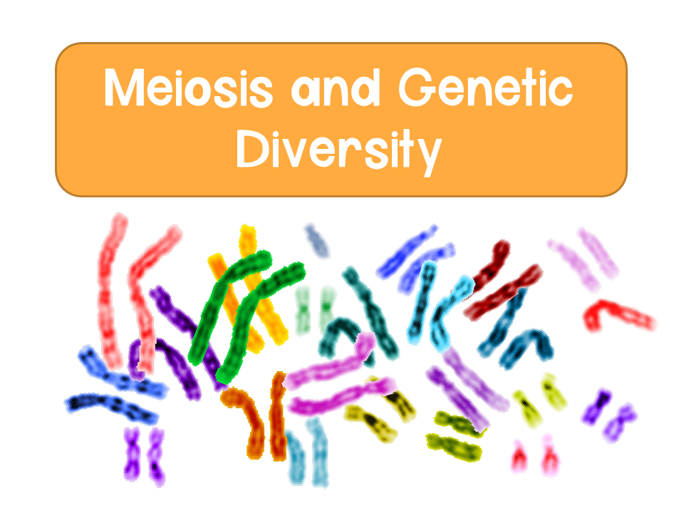
Notes:
Here are some helpful videos for meiosis:
Amoeba sisters: https://www.youtube.com/watch?v=VzDMG7ke69g
CrashCourse: https://www.youtube.com/watch?v=qCLmR9-YY7o
Bozeman: https://www.youtube.com/watch?v=16enC385R0w&t=422s

Slide 2
Heredity
Genetics: the study of heredity and hereditary variation
Heredity: the transmission of traits from one generation to the next
Traits are passed from parent to offspring through genes
    Segments of DNA that code for basic units of heredity
  Offspring acquire genes from parents by inheriting chromosomes

Slide 3
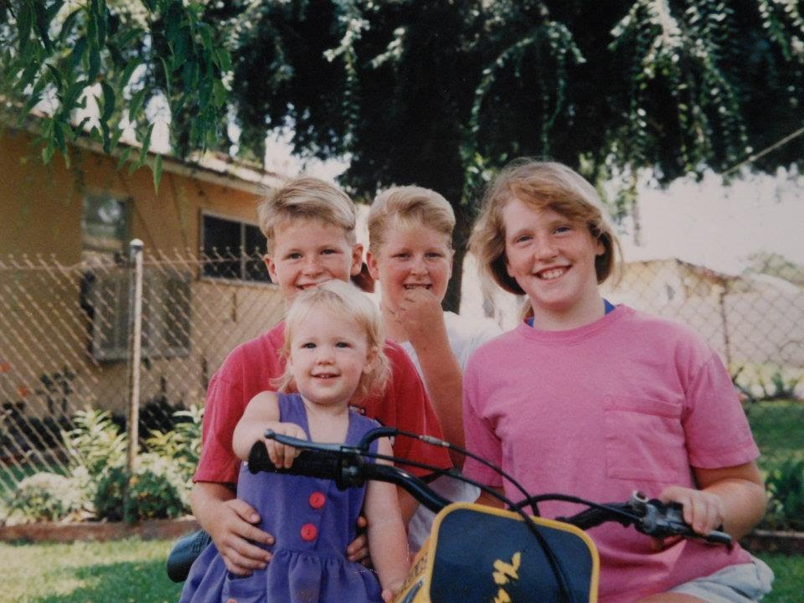
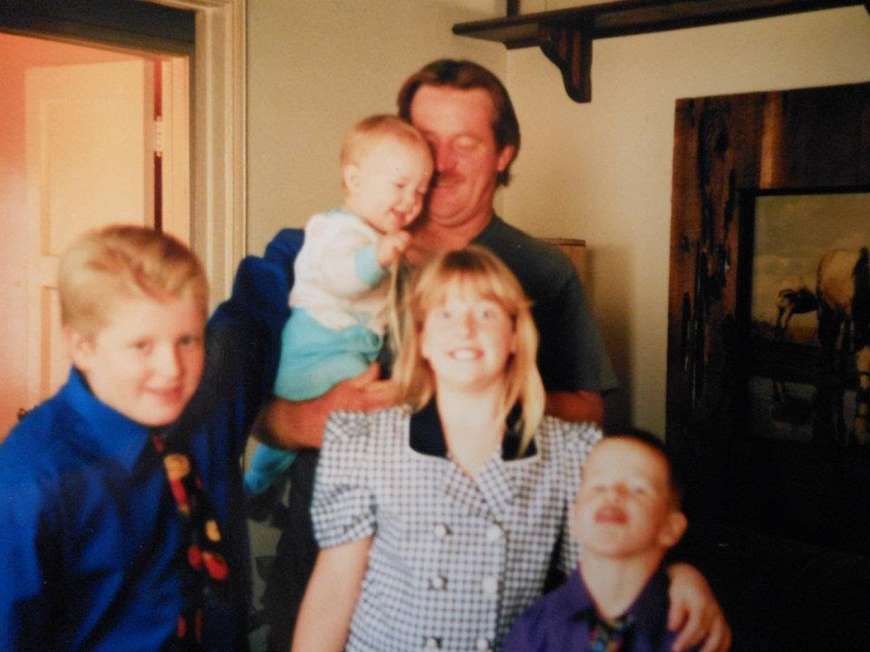
Notes:
If you are comfortable, you can put pictures of your parents and yourself here. Or any picture of parents and children. I usually do for my students so they can see how there are similarities, but variation when traits are passed on. Here are the images of my family that I show my students, so they can see the unique characteristics we have. Feel free to add your pictures here!

Slide 4
Asexual vs Sexual Reproduction
Asexual
Sexual
Single individual
No fusion of gametes
Clones: offspring are exact copies of parent
Mutations are the only source of variation
Can produce asexually through mitosis
Two parents (male/female)
Offspring are unique combinations of genes from parents
Genetically varied from parents and siblings

Slide 5
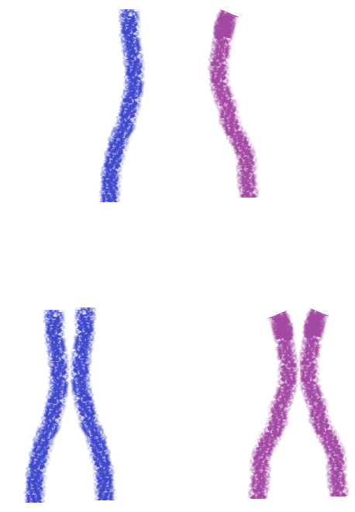
Homologous Chromosomes
Homologous chromosomes: a pair of chromosomes (same size, length, centromere position) that carry the same genetic information
One homologous chromosome is inherited from mom and one is inherited from dad
Homologous pair of chromosomes
Paternal
Maternal
Sister chromatids
Replication
Homologous pair of chromosomes

Slide 6
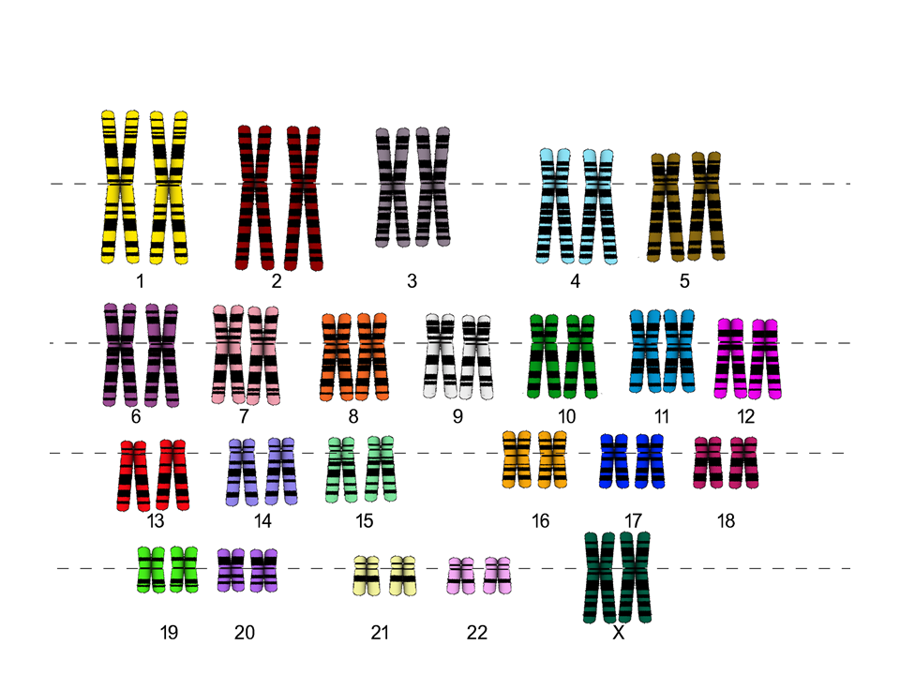
Karyotypes

Slide 7
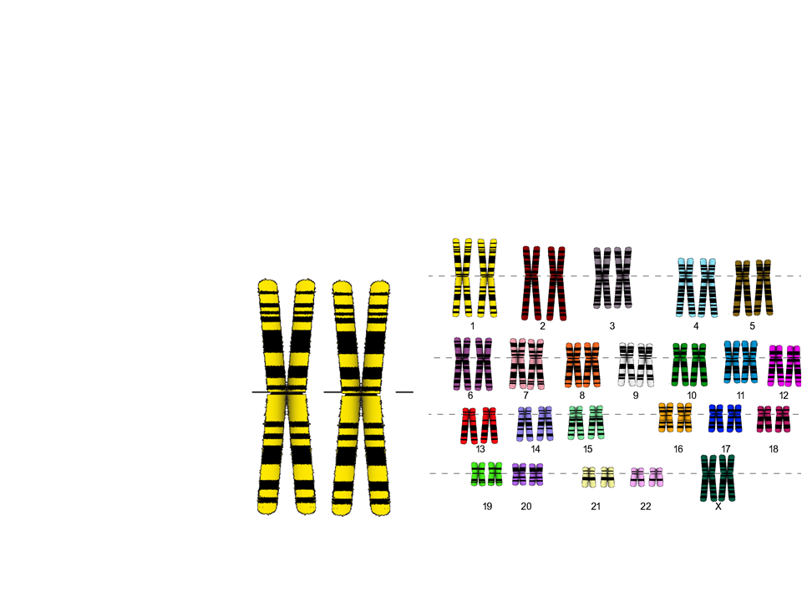
Karyotypes
Karyotypes: a display of chromosome pairs ordered by size and length
Pair of homologous duplicated chromosomes
Note: in actual karyotypes it is difficult to see the sister chromatids in each pair
Sister Chromatids

Slide 8
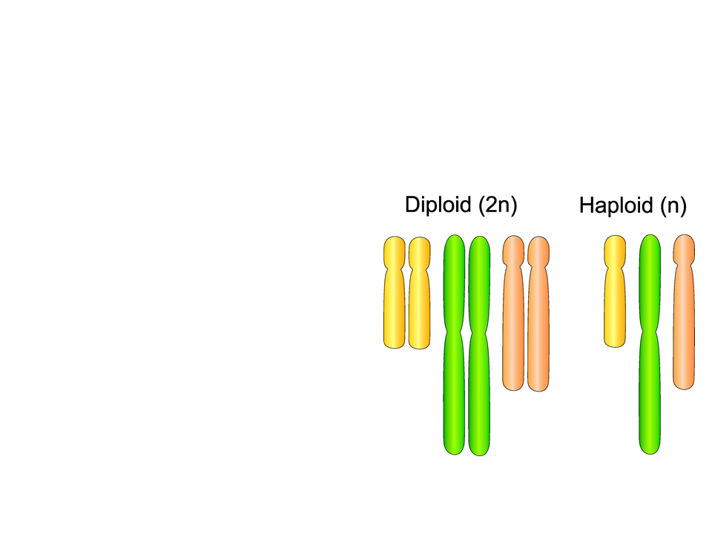
Cells and Chromosomes
Somatic (body) cells
  Diploid, or 2n: two complete sets of each chromosome
    Humans: 2n = 46
Gametic (sex) cells:
  Haploid, or n: one set of each chromosome
  Humans (sperm and eggs): n = 23

Slide 9
Cells and Chromosomes
Eukaryotes have DNA that is packaged in chromosomes
There are two types of chromosomes:
  Autosomes: chromosomes that do not determine sex (humans have 22 pairs)
  Sex chromosomes: X and Y
    Eggs: X (humans: 22 + X)
    Sperm: X or Y (humans: 22 + X OR 22 + Y)
Note: all sexually reproducing organisms have both a diploid and a haploid number

Slide 10
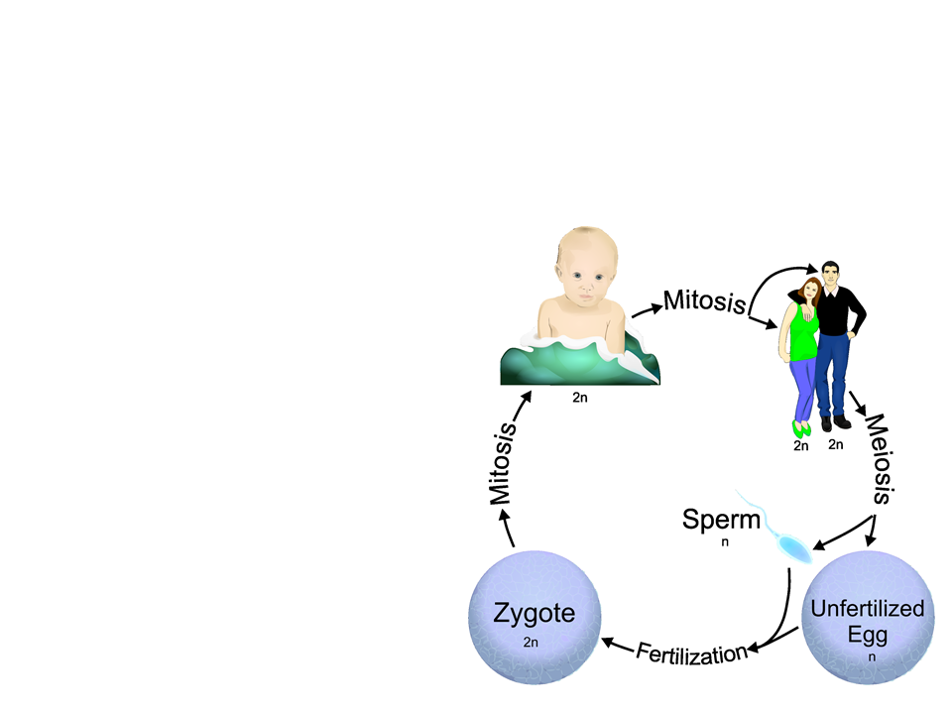
Life Cycles
Life cycle: sequence of stages in the reproductive history of an organism from conception to its own reproduction
Fertilization and meiosis alternate in sexual life cycles
  Fertilization is when a sperm cell (haploid) fuses with an egg (haploid) to form a zygote (diploid)
Notes:
I will walk through the image to the right with my students. I make sure to emphasize that one the zygote is formed, it will divide via mitosis.

Slide 11
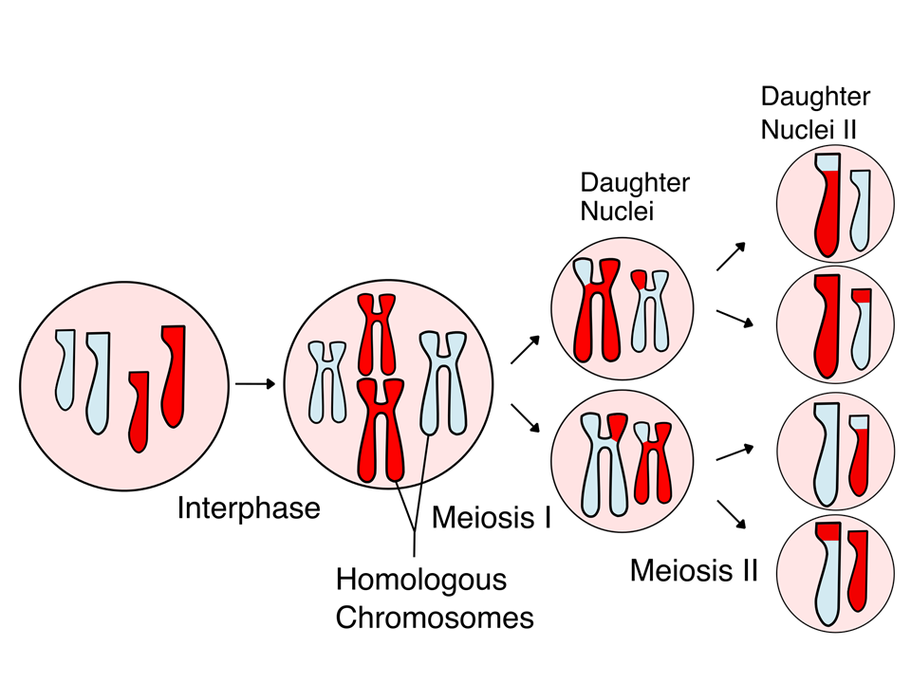
Meiosis

Slide 12
Meiosis
Meiosis: a process that creates haploid gamete cells in sexually reproducing diploid organisms
  Results in daughter cells with half the number of chromosomes as the parent cell
    Example: humans
      Diploid: 2n= 46
      Meiosis produces sperm and eggs that are haploid: n=23
  Involves two rounds of division
    Meiosis I and Meiosis II

Slide 13
Mitosis vs Meiosis
While meiosis is similar to mitosis, there are some key differences:
Mitosis
Meiosis
Occurs in somatic cells
1 division
Results in 2 diploid daughter cells
Daughter cells are genetically identical
Forms gametes (sperm/egg)
2 divisions
Results in 4 haploid daughter cells
Each daughter cell is genetically unique

Slide 14
Key Events in Meiosis
There are three key events in meiosis that are unique:
Prophase I: synapsis and crossing over
Metaphase I: tetrads (homologous pairs) line up at the metaphase plate
Anaphase I: homologous pairs separate

Slide 15
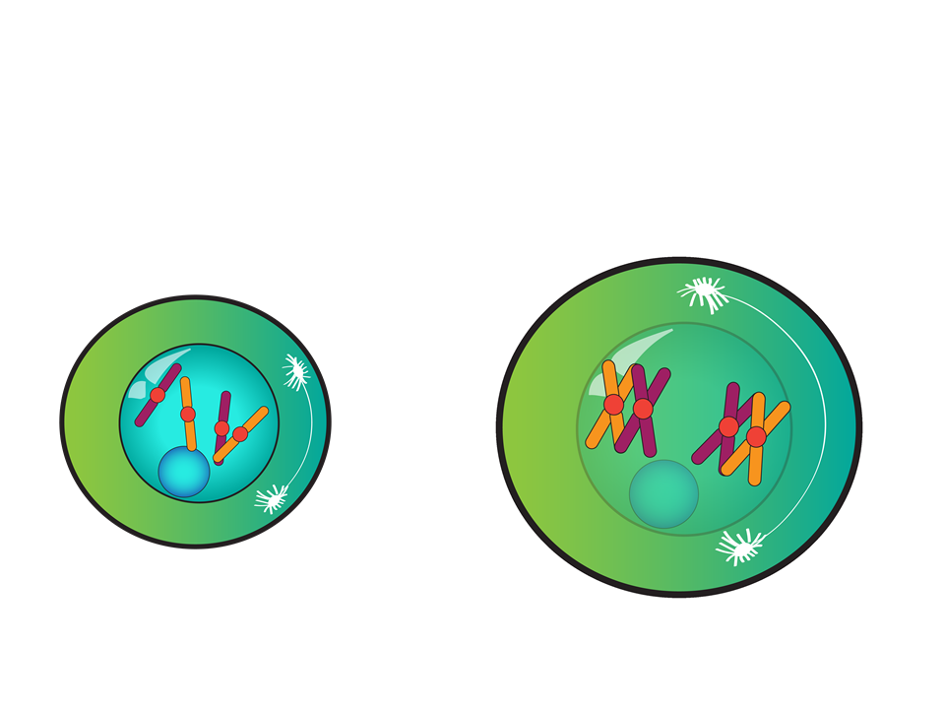
Meiosis I
Interphase: cell goes through G1, S (DNA is copied), and G2

Slide 16
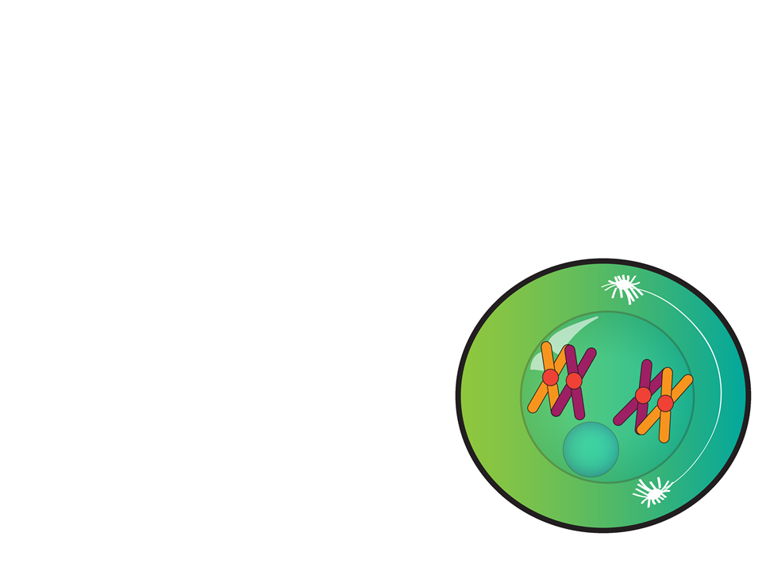
Meiosis I
Prophase I:
Synapsis: homologous chromosomes pair up and physically connect to each other forming a tetrad
    Crossing over (recombination) occurs at the chiasmata and DNA is exchanged between the homologous pairs
      Every chromatid that is produced has a unique combination of DNA

Slide 17
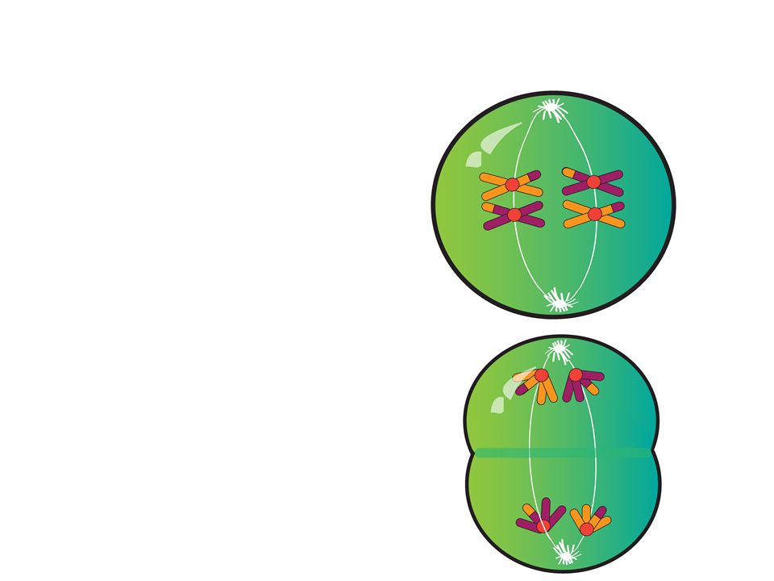
Meiosis I
Metaphase I
Independent orientation: tetrads line up at the metaphase plate
Anaphase I: pairs of homologous chromosomes separate
Sister chromatids are still attached

Slide 18
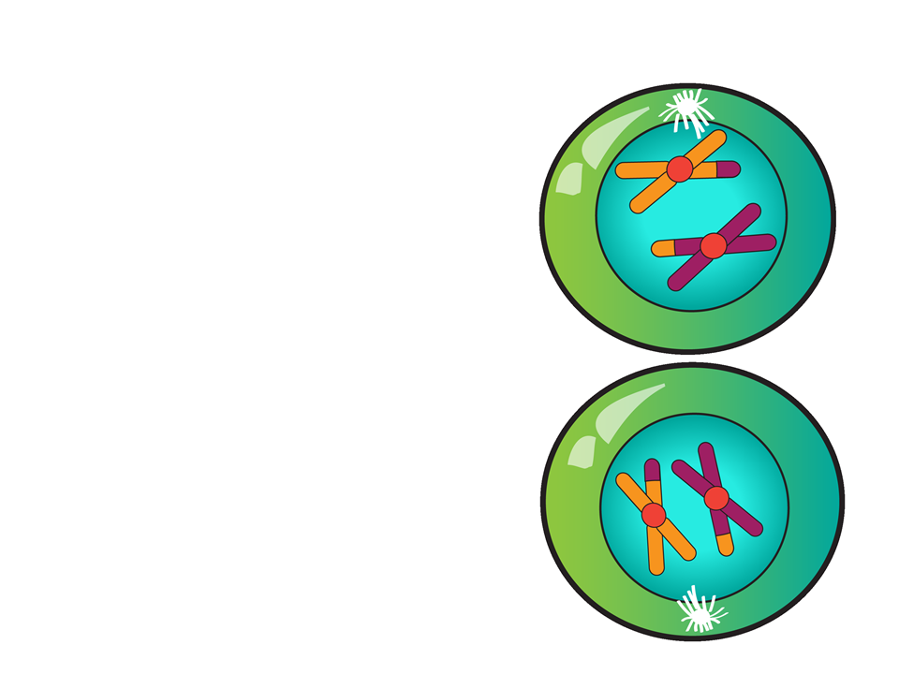
Meiosis I
Telophase I and Cytokinesis:
Nuclei and cytoplasm divide
There is now a haploid set of chromosomes in each daughter cell

Slide 19
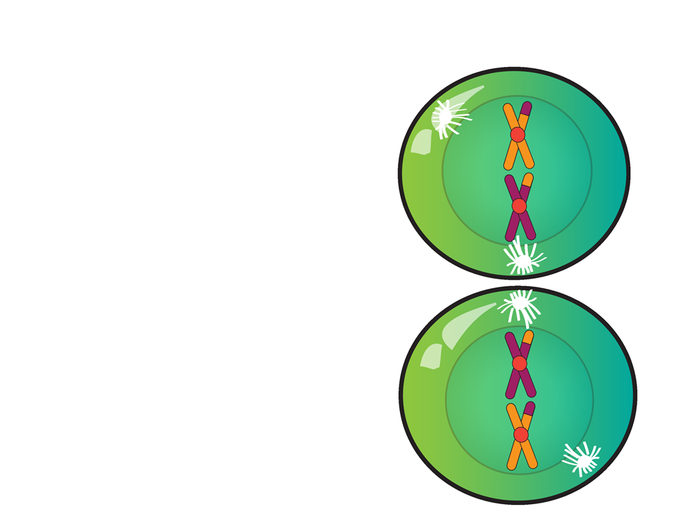
Meiosis II
Prophase II:
No crossing over
Spindle forms

Slide 20
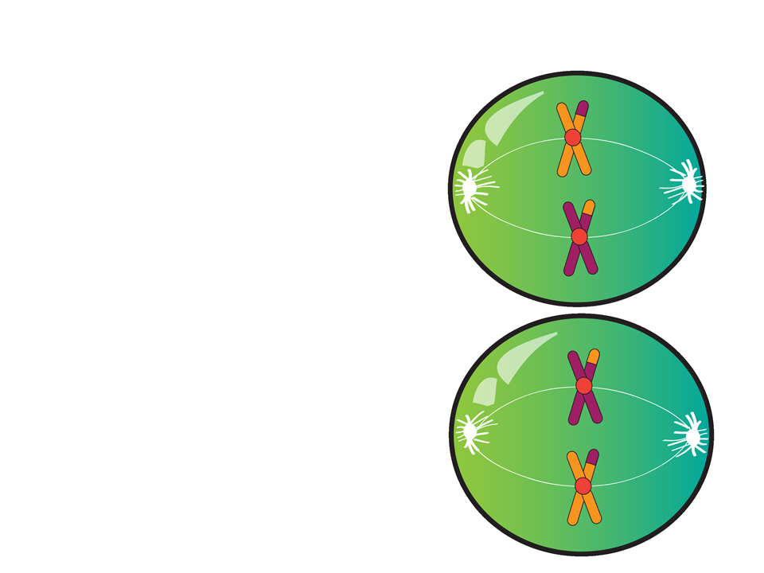
Meiosis II
Metaphase II:
Chromosomes line up at the metaphase plate
Because of crossing over in meiosis I, the chromatids are unique

Slide 21
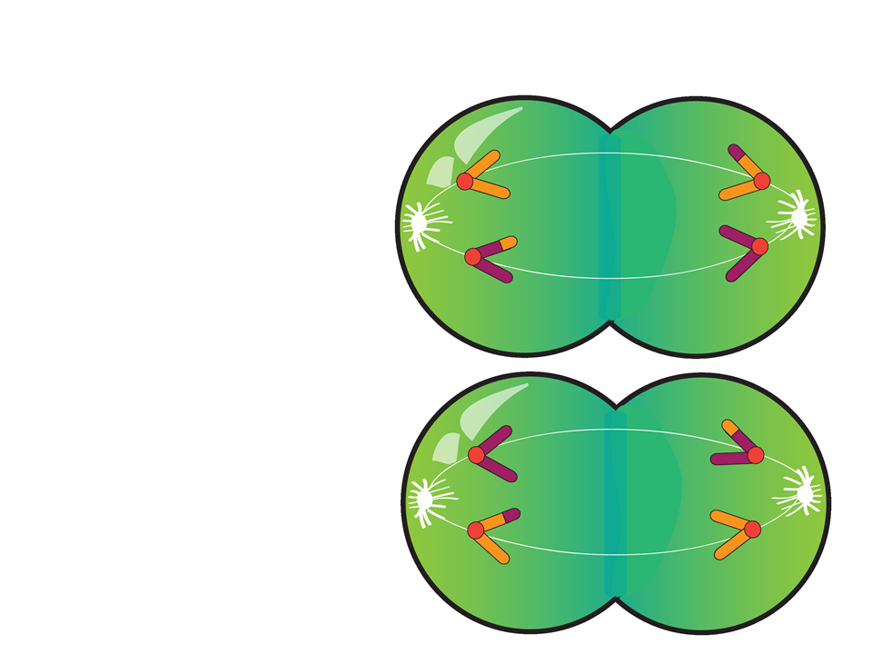
Meiosis II
Anaphase II:
Sister chromatids separate and move towards opposite poles

Slide 22
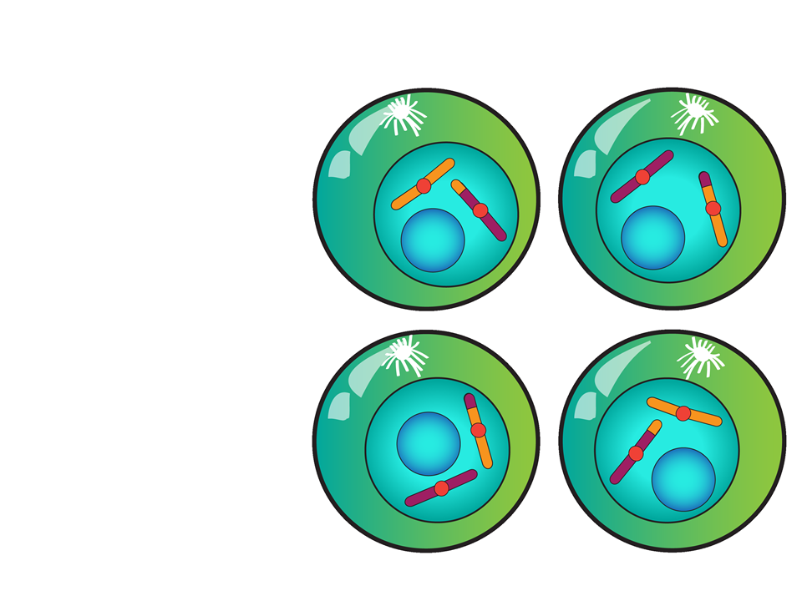
Meiosis II
Telophase II and Cytokinesis:
4 haploid cells
Nuclei reappear
Each daughter cell is genetically unique

Slide 23
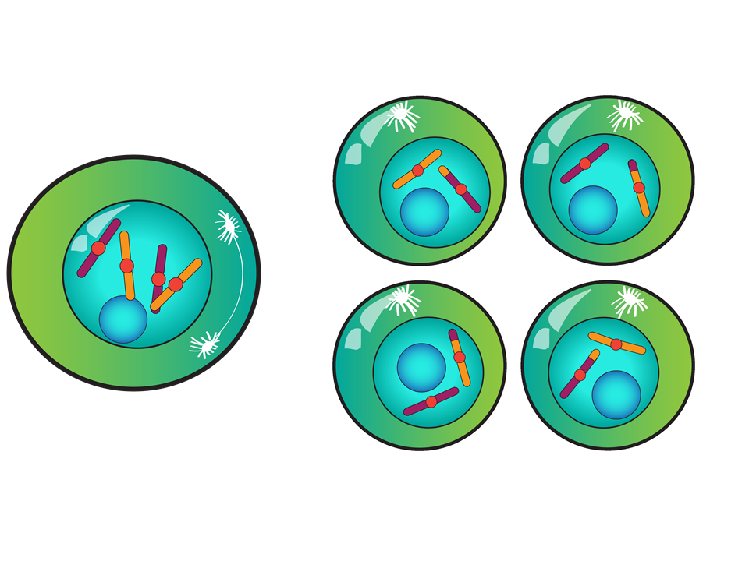
Meiosis Review
Early Meiosis I
Parent cell: 2n = 4
End of Telophase II and cytokinesis
Each daughter cell: n = 2

Slide 24
How Does Meiosis Lead to Genetic Variation?
Crossing over
  Produces recombinant chromosomes: they exchange genetic material
Independent assortment of chromosomes
  Chromosomes are randomly oriented along the metaphase plate during Metaphase I
    Each can orient with either the maternal or paternal chromosomes closer to a given pole
Random fertilization
  Any sperm can fertilize any egg

Slide 25
Putting It All Together
Meiosis followed by fertilization ensures genetic diversity in sexually reproducing organisms and provides genetic variation that plays a role in natural selection.
This cellular process is driven by the interaction of subcellular components and uses free energy that is required for the growth and reproduction of living systems

