Slide 1
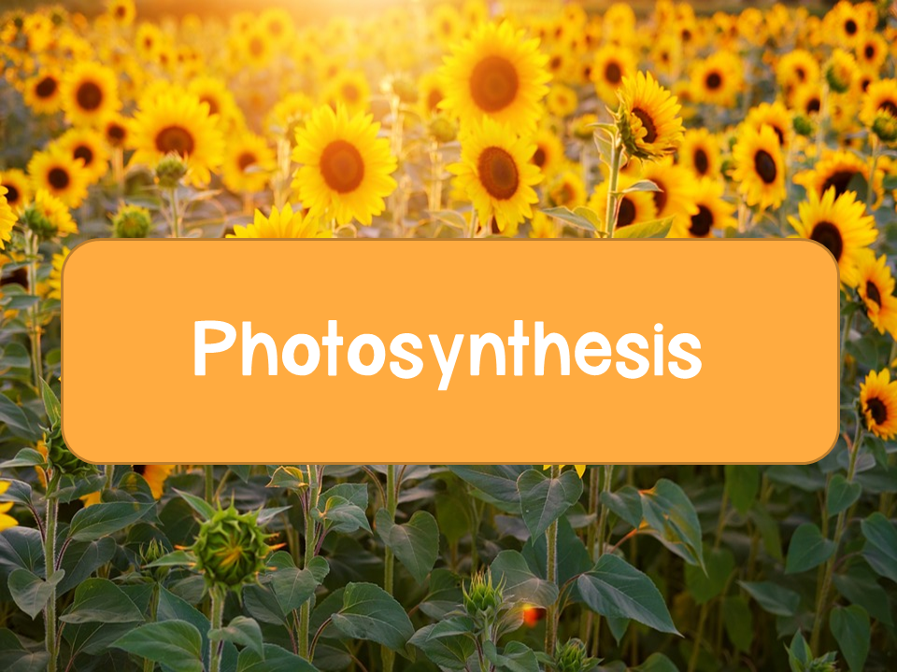

Slide 2
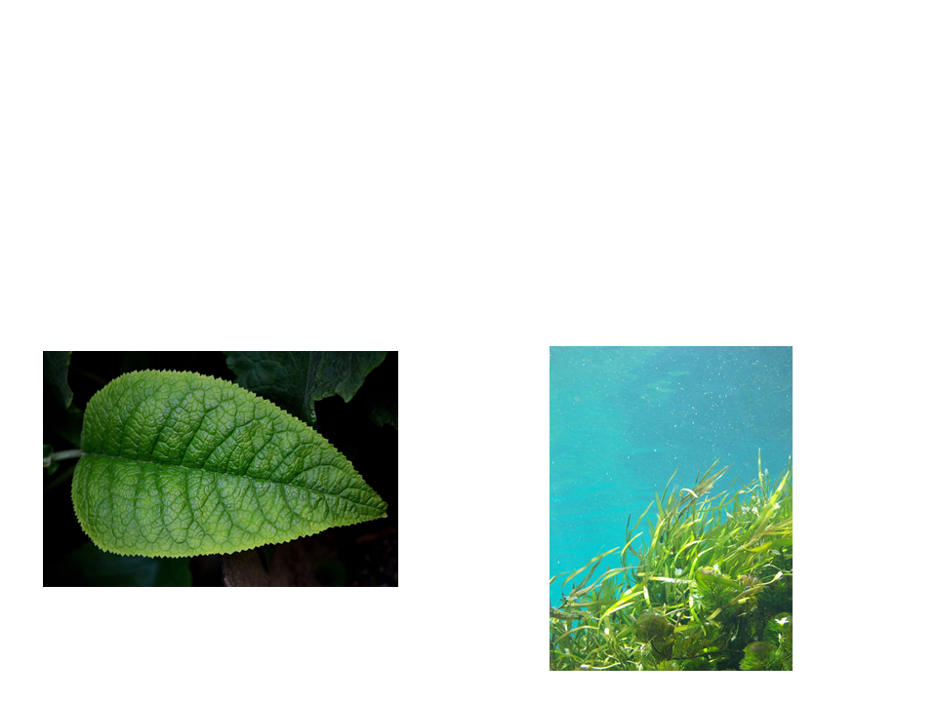
Photosynthesis
Photosynthesis: the conversion of light energy to chemical energy
  Plants are autotrophs (more specifically photoautotrophs)

Slide 3
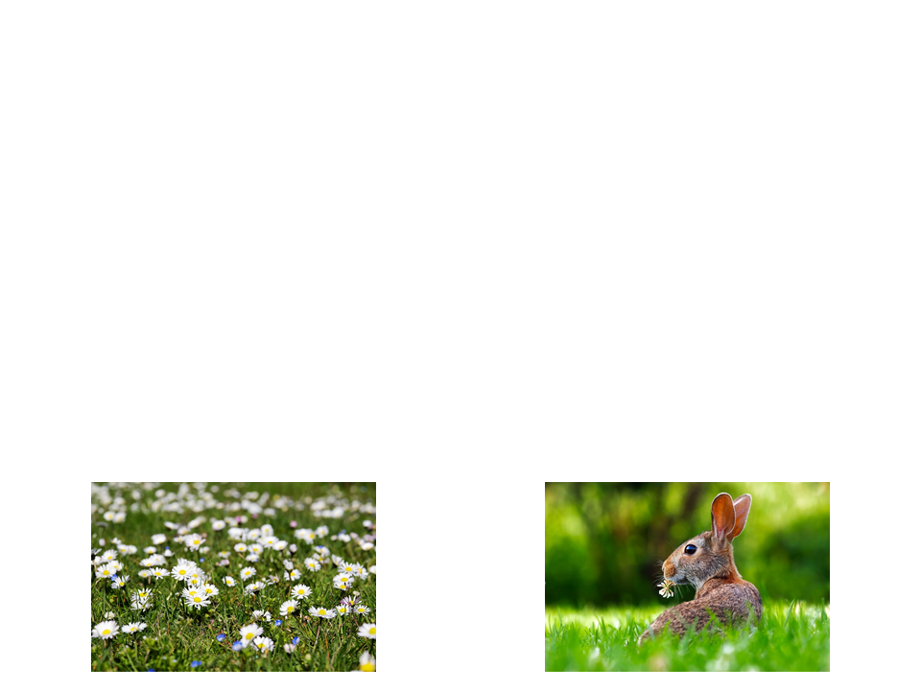
Autotroph vs Heterotroph
Autotrophs
Heterotrophs
Organisms that produce their own food (organic molecules) from simple substances in their surroundings
Organisms unable to make their own food so they live off of other organisms

Slide 4
Evolution of Photosynthesis
Photosynthesis first evolved in prokaryotic organisms
  Cyanobacteria: early prokaryotes capable of photosynthesis
    Oxygenated the atmosphere of early Earth
Prokaryotic photosynthetic pathways were the foundation of Eukaryotic photosynthesis

Slide 5
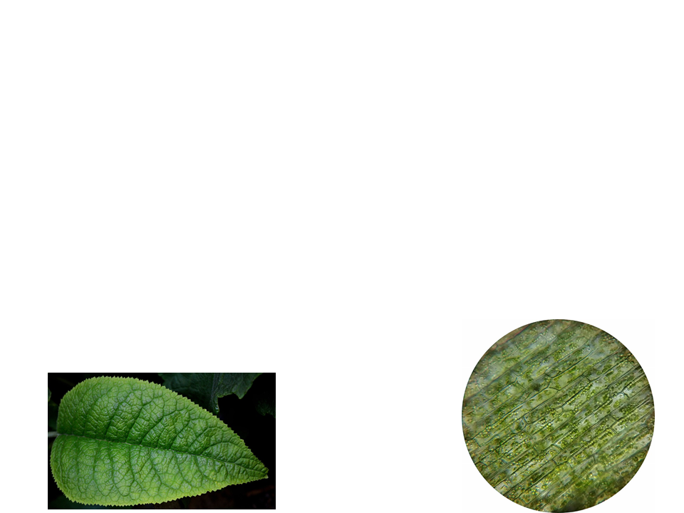
Site of Photosynthesis
Leaves are the primary location of photosynthesis in most plants
Chloroplast: organelle for the location of photosynthesis
  Found in the mesophyll, the cells that make up the interior tissue of the leaf
  Stomata: pores in leaves that allow CO₂ in and O₂ out

Slide 6
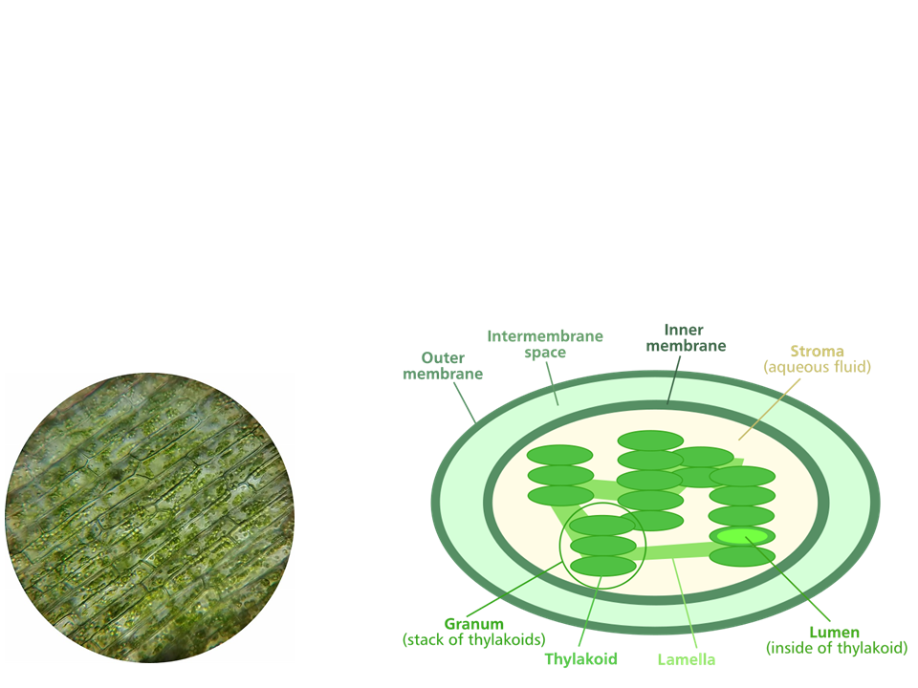
Structures of a Chloroplast
Chloroplasts are surrounded by a double membrane
Stroma: aqueous internal fluid
Thylakoids form stacks known as grana
Chlorophyll: green pigment in thylakoid membranes

Slide 7
Photosynthesis
Simplified Formula:
6 CO₂ + 6 H₂O + light energy C₆H₁₂O₆ + 6 O₂
6 CO₂ 12 H₂O
Reactants
C₆H₁₂O₆ 6 H₂O 6 O₂
Products
Tracking atoms in photosynthesis using the non-simplified formula

Slide 8
Photosynthesis
Photosynthesis splits H₂O into H and O
  Redox reaction: reaction involving complete or partial transfer of one or more electrons from one reactant to another
    In photosynthesis: the electrons are transferred with H+ (from split H₂O) to CO₂ reducing it to sugar

Slide 9
Photosynthesis
Remember: OIL RIG or LEO goes GER
Oxidation is loss of e-
Reduction is gain of e-
6 CO₂ + 6 H₂O + light energy C₆H₁₂O₆ + 6 O₂
Reduction
Oxidation

Slide 10
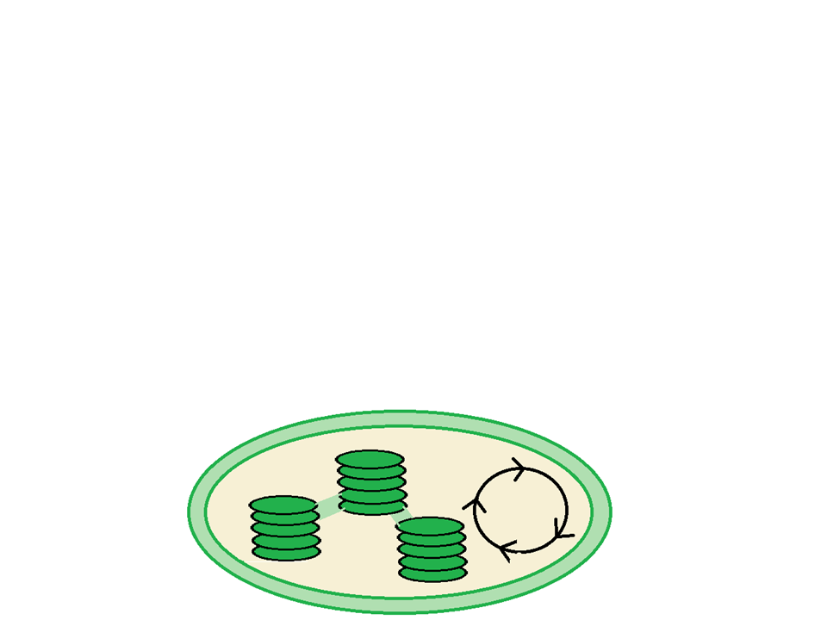
Stages of Photosynthesis
There are two stages to photosynthesis: the light reactions and the calvin cycle
“Photo”
“Synthesis”
light reactions
calvin cycle

Slide 11
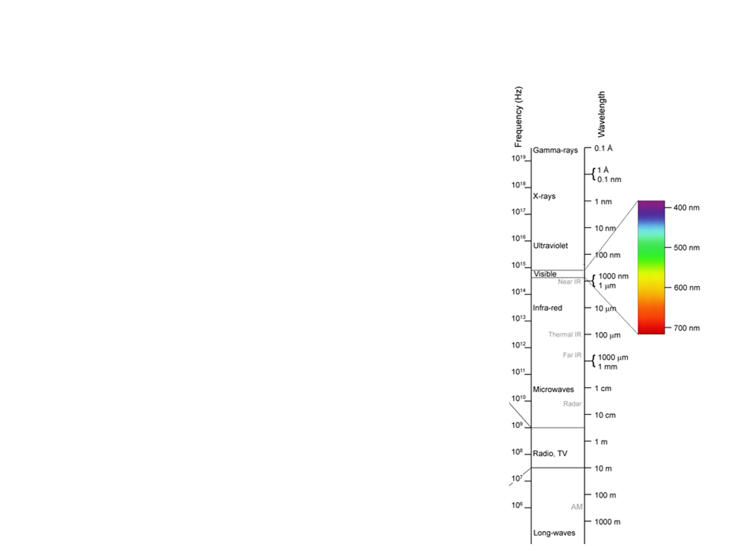
Understanding Light
Light: electromagnetic energy
  Made up of particles of energy called photons
  Travel in waves
  Wavelength: the distance from the crest of one wave to the crest of the next
    The entire range is known as the electromagnetic spectrum
      380 nm to 750 nm is visible light

Slide 12
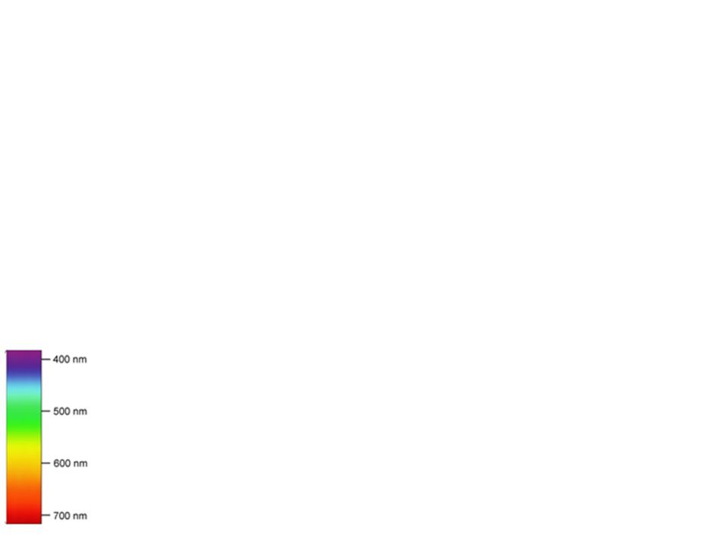
Understanding Light
Short wavelengths = higher energy
Long wavelengths = lower energy
When light interacts with matter it can be:
  Reflected
  Transmitted
  Absorbed
    Pigments are able to absorb visible light
      The color we see is the reflected wavelengths
      Example: leaves are green because chlorophyll absorbs violet-blue and red light, so it reflects green

Slide 13
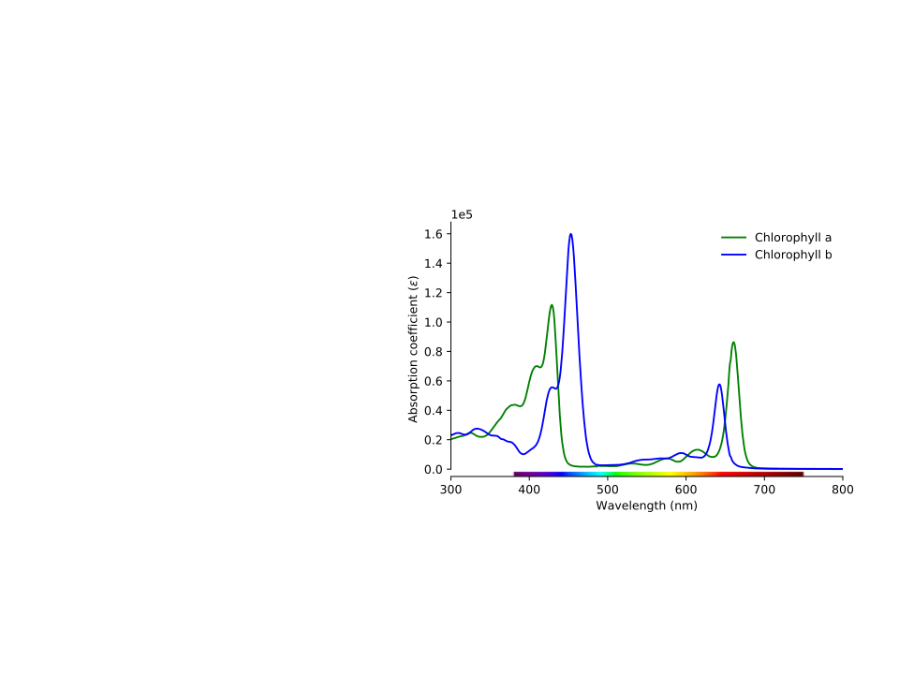
Photosynthetic Pigments
Chlorophyll a:
Primary pigment
Involved in the light reactions
Blue/green pigment
Chlorophyll b:
Accessory pigment
Yellow/green pigment

Slide 14
Photosynthetic Pigments
Carotenoids:
Broaden the spectrum of colors that drive photosynthesis
Yellow/orange pigment
Photoprotection: carotenoids absorb and dissipate excessive light energy that could damage chlorophyll or interact with oxygen

Slide 15
Quick Check
A photon of which color of light would contain more energy: yellow (590 nm) or purple ( 410 nm)?
  Answer: purple (410 nm); the shorter the wavelength the higher the energy
Contrast heterotrophs and autotrophs
  Answer: autotrophs produce their own food from their surroundings, while heterotrophs rely on other organisms for food.

Slide 16
The Light Reactions

Slide 17
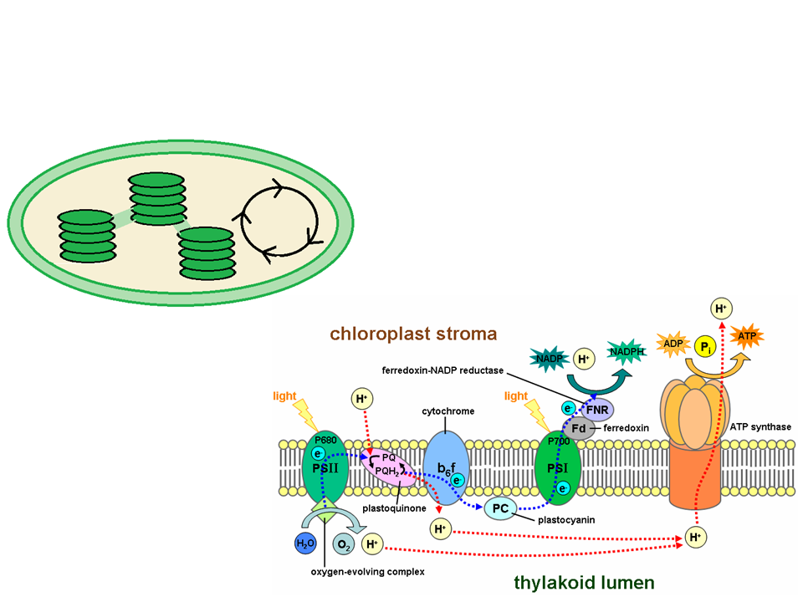
Overview
H₂O
Light
Occur in the thylakoid membrane in the photosystems
Converts solar energy to chemical energy
O₂
ATP and NADPH

Slide 18
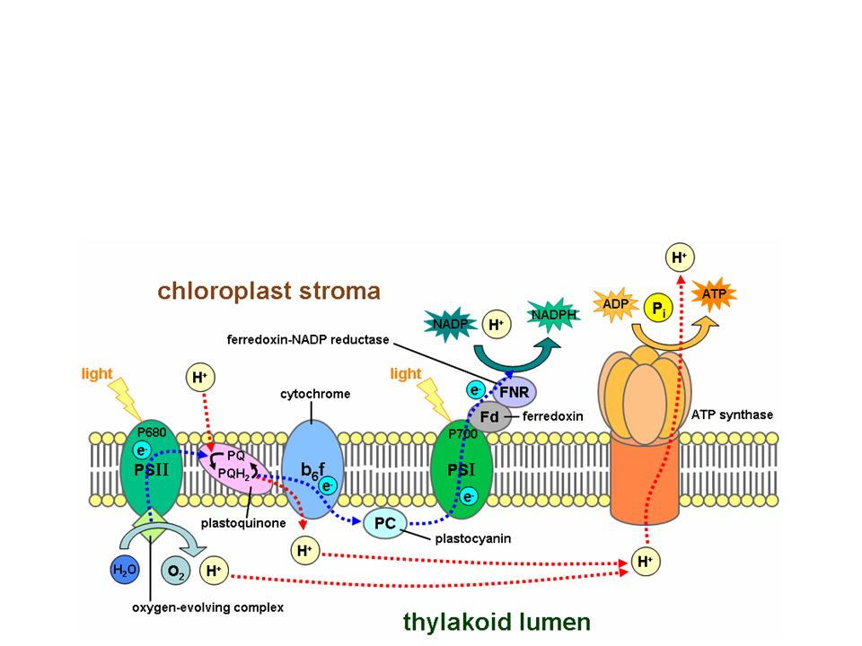
Light Reactions
Chemical energy is in two forms: NADPH and ATP
The cell accomplishes this conversion by using light energy (photons) to excite electrons

Slide 19

How is Light Important to Chlorophyll?
Chlorophyll absorbs a photon of light
e⁻ is boosted from a ground state to an excited state
  e⁻ is unstable
  Falls back to ground state
    Releases energy as heat
    Emits photons as fluorescence
Excited state
heat
e⁻
Photon
photons
Ground state
Chlorophyll molecule

Slide 20
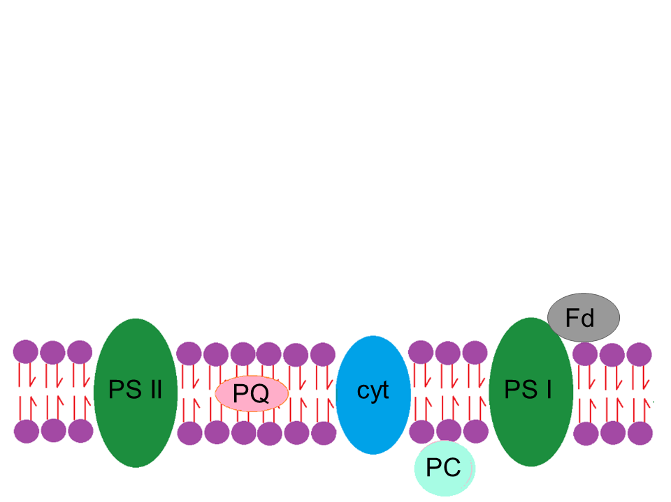
Photosystems
Photosystems: reaction center and light capturing complexes
Reaction center: a complex of proteins associated with chlorophyll a and an electron acceptor
Light capturing complexes: pigments associated with proteins
  Think: antenna for the reaction centers

Slide 21
Photosystems
In the thylakoid membrane there are two photosystems
Photosystem 2: reaction center P680
  Absorbs light at 680 nm
Photosystem 1: reaction center P700
  Absorbs light at 700 nm
Named in order of their discovery
Photosystem 2
Photosystem 1

Slide 22
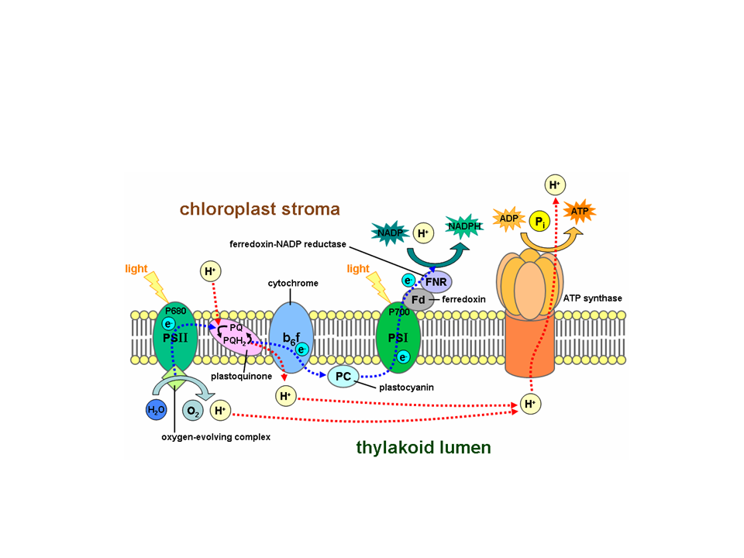
Looking in Photosystems
In the next few slides, electron flow through the thylakoid membrane will be examined
The picture above will be broken down into steps. We will start at photosystem II

Slide 23
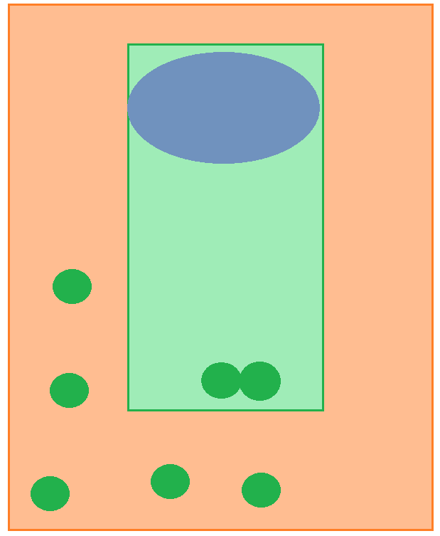
Inside Photosystem II
Light energy (photon) causes an e⁻ to go from an excited state back to a ground state. This repeats until it reaches the P680 pair of chlorophyll a molecules
Primary acceptor
Light
P680
Pigment molecules
Photosystem II

Slide 24
Inside Photosystem II
The e⁻ is transferred to a primary e⁻ acceptor, forming P680+
Primary acceptor
e-
Light
P680+

Slide 25
Inside Photosystem II
H₂O is split into:
2 e⁻
  Reduce P680+
2 H+
  Released into thylakoid space
1 oxygen atom (which immediately bonds to another oxygen atom)
H₂O
Primary acceptor
2 H+
+
e-
½ O₂
e-
e-
Light
P680+

Slide 26
Inside Photosystem II
Linear electron flow: each excited electron will pass from PS II to PS I via the electron transport chain
H₂O
Primary acceptor
2 H+
e-
+
e-
½ O₂
e-
e-
Light
PQ
P680+
cytochrome
PC

Slide 27
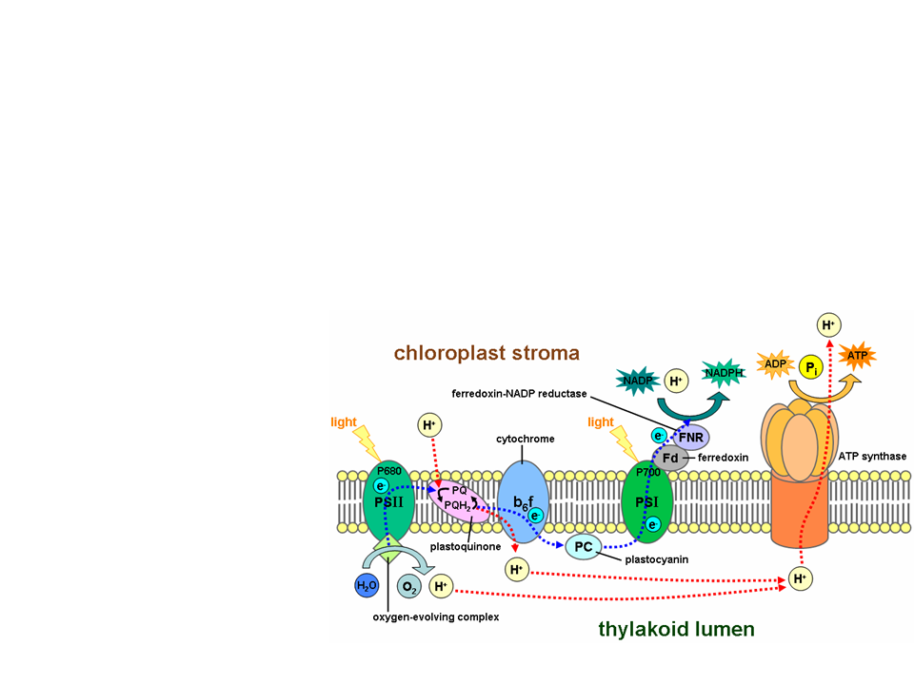
Generation of ATP
The “fall” of electrons from PS II to PS I provides energy to form ATP
The H⁺ gradient is a form of potential energy
ATP synthase couples the diffusion of H⁺ to the formation of ATP

Slide 28
Inside Photosystem I
e-
PQ
cytochrome
Primary acceptor
PC
e-
Light
Light energy excites electrons in the P700 chlorophyll molecules
Become P700+
+
P700

Slide 29
Inside Photosystem I
Electrons go down a second transport chain
Primary acceptor
e-
e-
Fd
Light
e-
e-
P700+
NADP+ reductase

Slide 30
Inside Photosystem I
NADP⁺ reductase catalyzes the transfer of e⁻ from Fd to NADP⁺
Primary acceptor
e-
e-
Fd
Light
e-
e-
P700+
NADP+ reductase
NADPH
NADP⁺ + H⁺

Slide 31
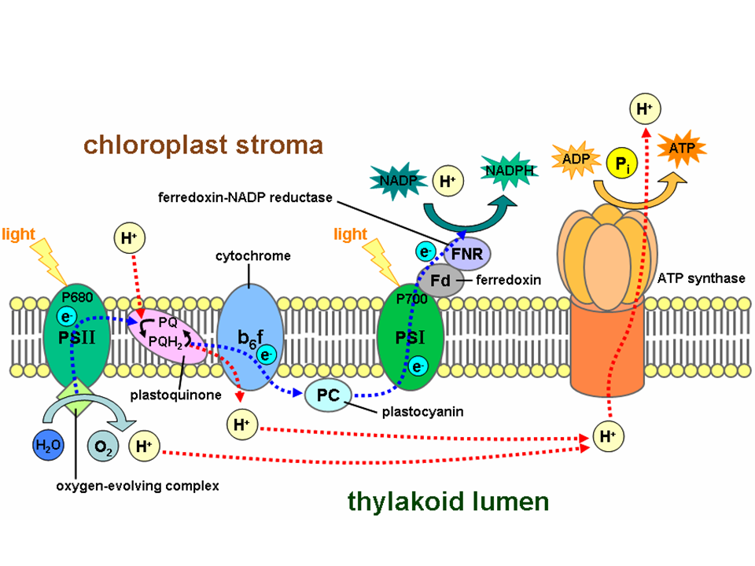
Light Reactions:Putting it all Together

Slide 32
Inputs and Outputs
Inputs
H₂O
ADP
NADP+
Light Reactions
Outputs
O₂
ATP
NADPH
Notes:
Important! Why does this matter: ATP provides the energy required for the Calvin cycle, while NADPH supplies the high-energy electrons needed to reduce carbon dioxide, facilitating the synthesis of carbohydrates (sugars).

Slide 33
Light Reactions Summary
Converts solar energy to chemical energy
  Chemical energy is in 2 forms: NADPH and ATP
Water is split
  Provides a source of electrons and protons (H+)
  Releases O₂ as a by-product
Light absorbed by chlorophyll drives the transfer of electrons and hydrogen ions from H₂O to an electron acceptor called NADP⁺
  NADP⁺ is reduced to NADPH
Generates ATP by phosphorylating ADP

Slide 34
Calvin Cycle

Slide 35
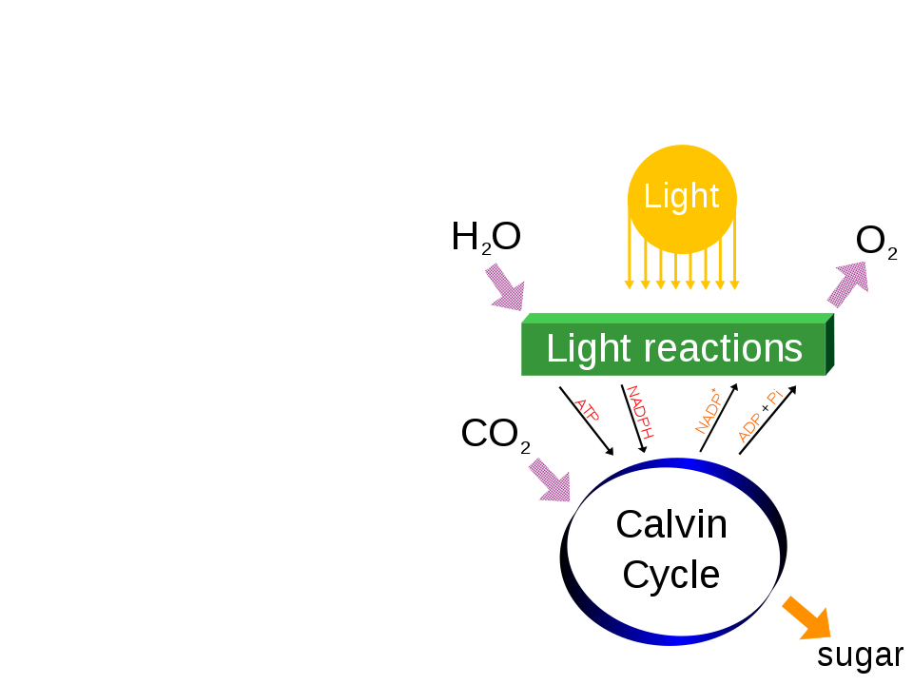
Calvin Cycle
The calvin cycle is cyclic electron flow
Uses ATP and NADPH to reduce CO₂ to sugar (G3P)
For net synthesis of 1 G3P molecule, the cycle must take place 3 times

Slide 36
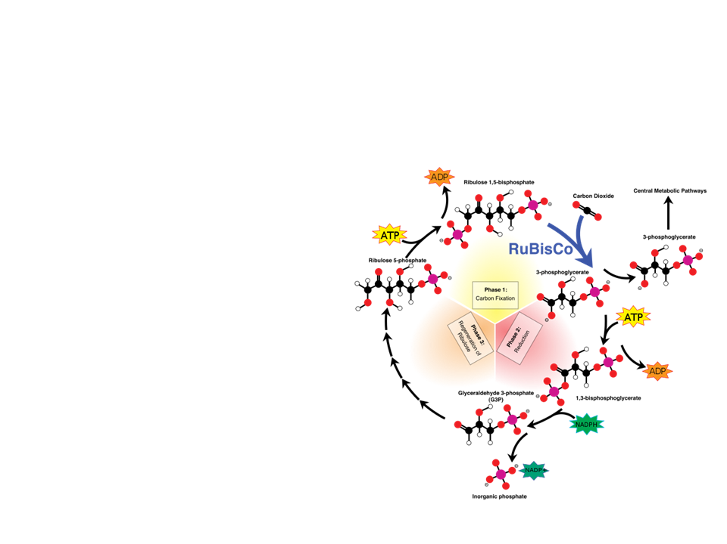
Calvin Cycle
Three phases:
Carbon fixation
Reduction
Regeneration of RuBP

Slide 37
Phase 1: Carbon Fixation
CO₂ is incorporated into the Calvin cycle one at a time
  Each CO₂ attaches to a molecule of RuBP
    Catalyzed by the enzyme rubisco
  Forms 3-phosphoglycerate

Slide 38
Phase 2: Reduction
Each molecule of 3-phosphoglycerate is phosphorylated by ATP (uses 6 total)
  Becomes 1,3-bisphosphoglycerate
    6 NADPH molecules donate electrons to 1,3-bisphosphoglycerate
      Reduces to G3P
      6 molecules of G3P are formed, but only one is counted as a net gain
        The other 5 G3P molecules are used to regenerate RuBP

Slide 39
Phase 3: Regeneration of RuBP
5 G3P molecules are used to regenerate 3 molecules of RuBP
  Uses 3 ATP for regeneration
Cycle is now ready to take in CO₂ again

Slide 40
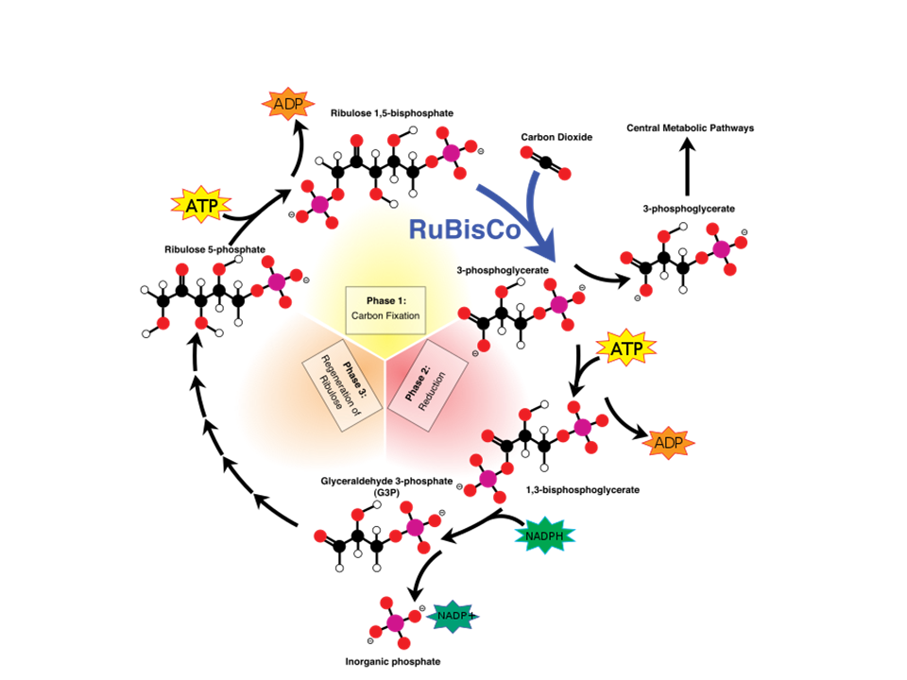
Calvin Cycle: Putting it all Together

Slide 41
Inputs and Outputs
Inputs
3 CO₂
9 ATP
6 NADPH
Calvin Cycle
Outputs
1 G3P
9 ADP
6 NADP+

Slide 42
Calvin Cycle Summary
Uses NADPH, ATP, and CO₂
Produces a 3-C sugar G3P
Three phases:
Carbon fixation
Reduction
Regeneration of RuBP

Slide 43
Problem for C3 Plants
Photorespiration:
  On very hot days plants close their stomata to stop water loss
  Causes less CO₂ to be present, and more O₂
  Rubisco binds to O₂ and uses ATP
    The process produces CO₂
    NO sugar is produced
    BAD for the plant

Slide 44
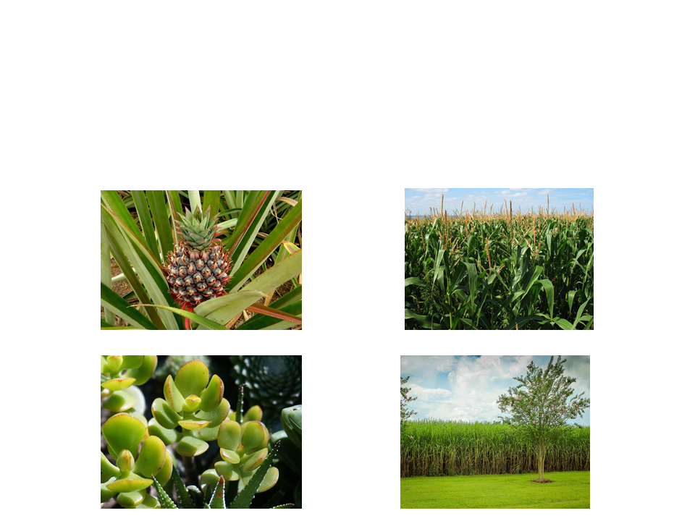
Adaptations
Plants that live in hot, dry climates have evolved to have alternative mechanisms of carbon fixation

Slide 45
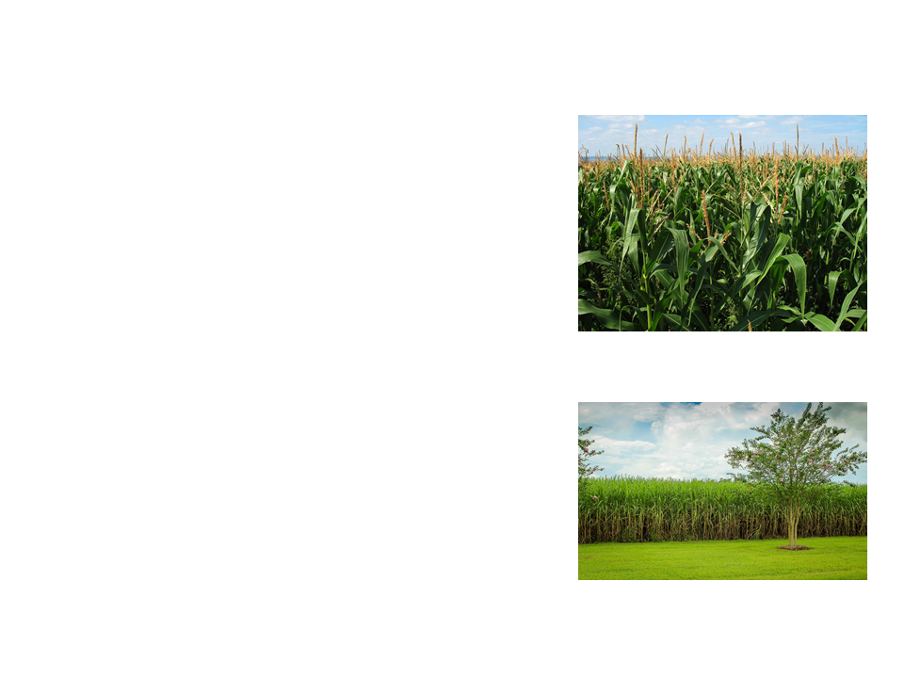
Adaptations
C₄ Plants
  Spatial separation of steps
  Stomata partially close to conserve water
  Mesophyll cells fix CO₂ into a 4-C molecule
    Transferred to bundle sheath cells
      Releases CO₂ to be used in the Calvin cycle
  Examples: maize (corn), grasses, sugarcane

Slide 46
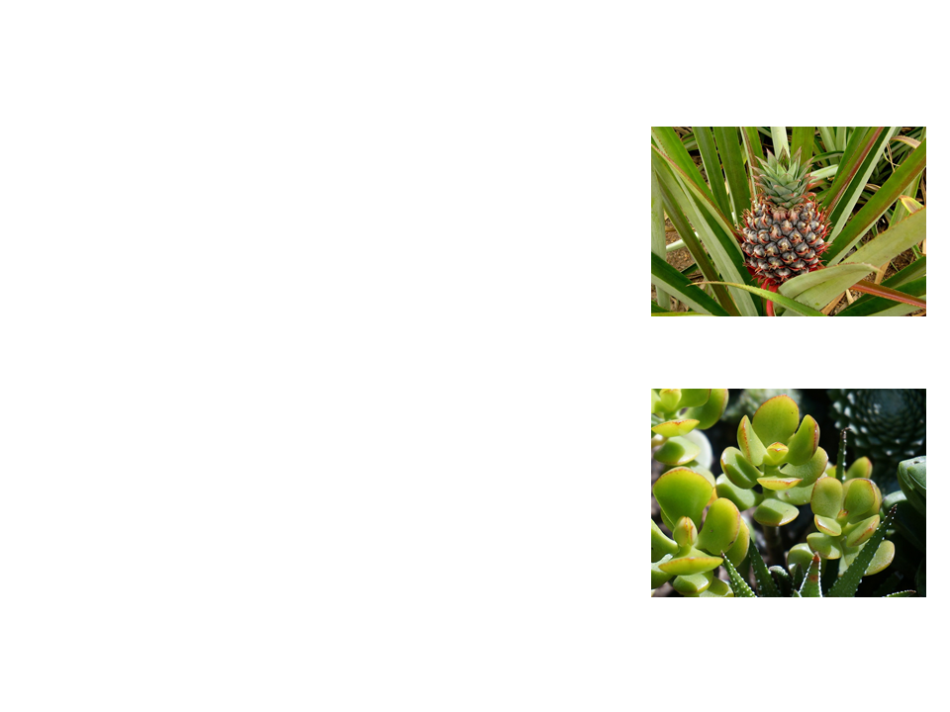
Adaptations
CAM plants
  Open stomata at night and close during the day
  CO₂ is incorporated into organic acids and stored in vacuoles
  During the day, light reactions occur and CO₂ is released from the organic acids and incorporated into the Calvin cycle
  Examples: pineapples, cacti, succulents, jade

Slide 47
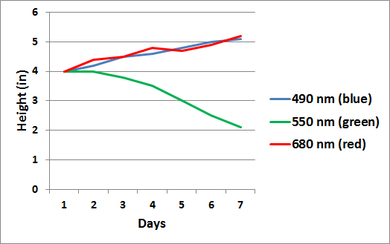
Practice MiniFRQ
A student wanted to study the effect of varying colors of light on the growth of plants. The student exposed tomato plants to 3 different wavelengths of light for the course of one week and measured the overall height each plant each day. All other conditions were kept consistent between the plants. The results are below:
Identify the wavelength that caused the least amount of growth.
Explain why the wavelength identified in part a was ineffective.
Notes:
The 550 nm (green) wavelength was least effective
Chlorophyll does not absorb green light. Optimal chlorophyll absorption occurs in the violet-blue and red wavelengths.

Slide 48
Practice FRQ
Rubisco can bind to CO₂ or O₂ in the Calvin cycle. After learning this, a student was interested in photorespiration. After doing research she claimed that it is simply a metabolic relic; early atmospheric conditions did not have oxygen, therefore it never posed a problem early on. Would you support or reject this claim? Justify your response.
Notes:
Have an open discussion with students about why photorespiration may occur. There are 2 primary theories. 1) Like stated in the FRQ, it is a metabolic relic. Early Earth had primarily only CO2 in the atmosphere, therefore, binding of oxygen to rubisco was not a problem. 2) Some theories suggest that photorespiration may protect plants against harmful products that build up when the Calvin Cycle is low.

