Slide 1
1.7 Comparison in the Period from c. 1200 to c. 1450
Dr. Robert E. Sawyer

Slide 2
Learning Objectives
Identify major examples of state formation across Afro-Eurasia and the Americas.
Compare how different states maintained authority and organized power.
Explain how geography, religion, and trade shaped political systems.
Analyze similarities and differences in continuity and innovation among states between 1200–1450.
Key Concept (KC 3.2)
State formation and development demonstrated continuity, innovation, and diversity in various regions.
Notes:
Insert a map of your country.

Slide 3
Overview
Between 1200 and 1450, states across the world developed new methods to organize power and maintain control. Although these societies differed in culture and belief systems, they all faced similar challenges—defending borders, collecting taxes, and managing resources.
The Song Dynasty in East Asia, Delhi Sultanate in South Asia, Great Zimbabwe and Hausa city-states in Africa, and Aztec and Inca states in the Americas each showed both continuity (building on existing traditions) and innovation (developing new systems suited to their environment and culture).
This lesson helps students compare how and why different states developed similar or different political systems, emphasizing that diversity did not mean isolation.
Notes:
Insert a map of your country.

Slide 4
Keywords and Phrases
Term | Definition
Bureaucracy | A system of government in which officials carry out the administration according to set rules or ranks.
Caliphate | An Islamic state led by a religious and political leader, the caliph, seen as a successor to the Prophet Muhammad.
Mandate of Heaven | A Chinese belief that rulers were chosen by divine will; if they failed to govern well, the mandate could be lost.
City-state | A self-governing urban center and the surrounding lands it controls, common in Africa and Mesoamerica.
Syncretism | The blending of different beliefs or cultural traditions into a new system, often seen in religion or governance.
Notes:
Insert a map of your country.

Slide 5
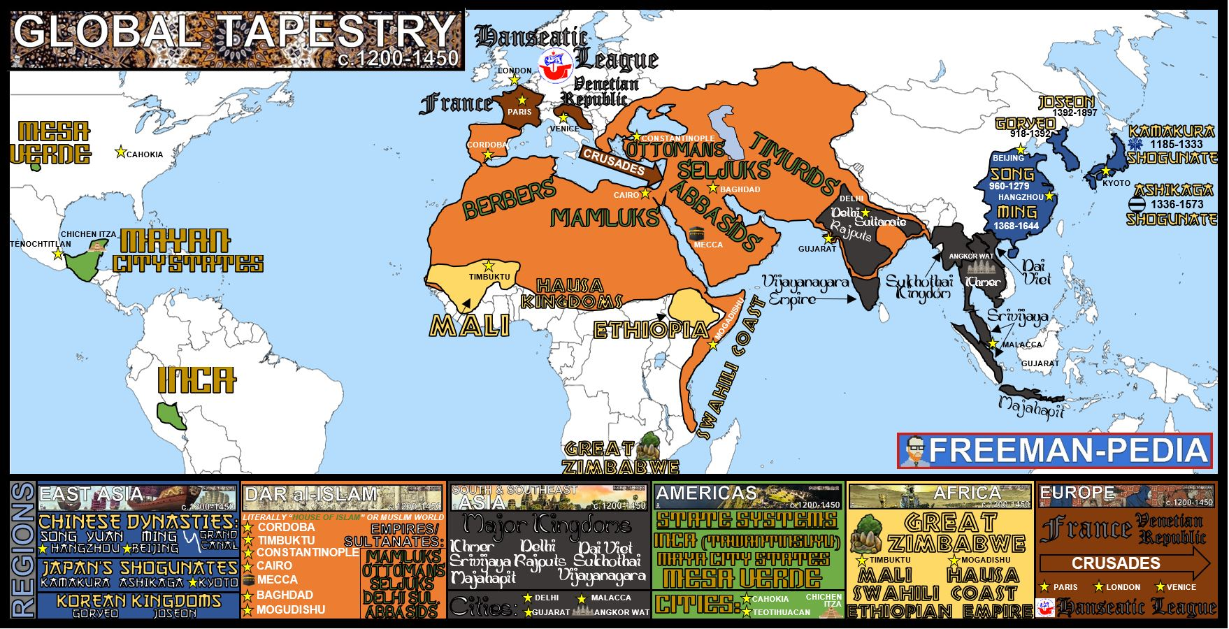

Slide 6
Background Reading
From 1200 to 1450, major civilizations across the Eastern Hemisphere built on existing traditions while adapting to new realities. The Song Dynasty (960–1279) refined the Confucian bureaucratic system developed during earlier dynasties. Its use of the civil service exam ensured that government officials were chosen by merit, not family background, although the emperor still held ultimate authority.
In South Asia, the Delhi Sultanate introduced Islamic rule to a largely Hindu region. While the sultans borrowed administrative methods from earlier Indian kingdoms, they also introduced Islamic law and taxation systems that changed local governance.
Notes:
Insert a map of your country.

Slide 7
Background Reading
In Africa, powerful kingdoms like Mali and Great Zimbabwe rose due to control over trade networks. Leaders relied on tribute, trade wealth, and kinship ties rather than centralized bureaucracies.
In the Americas, civilizations like the Aztec Empire and Inca Empire demonstrated sophisticated state organization. The Aztecs demanded tribute and military service from conquered peoples, while the Incas created an imperial network connected by roads and forced labor systems such as mit’a.
Across regions, states sought to legitimize power through religion, tradition, and public works, yet their methods reflected the unique cultural and environmental contexts of their societies.
Notes:
Insert a map of your country.

Slide 8
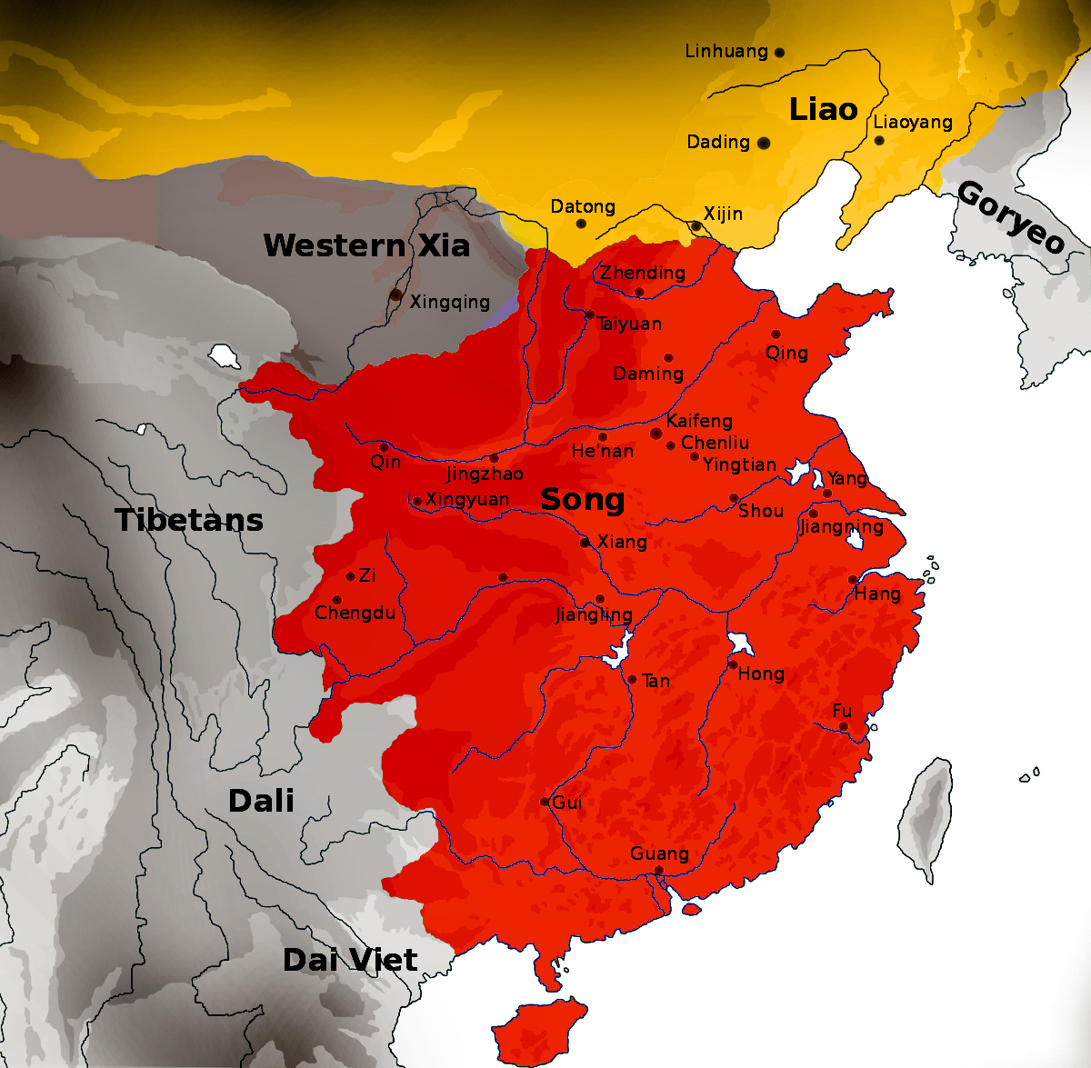
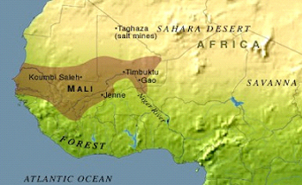
Primary Sources
Notes:
Insert a map of your country.

Slide 9
Source 1: Emperor Taizong on Government (Tang–Song Tradition, c. 7th century CE)
Source: “Emperor Taizong on Effective Government,” from the Internet History Sourcebooks Project, Fordham University.
https://sourcebooks.fordham.edu/eastasia/taizong-govt.asp
The ruler is a boat, the people are the water. The water can carry the boat, but it can also overturn it. The people are the foundation of the state; if the foundation is firm, the state is stable. Therefore, a wise ruler loves and nourishes the people as one would protect the roots of a tree. If the roots are strong, the branches will flourish.
A ruler should not rely on his own desires. He must appoint upright ministers, listen to criticism, and reward those who serve the people well. When the ruler forgets the people, disasters will follow. When he listens to honest advice, his virtue will shine.
Notes:
Insert a map of your country.

Slide 10
Guided Source Analysis
Questions for Source 1 (Song China):
According to Emperor Taizong, what makes a ruler successful?
How does this passage reflect Confucian values of governance?
How might such ideals strengthen state power in China?
Notes:
Insert a map of your country.

Slide 11
Source 2: Ibn Battuta Describes the Mali Empire (c. 1352 CE)
Source: “Ibn Battuta: Travels in Asia and Africa, 1325–1354,” trans. H.A.R. Gibb, from the Internet Medieval Sourcebook, Fordham University.
https://sourcebooks.fordham.edu/source/1354-ibnbattuta.asp
The people of Mali have a deep hatred of injustice. Their sultan does not forgive anyone guilty of the least act of it. Their government is well ordered, and no one among them is afraid of being wronged. In the kingdom, there is complete safety; a man may travel alone without fear of thieves or robbers.
The inhabitants are Muslims who constantly attend prayers and study the Qur’an. The women are respected and enjoy freedom, and the king honors scholars and clerics. Yet their customs differ from those of other Muslim peoples: they eat certain foods forbidden in our lands, and their ceremonies include dancing and music.
Notes:
Insert a map of your country.

Slide 12
Guided Source Analysis
Questions for Source 2 (Mali Empire):
What aspects of the Mali Empire impressed Ibn Battuta?
How does this description show a blend of Islamic and local traditions?
In what ways does Mali’s system differ from the Chinese imperial model?
Notes:
Insert a map of your country.

Slide 13
Comparison Chart: State Formation, c. 1200–1450
Region | Example State | Basis of Power | Method of Governance | Source of Legitimacy | Notable Innovation
East Asia | Song Dynasty | Bureaucracy, taxation | Merit-based civil service exams | Mandate of Heaven | Gunpowder, paper currency
South Asia | Delhi Sultanate | Military conquest | Islamic administration over Hindu subjects | Religious law and taxation | Indo-Islamic cultural fusion
Africa | Mali Empire | Control of trade routes | Tributary system, Islamic advisors | Wealth and justice | Expansion of Islam via trade
Europe | Holy Roman Empire | Feudal relationships | Decentralized monarchy | Christian Church | Blend of feudal and religious authority
Americas | Aztec / Inca | Tribute and labor | Militarized tribute states | Religious rituals and divine kingship | Road networks, record-keeping (quipu)
Notes:
Insert a map of your country.

Slide 14
Change, Continuity, and Comparison
Continuities (1200–1450):
Religion used to justify authority (Mandate of Heaven, Caliphate, divine kingship).
Reliance on agriculture and tribute for state revenue.
Patriarchal structures and limited social mobility.
Notes:
Insert a map of your country.

Slide 15
Change, Continuity, and Comparison
Changes (1200–1450):
Rise of new ruling groups (Turkic states, Delhi Sultanate, Mali Empire).
Increased trade networks connected regions politically and economically.
Technological and cultural diffusion reshaped state structures (e.g., paper, gunpowder, Islam).
Notes:
Insert a map of your country.

Slide 16
Change, Continuity, and Comparison
Comparisons:
China vs. Mali: Bureaucratic merit vs. kinship and religious leadership.
Delhi Sultanate vs. Song: Both centralized, but religious foundations differed.
Inca vs. Mali: Tribute and labor control systems shaped empire expansion differently.
Notes:
Insert a map of your country.

Slide 17
Reflection Activity
Task:
Using information from the chart and sources, write a short comparative paragraph (5–6 sentences):
Compare one Afro-Eurasian state (Song, Delhi Sultanate, or Mali) with one American state (Aztec or Inca) in terms of how each established and maintained authority between 1200–1450.
Guiding prompt:
What role did religion play?
How was power organized?
How did geography influence their systems?
Notes:
Insert a map of your country.

Slide 18
Key Takeaways
Between 1200–1450, most major states sought to balance tradition and innovation.
Rulers legitimized authority through religion, law, and social hierarchy.
While some, like the Song, used bureaucratic merit, others, like Mali, used trade wealth and kinship.
Despite different systems, all faced similar challenges: maintaining loyalty, managing resources, and defending territory.
These patterns of state formation shaped later empires in the Early Modern Era.
Notes:
Insert a map of your country.

Slide 19
Questions?

