Slide 1
1.6 Part 3: Agriculture and Social Organization in Medieval Europe (c. 1200–1450)
Dr. Robert E. Sawyer

Slide 2
Learning Objectives
Describe how agricultural production shaped social hierarchy in Europe from 1200–1450.
Explain how systems of coerced and free labor structured European society.
Analyze how demographic and economic changes challenged the feudal order.
Key Concept (KC-3.3.III.C)
Europe was largely an agricultural society dependent on free and coerced labor, including serfdom.
Notes:
Insert a map of your country.

Slide 3
Overview
Between 1200 and 1450, Europe remained a rural, farming society. Agriculture shaped nearly every part of life—from how people worked and worshiped to how governments and economies functioned.
The manorial system (a network of self-sufficient estates) defined the economy. Peasants and serfs worked the land for their lords, while nobles gained wealth and power through land ownership. This agricultural foundation created a rigid social hierarchy that lasted for centuries.
Over time, crises such as the Black Death and the growth of towns weakened the manorial system, leading to early changes in Europe’s economy and labor systems.
Notes:
Insert a map of your country.

Slide 4
Keywords and Phrases
Term | Definition
Demesne | The part of a manor farmed for the lord’s own use by serfs.
Tithe | A payment (usually one-tenth of income or crops) to support the Church.
Corvée Labor | Unpaid work peasants owed their lord, such as repairing roads or plowing fields.
Tenant Farmer | A peasant who paid rent for land instead of owing labor.
Open-Field System | Shared village farmland divided into strips worked cooperatively.
Notes:
Insert a map of your country.

Slide 5
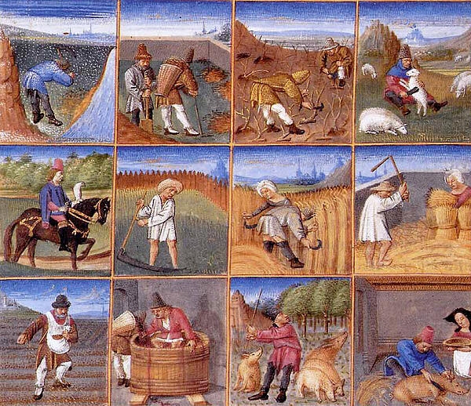

Slide 6
I. Background Reading – The Agricultural World of Medieval Europe
Medieval Europe’s economy and daily life were built around farming. Manors were estates owned by lords and worked by peasants or serfs. Each manor had farmland, a church, a village, and common pastures.
Peasants owed their lords labor, rent, and loyalty in exchange for protection. Agricultural cycles followed the Church calendar—plowing, planting, and harvesting were often linked to religious festivals.
Most land was divided under the three-field system—one for winter crops, one for spring crops, and one left fallow (unused). This method increased yields but required community cooperation. Because travel and trade were limited, each manor aimed to be self-sufficient.
Notes:
Insert a map of your country.

Slide 7
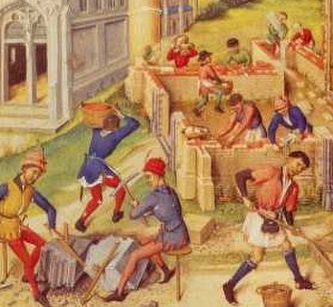
II. Primary Source Readings
These authentic sources describe life and labor in medieval Europe. Both are provided by the Internet Medieval Sourcebook (Fordham University)—a verified historical archive students can access freely.
Notes:
Insert a map of your country.

Slide 8
Source 1: “Manorial Management & Organization” (c. 1275)
Internet Medieval Sourcebook, Fordham University
https://sourcebooks.fordham.edu/source/1275manors1.asp
The steward of lands ought to be prudent and faithful and profitable, and he ought to know the law of the realm, to protect his lord’s business and to instruct and give assurance to the bailiffs who are beneath him in their difficulties. He ought two or three times a year to make his rounds and visit the manors of his stewardship, and then he ought to inquire about the rents, services, and customs, hidden or withdrawn, and about franchises of courts, lands, woods, meadows, pastures, waters, mills, and other things which belong to the manor and are done away with without warrant, by whom, and how: and if he be able let him amend these things in the right way without doing wrong to any, and if he be not, let him show it to his lord, that he may deal with it if he wish to maintain his right.
Notes:
Insert a map of your country.

Slide 9
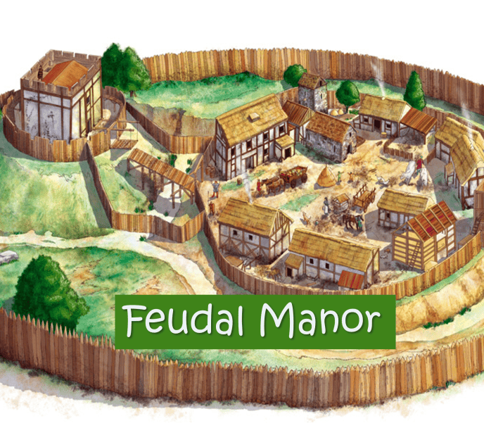
Source 1: “Manorial Management & Organization” (c. 1275)
The steward ought, at his first coming to the manors, to cause all the demesne lands of each to be measured by true men, and he ought to know by the perch of the country how many acres there are in each field, and thereby can know how much wheat, rye, barley, oats, peas, beans, and dredge one ought by right to sow in each acre.
Notes:
Insert a map of your country.

Slide 10
Source 2: “Peasant Life – Village and Manor”
Internet Medieval Sourcebook, Fordham University
https://sourcebooks.fordham.edu/lect/med18.asp
Daily Life – basically North European and English Evidence. Pre-dawn breakfast – black bread and ale. Work and marriage. Outside work – largely male – plowing, harvesting, trapping. Inside work – largely female – kitchen garden, animal maintenance, repair, cooking.
Fees for lords’ tools – mill etc. Housing – thatch and timber, one or two rooms, no furniture, animals in the house, beds shared. Nuclear and extended families.
Notes:
Insert a map of your country.

Slide 11
Student Source Analysis
Answer in 2–3 sentences per question:
What do these excerpts show about how manorial life was organized and supervised?
How do they reflect the responsibilities and limits of peasant life?
What can you learn about gender roles and social hierarchy from these accounts?
Why might the Church have supported this agricultural structure?
Notes:
Insert a map of your country.

Slide 12
III. Labor Systems and Social Hierarchy
Rank | Description | Relationship to Agriculture
King | Granted land to nobles in exchange for loyalty and soldiers. | Owned large territories worked indirectly by peasants.
Nobles (Lords) | Controlled manors and collected rent from peasants. | Directed local production; benefited from serf labor.
Knights/Vassals | Received land from nobles in exchange for service. | Oversaw smaller estates, managed local order.
Peasants/Serfs | Worked land, paid taxes, owed labor. | Produced food that supported all other classes.
Notes:
Insert a map of your country.

Slide 13
IV. Change Over Time: 1300–1450
Population Decline (Black Death): Labor shortages gave surviving peasants leverage to demand higher pay or freedom.
Urban Migration: Peasants left manors for towns (“Town air makes you free”).
Technological Improvement: Iron plows, water mills, and horse collars improved farming.
Shift Toward Wage Labor: Cash rents replaced unpaid labor, weakening serfdom.
Notes:
Insert a map of your country.

Slide 14
V. Reflection Chart
Category | 1200–1300 | 1300–1450
Labor System | Serfdom and obligatory labor | More wage labor and tenant farming
Land Ownership | Lords control manors | Leasing and private tenancies grow
Social Mobility | Very limited | Slight increase after Black Death
Economic Exchange | Mostly local trade | Town markets and fairs expand
Notes:
Insert a map of your country.

Slide 15
VI. Key Takeaways
Europe’s society depended on agriculture, shaping power, class, and religion.
Serfdom tied peasants to the land, reinforcing hierarchy.
Agricultural crises and the Black Death brought gradual social change.
By 1450, Europe began moving toward freer labor and early market economies.
Notes:
Insert a map of your country.

Slide 16
Questions?

