Slide 1
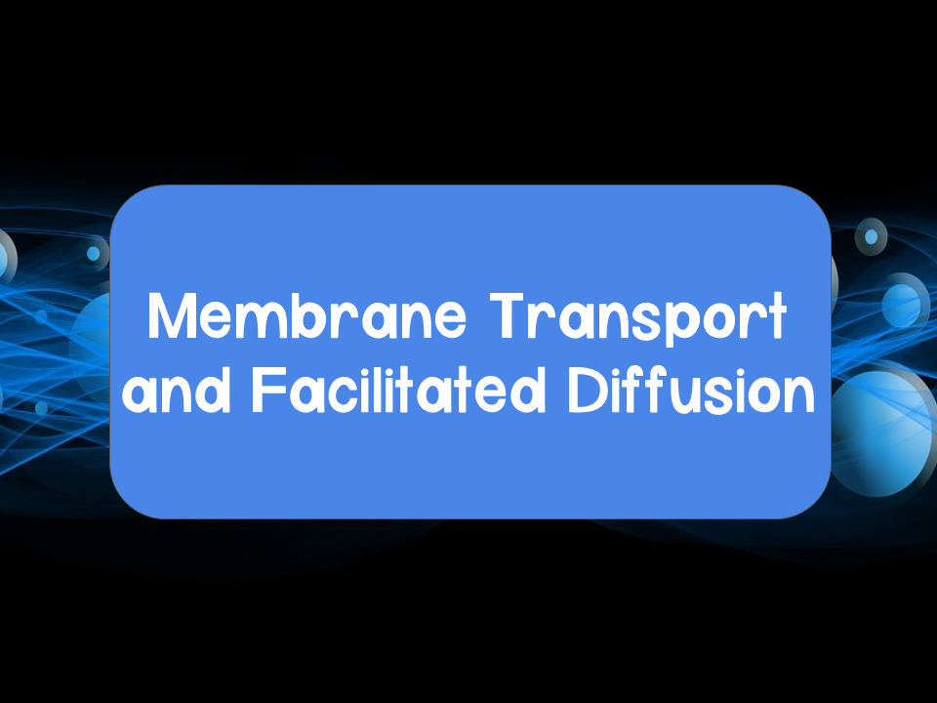
Notes:
Videos relating to this topic:
Bozeman: https://www.youtube.com/watch?v=RPAZvs4hvGA&t=511s
Amoeba Sisters: https://www.youtube.com/watch?v=Ptmlvtei8hw
Crash Course: https://www.youtube.com/watch?v=dPKvHrD1eS4

Slide 2
Selective Permeability
Some substances can cross the membrane more easily than others
Easy passage across the membrane:
Small nonpolar, hydrophobic molecules
  Examples:
    Hydrocarbons
    CO_{2,} O_{2,} N₂
Difficult passage or protein assisted passage:
Hydrophilic, polar molecules, large molecules, ions
  Examples:
    Sugars, water

Slide 3
Transport Across a Membrane
There are two main types of transport across a membrane: passive and active

Slide 4
Passive Transport
Passive transport: transport of a molecule that does not require energy from the cell because a solute is moving with its concentration or electrochemical gradient
  Involved in the import of materials and export of waste
  Examples:
    Diffusion
    Osmosis
    Facilitated diffusion

Slide 5
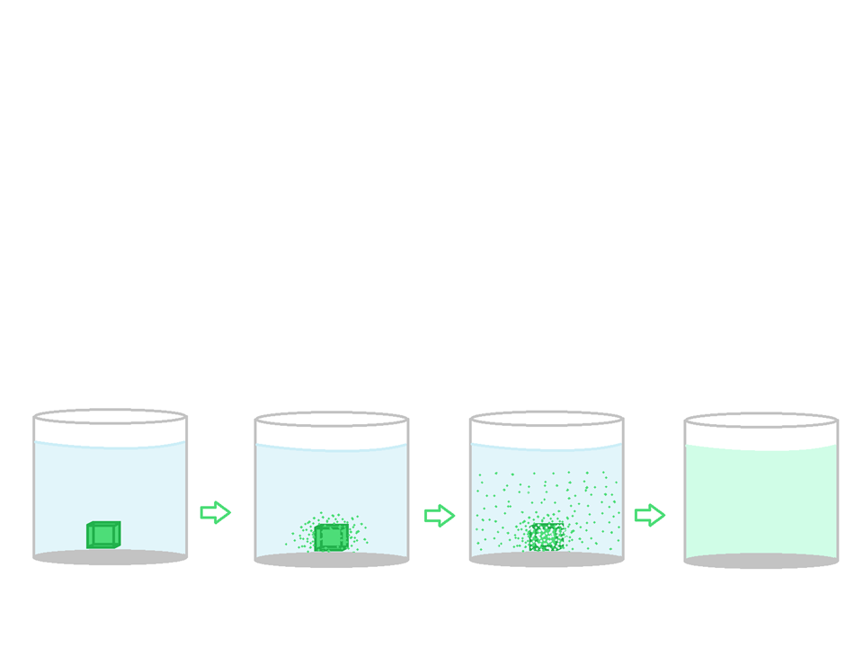
Passive Transport
Diffusion: spontaneous process resulting from the constant motion of molecules
  Substances move from a high to low concentration
    Move DOWN the concentration gradient

Slide 6
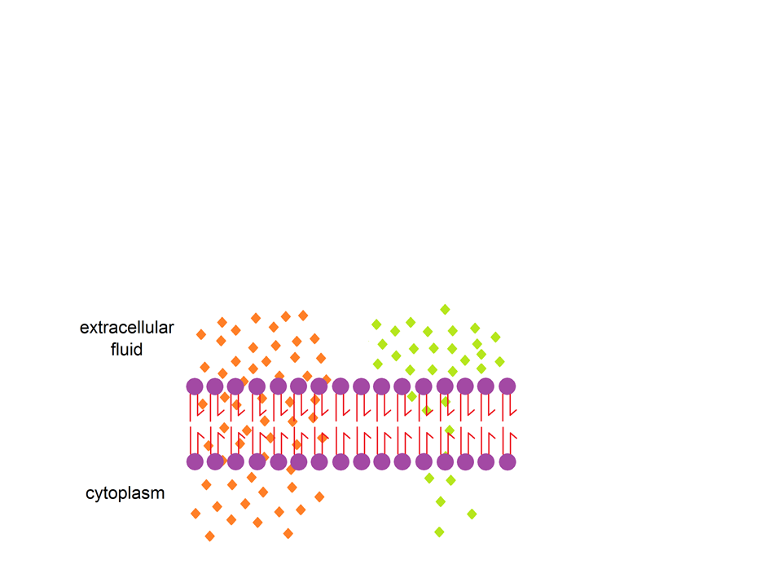
Passive Transport
Molecules diffuse directly across membrane
Different rates of diffusion for different molecules
Remember: even with diffusion the membrane is still selectively permeable

Slide 7
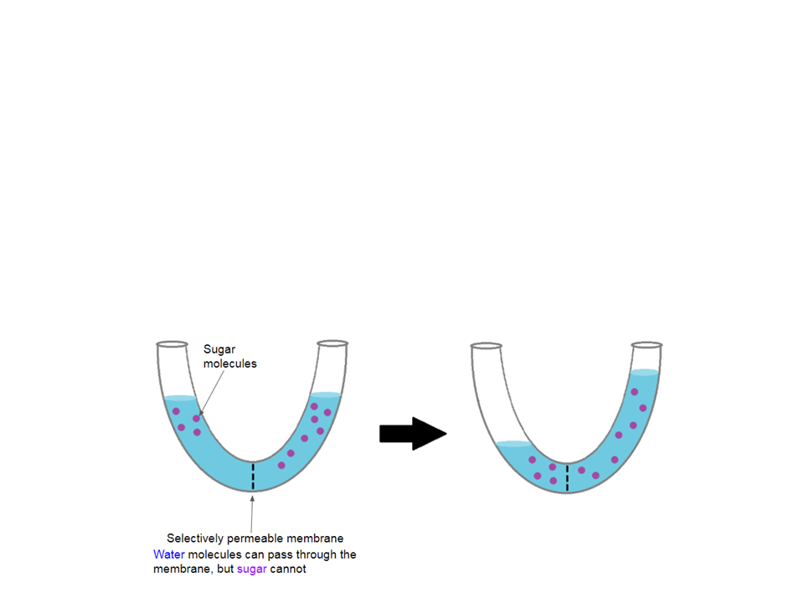
Passive Transport
Osmosis: the diffusion of water down its concentration gradient across a selectively permeable membrane
Can also be thought of as the diffusion of water from areas of low solute concentration to areas of high solute concentration

Slide 8
Passive Transport
Facilitated diffusion: diffusion of molecules through the membrane via transport proteins
  Increases rate of diffusion for:
    Small ions, water, carbohydrates
  Two categories of transport proteins: channel and carrier
    Each transport protein is specific for substances it can facilitate movement for

Slide 9
Passive Transport
Why is facilitated diffusion passive transport and not active transport?
  Facilitated diffusion is still passive transport because the substances the proteins are helping to move are moving DOWN their concentration gradient and NO energy is required

Slide 10
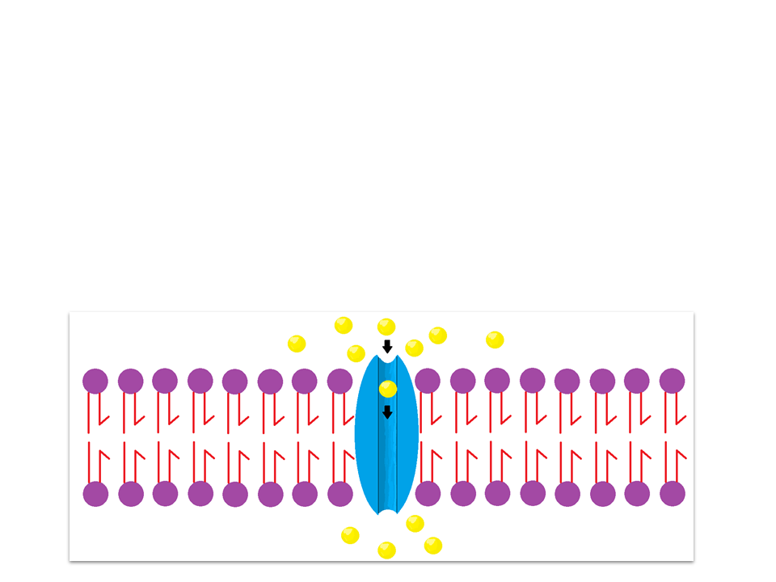
Passive Transport
Channel proteins: provide a channel for molecules and ions to pass
  Channel is hydrophilic
      Many are gated channels
        Only allow passage when there is a stimulus
      Aquaporins: specific channel protein for water

Slide 11
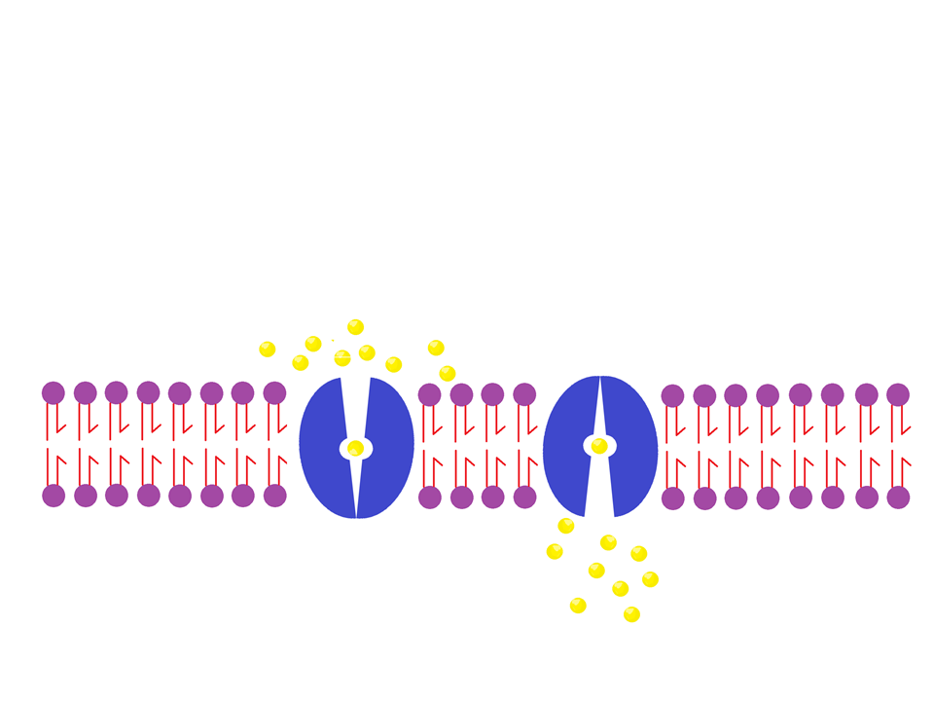
Passive Transport
Carrier proteins: undergo conformational changes for substances to pass

Slide 12
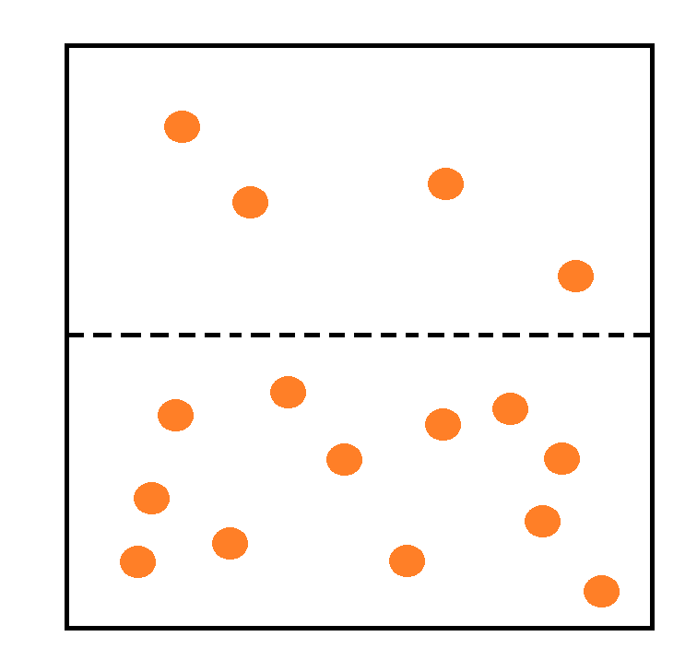
Practice
In terms of diffusion, describe what is most likely to happen to the particles in the image below? (The dashed lines represent a plasma membrane)
Notes:
Particles will move from high to low concentration, so they would move from the bottom to the top.

Slide 13
Practice: Concept Check
Explain why energy is NOT required for facilitated diffusion.
Notes:
2. Energy is not required because the molecules are still moving down their concentration gradient

Slide 14
Practice Problems
Work on the practice problems.

Slide 15
Active Transport
Active transport: transport of a molecule that requires energy because it moves a solute against its concentration gradient
    Pumps
    Cotransport
    Exocytosis
    Endocytosis

Slide 16
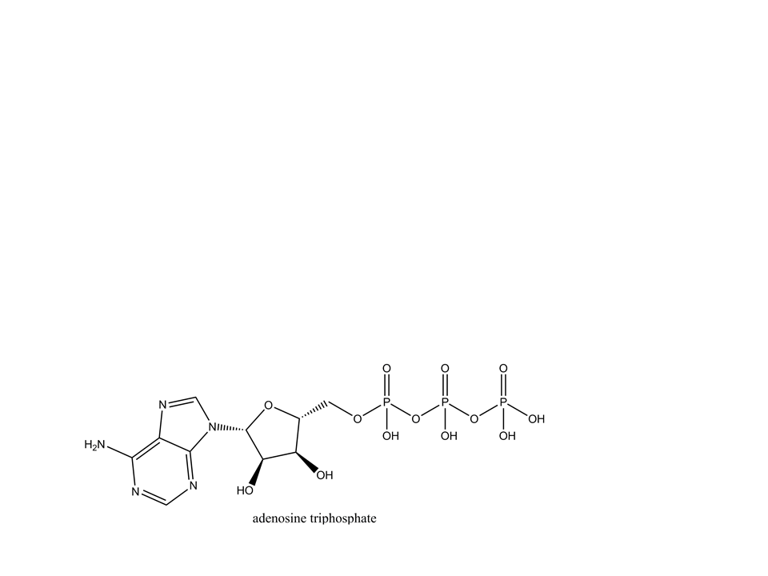
Active Transport
Active transport requires energy
  Adenosine Triphosphate (ATP): Energy source used by cells
  ATP can transfer the terminal phosphate group to the transport protein, which changes the shape of the transport protein to better move a substance
Also known as conformational change

Slide 17
Active Transport
Pumps: maintain membrane potential
Membrane potential: unequal concentrations of ions across the membrane results in an electrical charge (electrochemical gradient)
  The cytoplasm is relatively negative in comparison to the extracellular fluid
  Energy is stored in electrochemical gradients

Slide 18
Active Transport
Examples of pumps:
Electrogenic pumps: proteins that generate voltage across membranes, which can be used later as an energy source for cellular processes
Sodium potassium pump
  Animal cells will regulate their relative concentrations of Na⁺ and K⁺
    3 Na⁺ get pumped out of the cell
    2 K⁺ get pumped into the cell
      Results in a +1 net charge to the extracellular fluid

Slide 19
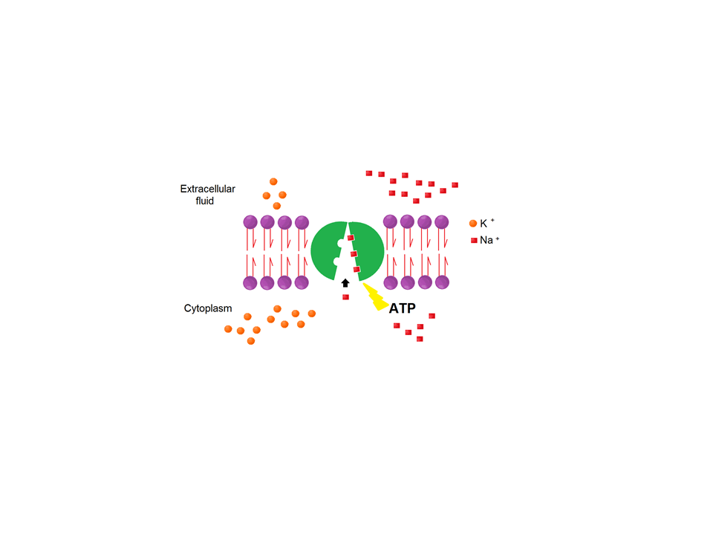
Sodium Potassium Pumps
In this shape, the protein has an affinity towards Na⁺
ATP phosphorylates the protein, which causes a conformational change
Animal cells have a relatively high concentration of K⁺ inside the cell in comparison to outside the cell
Animal cells have a relatively low concentration of Na⁺ inside the cell in comparison to outside the cell

Slide 20
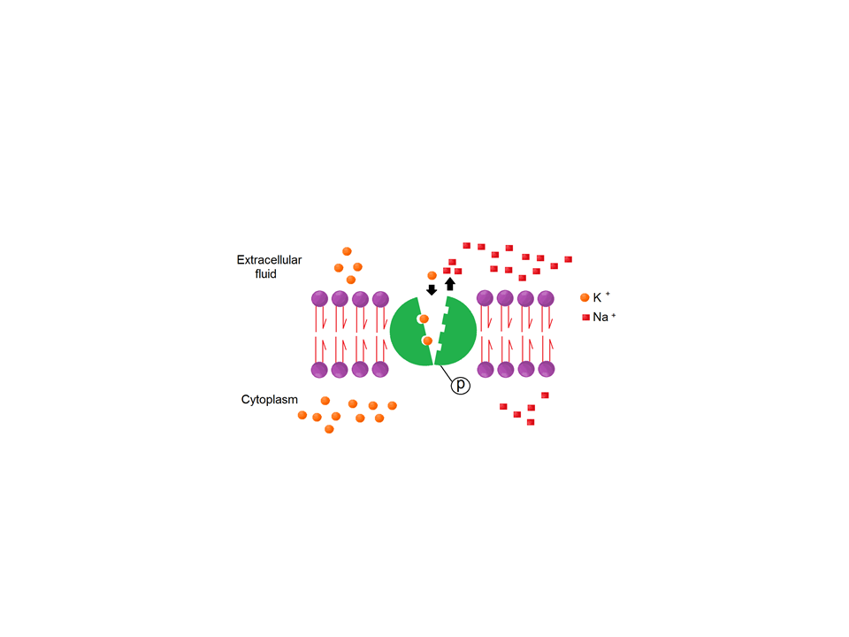
Sodium Potassium Pumps
The new shape causes the affinity of the protein to be towards K⁺
When K⁺ binds to the protein, this phosphate group will be released

Slide 21
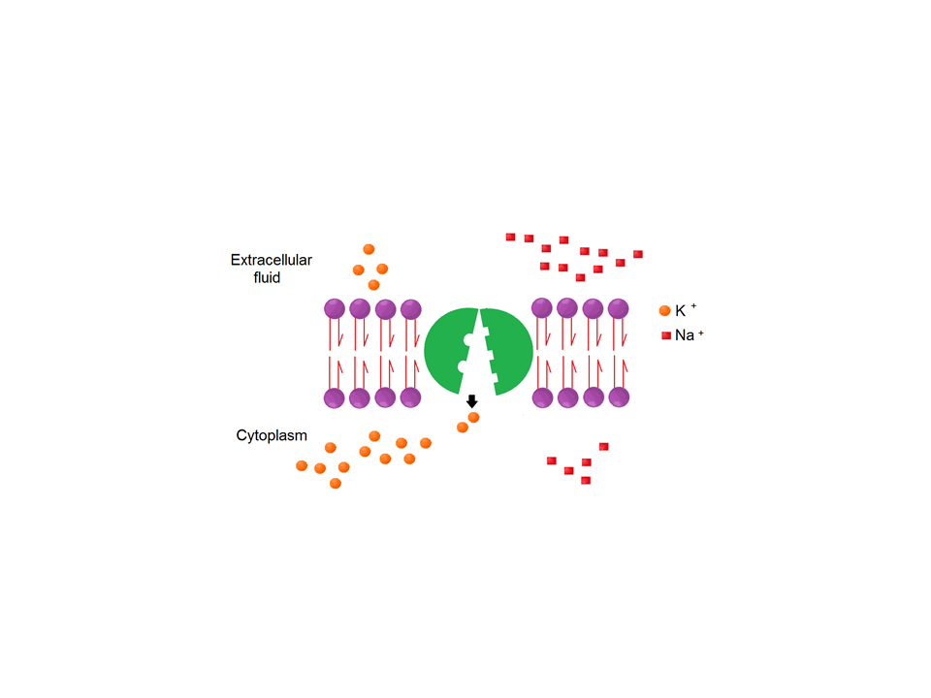
Sodium Potassium Pumps
Loss of the phosphate group causes the protein to return to its original shape

Slide 22
Active Transport
Examples of pumps:
Proton pump: integral membrane protein that builds up a proton gradient across the membrane
  Used by plants, fungi, and bacteria
  Pumps H+ out of the cell

Slide 23
Active Transport
Cotransport: the coupling of a favorable movement of one substance with an unfavorable movement of another substance
  Uses the energy stored in electrochemical gradients (generated by pumps) to move substances against their concentration gradient
Notes:
The energy stored in these electrochemical gradients is released when the substance start to move back down (with) their concentration gradient

Slide 24
Active Transport
Favorable movement: downhill diffusion
Unfavorable movement: uphill transport

Slide 25
Active Transport
Plants use cotransport for sugars and amino acids
Example: sucrose-H⁺ cotransporter
  Sucrose can travel into a plant cell against its concentration gradient ONLY if it is coupled with H⁺ that is diffusing down its electrochemical gradient

Slide 26
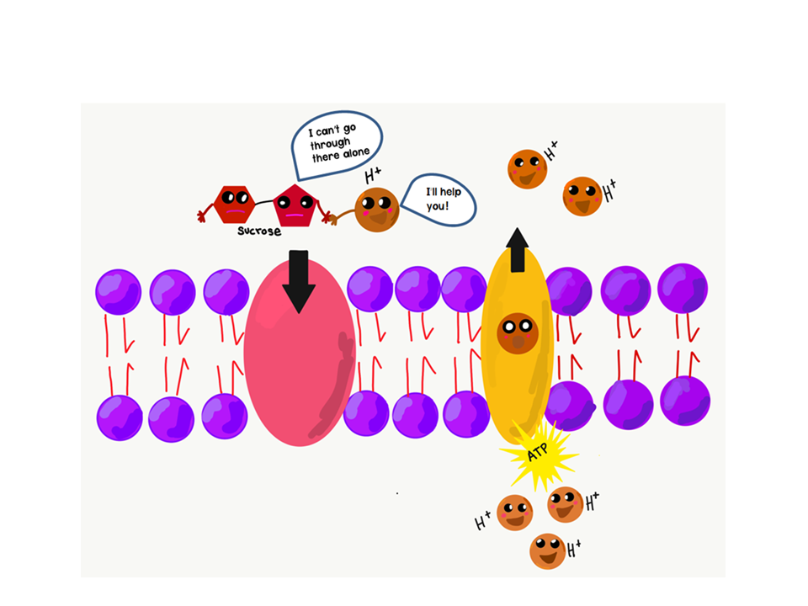
Cotransport

Slide 27
Active Transport
Transport of large molecules is done through exocytosis and endocytosis
Exocytosis: the secretion of molecules via vesicles that fuse to the plasma membrane
Vesicles can fuse to the membrane by forming a bilayer
  Once fused, the contents of the vesicle are released to the extracellular fluid
  Example: nerve cells releasing neurotransmitters

Slide 28
Active Transport
Endocytosis: the uptake of molecules from vesicles fused from the plasma membrane (think: opposite of exocytosis)
Phagocytosis
Pinocytosis
Receptor-mediated

Slide 29
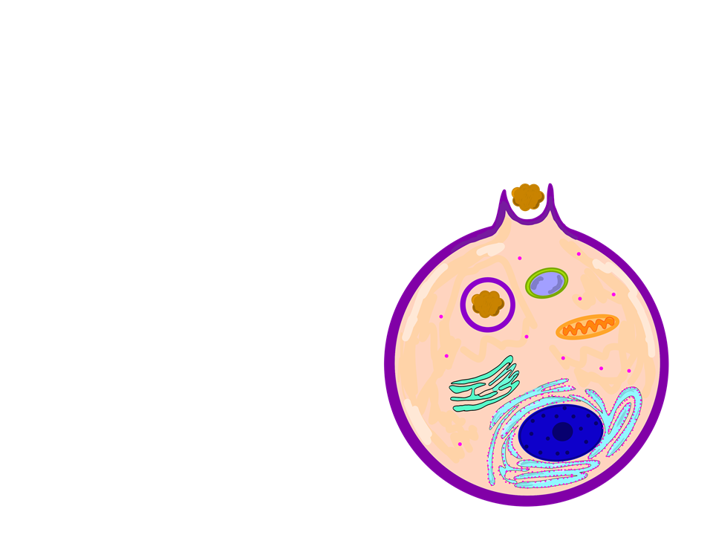
Active Transport
Phagocytosis: when a cell engulfs particles to be later digested by lysosomes
Cell surrounds particle with pseudopodia
Packages particles into a food vacuole
  Food vacuole fuses with a lysosome to be digested

Slide 30
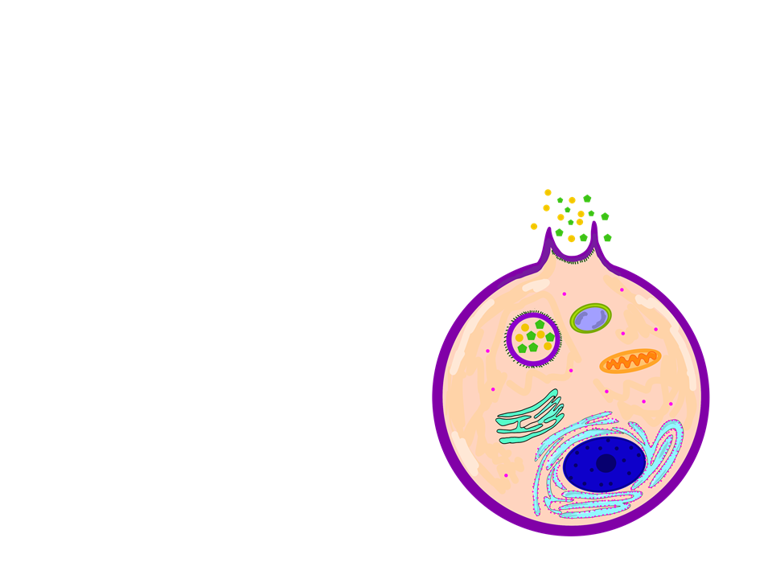
Active Transport
Pinocytosis: nonspecific uptake of extracellular fluid containing dissolved molecules
Cell takes in dissolved molecules in a protein coated vesicle
  Protein coat helps to mediate the transport of molecules

Slide 31
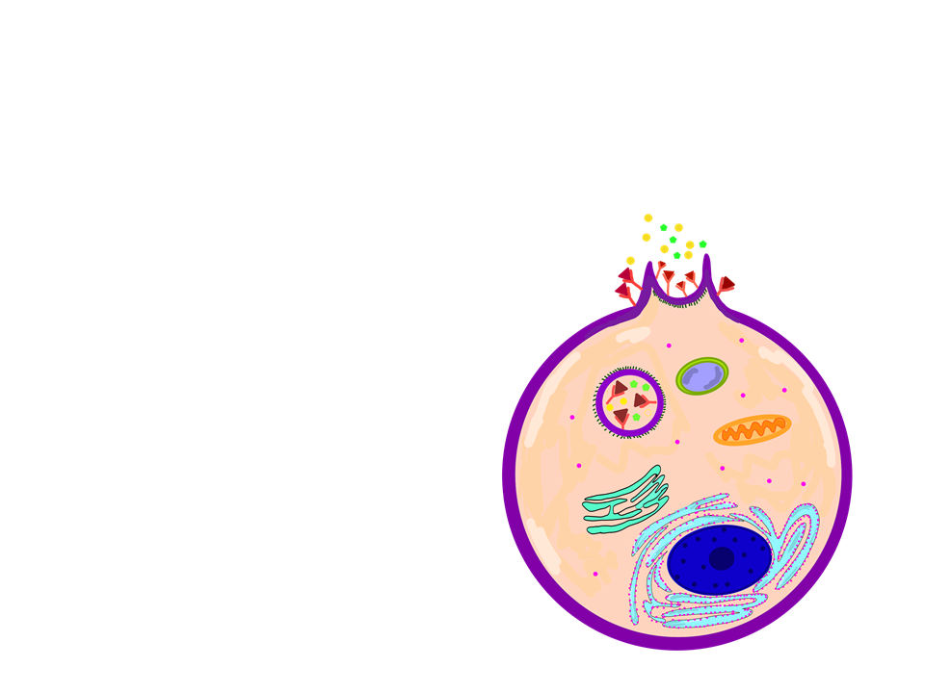
Active Transport
Receptor mediated endocytosis: specific uptake of molecules via solute binding to receptors on the plasma membrane
Allows the cell to take up large quantities of a specific substance
When solutes bind to the receptors, they cluster in a coated vesicle to be taken into the cell

Slide 32
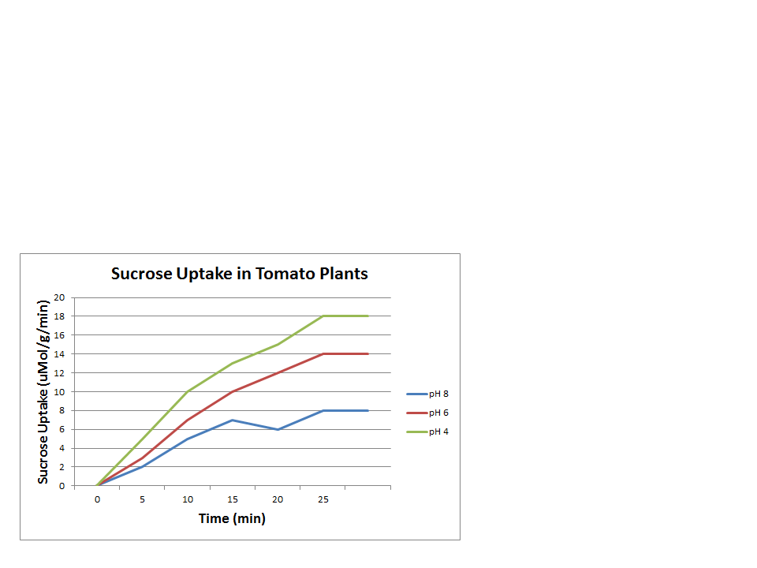
Practice FRQ
You want to determine the effect of pH on the uptake of sucrose in tomato plant cells. You expose the cells to a sucrose solution at varying pH levels and record the data seen in the chart below.
Identify the optimal pH for sucrose uptake.
Describe why the pH identified in part (a) would lead to an increase in sucrose uptake.
Predict how a pH of 2 would affect sucrose uptake.
Notes:
pH 4 is the optimal pH.
Lower pH causes an excess of H+ in solutions. In order for sucrose to be taken up by cells, it must travel with H+, which is moving down its concentration gradient. Therefore, since there is a higher concentration of H+ at the lower pH, sucrose is able to be taken up at a faster rate due to cotransport.
At a certain pH plants cells will no longer be able to survive. Decreasing the pH to 2 would likely have a negative affect on the plant, preventing normal processes from occuring, therefore disrupting sucrose uptake.

Slide 33
Practice FRQ
When a pathogen, such as a bacteria, invades the human body, the immune system is alerted. Once alerted, white blood cells such as macrophages locate the pathogen and engulf it through phagocytosis. (a) Describe the process of phagocytosis. (b) Identify the most likely component of the plasma membrane that the immune system uses to recognize the pathogen.
Notes:
In phagocytosis a cell will engulf a particle using pseudopodia to wrap around it. It takes the particle inside the cell as a food vacuole. This food vacuole will fuse with a lysosome and the contents will be digested.
Glycoproteins (these are used for cell to cell communication)

Slide 34
Practice
Work on pages 47-48

