Slide 1
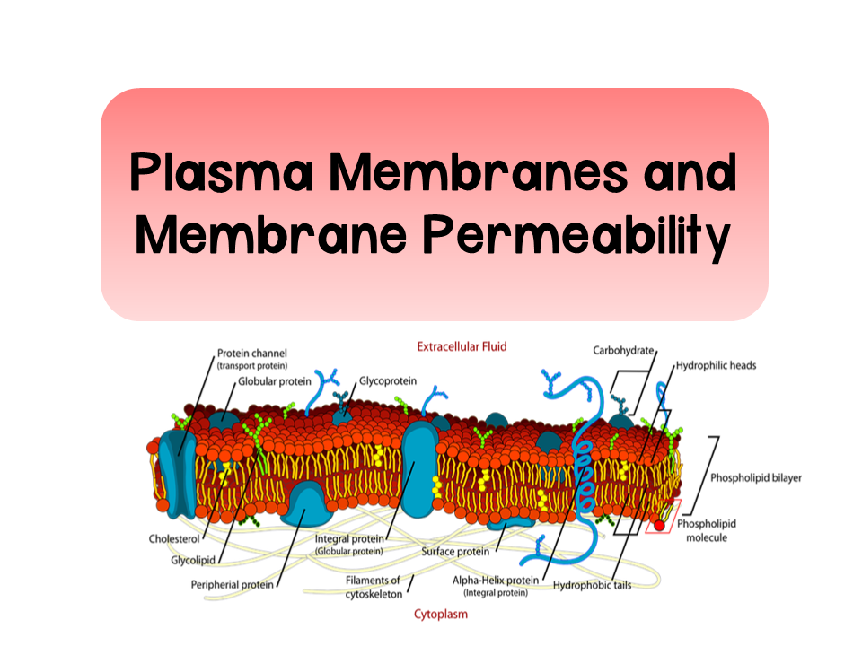
Notes:
Videos relating to this topic:
Amoeba Sisters: https://www.youtube.com/watch?v=qBCVVszQQNs
Bozeman: https://www.youtube.com/watch?v=S7CJ7xZOjm0

Slide 2
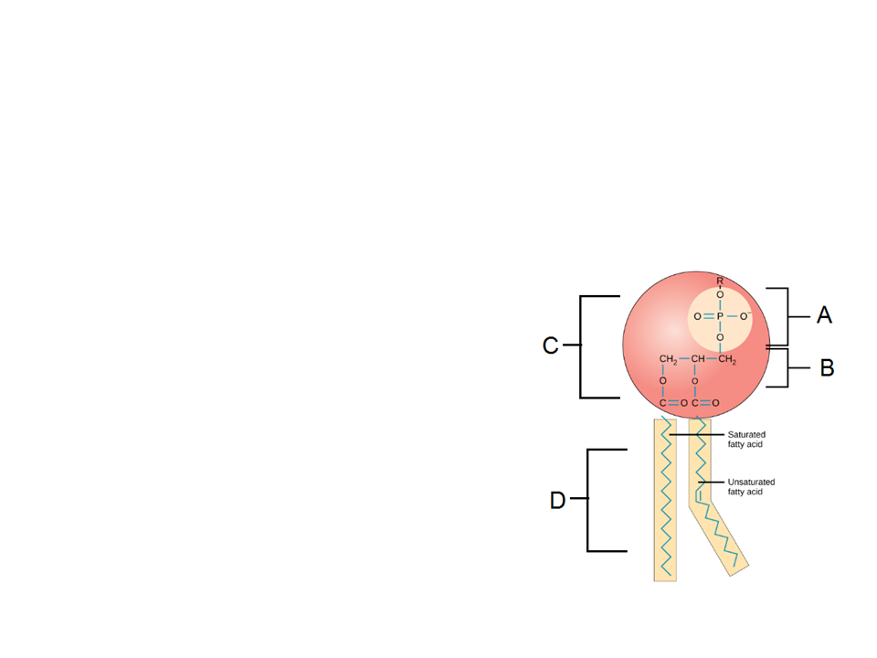
Plasma Membrane
Take a few minutes to review your unit 1 notes on phospholipids
Examine the phospholipid to the right and identify the structures
A:
B:
C:
D:
Phosphate group
Glycerol
Hydrophilic head
Hydrophobic tails

Slide 3
Plasma Membrane
Answer review questions 2-4

Slide 4
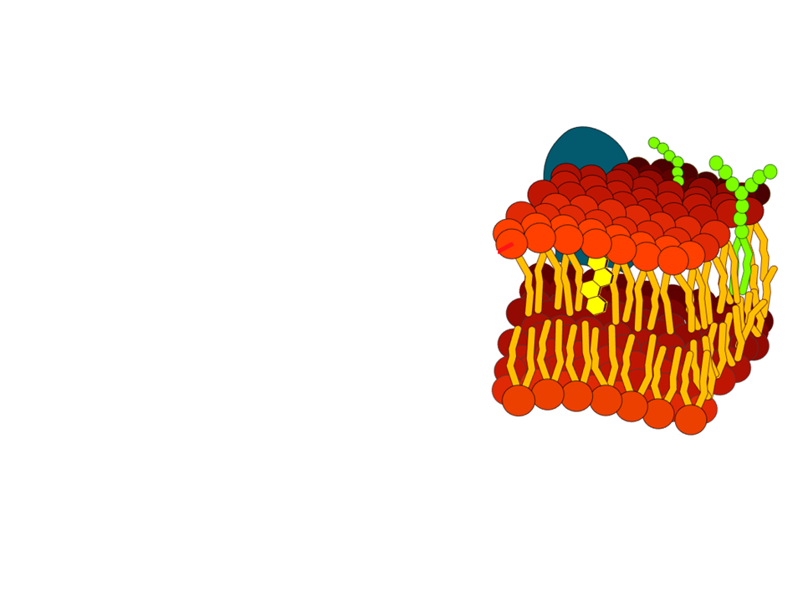
Plasma Membrane
Separates internal cell environment from external environment
Comprised primarily of phospholipids
Phospholipids are amphipathic
  Hydrophilic head and hydrophobic tails
  Forms a bilayer

Slide 5
Plasma Membrane
Selective permeability: The ability of membranes to regulate the substances that enter and exit
Hydrophilic heads oriented TOWARD aqueous environments
Hydrophobic tails are facing inwards AWAY from aqueous environments

Slide 6
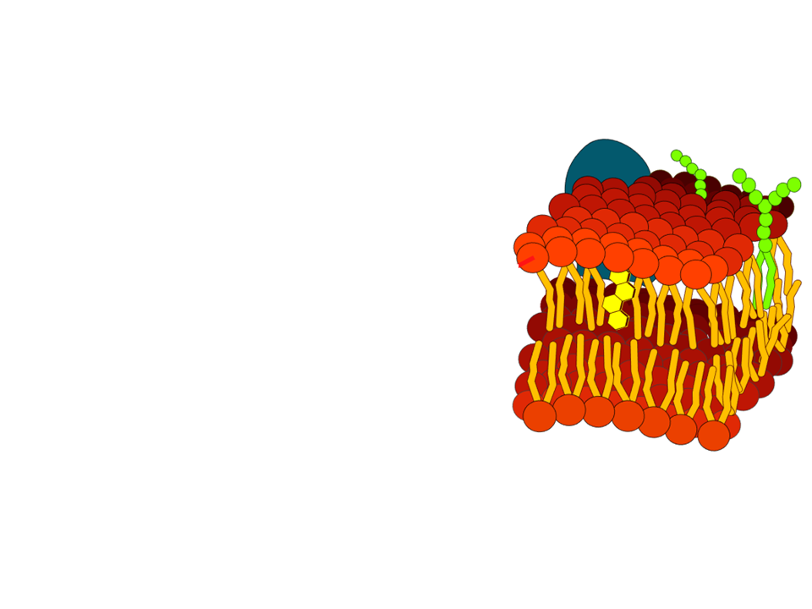
Fluid Mosaic Model
A model to describe the structure of cell membranes
Fluid: membrane is held together by weak hydrophobic interactions and can therefore move and shift
  Temperature affects fluidity
  Unsaturated hydrocarbon tails help maintain fluidity at low temps
    Kinked tails prevent tight packing of phospholipids

Slide 7
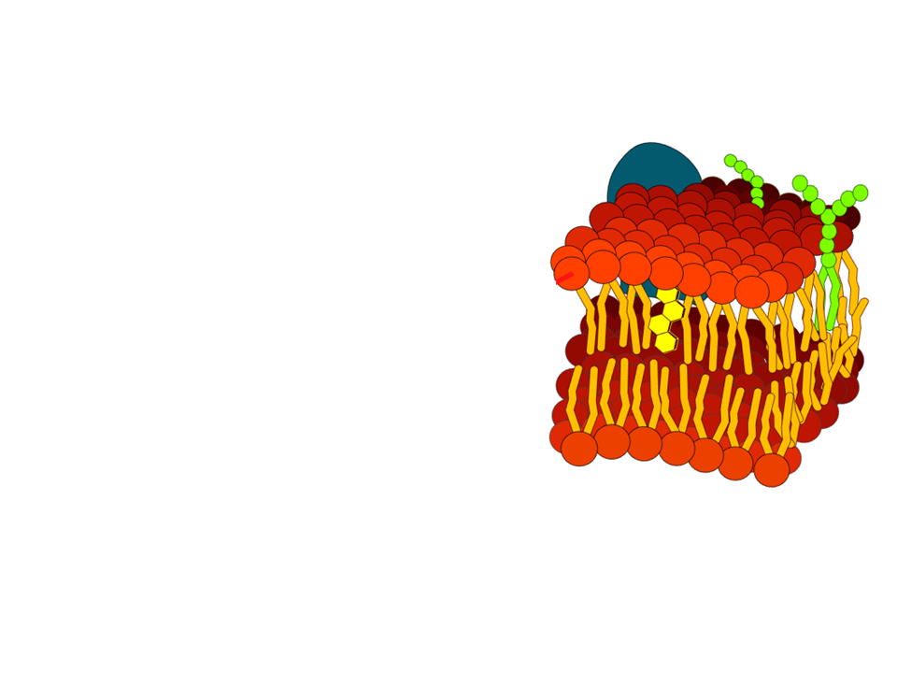
Fluid Mosaic Model
  Cholesterol helps maintain fluidity at high and low temps
    High temp: reduces movement
    Low temp: reduces tight packing of phospholipids
Mosaic: comprised of many macromolecules

Slide 8
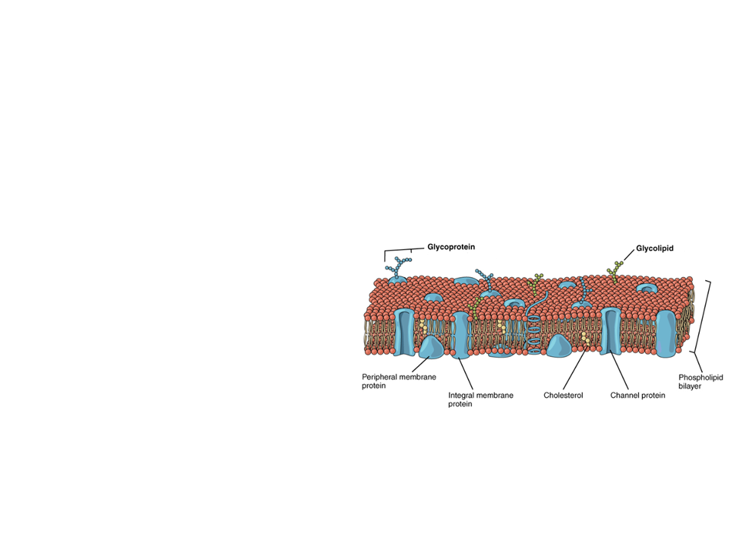
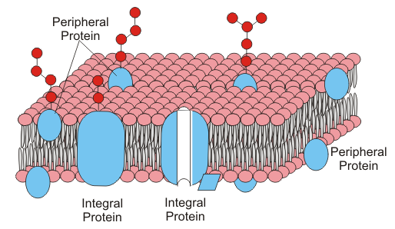
Membrane Proteins
There are two major categories of proteins in the membrane
Integral proteins
  Proteins that are embedded into the lipid bilayer
    aka transmembrane proteins
    Amphipathic
Peripheral proteins
  Proteins that are not embedded into the lipid bilayer
    Loosely bonded to the surface

Slide 9
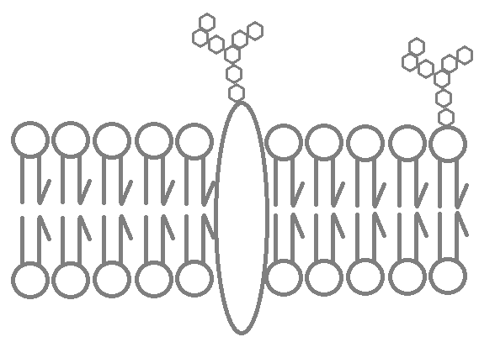
Membrane Carbohydrates
Important for cell-to-cell recognition
Glycolipids
  Carbohydrates bonded to lipids
Glycoproteins
  Carbohydrates bonded to proteins
  Most abundant

Slide 10
Plant Cells

Slide 11
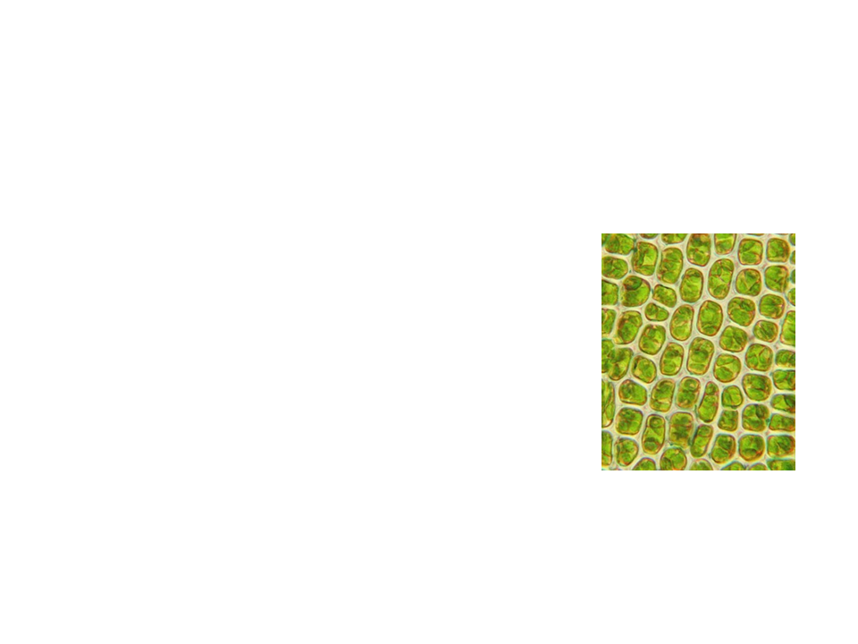
Plants
Plants have a cell wall that cover their plasma membranes
Extracellular structure (not found in animal cells)
  Provides:
    Shape/structure
    Protection
    Regulation of water intake

Slide 12
Plants
The cell wall is composed of cellulose
Thicker than plasma membranes
Contain plasmodesmata
  Hole-like structures in the cell wall filled with cytosol that connect adjacent cells

Slide 13
Practice FRQ
The Channichthyidae fish, also known as the crocodile ice fish, lives in the Southern Ocean around Antarctica. These waters are known to maintain extremely low temperatures all year, ranging from approximately 28℉ to 35℉. These fish have adaptations that allow them to live in cold, low oxygen waters. (a) Describe the expected membrane lipid composition of the cells from the Channichthyidae fish. (b) Explain how the membrane lipid composition you described in part (a) is advantageous for the fish's survival in its environment.
Notes:
Teachers like to tackle the practice FRQs differently, so I did not provide directions in their packets. Usually what I do is give them time to work on it individually or with a partner. Then they can review looking at their notes. To make grading simple I tell that that each question asked is worth one point. For this FRQ it would be worth 2 points. As a class, we then go over the correct responses and the reasoning behind them.
The membranes would most likely have a high proportion of unsaturated hydrocarbon tails AND/OR a high level of cholesterol.
This would allow their membranes to remain fluid at low temperatures. Unsaturated tails have “kinks” due to double bonds. This prevents packing of lipids within the membrane, therefore allowing it to remain fluid. AND/OR cholesterol disrupts the regular packing of phospholipids. This allows the fish to survive at low temps.

Slide 14
Practice Problems
Work on the practice problems.

