Slide 1
1.6: Developments in Europe
Part 2
Dr. Robert E. Sawyer

Slide 2
Learning Objective
Explain the causes and consequences of political decentralization in Europe from c. 1200 to c. 1450.
Key Concept (KC-3.2.I.B.ii)
Europe was politically fragmented and characterized by decentralized monarchies, feudalism, and the manorial system.
Notes:
Insert a map of your country.

Slide 3
Overview
Between 1200 and 1450, Europe remained politically fragmented despite growing cultural unity through Christianity. The continent was dominated by feudal monarchies, manorial estates, and a hierarchical system of loyalties between kings, nobles, knights, and peasants. This decentralized system both ensured local stability and limited central authority, shaping Europe’s gradual evolution toward stronger monarchies in the late medieval and early modern periods.
Notes:
Insert a map of your country.

Slide 4
Keywords and Phrases
Term | Definition
Feudalism | Political system based on reciprocal obligations among kings, nobles, and vassals.
Manorialism | Economic system based on self-sufficient agricultural estates worked by serfs.
Vassalage | The loyalty and service owed by a knight to a lord in exchange for land.
Fief | Land granted by a lord to a vassal as a reward for service.
Serfdom | Labor system in which peasants were bound to the land and subject to a lord’s authority.
Magna Carta (1215) | Charter limiting English royal power and protecting feudal rights.
Capetian Dynasty | French royal family that gradually centralized authority.
Holy Roman Empire | Decentralized empire in Central Europe where local princes retained power.
Notes:
Insert a map of your country.

Slide 5
I. Causes of Decentralization
Collapse of Central Authority (Post-Rome):
After the fall of the Western Roman Empire (476 CE), Europe lacked a unified government. Local rulers filled the vacuum, creating regional kingdoms and lordships.
Invasions and Insecurity:
Frequent invasions from Vikings (north), Magyars (east), and Muslim raiders (south) led to militarized societies that depended on local defense rather than distant monarchs.
Notes:
Insert a map of your country.

Slide 6
I. Causes of Decentralization
Weak Monarchies:
Early medieval kings often had limited taxation power and few standing armies. They relied on feudal oaths from nobles for soldiers and loyalty.
Geography and Communication:
Europe’s diverse terrain—mountains, rivers, and forests—made central control difficult and encouraged regional autonomy.
Notes:
Insert a map of your country.

Slide 7
II. The Structure of Feudalism
Feudalism was a political and military system based on reciprocal obligations among social classes.
Rank | Description | Obligation
King | Claimed ownership of all land; granted fiefs (land) to nobles. | Provided protection and legitimacy.
Nobles/Lords | Controlled fiefs; maintained private armies of knights. | Owed loyalty, military service, and counsel to the king.
Knights/Vassals | Granted smaller estates (manors) by lords. | Served as mounted warriors and enforced order locally.
Peasants/Serfs | Worked the land; bound to their manors. | Paid taxes or labor (corvée) in return for protection.
Key Terms:
Fief: A land grant exchanged for loyalty.
Vassalage: The mutual relationship between lord and knight.
Serfdom: The economic foundation of feudal society; peasants tied to land rather than free laborers.
Notes:
Insert a map of your country.

Slide 8
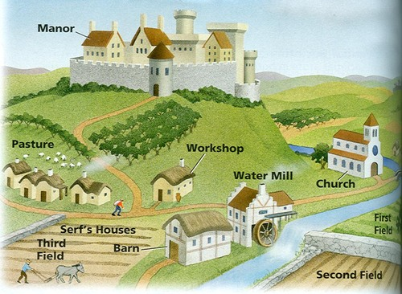

Slide 9
III. The Manorial System: Economic Foundation of Feudalism
The manor was the basic economic unit of medieval Europe.
Features included:
  Self-sufficient estates producing food, tools, and goods locally.
  A manor typically included a lord’s castle, village, fields, church, and mill.
  Serfs worked d and paid dues to their lord in labor or goods.
Consequence:
  Manorialism limited long-distance trade and urban growth but provided stability and protection during times of political chaos.
  As markets expanded in the 13th century, towns and guilds began to challenge the self-sufficiency of manors.
Notes:
Insert a map of your country.

Slide 10
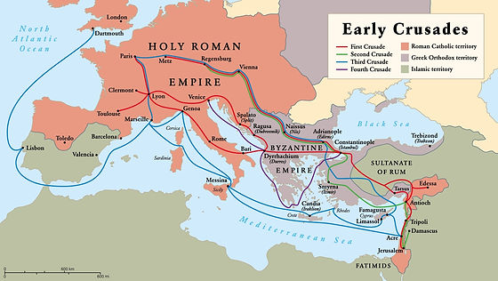

Slide 11
IV. The Holy Roman Empire and Fragmented Monarchies
While kings in France and England gradually centralized power, the Holy Roman Empire (Germany and Italy) remained decentralized due to strong local princes and the influence of the Catholic Church.
  The emperor relied on cooperation with nobles and bishops.
  Conflicts between emperors and popes (e.g., over investiture) weakened imperial authority.
  Germany remained divided into hundreds of semi-independent principalities.
Comparative Note:
Unlike the Abbasid Caliphate or Song Dynasty, European rulers lacked professional bureaucracies — a key reason for slower centralization.
Notes:
Insert a map of your country.

Slide 12
V. Consequences of Decentralization
Area | Consequence | Explanation
Political | Local autonomy | Nobles held real power; monarchs had limited authority.
Economic | Self-sufficiency | Limited trade; dependence on agriculture and manorial labor.
Social | Rigid hierarchy | Serfs bound to land; nobility dominated military and governance.
Military | Fragmented forces | Lords maintained private armies; no standing national military.
Cultural | Regionalism | Local dialects, laws, and customs developed independently.
Notes:
Insert a map of your country.

Slide 13
VI. The Gradual Move Toward Centralization
By 1300–1450, several factors began to weaken feudal fragmentation:
Growth of Towns and Trade:
Urban merchants demanded charters and royal protection, linking wealth to monarchies rather than local lords.
Rise of Bureaucracies:
Kings began employing educated officials (often from the middle class) to administer taxes and justice.
Notes:
Insert a map of your country.

Slide 14
VI. The Gradual Move Toward Centralization
By 1300–1450, several factors began to weaken feudal fragmentation:
Standing Armies and Taxation:
Monarchs like Philip II of France and Edward I of England built national armies funded by new taxes.
Crises of the 14th Century:
The Black Death, Hundred Years’ War, and peasant revolts weakened feudal obligations and accelerated social change.
Result:
Feudal decentralization laid the groundwork for the emergence of modern states — monarchies with centralized institutions.
Notes:
Insert a map of your country.

Slide 15

Case Studies
Refer to the handout on the platform for the case studies.
Notes:
Insert a map of your country.

Slide 16
Concept Reinforcement Table
Concept | Example | AP Skill Connection
Decentralization | Feudal relationships; weak monarchies | Causation – how geography and warfare shaped political structure
Reciprocal Obligations | Lord–vassal bonds | Comparison – contrast with centralized Asian states
Manorial Economy | Serf labor and self-sufficiency | Continuity and change – evolution toward commercial economy
Religious–Political Tensions | Investiture Controversy | Contextualization – Europe’s unique path to political modernization
Notes:
Insert a map of your country.

Slide 17
Summary Takeaways
Feudalism and manorialism defined Europe’s decentralized political and economic structure.
Local lords wielded real power, while monarchs struggled to enforce authority.
Despite fragmentation, Christianity provided cultural cohesion.
By the 14th century, crisis and commerce began to undermine feudalism, setting the stage for modern nation-states.
Notes:
Insert a map of your country.

Slide 18
Reflection and Review Prompts
Answer the following questions on the platform:
What factors explain Europe’s political decentralization between 1200 and 1450?
How did feudalism and manorialism contribute to both order and stagnation in medieval Europe?
Compare the European feudal system with a centralized state such as the Song Dynasty.
How did changes between 1300 and 1450 begin to challenge feudal decentralization?
Notes:
Insert a map of your country.

Slide 19
Questions?

