Slide 1
1.6: Developments in Europe
Part 1
Dr. Robert E. Sawyer

Slide 2
Learning Objective
Explain how the beliefs and practices of the predominant religions in Europe affected European society.
Key Concept (KC-3.1.III.D.v)
Christianity, Judaism, Islam, and their core beliefs and practices continued to shape societies in Europe.
Notes:
Insert a map of your country.

Slide 3
Overview
Between 1200 and 1450, Europe experienced profound religious and cultural transformation. Christianity dominated social and political life, Judaism faced both tolerance and persecution, and Islamic knowledge profoundly influenced European intellectual revival through contact with Muslim Spain and the Crusades.
Together, these interactions shaped European identity, education, art, and governance. This lesson explores how belief systems structured European society and how cross-cultural exchanges with the Islamic world enriched European thought.
Notes:
Insert a map of your country.

Slide 4
Keywords and Phrases
Term | Definition
Scholasticism | Method of reasoning combining faith and logic, developed by Thomas Aquinas.
Monasticism | Religious life in monasteries devoted to prayer, study, and labor.
Divine Right | Belief that monarchs derive authority directly from God.
Investiture Controversy | Conflict between Church and state over appointment of bishops.
Al-Andalus | Muslim-ruled Spain, center of intellectual exchange between faiths.
Gothic Architecture | Style characterized by pointed arches and stained glass, symbolizing divine light.
Notes:
Insert a map of your country.

Slide 5
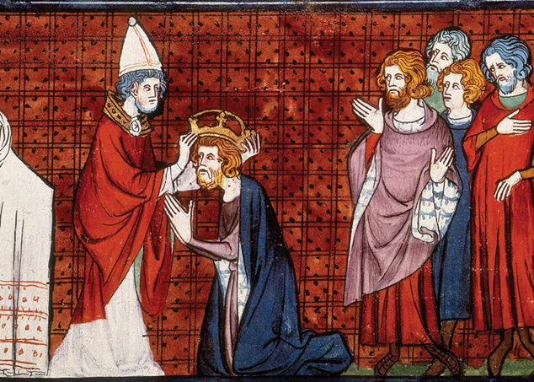

Slide 6
I. The Power of the Catholic Church
By 1200, the Roman Catholic Church was the most powerful institution in Western Europe. It united diverse kingdoms under a shared spiritual authority centered in Rome. The Pope served as both a religious and political leader, influencing monarchs and legitimizing rulers.
Notes:
Insert a map of your country.

Slide 7
I. The Power of the Catholic Church
The Church:
Regulated daily life through sacraments and moral laws.
Controlled education via cathedral schools and monasteries, which preserved classical texts.
Served as the largest landowner, collecting tithes (a 10% income tax).
Sponsored monumental architecture such as Gothic cathedrals (Notre-Dame, Chartres) symbolizing divine order and human aspiration.
Notes:
Insert a map of your country.

Slide 8
I. The Power of the Catholic Church
This unity provided social stability — but also led to conflicts between religious and secular power (e.g., Pope Gregory VII vs. Emperor Henry IV during the Investiture Controversy).
Notes:
Insert a map of your country.

Slide 9
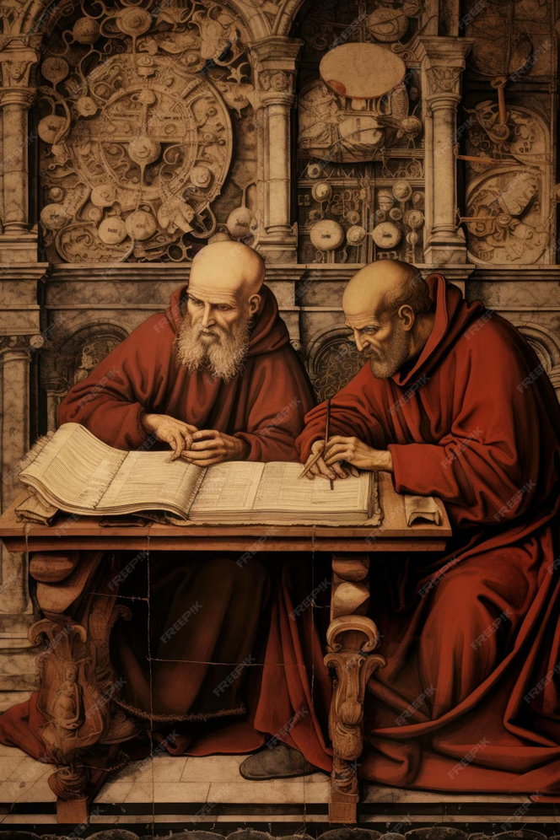

Slide 10
II. The Role of Monasticism and Scholarship
Monastic orders like the Benedictines and Franciscans emphasized prayer, manual labor, and education. Monks copied manuscripts, preserved knowledge, and operated early hospitals and schools. By the 13th century, universities such as Paris and Bologna emerged from these monastic traditions.
Notes:
Insert a map of your country.

Slide 11
II. The Role of Monasticism and Scholarship
In these centers of learning:
Scholars like Thomas Aquinas blended Christian theology with Aristotelian philosophy, arguing that faith and reason were compatible.
This intellectual movement, known as Scholasticism, laid the foundation for European rationalism.
Thus, the Church not only shaped moral life but also guided the intellectual and scientific revival of medieval Europe.
Notes:
Insert a map of your country.

Slide 12
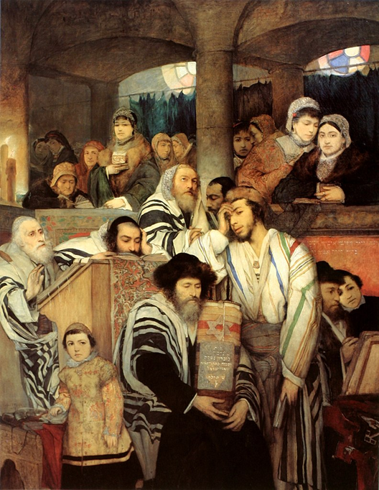

Slide 13
III. Judaism in Christian Europe
Jewish communities lived throughout medieval Europe — especially in Spain, France, and the Holy Roman Empire. They played vital roles in commerce, medicine, and scholarship.
Notes:
Insert a map of your country.

Slide 14
III. Judaism in Christian Europe
However, Jewish life was often precarious:
Protected by rulers when economically useful, yet blamed for disasters such as the Black Death (1347–1351).
Subject to restrictions, forced conversions, and periodic expulsions (notably from England in 1290 and France in 1306).
Despite persecution, Jewish scholars like Maimonides (in Muslim Spain) and later communities in Italy helped preserve and transmit classical Greek and Arabic learning to Europe.
Key Idea: Judaism contributed to Europe’s intellectual exchange but faced systemic marginalization — revealing the tension between cultural diversity and Christian hegemony.
Notes:
Insert a map of your country.

Slide 15
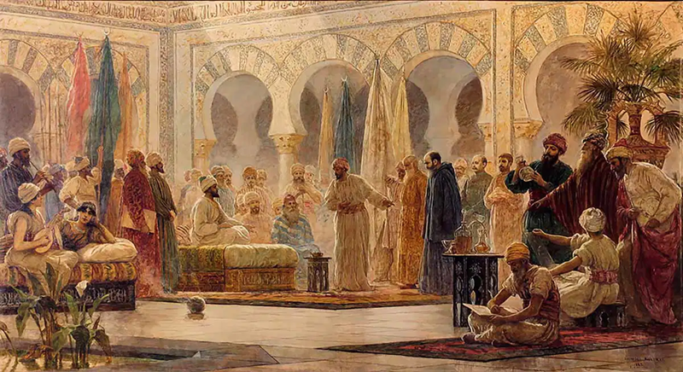

Slide 16
IV. Islamic Influence on European Development
While Western Europe was predominantly Christian, Islamic civilization profoundly influenced its growth. Through contact with Muslim Spain (al-Andalus), the Crusades, and Mediterranean trade, Europeans encountered advanced Islamic scholarship.
Notes:
Insert a map of your country.

Slide 17
IV. Islamic Influence on European Development
Muslim contributions to Europe included:
Preservation and translation of Greek texts (Aristotle, Ptolemy, Galen).
Innovations in mathematics (algebra), medicine, and astronomy.
The introduction of paper-making and advances in navigation (astrolabe, compass refinement).
European scholars studied at centers like Córdoba and Toledo, where Christian, Jewish, and Muslim intellectuals collaborated.
This exchange helped spark Europe’s intellectual reawakening — the foundation of the Renaissance.
Notes:
Insert a map of your country.

Slide 18
V. Religion, Politics, and Society
Religious belief shaped governance and daily life in medieval Europe.
Kings ruled by “divine right”, claiming authority from God.
Laws and moral codes reflected Christian doctrine.
Religious festivals structured the agricultural calendar.
The Church’s social hierarchy mirrored Europe’s feudal system — both emphasizing obedience and duty.
Notes:
Insert a map of your country.

Slide 19
V. Religion, Politics, and Society
At the same time, reform movements such as the Dominicans and Franciscans sought to renew spiritual purity by preaching poverty and service, countering Church corruption. By 1450, cracks were appearing in the unity of Christendom — foreshadowing the later Reformation.
Notes:
Insert a map of your country.

Slide 20
Case Study 1 – Thomas Aquinas and Scholasticism
“Faith and reason are not opposed but complementary. Reason is the tool by which we understand the truths revealed by faith.”
— Thomas Aquinas, Summa Theologica (1265–1274)
Significance:
Aquinas represents Europe’s synthesis of Christian theology with Greek rationalism. His work illustrates intellectual innovation within religious continuity — a hallmark of the 1200–1450 period.
Notes:
Insert a map of your country.

Slide 21
Case Study 2 – Jewish and Muslim Influence in Spain
In Muslim Spain (al-Andalus), Jewish, Christian, and Muslim scholars collaborated in translation centers. For example, works of Aristotle translated from Arabic into Latin shaped medieval European science and philosophy.
This cross-cultural interaction represents diffusion of knowledge across religious boundaries, challenging the idea of a culturally “isolated” Europe.
Notes:
Insert a map of your country.

Slide 22
Case Study 3 – Gothic Cathedrals
The soaring spires and stained glass of Gothic cathedrals were not just artistic; they were visual theology.
They symbolized:
Human aspiration toward the divine.
The unity of art, religion, and technology.
The role of religion in shaping urban identity and communal labor.
Notes:
Insert a map of your country.

Slide 23
Concept Reinforcement Table
Theme | Illustration | AP Skill Connection
Religion as Authority | Papal power, monastic orders, divine right kingship | Causation – how belief systems legitimized rule
Intellectual Exchange | Islamic and Jewish scholarship influencing Europe | Continuity and change – transmission of knowledge
Cultural Unity and Conflict | Shared Christianity vs. persecution of minorities | Comparison – differing effects of religion on groups
Art and Architecture | Cathedrals and manuscripts expressing devotion | Contextualization – material culture of faith
Notes:
Insert a map of your country.

Slide 24
Summary Takeaways
Christianity dominated Europe’s political, social, and intellectual life.
Judaism and Islam contributed to cultural and intellectual exchange but faced varying degrees of tolerance.
Religious institutions acted as centers of education, governance, and art, while also enforcing hierarchical control.
The interaction of belief systems shaped Europe’s transformation — laying foundations for both the Renaissance and Reformation.
Notes:
Insert a map of your country.

Slide 25
Reflection and Review Prompts
How did the Catholic Church’s influence affect political authority and education in medieval Europe?
What role did Jewish and Muslim scholars play in shaping European intellectual life?
In what ways did religious belief both unite and divide European society between 1200 and 1450?
How does the interaction of Christianity, Judaism, and Islam in this period reflect the broader AP theme of “Cultural Developments and Interactions”?
Notes:
Insert a map of your country.

Slide 26
Questions?

