Slide 1
State Building in Africa –
1200-1450
Dr. Robert E. Sawyer

Slide 2
Learning Objective
Explain how and why states in Africa developed and changed over time.
Key Concept (KC-3.2.I.D.ii)
In Africa, as in Eurasia and the Americas, state systems demonstrated continuity, innovation, and diversity, and expanded in scope and reach.
Notes:
Insert a map of your country.

Slide 3
Overview
Between 1200 and 1450, Africa saw the rise of powerful and diverse state systems that connected local societies to global trade networks. These states demonstrated both continuity with traditional African political structures and innovation in administration, religion, and commerce.
Three major case studies illustrate these patterns: Great Zimbabwe, Ethiopia, and the Hausa Kingdoms.
Notes:
Insert a map of your country.

Slide 4
Keywords and Phrases
Term | Definition
Great Zimbabwe | Powerful southern African kingdom known for trade wealth and monumental stone architecture.
Solomonic Dynasty | Ethiopian Christian rulers claiming descent from King Solomon and the Queen of Sheba.
Lalibela | Ethiopian city famous for rock-hewn churches carved into the ground.
Hausa Kingdoms | West African city-states linked by trade and Islam.
Syncretism | The blending of different religious or cultural beliefs.
Trans-Saharan Trade | Network connecting West Africa to North Africa and the Mediterranean world.
Notes:
Insert a map of your country.

Slide 5
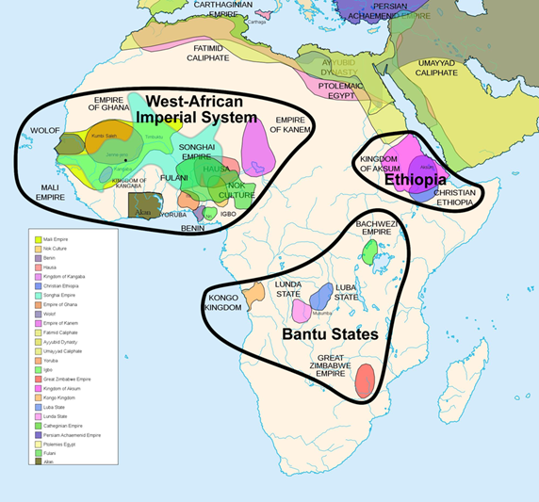

Slide 6
Background Reading: State Formation in Africa (1200–1450)
African societies developed in many different environments — from savanna trade routes to highland plateaus — producing distinct political forms. While some states relied on kinship networks and clan-based leadership, others built centralized monarchies or city-based kingdoms linked to regional and trans-Saharan trade.
Notes:
Insert a map of your country.

Slide 7
Background Reading: State Formation in Africa (1200–1450)
African political systems during this period show three key trends:
Continuity: Long-standing local governance, clan systems, and spiritual traditions persisted.
Innovation: New forms of bureaucracy, architecture, and religious syncretism emerged.
Integration: Growing connections with trade networks and Islamic influences reshaped economic and political life.
Notes:
Insert a map of your country.

Slide 9
Case Study 1 – Great Zimbabwe: Power through Trade and Architecture
Geographic and Economic Context
Located in southeastern Africa between the Zambezi and Limpopo rivers.
Controlled trade between the interior gold fields and coastal ports such as Sofala and Kilwa on the Swahili Coast.
Became a center of wealth through gold, cattle, and ivory trade.
Notes:
Insert a map of your country.

Slide 10
Case Study 1 – Great Zimbabwe: Power through Trade and Architecture
Political and Social Organization
Governed by a divine king, supported by nobles and traders.
Authority came from control of trade routes and the flow of tribute from subordinate communities.
Society was stratified — the king’s wealth and prestige were symbolized in monumental stone architecture.
Notes:
Insert a map of your country.

Slide 11
Case Study 1 – Great Zimbabwe: Power through Trade and Architecture
Cultural and Technological Achievements
Famous for the Great Enclosure, massive stone walls built without mortar — representing both engineering skill and centralized labor organization.
Evidence of long-distance trade: Chinese porcelain, Persian glassware, and Arab coins found at the site.
Religion and power intertwined — rulers may have been viewed as intermediaries between the people and ancestral spirits.
Notes:
Insert a map of your country.

Slide 12
Case Study 1 – Great Zimbabwe: Power through Trade and Architecture
Historical Significance
Demonstrates African urbanization, trade integration, and political centralization without direct outside governance.
Declined around 1450 likely due to resource exhaustion (overgrazing and deforestation) and trade shifts toward coastal powers.
Notes:
Insert a map of your country.

Slide 14
Case Study 2 – Ethiopia: Continuity and Religious Legitimacy
Geographic and Political Context
Located in the Horn of Africa, highland region with strong agricultural base and access to the Red Sea.
Successor to ancient Aksumite civilization — one of the oldest Christian kingdoms in the world.
Maintained independence through geography (mountain fortresses) and diplomacy.
Notes:
Insert a map of your country.

Slide 15
Case Study 2 – Ethiopia: Continuity and Religious Legitimacy
Religion and Governance
Christianity remained central since the 4th century CE, but rulers combined it with local traditions and beliefs.
The Solomonic Dynasty (established c. 1270) claimed descent from the biblical King Solomon and the Queen of Sheba — linking divine ancestry to political authority.
Monasteries and churches became centers of learning, literacy, and administration.
Religion unified the people and differentiated Ethiopia from neighboring Islamic states.
Notes:
Insert a map of your country.

Slide 16
Case Study 2 – Ethiopia: Continuity and Religious Legitimacy
Cultural and Architectural Achievements
Construction of Lalibela’s rock-hewn churches — massive churches carved from solid rock symbolizing devotion and technological skill.
Development of Ge’ez script for religious and historical texts.
Cultural blending of African, Christian, and Arabic influences through trade and diplomacy.
Notes:
Insert a map of your country.

Slide 17
Case Study 2 – Ethiopia: Continuity and Religious Legitimacy
Historical Significance
Ethiopia represents continuity of pre-Islamic Christian kingdoms in Africa.
Demonstrates how religion provided legitimacy and stability in governance.
Serves as an example of resistance and adaptation amid expanding Islamic and trade networks.
Notes:
Insert a map of your country.

Slide 18
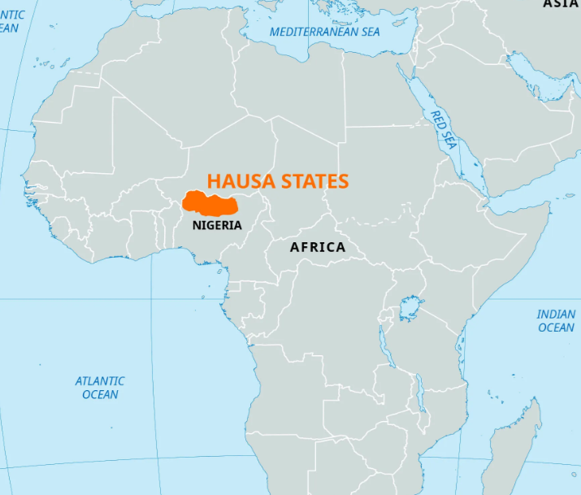

Slide 19
Case Study 3 – The Hausa Kingdoms: Decentralized Power and Trade Networks
Geographic and Economic Context
Collection of independent city-states in the central Sudan region (modern Nigeria).
Located between the Niger River and the Sahel trade routes connecting to North Africa.
Economy based on agriculture, textile production, ironworking, and trans-Saharan trade in salt, leather, and grain.
Notes:
Insert a map of your country.

Slide 20
Case Study 3 – The Hausa Kingdoms: Decentralized Power and Trade Networks
Political and Social Organization
No single central empire — rather, a loose confederation of cities such as Kano, Katsina, and Zazzau.
Each city-state had a king (Sarki) supported by nobles, warriors, and merchants.
Society structured around clans and occupational guilds.
Notes:
Insert a map of your country.

Slide 21
Case Study 3 – The Hausa Kingdoms: Decentralized Power and Trade Networks
Religious and Cultural Life
Adopted Islam gradually through trade with North African merchants.
Islamic influence brought literacy, scholarship, and legal systems while coexisting with traditional animist beliefs — an example of religious syncretism.
Women participated in markets and local production, indicating flexibility within gender norms compared to other Islamic societies.
Notes:
Insert a map of your country.

Slide 22
Case Study 3 – The Hausa Kingdoms: Decentralized Power and Trade Networks
Historical Significance
The Hausa states represent political diversity and adaptation: trade-based city-states rather than empires.
Their urban centers became important commercial and cultural hubs by the 15th century.
The region’s mixed Islamic–African character foreshadowed later West African political and cultural developments.
Notes:
Insert a map of your country.

Slide 23
Thematic Connections Across Africa (1200–1450)
Theme | Great Zimbabwe | Ethiopia | Hausa Kingdoms
Basis of Power | Trade wealth (gold, ivory) | Religious legitimacy (Christian monarchy) | Commerce and city governance
Governance Style | Centralized monarchy | Theocratic monarchy | Decentralized city-states
Religion | Ancestral worship | Christianity | Islam (with traditional elements)
Innovation | Monumental stone architecture | Rock-hewn churches, Ge’ez literature | Urban craft specialization, trade regulation
Continuity | African kingship traditions | Christian heritage from Aksum | Clan-based social organization
Connection to Trade | Linked interior Africa to Indian Ocean trade | Red Sea trade routes | Trans-Saharan and Sahel networks
Notes:
Insert a map of your country.

Slide 24
Concepts and Historical Thinking Skills for AP Exam Questions
1. Continuity and Change:
  Enduring local traditions vs. new trade and religious systems.
  Shifts from kinship-based to centralized states.
2. Comparison:
  Differences between centralized (Ethiopia, Great Zimbabwe) and decentralized (Hausa) governance.
  Contrasts between African and Afro-Eurasian state formation (bureaucracies, religions, economies).
Notes:
Insert a map of your country.

Slide 25
Concepts and Historical Thinking Skills for AP Exam Questions
3. Causation:
  How geography and trade routes shaped the development of African states.
  How religion (Christianity and Islam) influenced political authority and state legitimacy.
4. Evidence and Context:
  Connection to broader 1200–1450 global patterns: trade expansion, cultural exchange, and technology diffusion.
Notes:
Insert a map of your country.

Slide 26
Reflection and Review Prompts
Which African state best demonstrates innovation in governance? Explain your reasoning.
How did trade networks (Indian Ocean, Red Sea, Trans-Saharan) shape African political and cultural systems?
Compare the use of religion as a source of legitimacy in African and Eurasian states during this period.
In what ways do these examples challenge stereotypes about Africa’s “isolation” before European contact.
Notes:
Insert a map of your country.

Slide 27
Questions?

