Slide 1
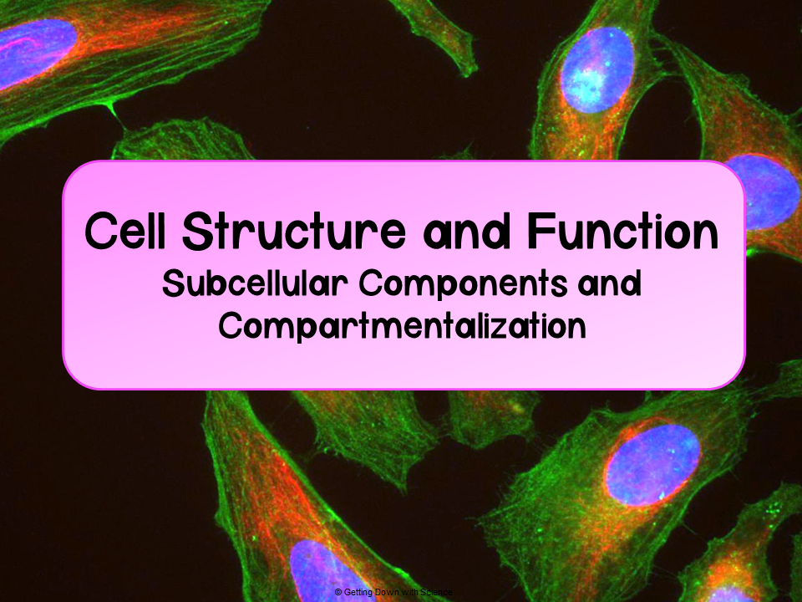
Notes:
Here are some related videos for these topics:
Bozeman: https://www.youtube.com/watch?v=aczbMlSMr8U&t=511s
Crash Course: https://www.youtube.com/watch?v=cj8dDTHGJBY&t=396s

Slide 2
Cells
Cells: the basic structural and functional units of every organism
  All cells:
Are bound by a plasma membrane
Contain cytosol
Contain chromosomes
Contain ribosomes
Notes:
As I go through the list, I verbally describe what each are, or I ask for students to explain each component

Slide 3
Cells
There are two types of cells: prokaryotes and eukaryotes
Prokaryotes
Eukaryotes
Domains Bacteria and Archaea
DNA is in the nucleoid region
Generally smaller in size than eukaryotes
Protists, fungi, animals, and plants
DNA is in the nucleus
Contain membrane bound organelles

Slide 4
Organelles

Slide 5
Organelles
Organelles: membrane bound structures in eukaryotes
Two classifications:
Endomembrane organelles
Nuclear envelope
Endoplasmic reticulum
Golgi complex
Lysosomes
Vesicles/Vacuoles
Plasma membrane
Energy organelles
Mitochondria
Chloroplasts

Slide 6
Compartmentalization
Compartmentalization in organelles allows for different metabolic reactions to occur in different locations
  Increases surface area for reactions to occur
  Prevents interfering reactions from occuring in the same location
Topic 2.10

Slide 7
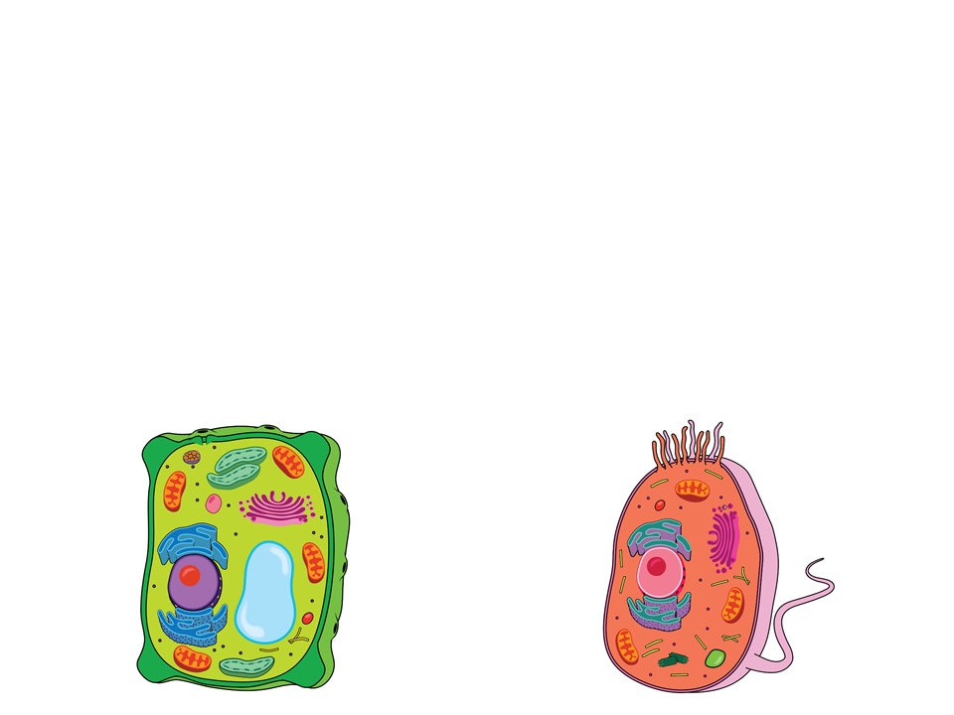
Unique Cell Components
Plants
Animals
Chloroplasts
Central vacuole
Cell wall
Plasmodesmata
Lysosomes
Centrosomes
Flagella

Slide 8
Endomembrane Organelles

Slide 9
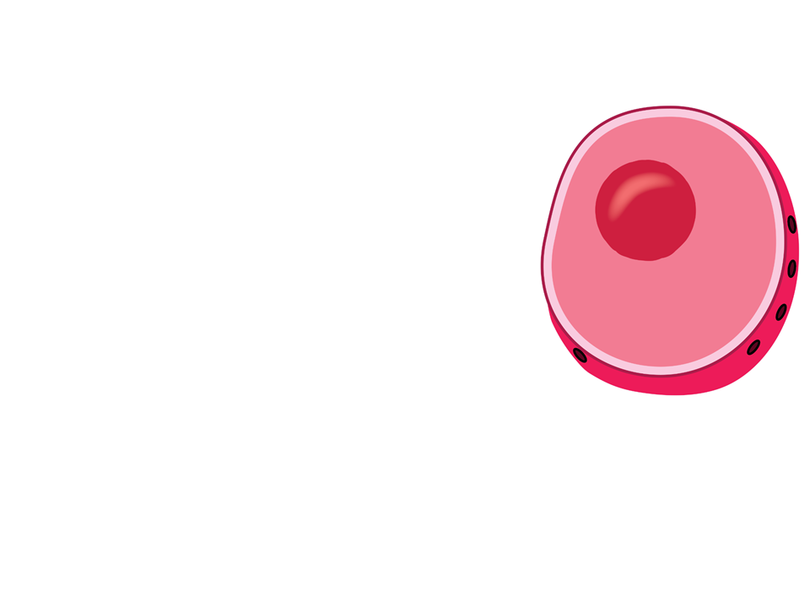
Nucleus
Contains chromosomes (genetic information)
  Enclosed by the nuclear envelope
    Double membrane
  Has pores
    Pores regulate entry and exit of materials from the cell

Slide 10
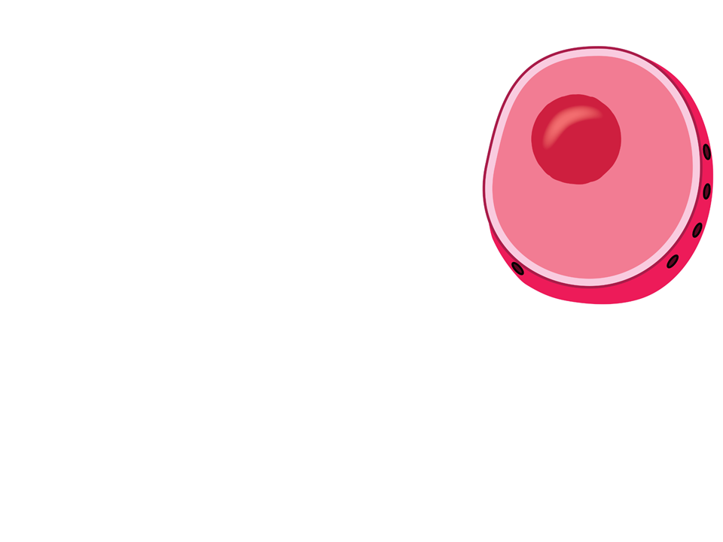
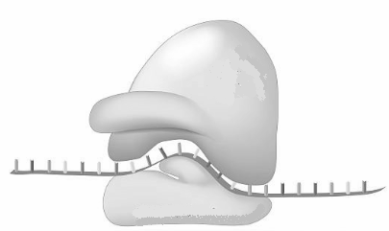
Nucleus
Contains a nucleolus
      Dense region of the nucleus where ribosomal RNA (rRNA) is synthesized
        rRNA is combined with proteins to form large and small subunits of ribosomes
        Subunits exit via nuclear pores
          Assemble into ribosomes
            Ribosomes translate messages found on mRNA into the primary structure of polypeptides

Slide 11
Review
In order for DNA to leave the nucleus, it must first be transcribed by RNA polymerase into messenger RNA (mRNA). The mRNA transcript must then be modified before leaving the nucleus to the cytoplasm. In the cytoplasm, the ribosomes decode the information in mRNA and form continuous chains of amino acids, thus forming a protein. This process of DNA → RNA → protein is known as transcription and translation and will be the main concepts covered in Unit 6. Answer questions 1-3.

Slide 12
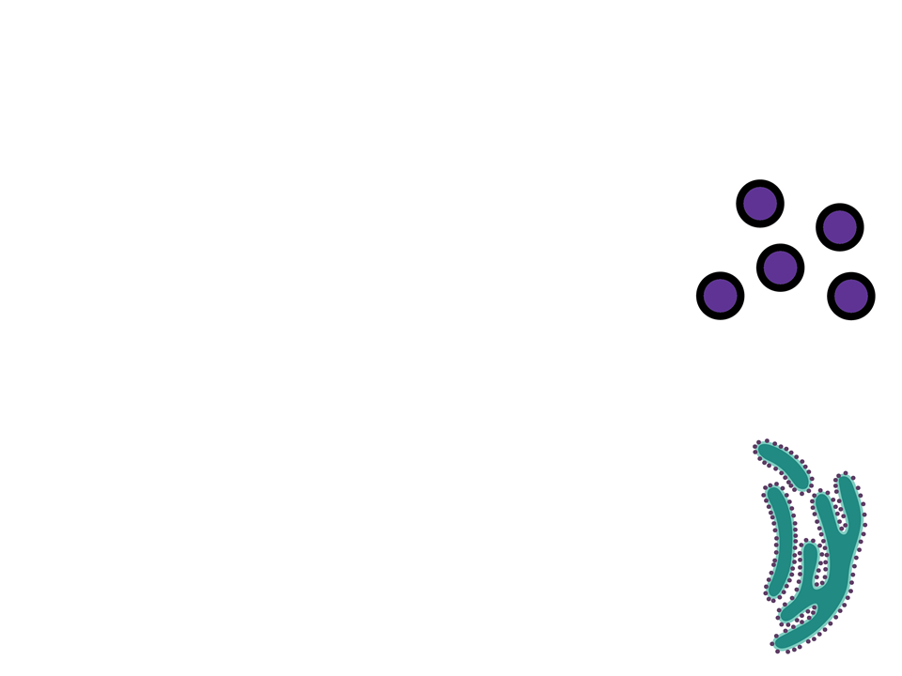
Ribosomes
Comprised of ribosomal RNA and protein
  Function: synthesize proteins
Note: some texts do not classify ribosomes as organelles because they are not bound by a membrane

Slide 13
Ribosomes
Can be found in two locations:
Cytosol
  Proteins produced here generally function only within the cytosol (i.e. enzymes)
  Known as “free ribosomes”
Bound to the endoplasmic reticulum or nuclear envelope
  Proteins produced here can be secreted from the cell
    Leave via transport vesicles

Slide 14
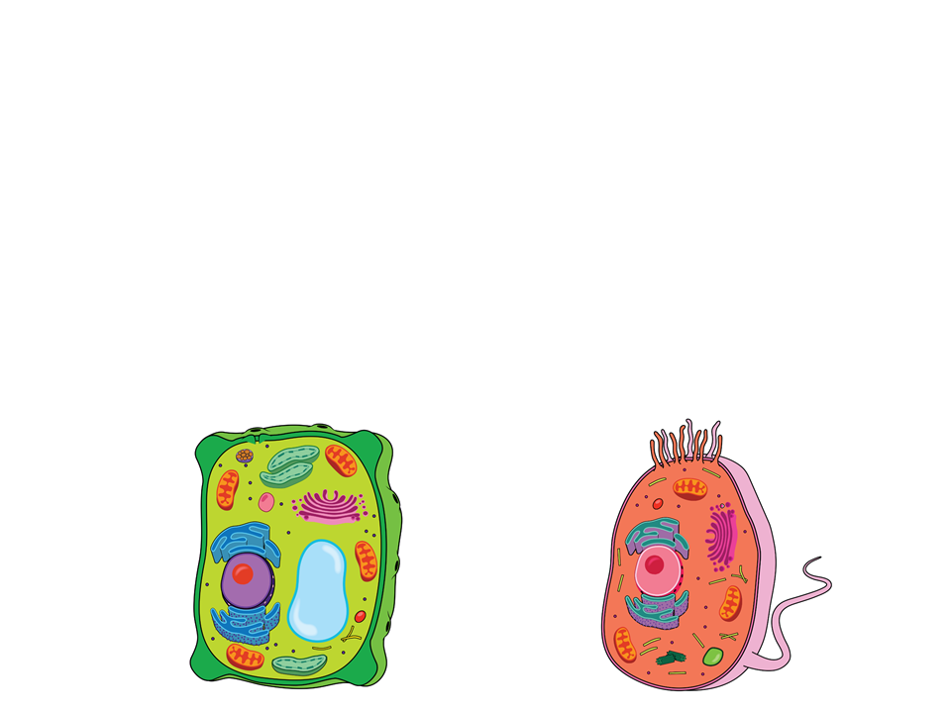
Endoplasmic Reticulum
A network of membranous sacs and tubes
  Functions:
    Synthesizes membranes
    Compartmentalize the cell to keep proteins formed in the rough ER separate from those of free ribosomes

Slide 15
Endoplasmic Reticulum
Two types: rough and smooth

Slide 16
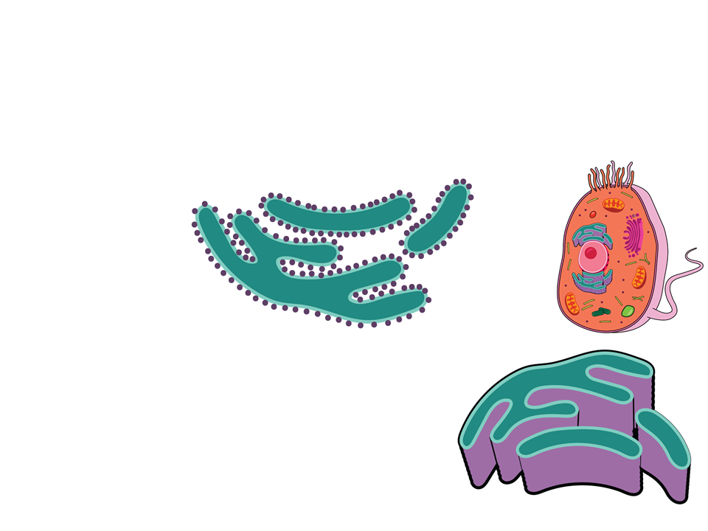
Endoplasmic Reticulum
Rough ER
  Contains ribosomes bound to the ER membrane
Smooth ER
Contains no ribosomes
Synthesizes lipids, metabolizes carbohydrates, and detoxifies the cell

Slide 17

Golgi Complex
Contains flattened membranous sacs called cisternae
Separate the sacs from the cytosol
Each cisternae is not connected
Has directionality
  Cis face:
    Receives vesicles from the ER
  Trans face:
    Sends vesicles back out into cytosol to other locations or to the plasma membrane for secretion

Slide 18

Golgi Complex
Functions:
Receives transport vesicles with materials from the ER
Modifies the materials
Sorts the materials
Adds molecular tags
Packages materials into new transport vesicles that exit the membrane via exocytosis
Ensures newly formed proteins are folded correctly or modified correctly

Slide 19

Lysosomes
Membranous sac with hydrolytic enzymes
Function:
  Hydrolyzes macromolecules in animal cells
  Autophagy: lysosomes can recycle their own cell’s organic materials
    Allows the cell to renew itself
Peroxisomes
Similar to lysosomes
Membrane bound metabolic compartment
  Catalyze reactions that produce H₂O₂
    Enzymes in peroxisomes then break down H₂O₂ to water

Slide 20
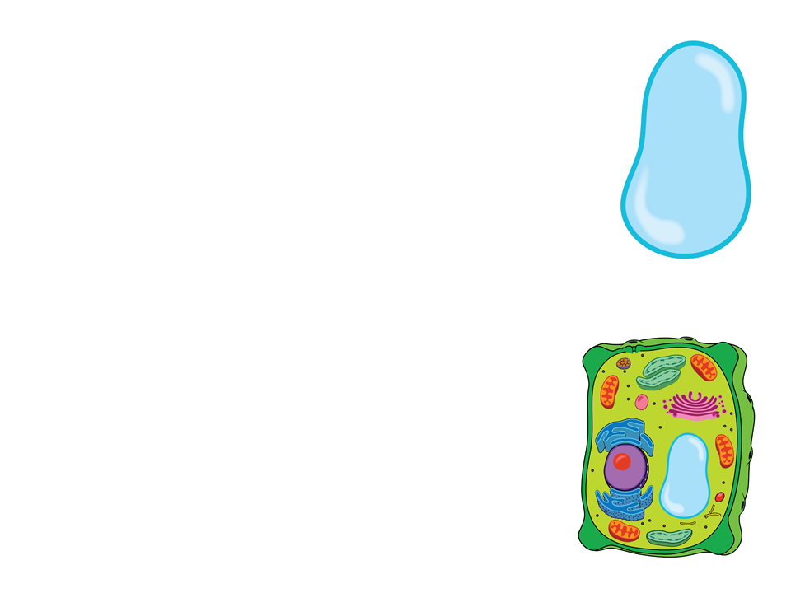
Vacuoles
Large vesicles that stem from the ER and Golgi
Selective in transport
Types:
Food vacuole
Form via phagocytosis (cell eating) and then are digested by lysosomes
Contractile vacuole
Maintain water levels in cells
Central vacuole
Found in plants
  Contains inorganic ions and water
  Important for turgor pressure

Slide 21
Practice FRQ
Hepatitis C is a virus that attacks the liver and can cause liver disease. Liver disease has been linked to a reduction in albumin levels in patients analyzed. Albumin is an important protein in humans. It functions primarily to regulate oncotic pressure of blood, which is important for the regulation of fluids in vessels of the body and tissue repair. On average, patients with liver disease show a 10-30% decrease in blood-albumin levels. (a) Identify the organelle in liver cells that is most likely being affected by hepatitis C and (b) justify your reasoning.
Notes:
Teachers like to tackle the practice FRQs differently, so I did not provide directions in their packets. Usually what I do is give them time to work on it individually or with a partner. Then they can review looking at their notes. To make grading simple I tell that that each question asked is worth one point. For this FRQ it would be worth 2 points. As a class, we then go over the correct responses and the reasoning behind them.
Ribosomes (students could also link this to ribosomes and nucleoli)
Ribosomes carry out protein synthesis. Albumin is a protein synthesized by the liver. Since hepatitis C causes a reduction of albumin production, it is likely that the ribosomes are being affected

Slide 22
Practice FRQ
In humans, pancreatic cells synthesize the protein insulin in the endoplasmic reticulum (ER). Patients diagnosed with type 1 diabetes have immune systems that mistakenly attack their pancreatic cells. Therefore, these patients cannot produce the hormone insulin and have to take medications to introduce insulin into their bodies. (a) Describe how insulin would be produced in a normal functioning (non-type 1 diabetes) pancreatic cell.
Notes:
Teachers like to tackle the practice FRQs differently, so I did not provide directions in their packets. Usually what I do is give them time to work on it individually or with a partner. Then they can review looking at their notes. To make grading simple I tell that that each question asked is worth one point. For this FRQ it would be worth 1 point. As a class, we then go over the correct responses and the reasoning behind them.
Insulin is produced at the ER and packaged into transport vesicles. It is taken to the golgi apparatus where it is modified. Once modified it is released from the golgi via exocytosis

Slide 23
Energy Organelles

Slide 24
Endosymbiont Theory
Endosymbiont Theory: the theory that explains the similarities mitochondria and chloroplasts have to a prokaryote
  Theory states that an early eukaryotic cell engulfed a prokaryotic cell
    Prokaryotic cell became an endosymbiont (cell that lives in another cell)
      Became one functional organism
Topic 2.11

Slide 25
Endosymbiont Theory
Evidence:
Double membrane
Ribosomes
Circular DNA
Capable of functioning on their own
Topic 2.11

Slide 26
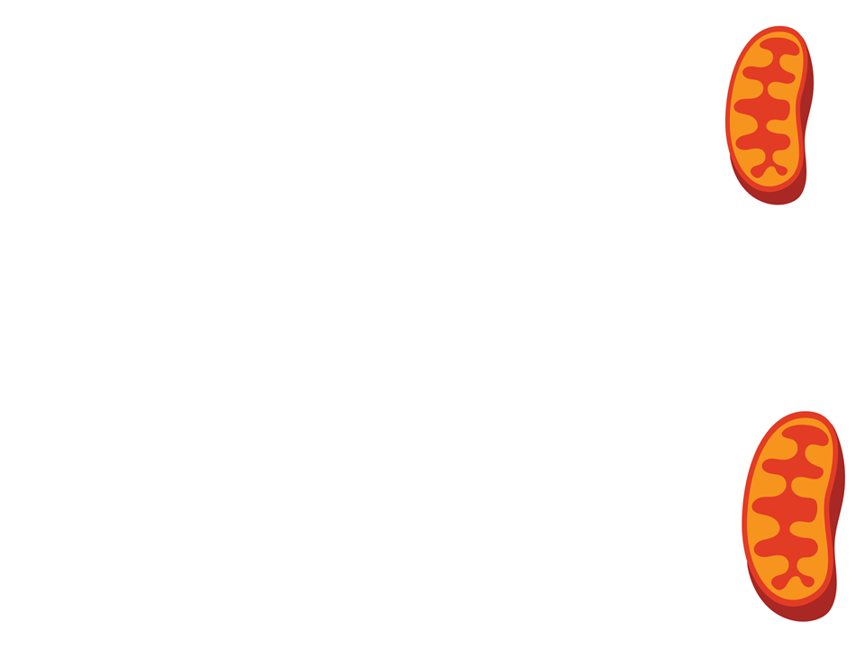
Mitochondria
Site of cellular respiration
Structure of the double membrane:
  Outer membrane is smooth
  Inner membrane has folds called cristae
    Divides the mitochondria into two internal compartments and increases the surface area

Slide 27

Mitochondria
Intermembrane: space between inner and outer membrane
Mitochondrial matrix: enclosed by inner membrane
      Location for the Krebs cycle
      Contains:
        Enzymes that catalyze cellular respiration and produce ATP
        Mitochondrial DNA
        Ribosomes

Slide 28
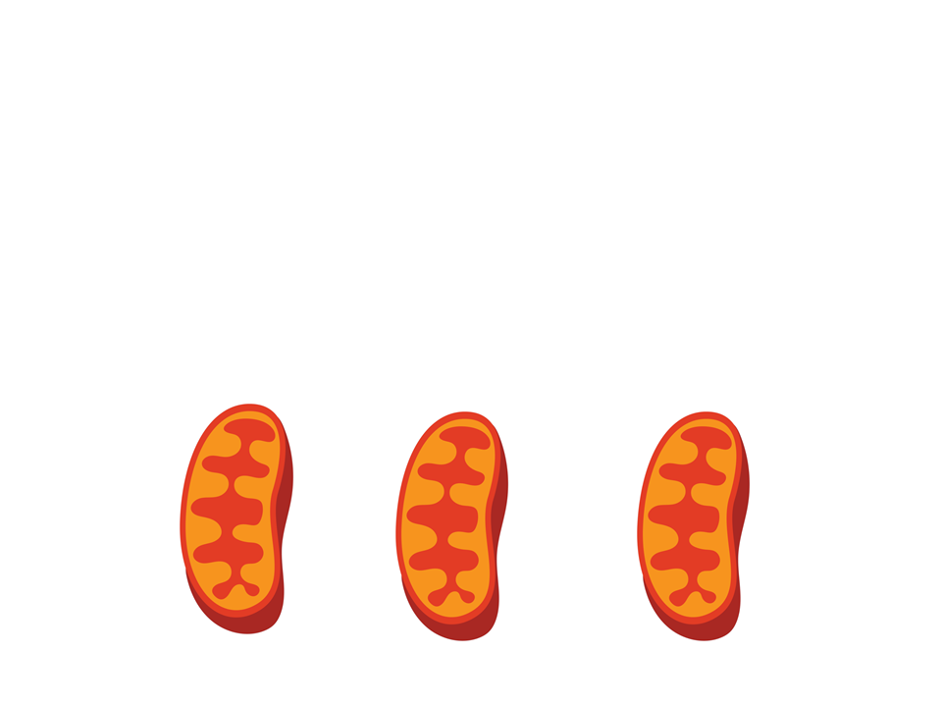
Mitochondria
The number of mitochondria in a cell correlates with metabolic activity
Cells with high metabolic activity have more mitochondria
  Example: cells that move/contract

Slide 29
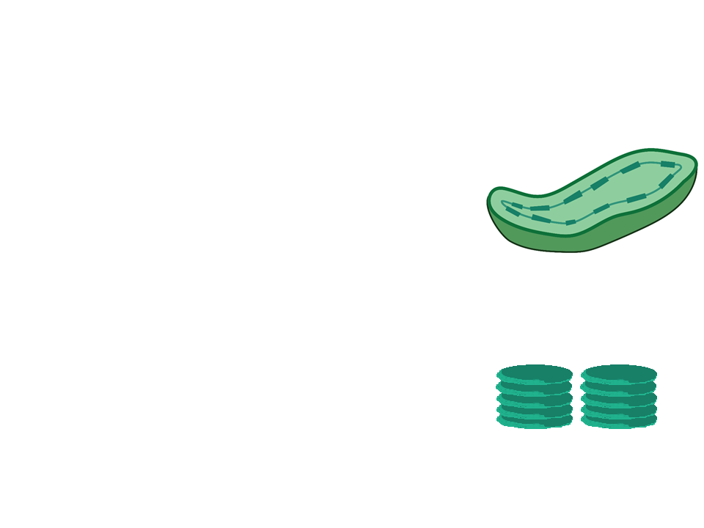
Chloroplast
Specialized organelles in photosynthetic organisms
  Site of photosynthesis
  Contains the green pigment chlorophyll
Inside of its double membrane:
  Thylakoids
    Membranous sacs that can organize into stacks called grana
      Light dependent reactions occur in grana

Slide 30
Chloroplast
Stroma: fluid around thylakoids
  Location for the Calvin cycle
  Contains
    Chloroplast DNA
    Ribosomes
    Enzymes

Slide 31
The Cytoskeleton

Slide 32
Cytoskeleton
A network of fibers throughout the cytoplasm
  Give structural support (especially for animal cells) and mechanical support:
    Anchor organelles
    Allow for movement of vesicles and organelles and/or the whole cell
      Movement occurs when the cytoskeleton interacts with motor proteins

Slide 33
Cytoskeleton
There are 3 types of fibers in the cytoskeleton:
Microtubules
Microfilaments
Intermediate filaments

Slide 34
Microtubules
Hollow rod-like structures made of the protein tubulin
Grow from the centrosome
  Assist in microtubule assembly

Slide 35
Microtubules
Functions:
Serve as structural support (think: tracks) for the movement of organelles that are interacting with motor proteins
Assist in the separation of chromosomes during cell division
Cell motility (i.e., cilia and flagella)

Slide 36
Microfilaments
Thin solid rods made of the protein actin
Functions:
Maintain cell shape
  Bear tension
Assist in muscle contraction and cell motility
  Actin works with another protein called myosin to cause a contraction
Division of animal cells
  Contractile ring of the cleavage furrow

Slide 37
Intermediate Filaments
Fibrous proteins made up of varying subunits
Permanent structural elements of cells
Functions:
Maintain cell shape
Anchor nucleus and organelles
Form the nuclear lamina
  Lines the nuclear envelope

Slide 38
Practice FRQ
You are working in a research lab and your goal is to determine the effect that alcohol has on the liver. You design an experiment where you expose samples of liver tissues to varying concentrations of alcohol as follows:
Sample | Concentration of alcohol | Duration of exposure
Sample 1 | 0.25 mg/mL | 20 minutes
Sample 2 | 0.35 mg/mL | 20 minutes
Sample 3 | 0.45 mg/mL | 20 minutes
After exposure to the alcohol, you analyze the liver samples. In all samples you find that the alcohol has been broken down (detoxified). However, in sample 3 you find damage to organelles has occured due to the high concentration of alcohol. (a) Identify one organelle in the liver that could be responsible for the detoxification of the alcohol in all three samples. (b) In sample 3 identify the organelle that would most likely be responsible for removing the damaged parts of organelles and (c) describe the steps it would take to do so.
Notes:
Students can choose to identify a detoxifying organelle: peroxisomes, smooth ER
Lysosome
Damaged components inside a cell become surrounded by a membrane forming a vesicle. Lysosomes would fuse with the membrane of this vesicle and digest the contents. These contents would then be able to be reused in the cytosol

