Slide 1
The Rise and Fall of the Abbasid Caliphate
Dr. Robert E. Sawyer

Slide 2
Learning Objective
Explain the causes and effects of the rise of Islamic states over time.
Key Concept (KC-3.2.I):
As the Abbasid Caliphate fragmented, new Islamic political entities emerged, most dominated by Turkic peoples. These states demonstrated continuity, innovation, and diversity.
Reasoning Process: Causation
Targeted Historical Skill: 1.A (Identify and Describe a historical development/process)
Notes:
Insert a map of your country.

Slide 3
Leading Question
The Abbasid Caliphate was once the most powerful Islamic empire. What might cause a large empire to weaken or fragment?
In this lesson, you will analyze excerpts about three Islamic states that rose after the Abbasid Caliphate fragmented. Your task is to identify key developments, explain causes and effects, and practice writing historically accurate responses.
Notes:
Insert a map of your country.

Slide 4
Brief Explanation of Abbasid Fragmentation
By the 1200s, the Abbasid Caliphate no longer had the strength to control its vast empire.
Loss of control: The caliphs in Baghdad became more symbolic religious leaders than powerful rulers.
Invasions: Outside groups such as the Mongols, Crusaders, and Turkic nomads attacked Abbasid lands.
Local rulers: Regional leaders, governors, and military commanders took power for themselves, creating new dynasties that were only loosely tied to the Abbasids.
This process is called fragmentation — the central empire broke into smaller, competing states.
Notes:
Insert a map of your country.

Slide 5
Continuity, Innovation, Diversity
When the Abbasids fragmented, new Islamic states emerged.
Continuity: Some things stayed the same. Example: Islamic law (sharia), the role of qadis (judges), and the spread of madrasas (schools) continued in new states.
Innovation: New political and cultural practices appeared. Example: The Mamluks rose from slave-soldiers to sultans, and the Seljuks fused Turkic military leadership with Persian bureaucratic traditions.
Diversity: Different regions developed unique blends of Islam with local traditions. Example: The Delhi Sultanate governed over a Hindu majority, creating a multi-religious society.
Summary: Abbasid fragmentation weakened centralized control but led to new Islamic states that showed a mix of continuity, innovation, and diversity.
Notes:
Insert a map of your country.

Slide 6
Source-Based Independent Analysis
Recall
Skill 1.A (Identify/Describe)
Identify = name the development (e.g., Mamluks rising to rule).
Describe = explain what it was or how it worked (e.g., slave-soldiers who became sultans).
Causation
Cause → Effect = show how one thing led to another.
Consider multiple causes and effects, short- vs. long-term.
Use linking words: because, led to, resulted in, in the short term, in the long term.
Notes:
Insert a map of your country.

Slide 7
Seljuk Empire — Turkic Expansion + Persian Bureaucrats
The Seljuks, once nomads from the steppe, spread across Persia and into Iraq in the 11th century. Though their warriors were Turkic, they relied upon the Persian bureaucrats who had long governed the region. The viziers and scribes preserved the methods of administration from earlier Islamic dynasties, collecting taxes, recording decrees, and maintaining order. By marrying Turkic military power with Persian administrative traditions, the Seljuks ensured stability in their newly conquered territories. Their rule strengthened Sunni Islam, as the sultans sponsored madrasas and religious scholars. At the same time, Persian cultural traditions continued to influence literature, art, and statecraft, demonstrating continuity even as new rulers introduced innovations.
Notes:
Insert a map of your country.

Slide 8
Delhi Sultanate — Islam in South Asia
When the armies of the Turks crossed the Indus and entered India, they brought with them the banners of Islam. The sultans of Delhi, though foreigners, ruled with determination, building mosques in their new capitals and appointing qadis to apply Islamic law. Yet they also faced a vast majority of Hindu subjects, whose customs and temples remained. Some rulers destroyed temples to demonstrate power, while others permitted them to stand in order to collect taxes. Over time, merchants and artisans converted to Islam, drawn by the opportunities offered in trade and service at the Sultan’s court. In this way, the Delhi Sultanate introduced Islamic institutions into South Asia while continuing to govern over a diverse and multi-religious society.
Notes:
Insert a map of your country.

Slide 9
Mamluk Sultanate — Slave-Soldiers in Egypt
The rulers of Egypt purchased young men from the steppes, trained them in arms, and raised them as Mamluks — slave-soldiers loyal to their masters. In time, these warriors seized power for themselves. After defeating the Mongols at the Battle of Ayn Jalut (1260), the Mamluks claimed the right to rule in Cairo. Though they began as slaves, they established a powerful sultanate, controlling trade through the Red Sea and defending the Islamic world from invasion. Their government combined military discipline with Islamic traditions of law and scholarship. Chroniclers emphasized the unusual nature of their rise, noting that outsiders could rise from servitude to kingship. By doing so, the Mamluks preserved Egypt’s independence and made Cairo a central hub of the Islamic world.
Notes:
Insert a map of your country.

Slide 10
Guiding Questions Example Answers

Slide 11
Seljuk Empire — Turkic Expansion + Persian Bureaucrats
Q1. Identify a historical development/process in this excerpt.
The Seljuks blended Turkic military leadership with Persian bureaucratic traditions to stabilize their empire.
Q2. What caused the Seljuks to rely on Persian bureaucrats?
Because the Seljuks were steppe warriors without experience in administration, they depended on Persian viziers and scribes to govern.
Q3. What effects did this have on governance and culture?
This caused continuity in taxation and record-keeping while also preserving Persian influence in literature, art, and governance.
Notes:
Insert a map of your country.

Slide 12
Delhi Sultanate — Islam in South Asia
Q1. Identify a historical development/process in this excerpt.
The Delhi Sultanate introduced Islamic law and institutions into South Asia while ruling over a Hindu majority.
Q2. What caused the Delhi Sultanate to spread Islamic institutions into India?
Turkic military conquest across the Indus caused Islamic rulers to establish mosques, appoint qadis, and expand Islamic authority.
Q3. What were the effects on religion and society in South Asia?
This caused both religious tension (temple destruction) and cultural diversity, as some groups converted to Islam for trade or political opportunities.
Notes:
Insert a map of your country.

Slide 13
Mamluk Sultanate — Slave-Soldiers in Egypt
Q1. Identify a historical development/process in this excerpt.
The rise of the Mamluk Sultanate, where former slave-soldiers took power and ruled Egypt.
Q2. What caused the Mamluks to rise from slave-soldiers to rulers?
Because the Mamluks were highly trained and disciplined, they defeated the Mongols at Ayn Jalut in 1260 and seized control in Cairo.
Q3. What effects did the Mamluk Sultanate have on trade and defense of the Islamic world?
Their rise caused Egypt to remain independent, protected the Islamic heartlands from Mongol invasions, and ensured Cairo’s position as a wealthy trade hub.
Notes:
Insert a map of your country.

Slide 14
Causation Example answers

Slide 15
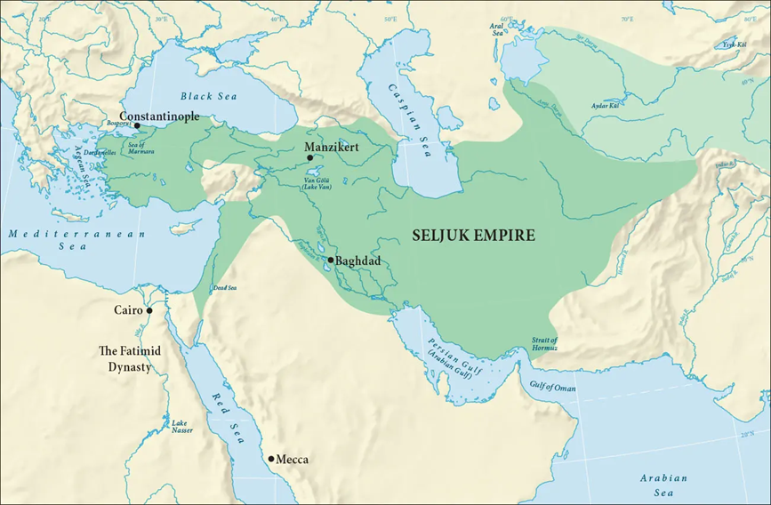
Seljuks
Because the Seljuks conquered Persia but relied on Persian bureaucrats, their rule preserved administrative traditions, which caused stability and continuity in governance.
https://alchetron.com/Seljuk-Empire
Notes:
Insert a map of your country.

Slide 16
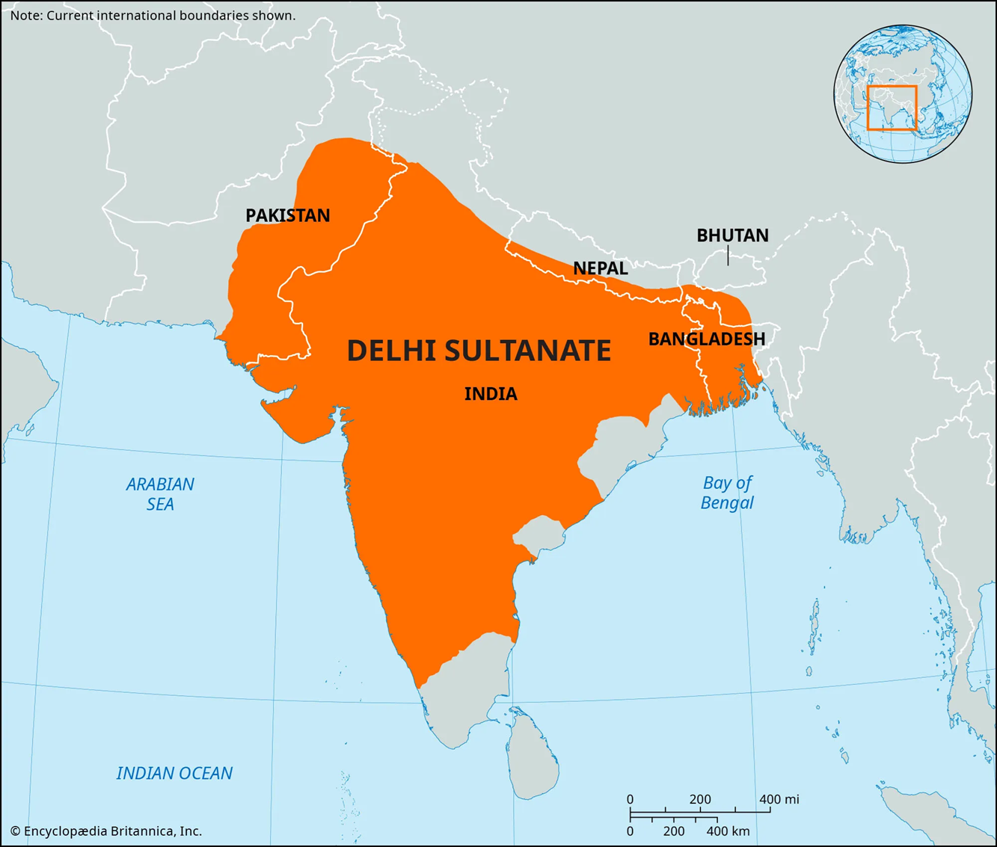
Delhi Sultanate
Because Turkic rulers established Islamic institutions in India, the Delhi Sultanate spread Islam, which caused both tension with Hindu subjects and new opportunities for Muslim merchants.
https://www.britannica.com/place/Delhi-sultanate
Notes:
Insert a map of your country.

Slide 17
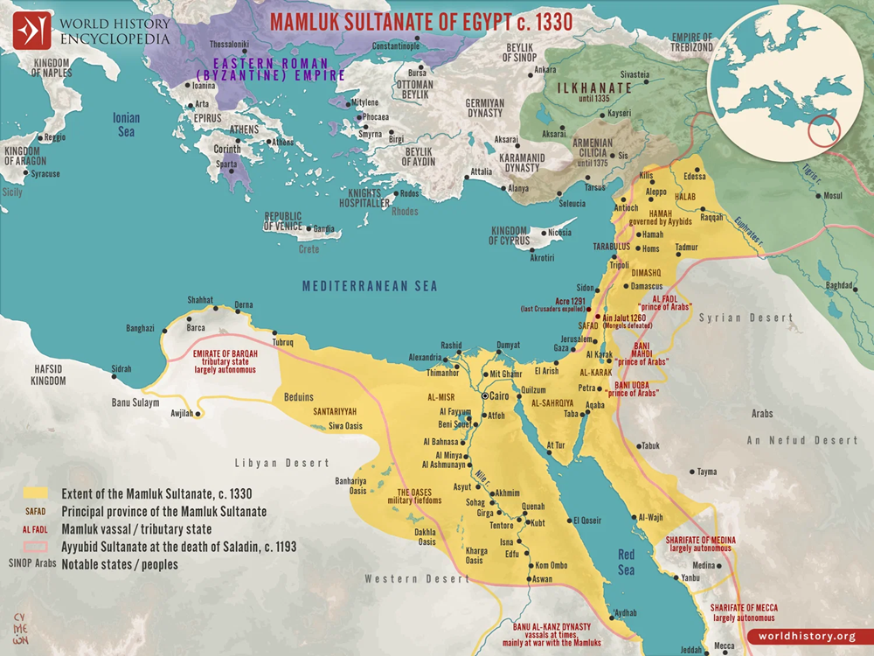
Mamluks
Because slave-soldiers seized power in Egypt, the Mamluks established a new sultanate, which caused the defense of the Islamic world against Mongol invasions.
https://www.worldhistory.org/image/16003/map-of-the-mamluk-sultanate-of-egypt-c-1330/
Notes:
Insert a map of your country.

Slide 18
Mini-DBQ Sample Paragraphs

Slide 19
Prompt A (Cause/Effect)
One cause of the rise of Turkic Islamic states was Turkic military expansion, as seen in the Seljuks and Delhi Sultanate. Conquest caused the creation of new political entities dominated by Turks. An effect was the blending of old and new traditions: the Seljuks relied on Persian bureaucrats, while the Delhi sultans spread Islam among South Asians. These examples show that Turkic expansion caused both new states and long-term changes in governance and religion.
Notes:
Insert a map of your country.

Slide 20
Prompt B (Continuity/Innovation)
A continuity after the Abbasids was the use of Islamic law and institutions, such as the Delhi sultans appointing qadis. An innovation was the rise of new ruling elites, like the Mamluks, who began as slave-soldiers but created their own sultanate in Egypt. This shows that Islamic governance preserved religious law while innovating in leadership, producing continuity and diversity.
Notes:
Insert a map of your country.

