Slide 1
Warm-Up (Ch. 2b Review)
Which of the following is a hydrophobic material: paper, table salt, wax, sugar, or pasta?
What kind of bonds are broken when water vaporizes?
If the pH of a lake is 4.0, what is the hydrogen ion [H+] concentration of the lake? What is the hydroxide [OH-] concentration?

Slide 2
Chapter 3a Warm-Up
Pick up a copy of the “Functional Groups” chart on the counter. Use page 47 to fill it out.

Slide 3
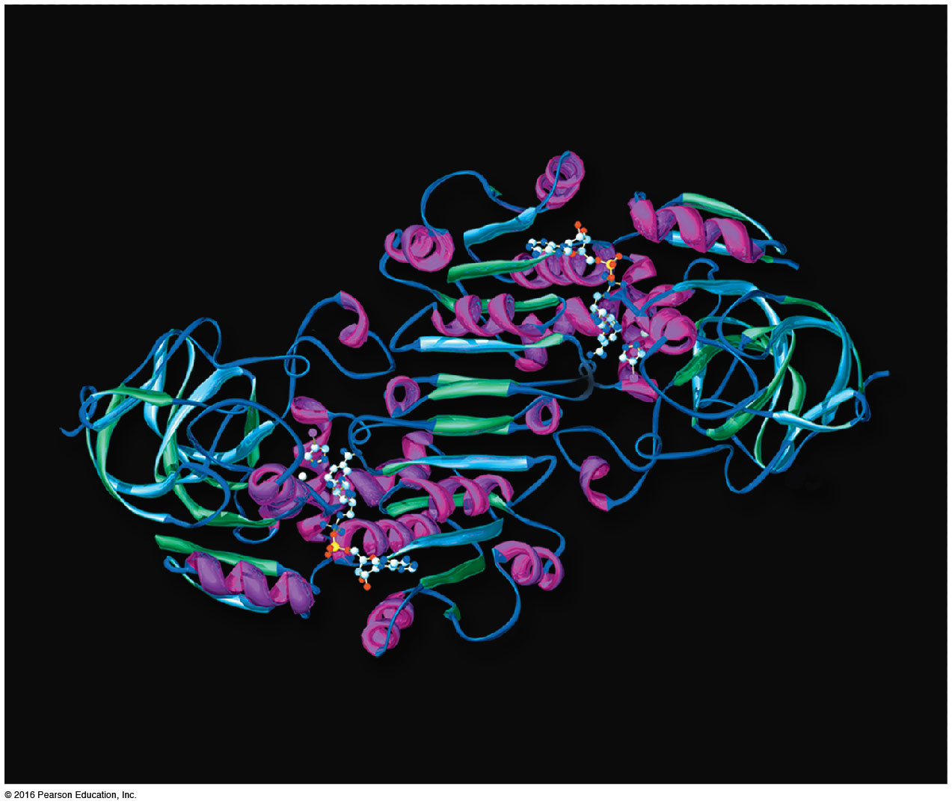
Chapter 3a
Carbon and the Molecular Diversity of Life

Slide 4
You Must Know
The properties of carbon that make it so important.

Slide 5
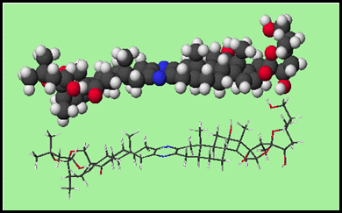
I. Importance of Carbon
Organic chemistry: branch of chemistry that specializes in study of carbon compounds
Organic compounds: contain Carbon (& H)
Major elements of life: CHNOPS
Carbon can form large, complex, and diverse molecules

Slide 6
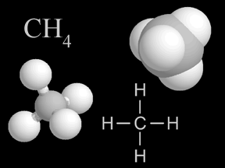
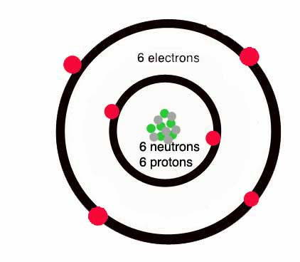
II. Diversity of Carbon
It has 4 valence electrons (tetravalence)
It can form up to 4 covalent bonds
  Most frequent bonding partners: H, O, N

Slide 7
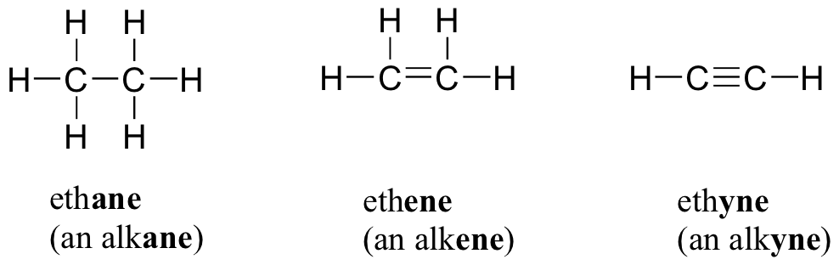
II. Diversity of Carbon
Bonds can be single, double, or triple covalent bonds.

Slide 8
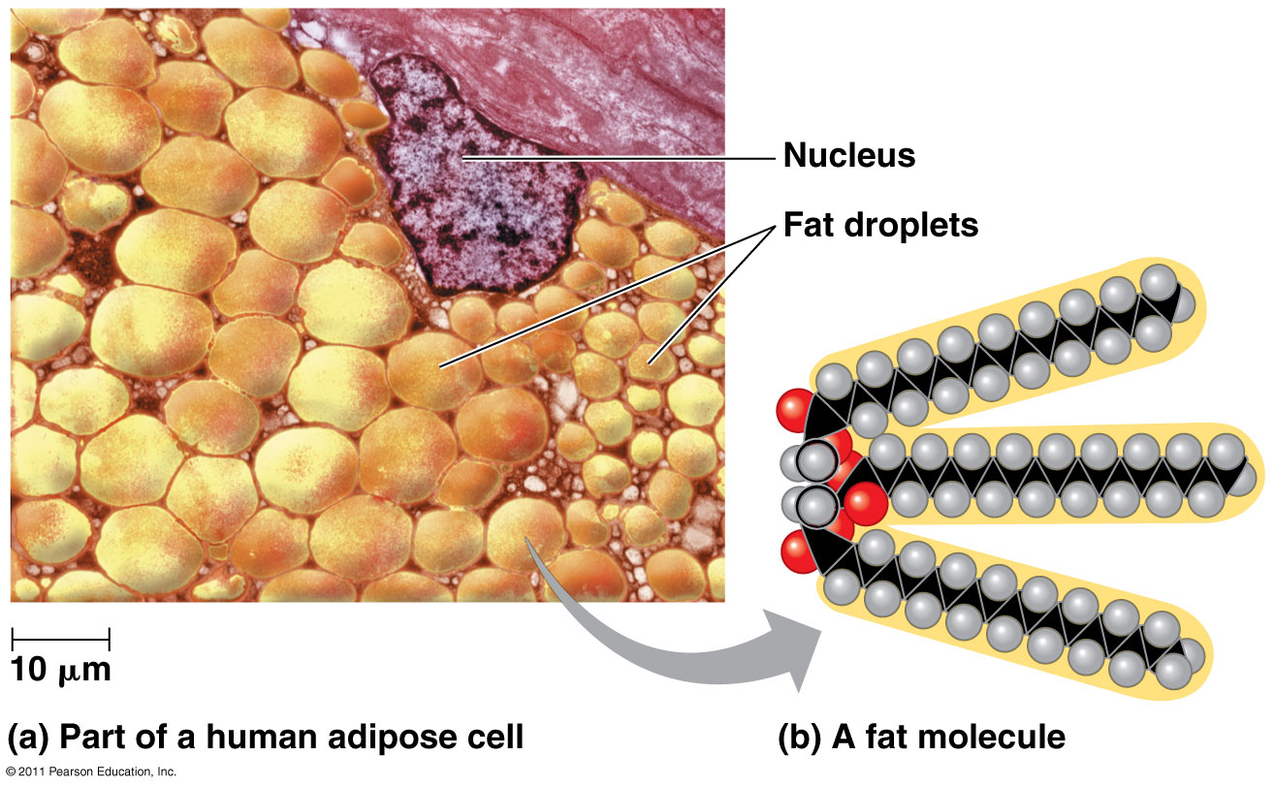
II. Diversity of Carbon
Carbon can form large molecules
  4 classes of macromolecules: carbohydrates, proteins, lipids, nucleic acids

Slide 9
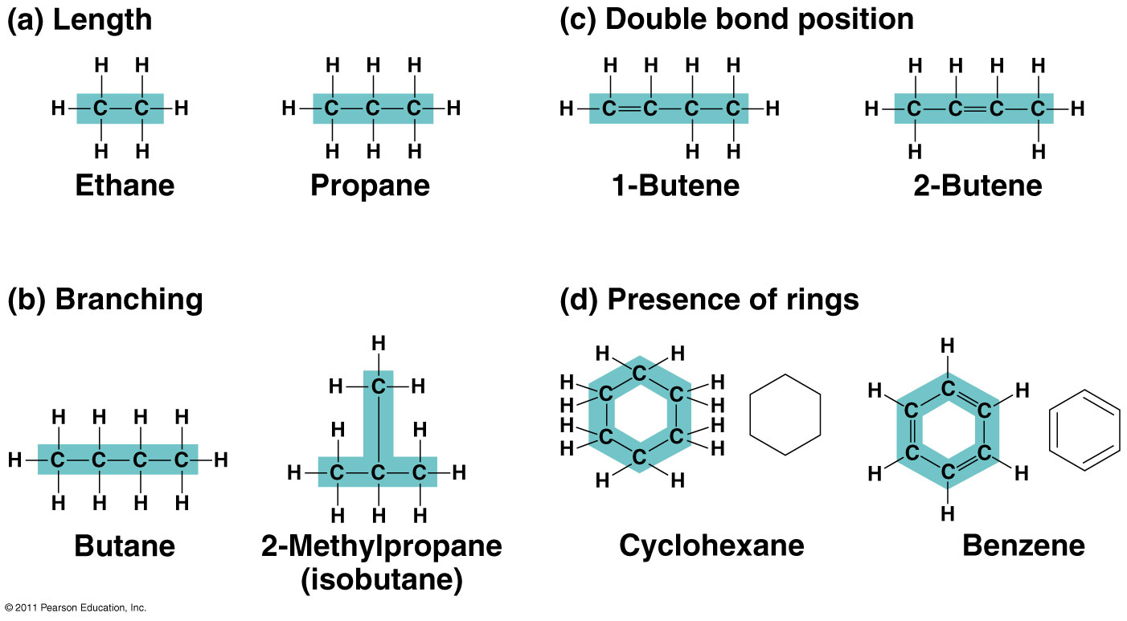
II. Diversity of Carbon
Molecules can be chains, ring-shaped, or branched

Slide 10
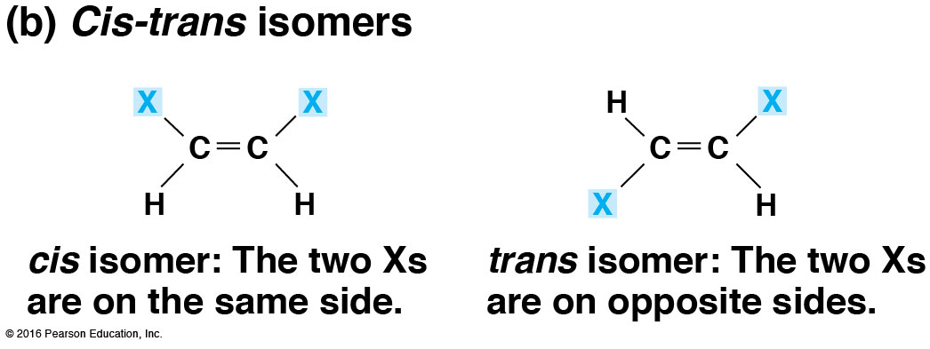
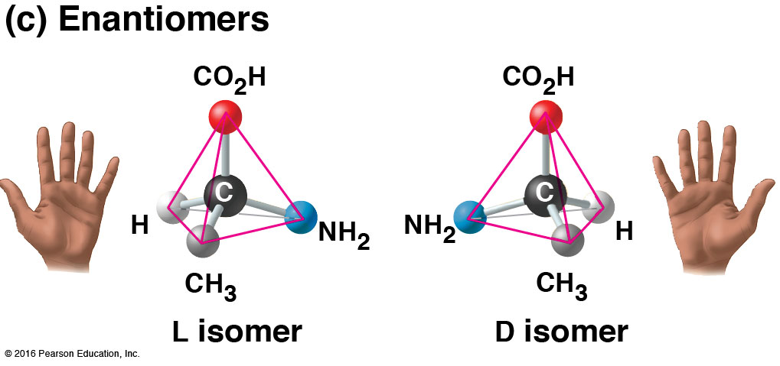
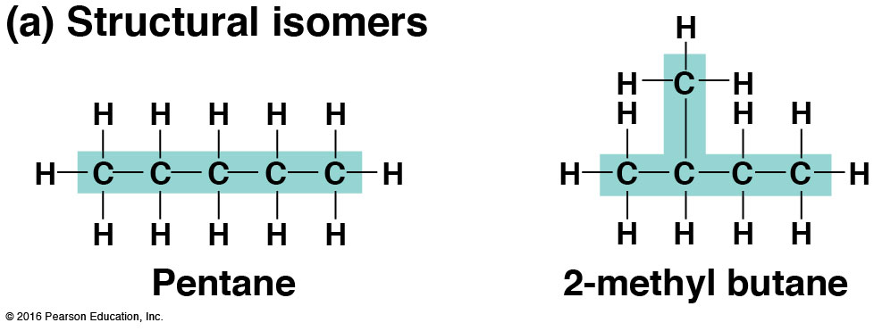
II. Diversity of Carbon
Forms isomers
  Molecules have same molecular formula, but differ in atom arrangement
  different structures → different properties/functions
Structural Isomer | Cis-Trans Isomer | Enantiomers
Varies in covalent arrangement | Differ in spatial arrangement | Mirror images of molecules

Slide 11
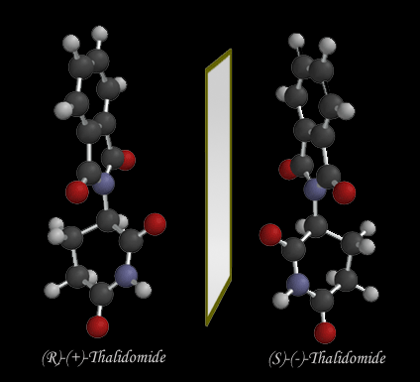
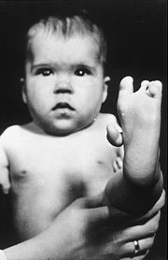
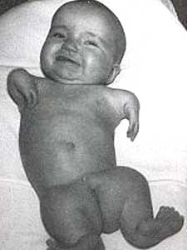
Drug manufacturing:
Thalidomide =
  “good” enantiomer → reduce morning sickness
  “bad” enantiomer → cause birth defects
  “good” converts to “bad” in patient’s body
  Now used to treat cancers, leprosy, HIV

Slide 12
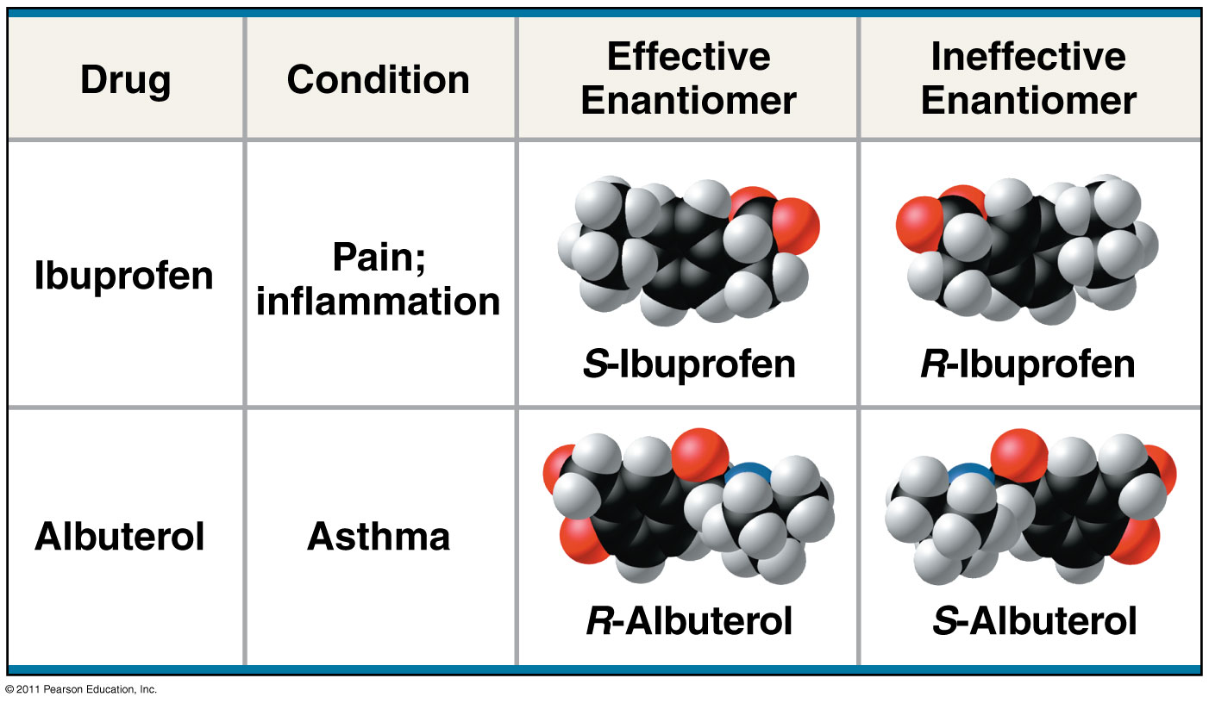
Fig. 4.8 The pharmacological importance of enantiomers

Slide 13
III. Functional Groups
Behavior of organic molecules depends on functional groups
Most common functional groups:
Hydroxyl
Carbonyl
Carboxyl
Amino
Sulfhydryl
Phosphate
Methyl

Slide 14
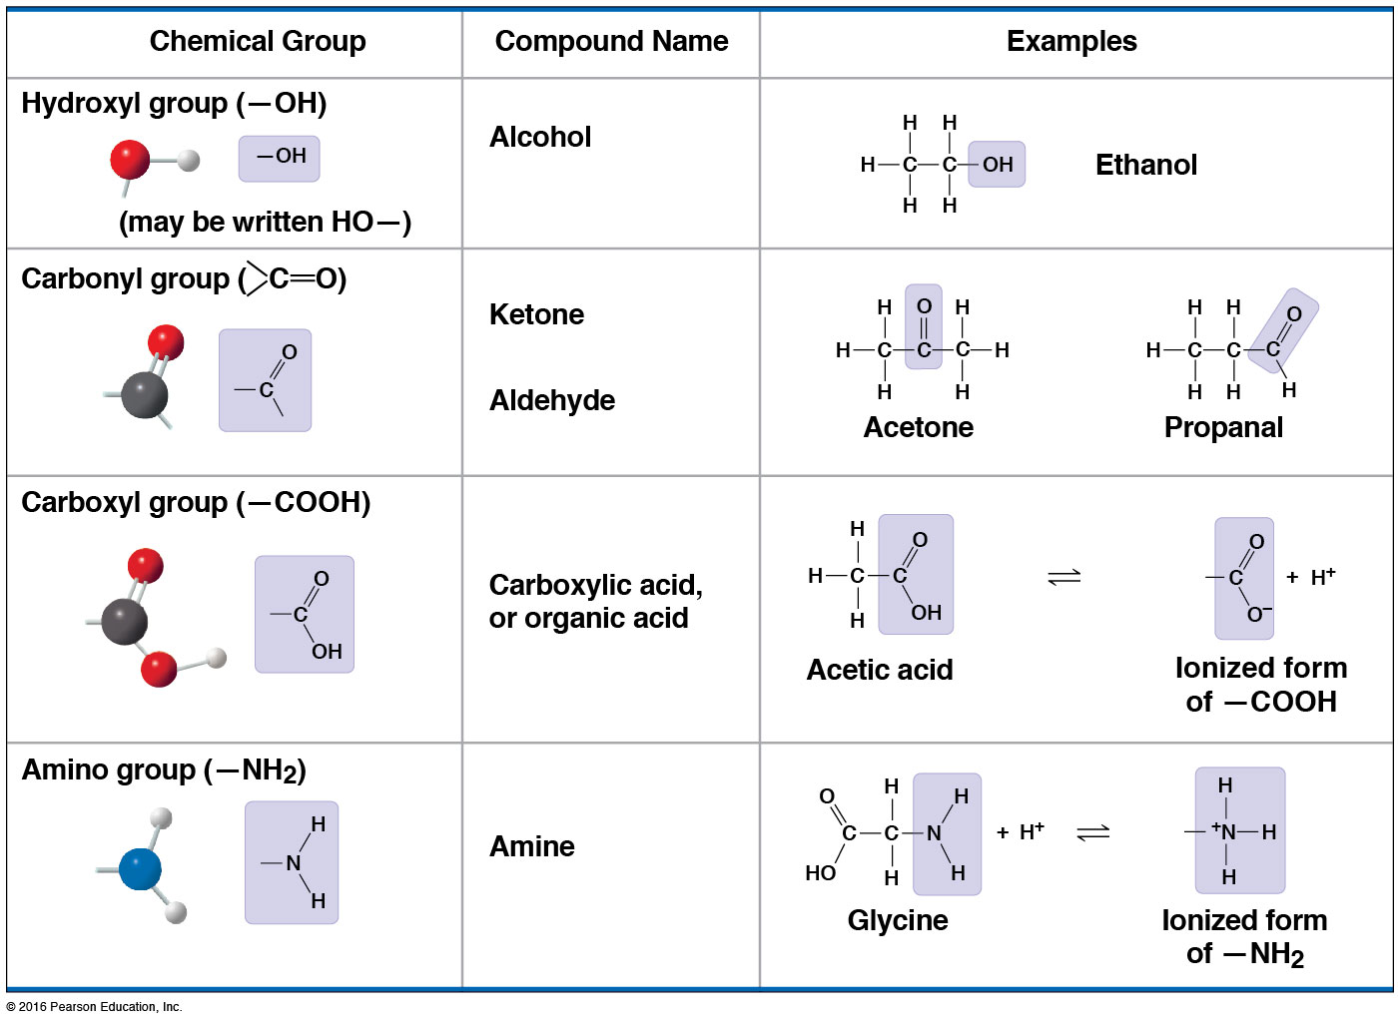

Slide 15
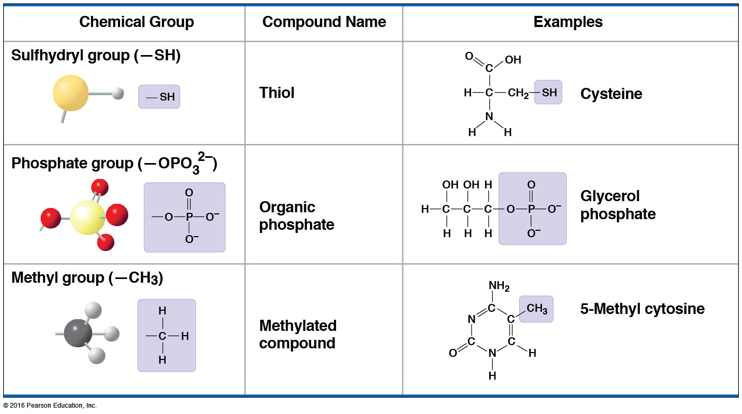

Slide 16
Functional Groups
Functional Group | Molecular Formula | Names & Characteristics | Draw an Example
Hydroxyl | -OH | Alcohols | Ethanol
Carbonyl | >CO | Ketones (inside skeleton) Aldehydes (at end) | Acetone Propanol
Carboxyl | -COOH | Carboxylic acids (organic acids) | Acetic acid
Amino | -NH₂ | Amines | Glycine
Sulfhydryl | -SH | Thiols | Ethanethiol
Phosphate | -OPO₃²⁻ / -OPO₃H₂ | Organic phosphates | Glycerol phosphate
Methyl | -CH₃ | Methylated compounds | 5-methyl cytidine

