Slide 1
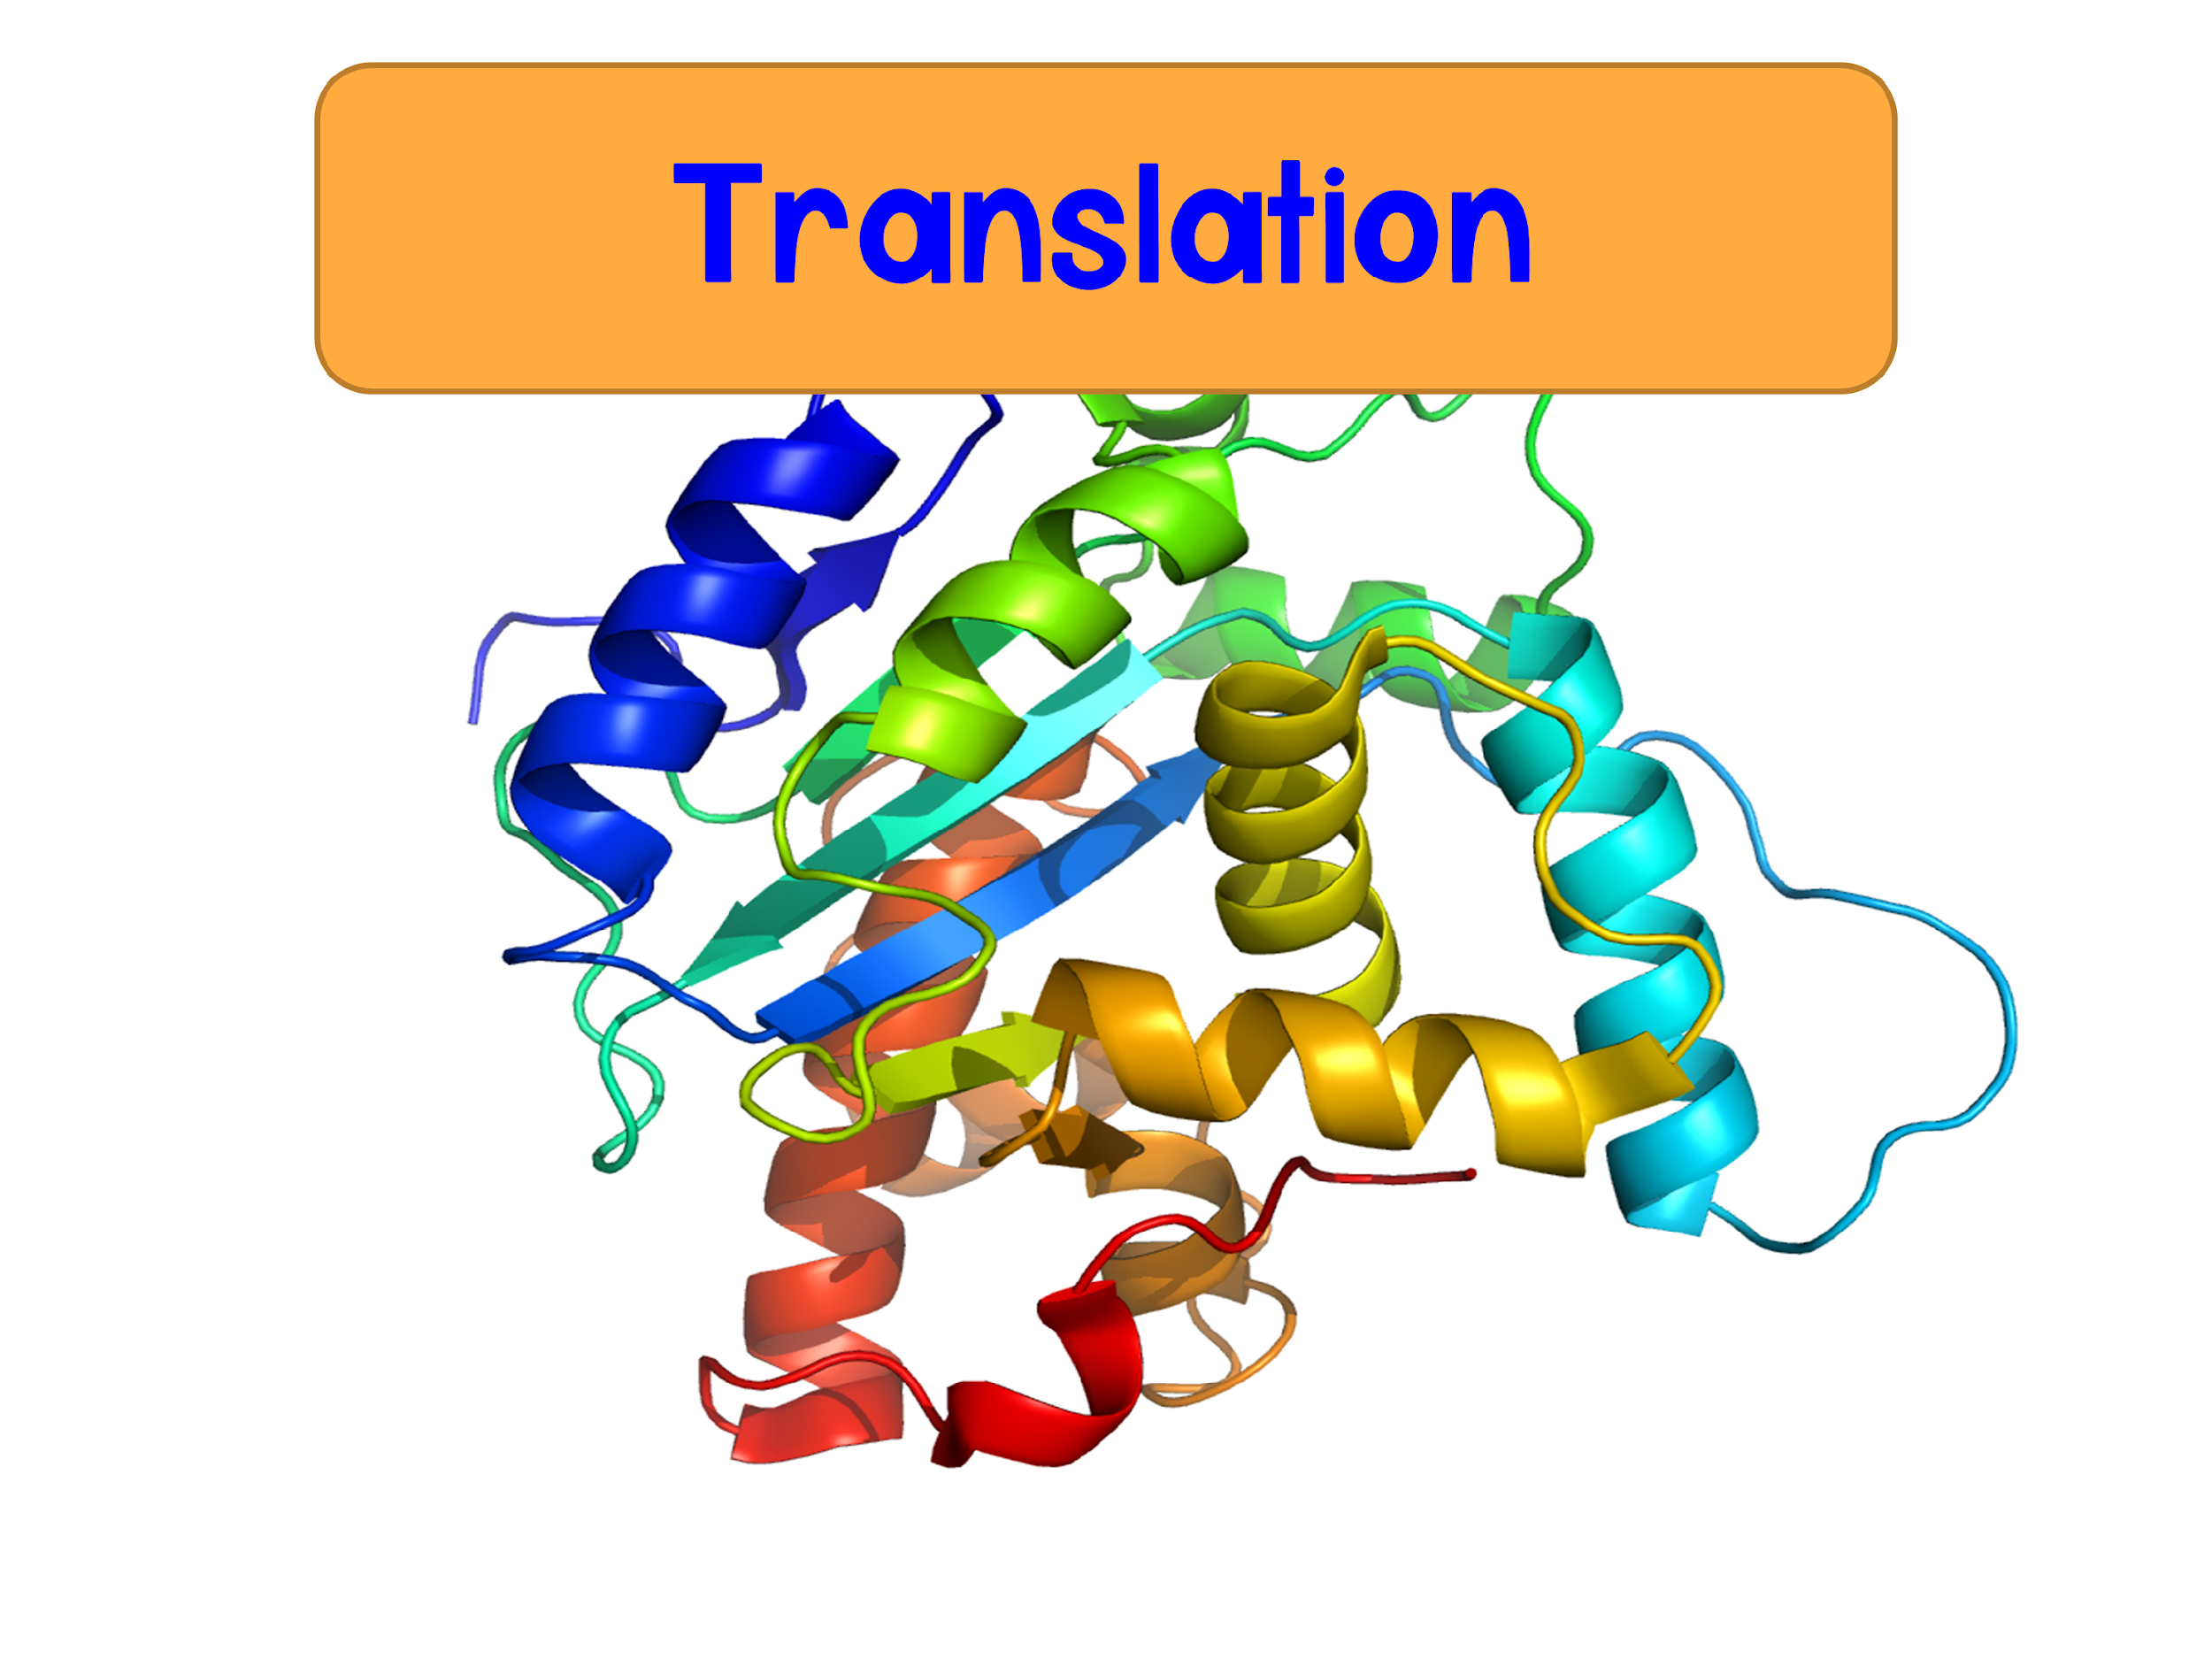

Slide 2
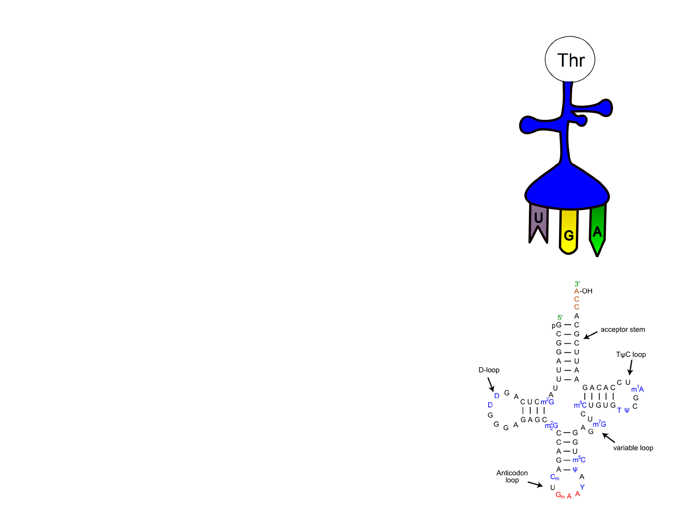
Translation
Translation: the synthesis of a polypeptide using information from the mRNA
  Occurs at the ribosome
  A nucleotide sequence becomes an amino acid sequence
tRNA is a key player in translating mRNA to an amino acid sequence

Slide 3
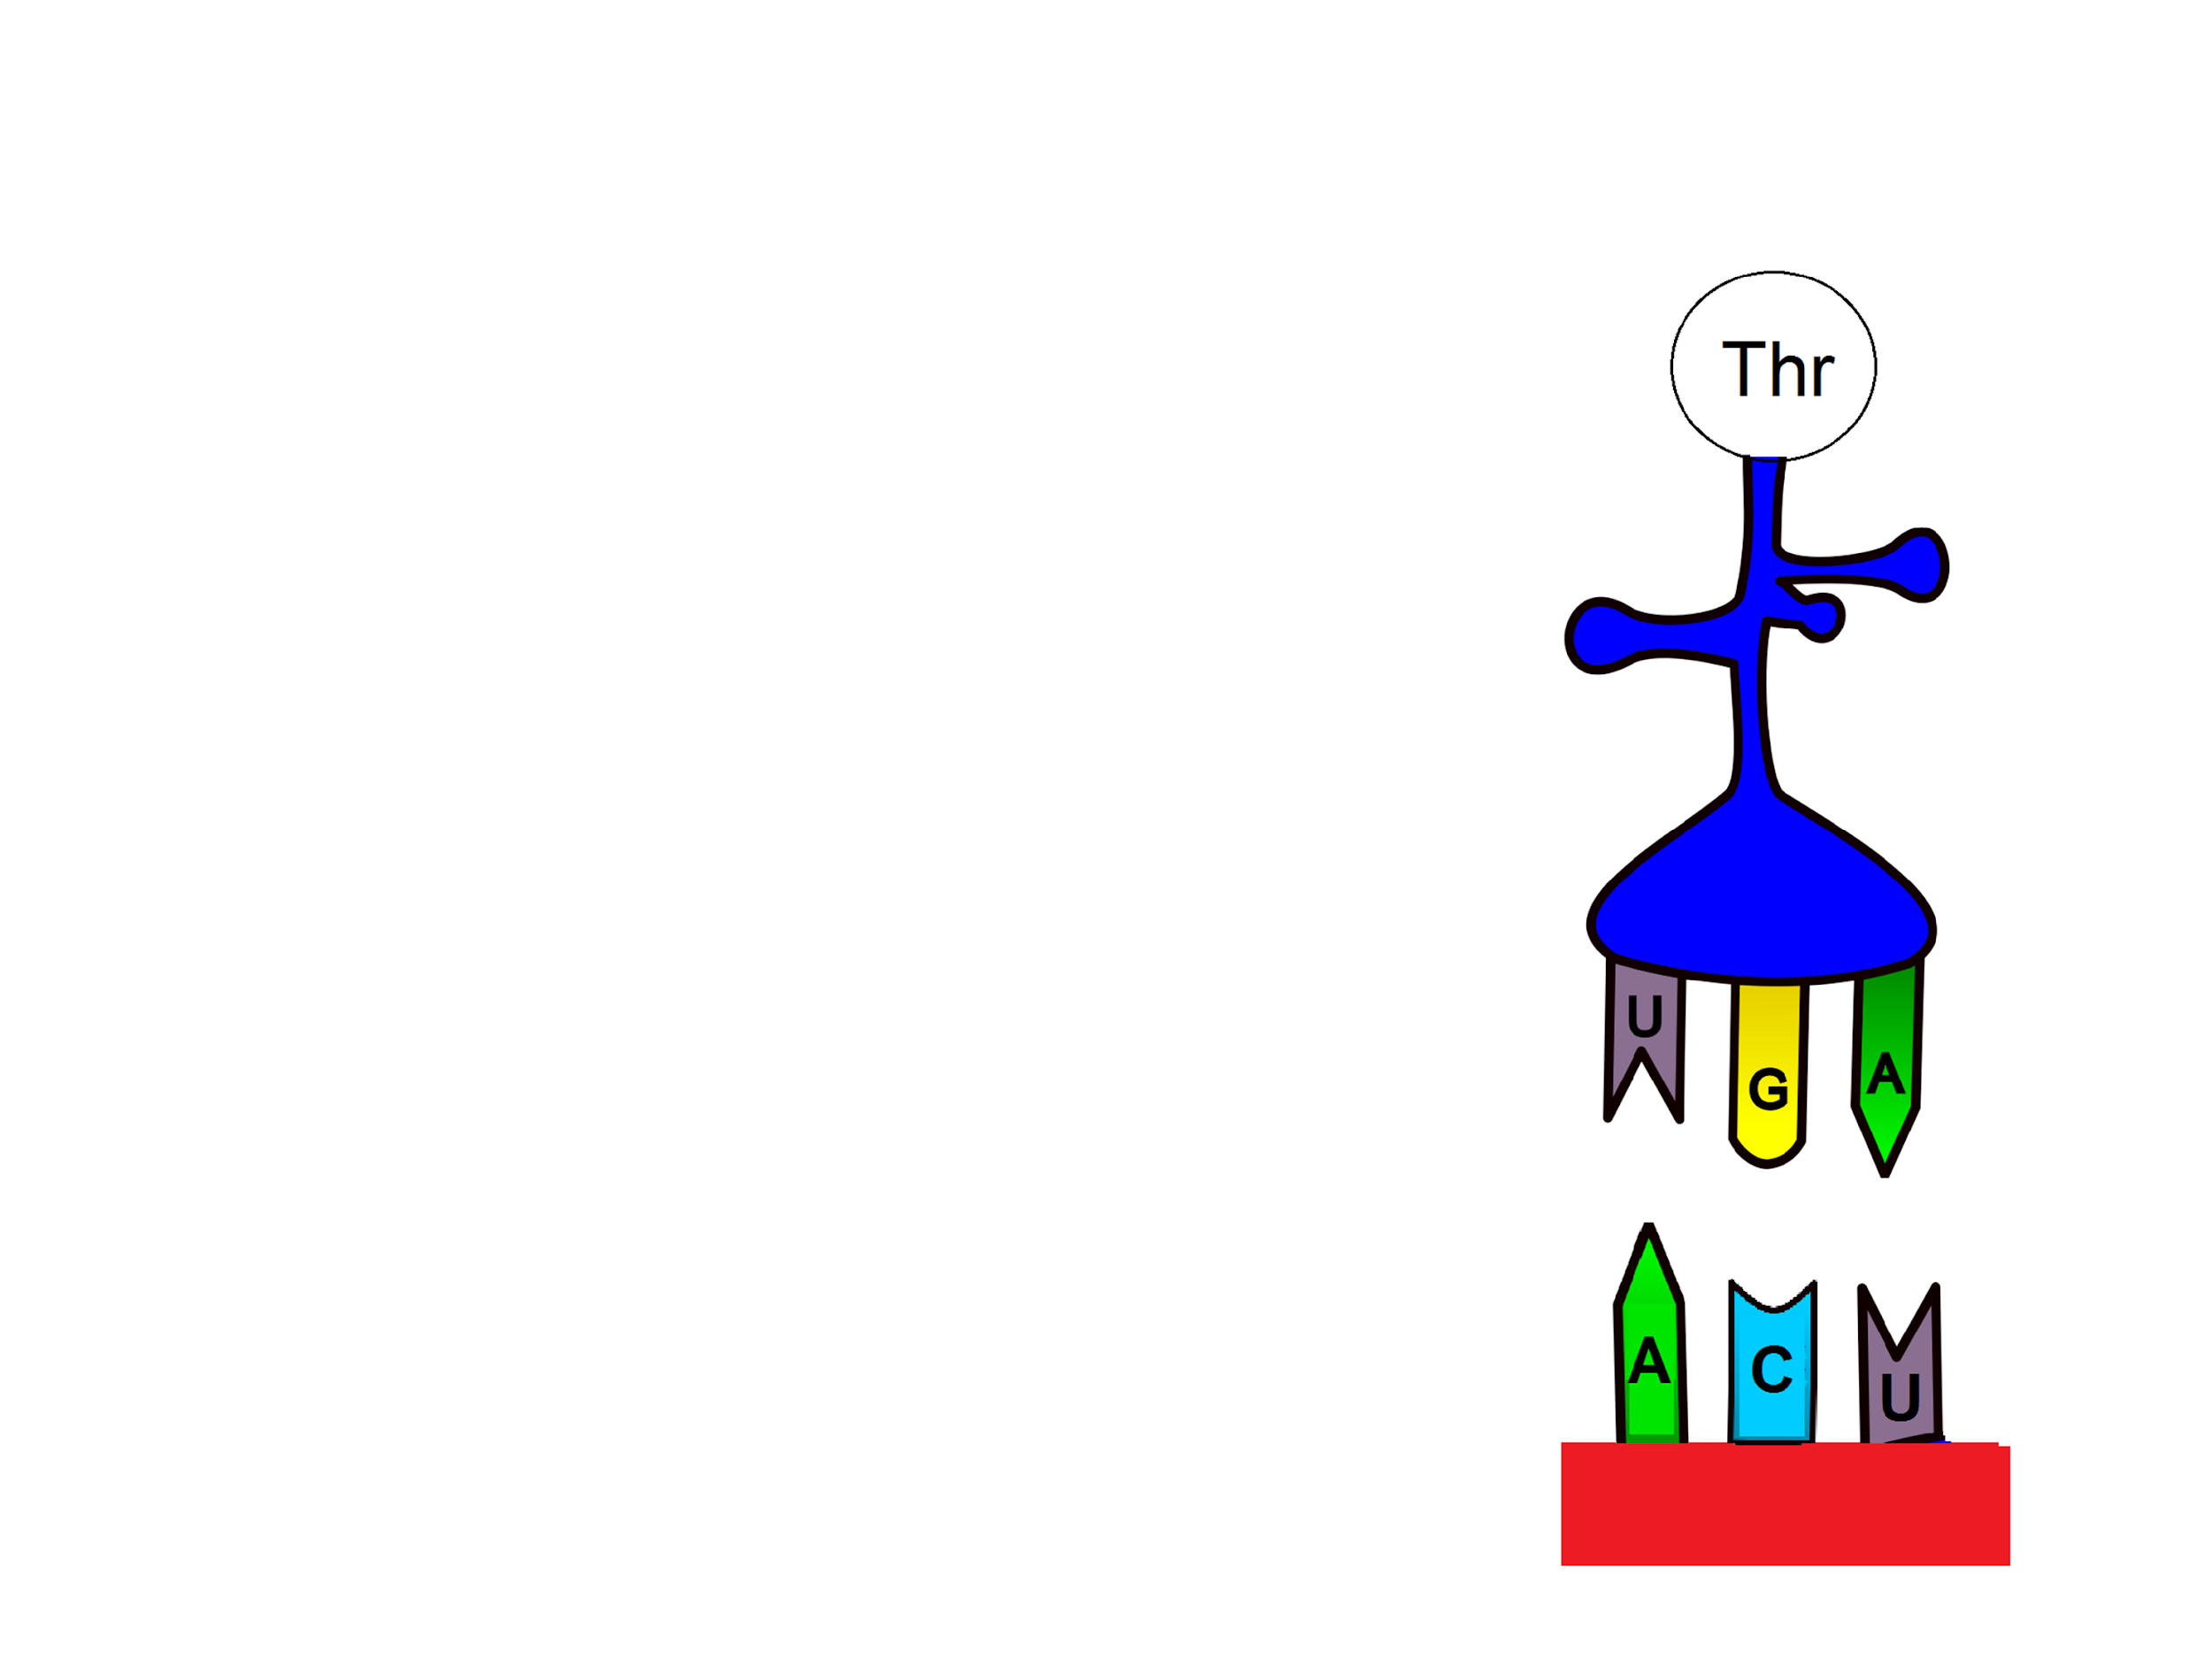
Transfer RNA
tRNA has an anticodon region which is complementary and antiparallel to mRNA
tRNA carries the amino acid that the mRNA codon codes for
  ACU codes for Thr
The enzyme aminoacyl-tRNA synthetase is responsible for attaching amino acids to tRNA
  When tRNA carries an amino acid it is “charged”
3’
5’
5’
mRNA
3’

Slide 4
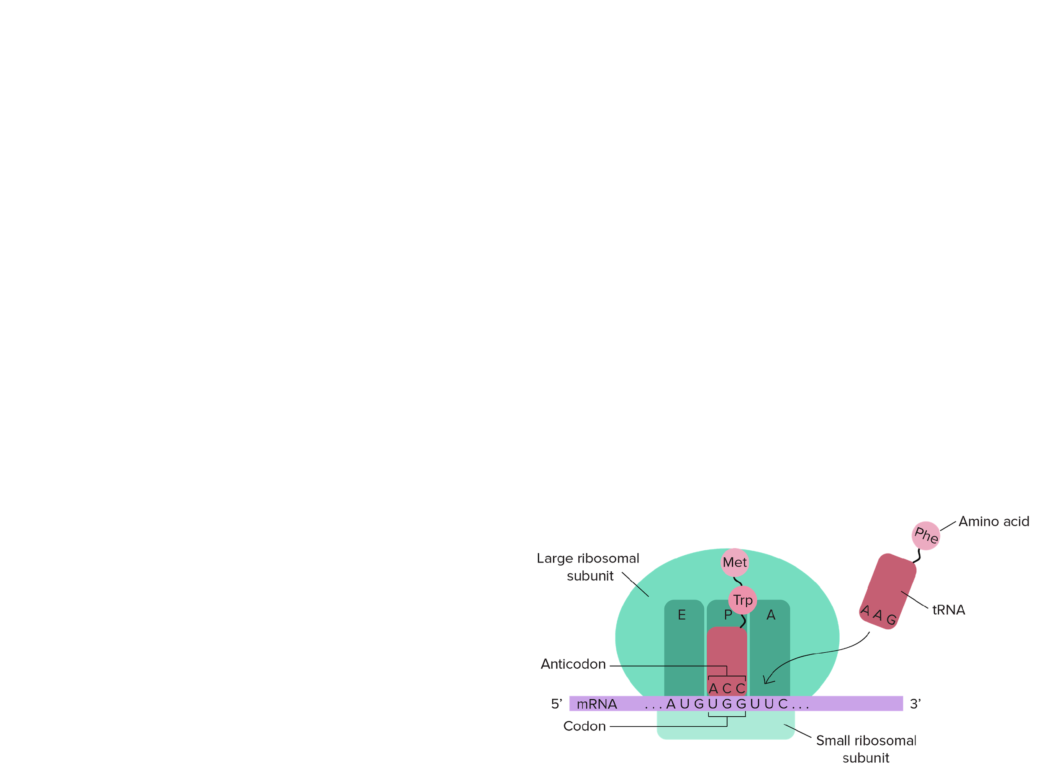
Ribosomes
Translation occurs at the ribosome
  Ribosomes have two subunits: small and large
  Prokaryotic and eukaryotic ribosomal subunits differ in size
    Prokaryotes: small subunit (30s) large subunit (40s)
    Eukaryotes: small subunit (40s) large subunit (60s)

Slide 5
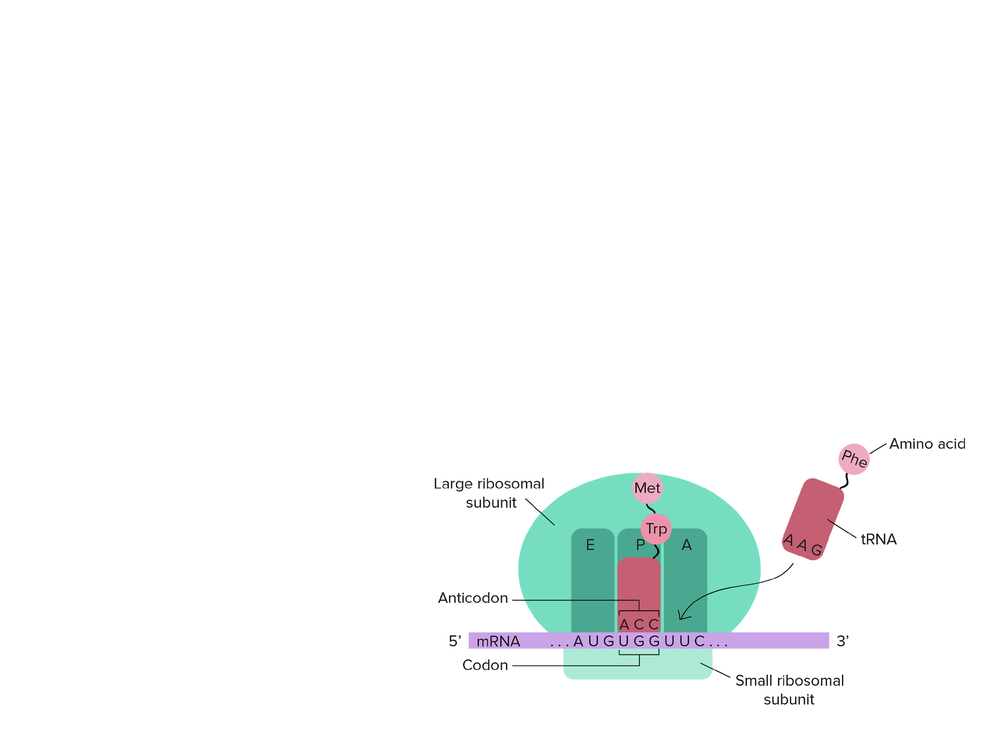
Ribosomes
The large subunit has three sites: A, P, and E
  A site: amino acid site
    Holds the next tRNA carrying an amino acid
  P site: polypeptide site
    Holds the tRNA carrying the growing polypeptide chain
  E site: exit site

Slide 6
Quick Check
How does the tRNA interact with the mRNA?
  Answer: through its anticodon
What codes for the amino acid?
  Answer: the mRNA codon
What are the three sites on the large ribosomal subunit?
  Answer: A, P, and E

Slide 7
Translation
Translation occurs in three stages
Initiation
Elongation
Termination

Slide 8
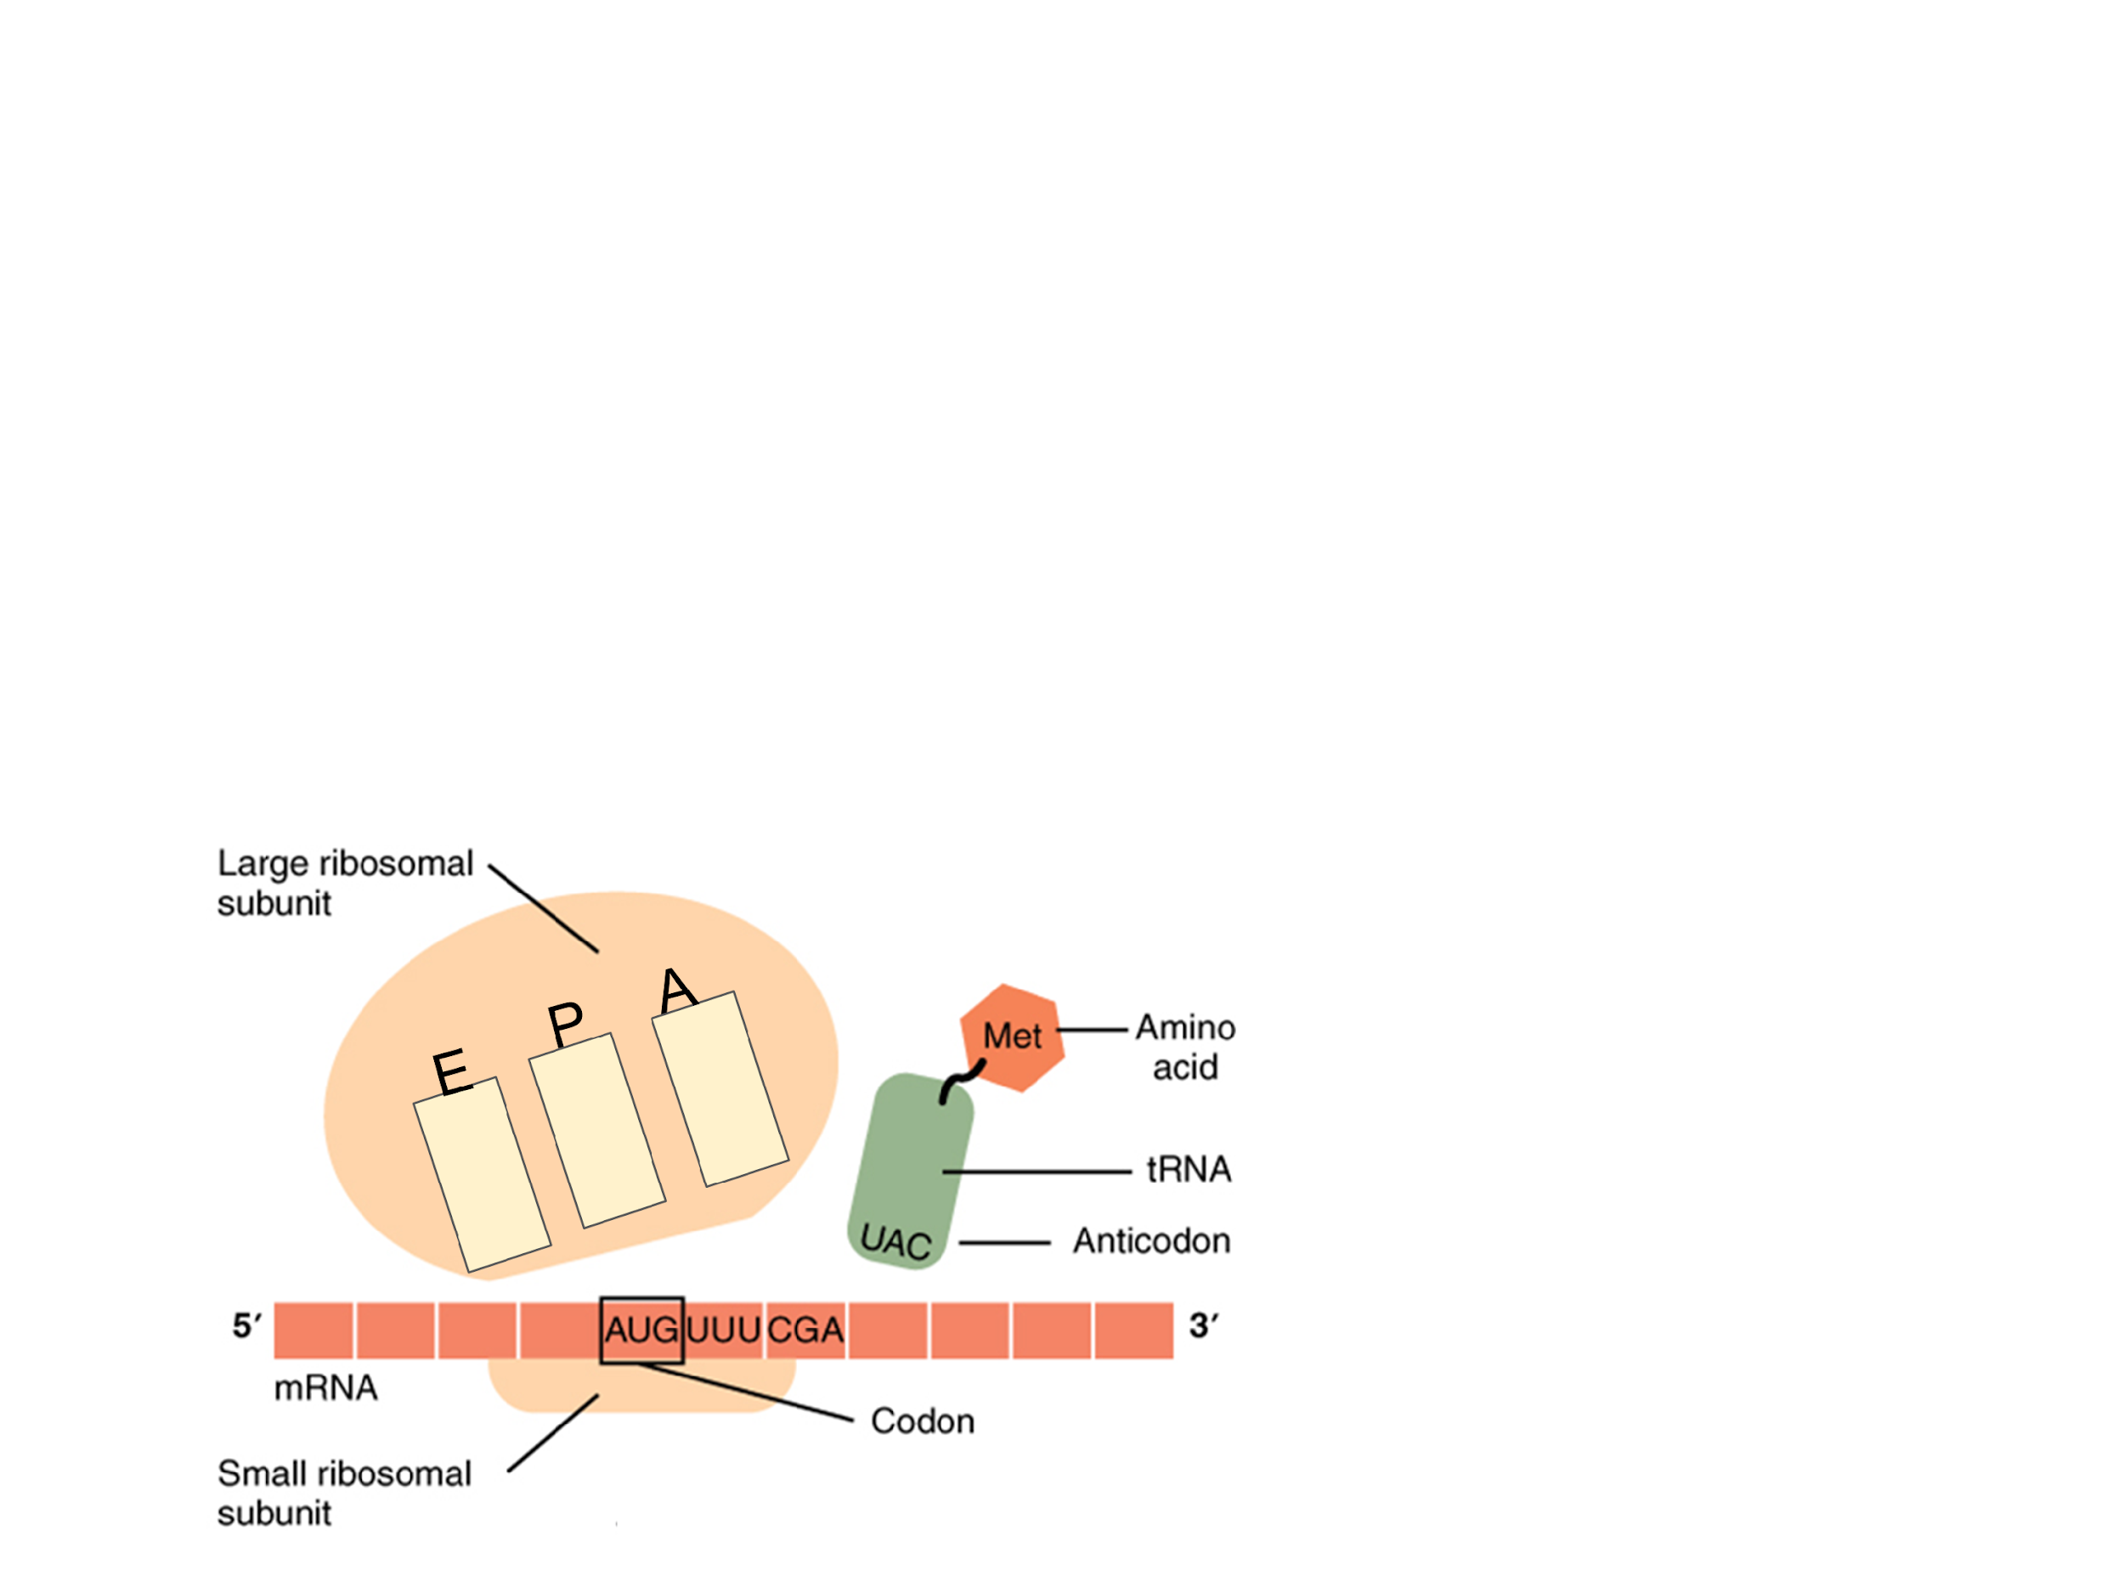
Step 1: Initiation
Translation begins when the small ribosomal subunit binds to the mRNA and a charged tRNA binds to the start codon, AUG, on the mRNA
  The tRNA carries methionine
  Next, the large subunit binds
Note: the first tRNA carrying Met will go to the P site, every other tRNA will go to the A site first

Slide 9
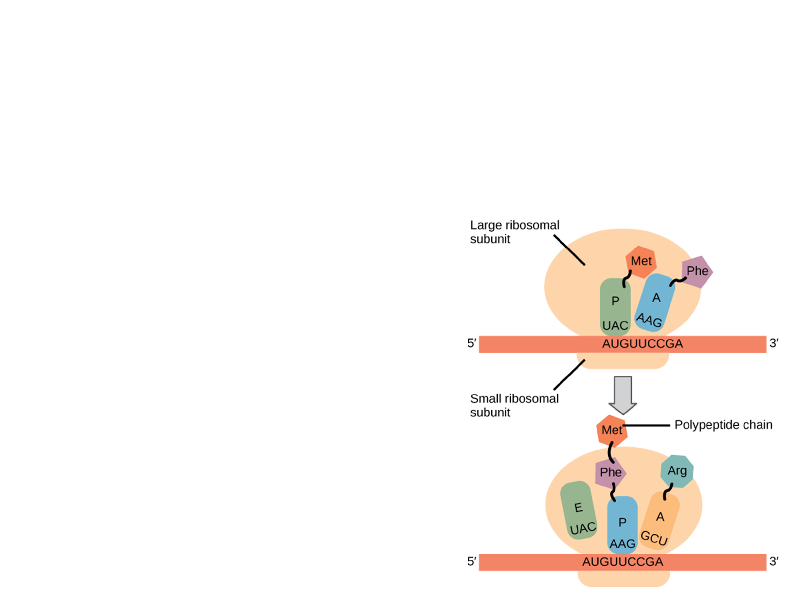
Step 2: Elongation
Elongation starts when the next tRNA comes into the A site
mRNA is moved through the ribosome and its codons are read
Each mRNA codon codes for a specific amino acid
  Codon charts are used to determine the amino acid
Since all organisms use the same genetic code, it supports the idea of common ancestry

Slide 10
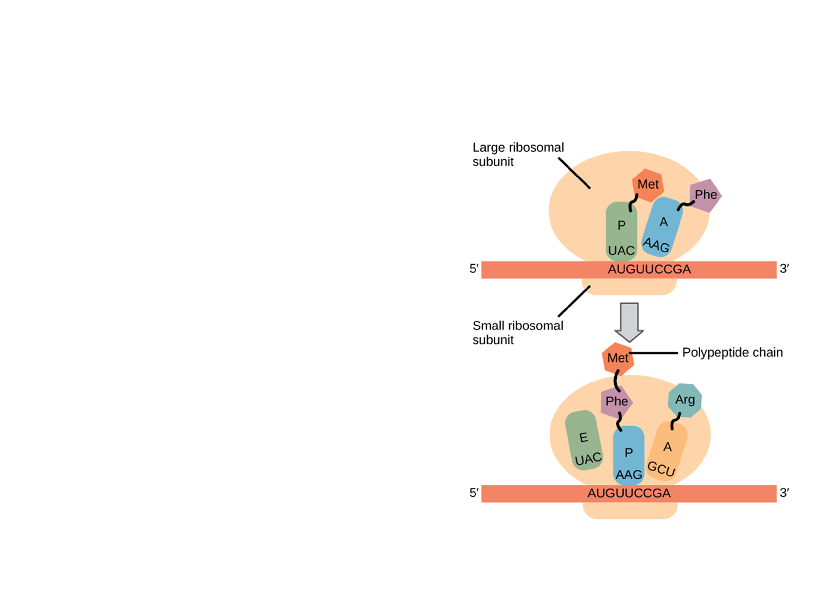
Step 2: Elongation
Elongation occurs in steps:
Codon recognition: the appropriate anticodon of the next tRNA goes to the A-site
Peptide bond formation: peptide bonds are formed that transfer the polypeptide to the A site tRNA
Translocation: The tRNA in the A site moves to the P site, the tRNA in the P site goes to the E site. The A site is open for the next tRNA

Slide 11
Step 3: Termination
Termination occurs when a stop codon in the mRNA reaches the A site of the ribosome
Stop codons do not code for amino acids
The stop codon signals for a release factor
  Hydrolyzes the bond that holds the polypeptide to the P site
  Polypeptide releases
  All translational units disassemble

Slide 12
Think, Pair, Share
Take a few minutes to review the three stages of translation with a partner

Slide 13
Quick Review
Before we move on to protein folding, take a minute to review primary, secondary, tertiary, and quaternary protein structures
Primary: chain of amino acids
Secondary: coils and folds due to hydrogen bonds forming
Tertiary: side chain interaction
Quaternary: 2+ polypeptide chains interacting

Slide 14
Protein Folding
As translation takes place, the growing polypeptide chain begins to coil and fold
  Genes determine the primary structure
    Primary structure determines the final shape
  Some polypeptides require chaperone proteins to fold correctly and some require modification before it can be functional in the cell

Slide 15
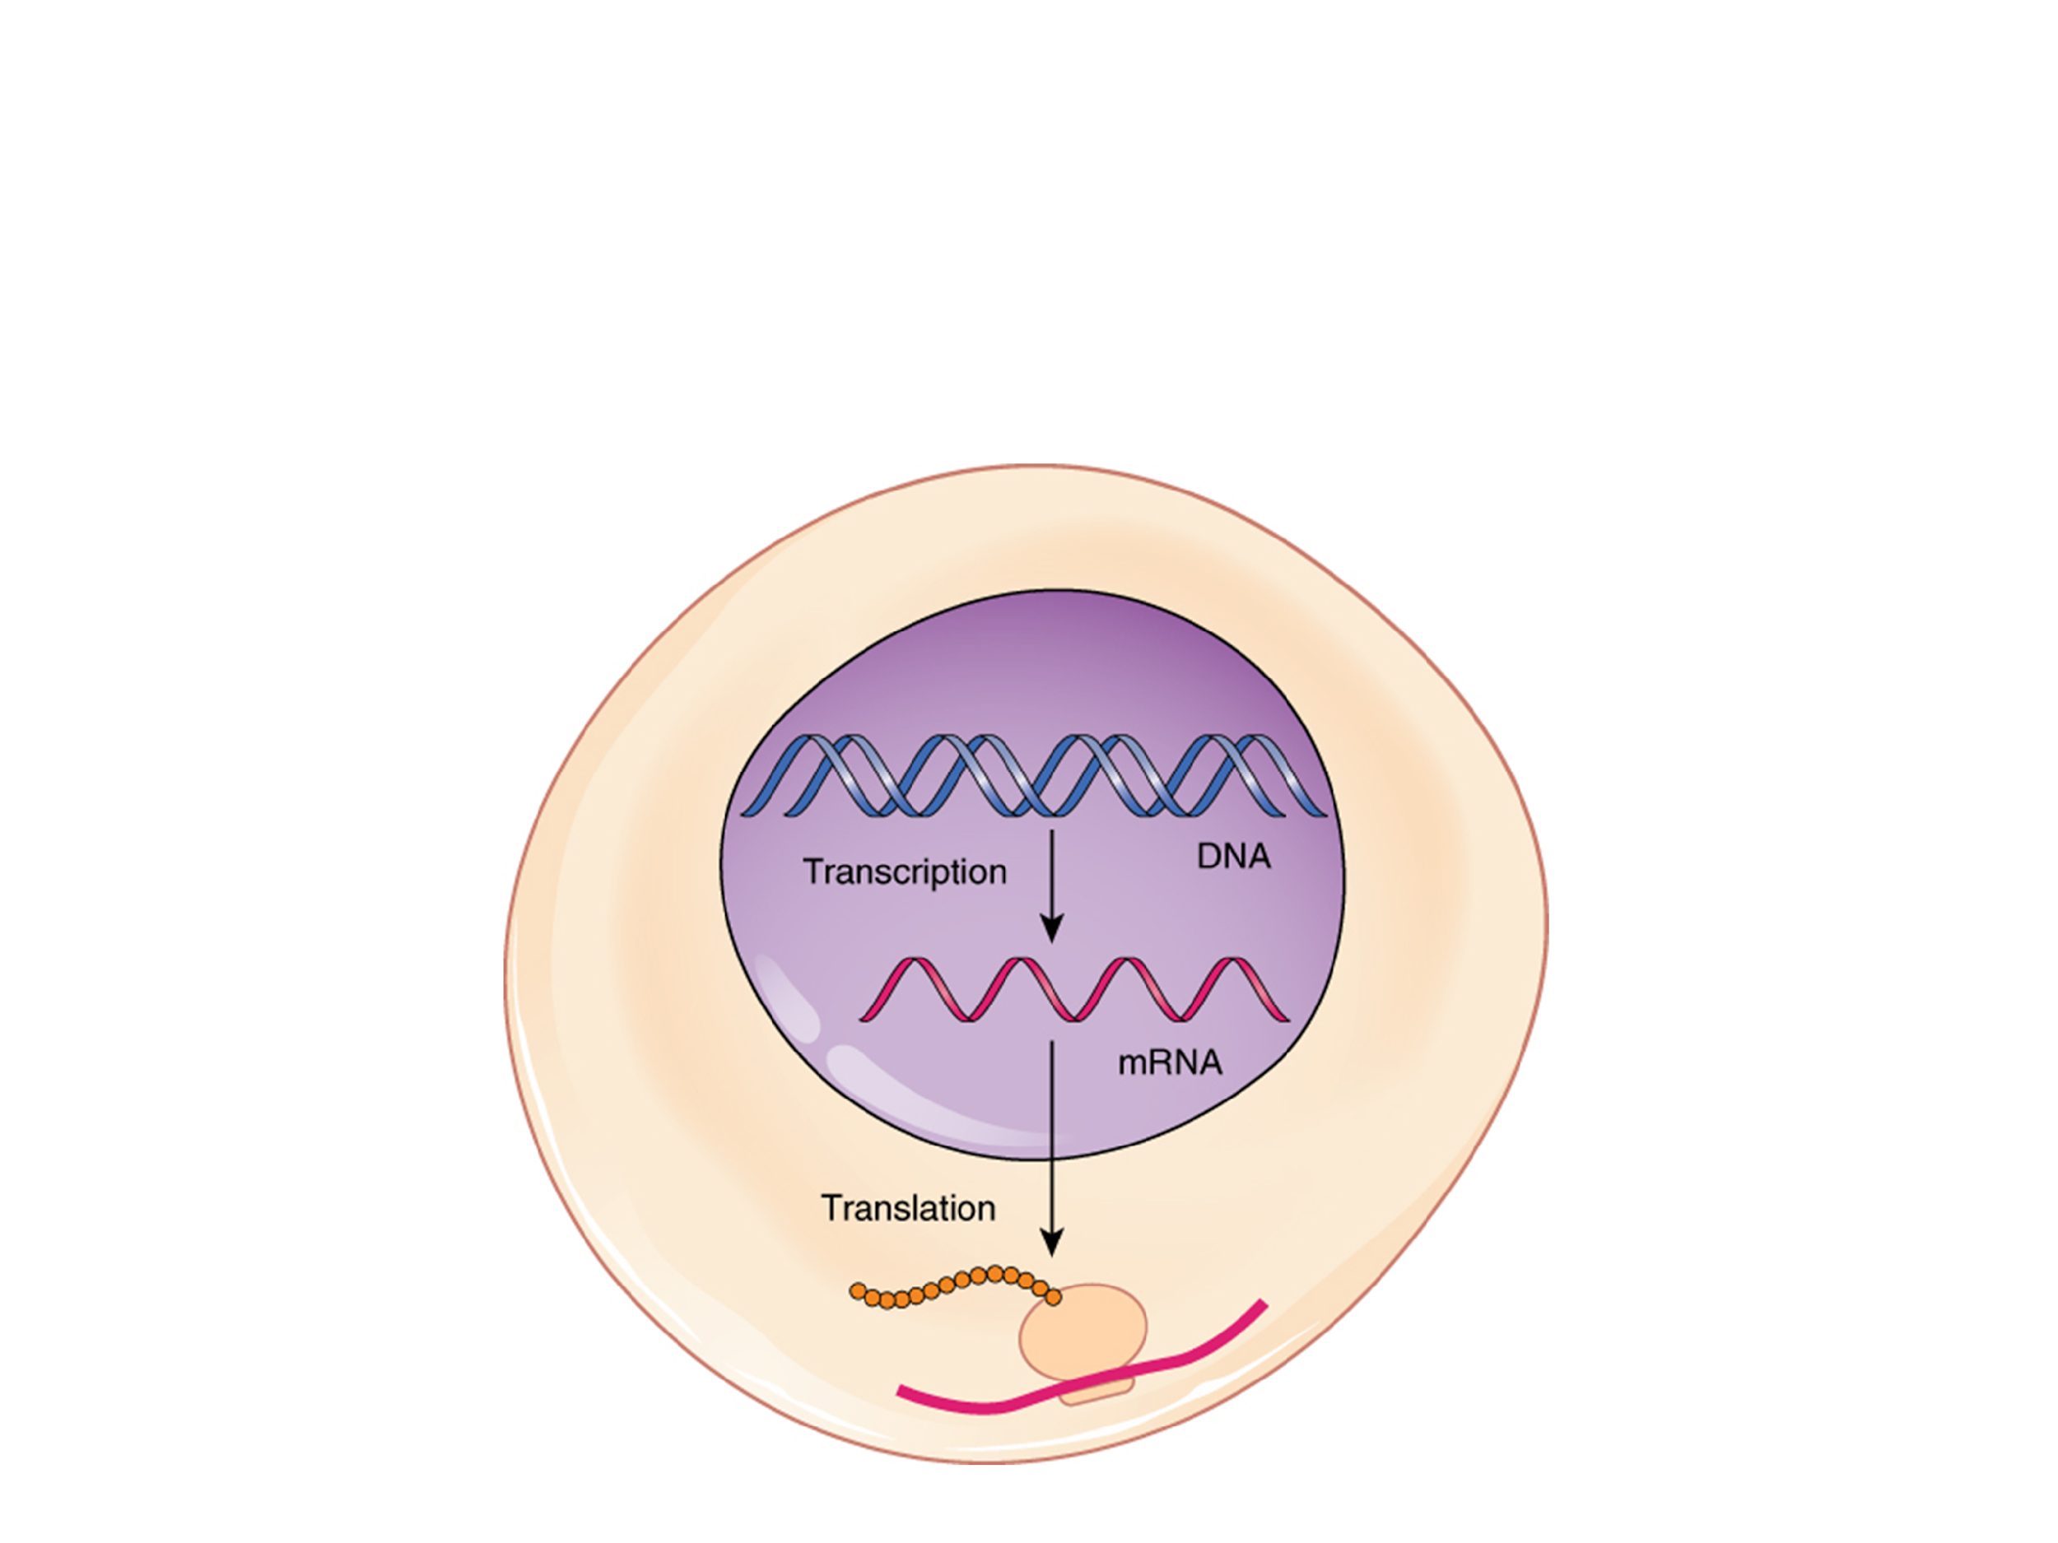
Putting it all Together
https://www.youtube.com/watch?v=h3b9ArupXZg

Slide 16
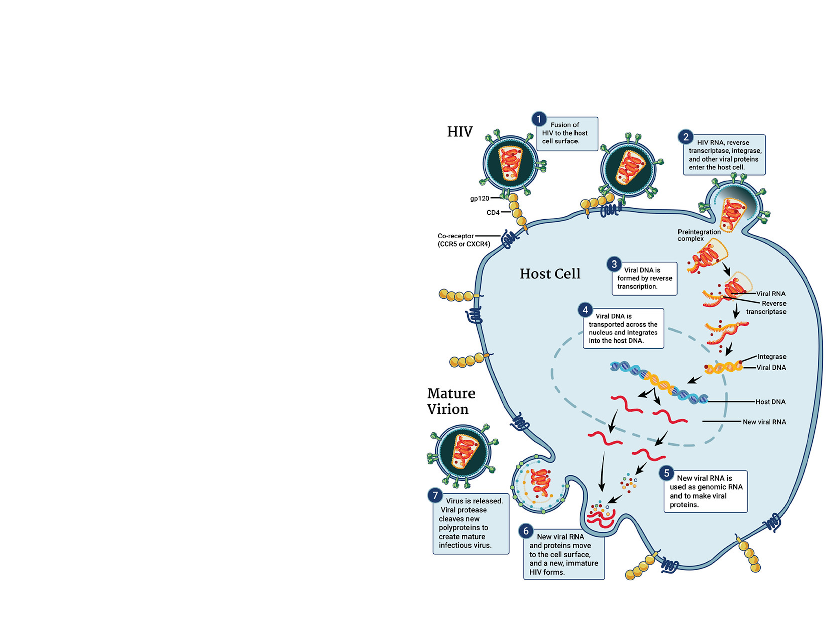
Retroviruses
Retroviruses, like HIV, are an exception to the standard flow of genetic information
Information flows from RNA to DNA
  Uses an enzyme known as reverse transcriptase
    Couples viral RNA to DNA
    DNA then becomes part of the RNA

Slide 17
Practice FRQ
All living organisms need a transfer of information to allow for genes to direct the synthesis of proteins. Explain how genes are transcribed and translated to produce a functional protein.
Notes:
Check student responses: they need to discuss the importance of both transcription and translation. Transcription allows for DNA to be transcribe to mRNA via the work of RNA polymerase. mRNA must be modified before it can leave the nucleus to go to the ribosome for translation. Translation turns the RNA nucleotide sequence into an amino acid sequence. A description of each stage (initiation, elongation, termination) would also be required.

Slide 18
Practice FRQ
Compare and contrast translation in prokaryotes and eukaryotes.
Notes:
In prokaryotes, translation occurs with transcription. In eukaryotes translation occurs after the mRNA has been modified. Ribosomes are responsible for translation, but the sizes differ in prokaryotes and eukaryotes, 30s/40s vs 40s/60s. Lastly, translation can occur in the mitochondria and chloroplast of eukaryotes.

