Slide 1
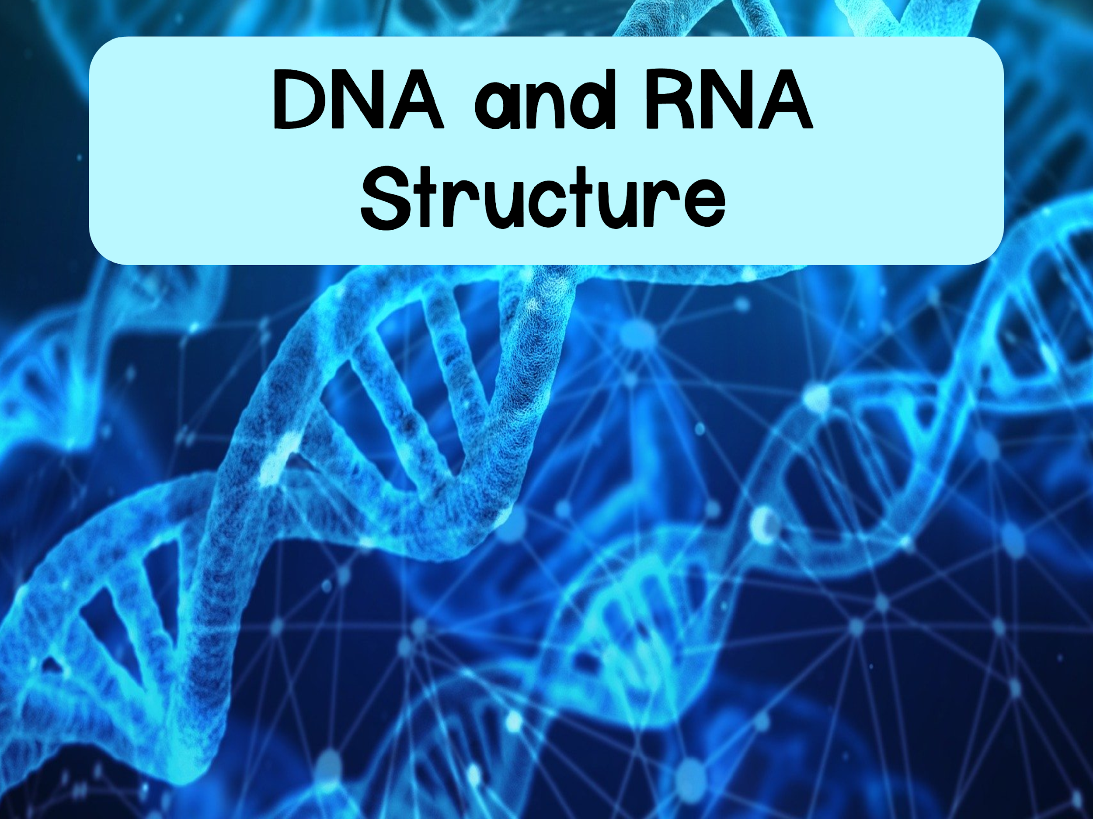

Slide 2
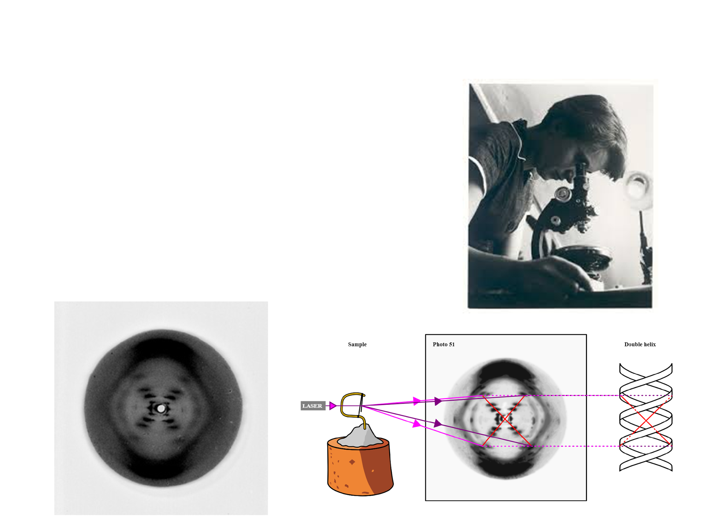
Discovery of DNA Structure
In the 1950s Rosalind Franklin performed X-Ray Crystallography of DNA
  Her work revealed a pattern that was regular and repetitive
Notes:
X-Ray Crystallography: some substances when purified turn into crystals. When X-Rays are passed through the crystals, it creates a “diffraction” pattern that reveals the overall shape and location of the crystals

Slide 3
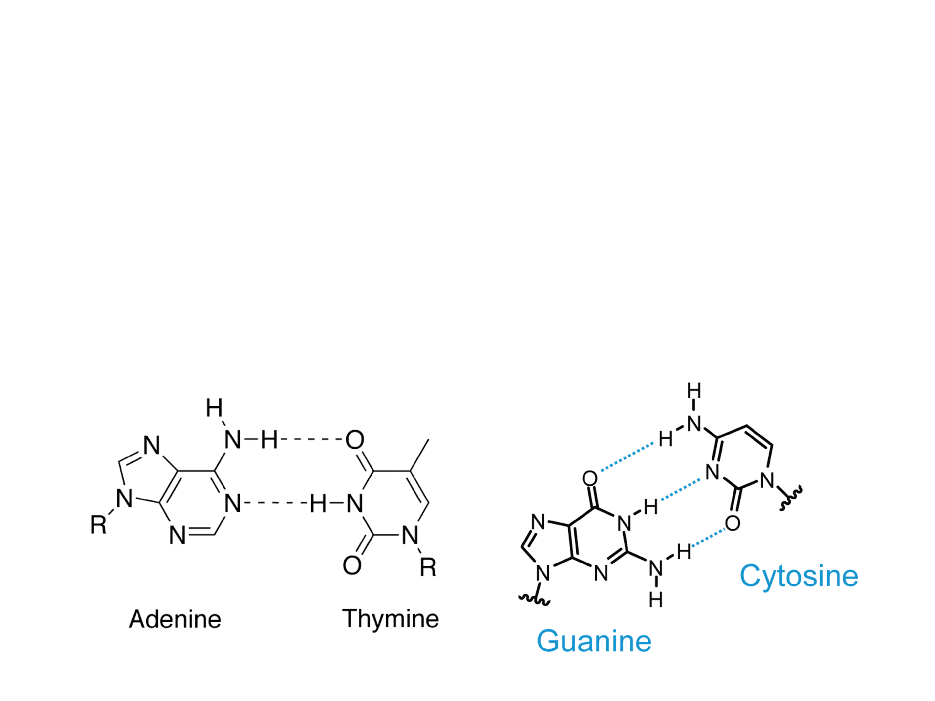
Discovery of DNA Structure
During the same time, Edwin Chargaff analyzed DNA samples from different species
  He found the following rule held true for all species:
    The amount of adenine equals the amount of thymine
    The amount of cytosine equals the amount of guanine

Slide 4
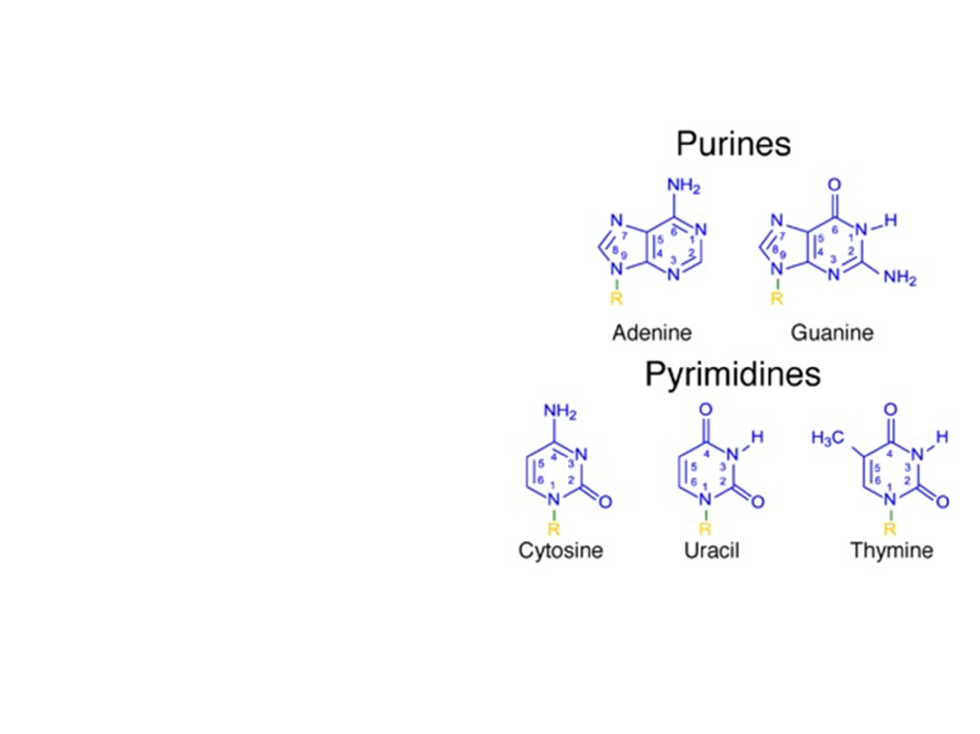
Nucleotide Structure
Purines
  Double ring structure (A, G)
Pyrimidines
  Single ring structure (C, U, T)

Slide 5
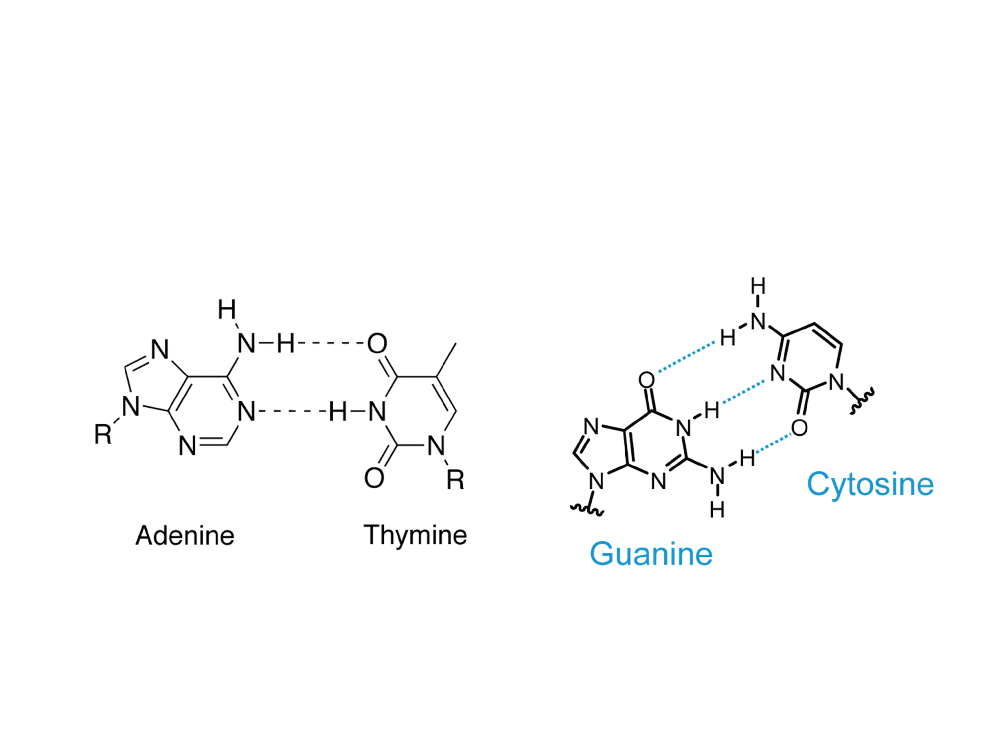
Nucleotide Pairing
The base pairs are held together by hydrogen bonds
Adenine and thymine have two hydrogen bonds
Cytosine and guanine have three hydrogen bonds

Slide 6
Quick Review
Think ahead to DNA replication. How might hydrogen bonds aid in this process?
  Answer: hydrogen bonds allow for the DNA strands to be easily separated during the replication process
A DNA sample is analyzed and you find that 22% is cytosine, how much thymine would you expect in the sample?
  Answer: 28%

Slide 7
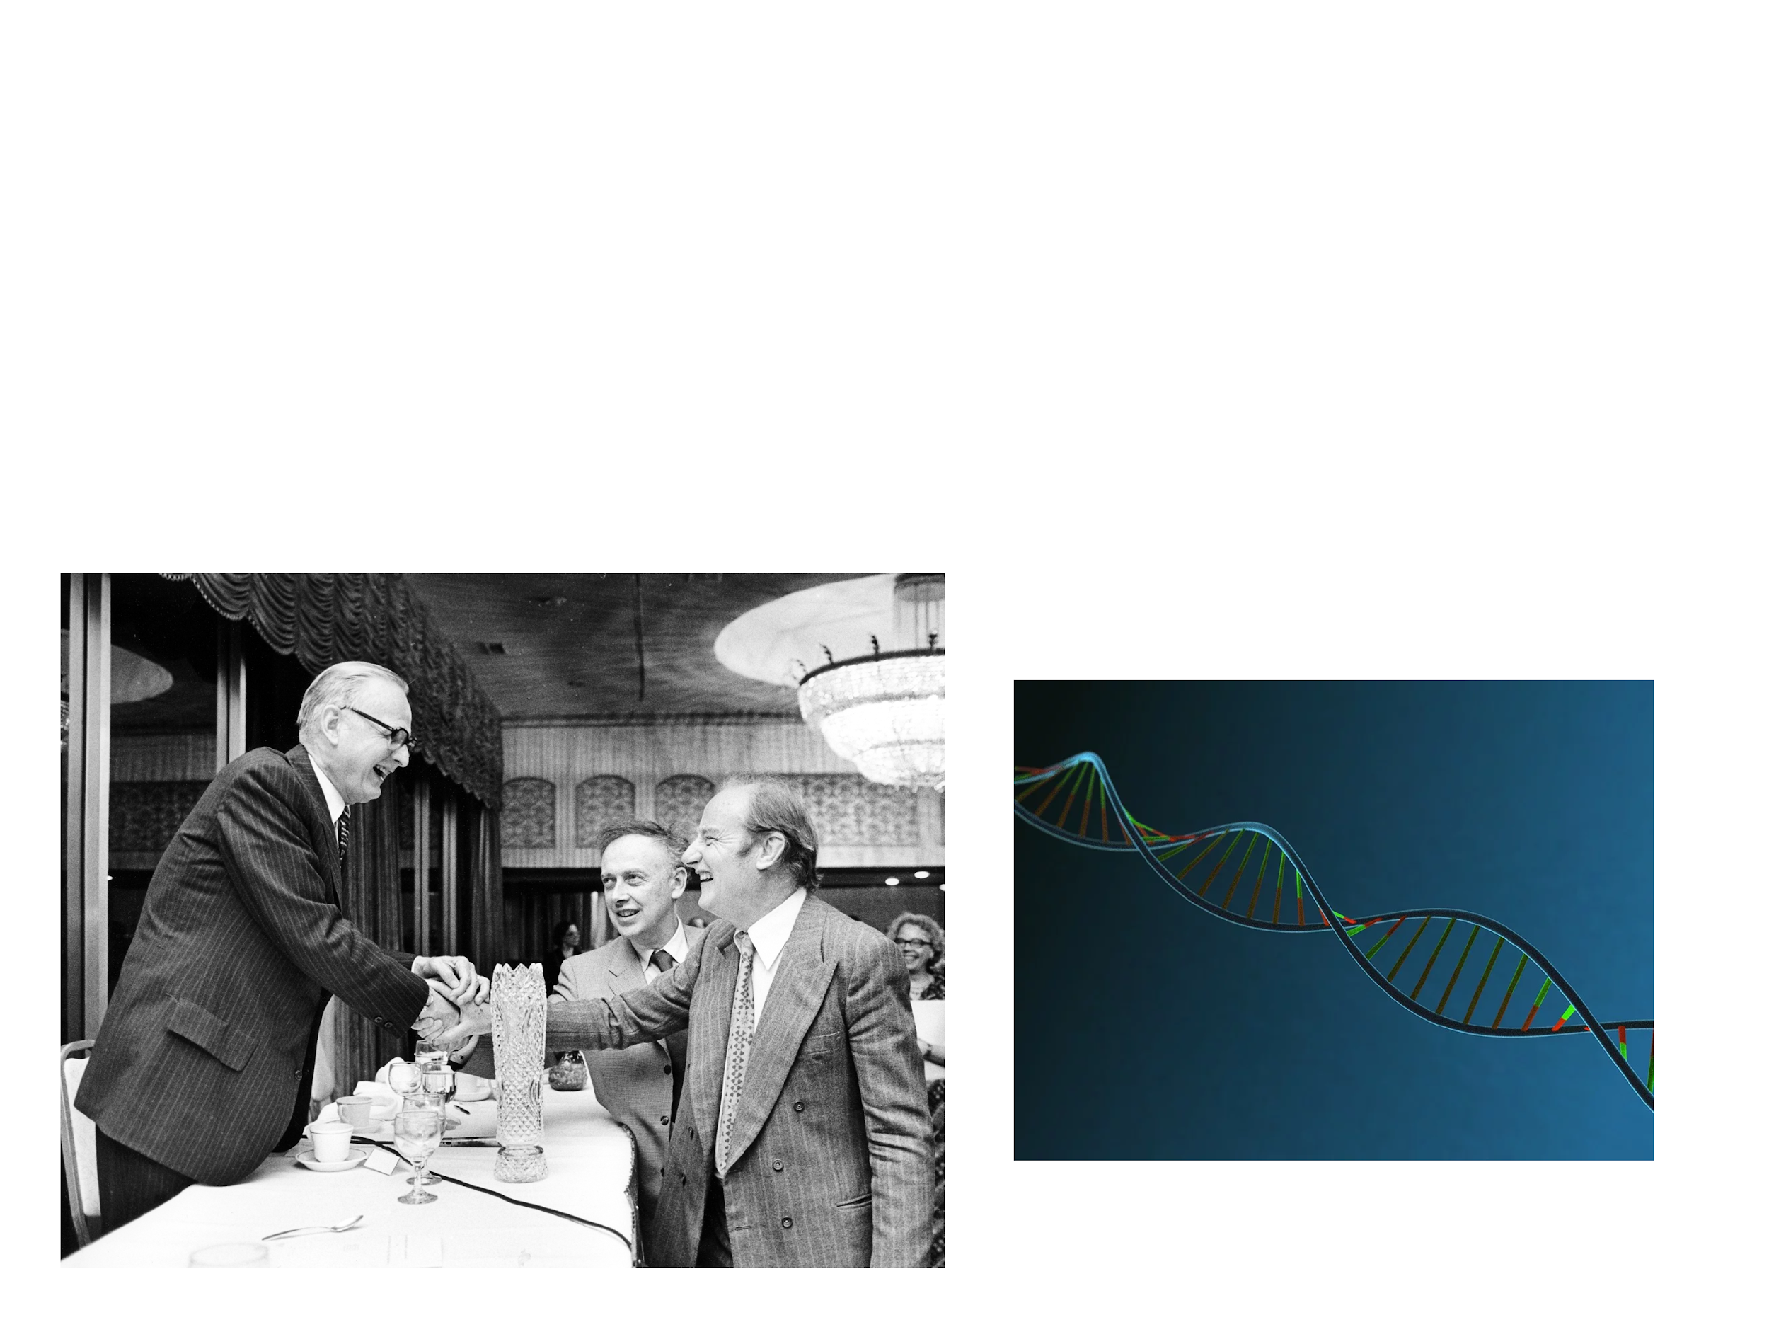
Discovery of DNA Structure
Watson and Crick combined the findings of Franklin (helix shape) and Chargaff (base pairing) to create the first 3D, double helix model of DNA

Slide 8
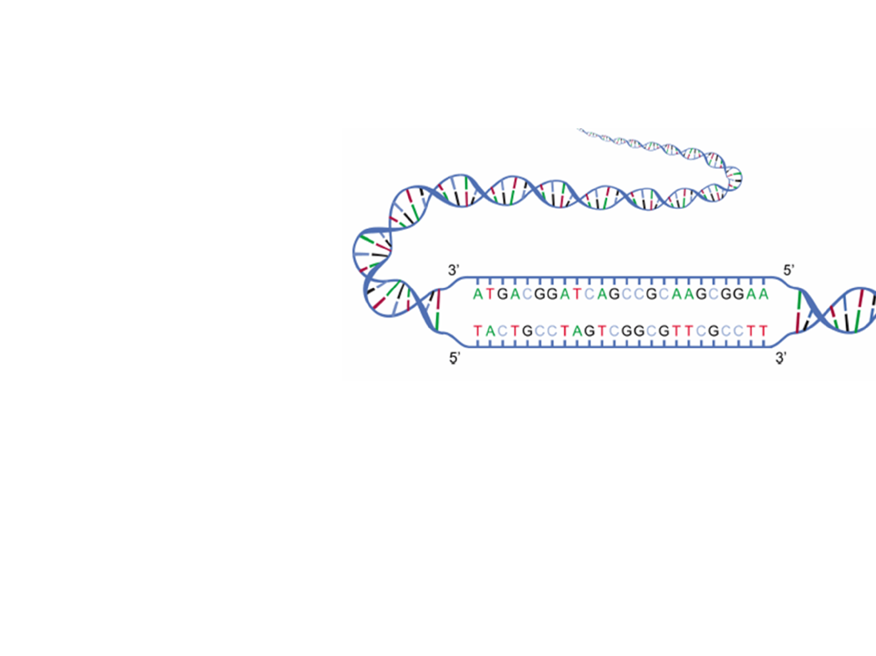
Key Features of DNA Structure
DNA is a double stranded helix
  Backbone: sugar-phosphate
  Center: nucleotides pairing
2. DNA strands are antiparallel
  One strand runs 5’ to 3’, other strand runs in opposite, upside-down direction 3’ to 5’
  5’ end: free phosphate group
  3’ end: free hydroxyl group

Slide 9
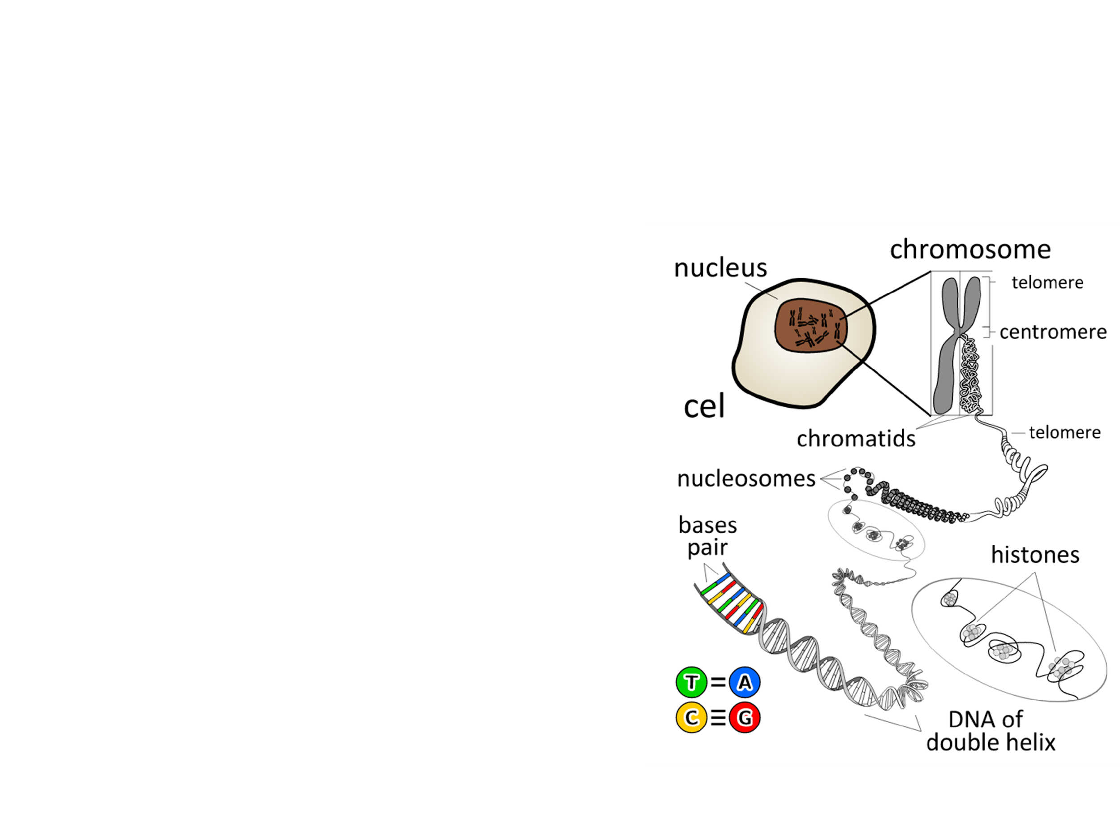
Key Function of DNA
DNA is the primary source of heritable information
  Genetic information is stored in and passed from one generation to the next through DNA
    Exception: RNA is the primary source of heritable information in some viruses

Slide 10
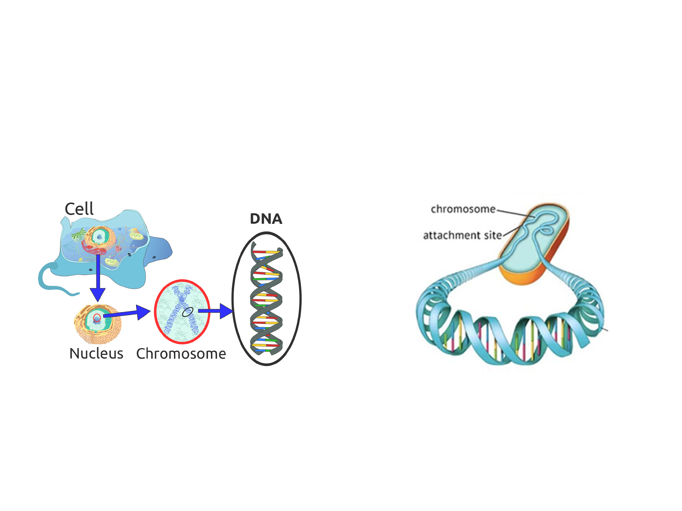
Prokaryotic vs Eukaryotic DNA
Eukaryotic Cells
Prokaryotic Cells
DNA found in nucleus
Linear chromosomes
DNA is in nucleoid region
Chromosomes are circular
Prokaryotes (and some eukaryotes) also contain plasmids
  Small, circular DNA molecules that are separate from the chromosomes

Slide 11
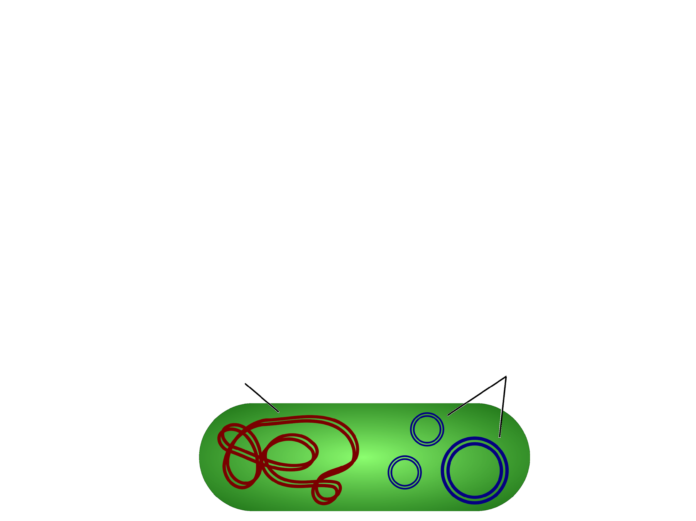
Plasmids
Plasmids replicate independently from the chromosomal DNA
  Primarily found in prokaryotes
    Contain genes that may be useful to the prokaryote when it is in a particular environment, but may not be required for survival
Chromosomal DNA
Plasmids

Slide 12
Plasmids
Plasmids can be manipulated in laboratories
  Plasmids can be removed from bacteria, then a gene of interest can be inserted into the plasmid to form recombinant plasmid DNA
  When the recombinant plasmid is inserted back into the bacteria the gene will be expressed
Chromosomal DNA
Plasmids

Slide 13
Plasmids
Bacteria can exchange genes found on plasmids with neighboring bacteria
  Once DNA is exchanged the bacteria can express the genes acquired
  Helps with survival of prokaryotes
Chromosomal DNA
Plasmids

Slide 14
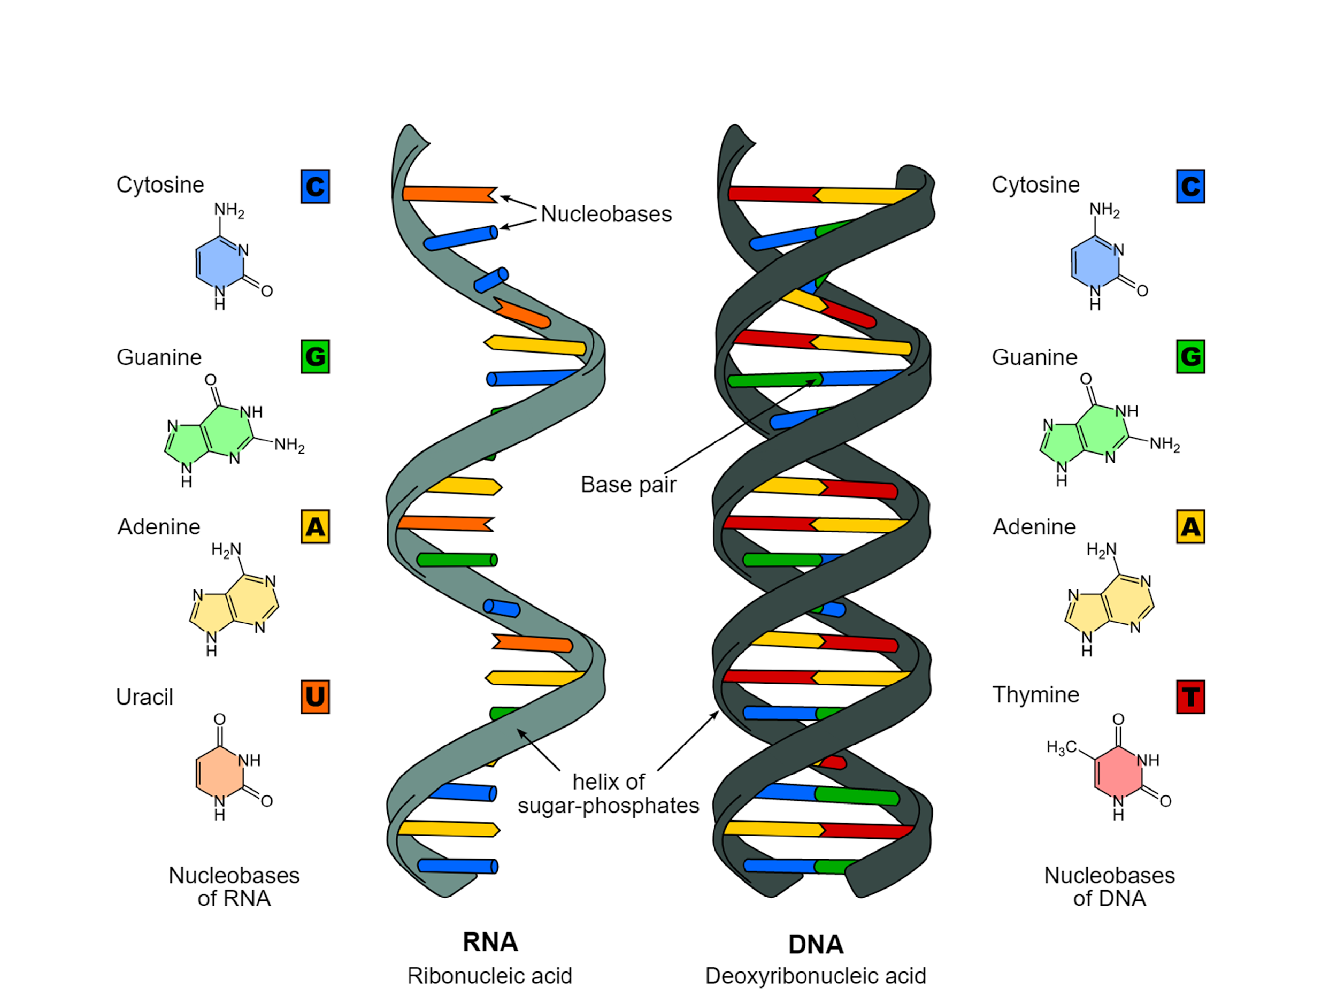
RNA vs DNA

Slide 15
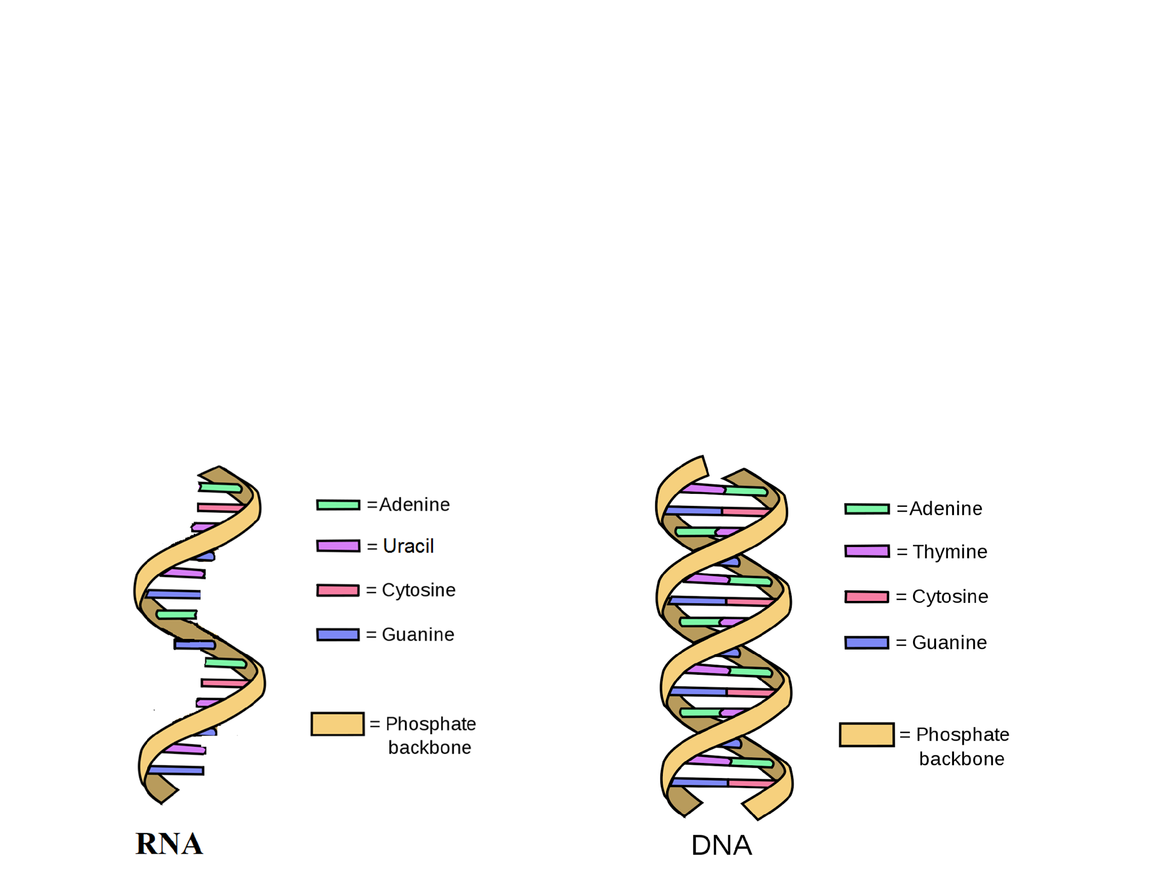
RNA vs DNA
RNA
DNA
Ribonucleic acid
Single stranded
A=U and C=G
Deoxyribonucleic acid
Double stranded
A=T and C=G

Slide 16
Quick Review
What was Chargaff’s rule?
  Answer: in any species, the amount of A=T and amount of C=G in the DNA
What comprises the backbone of DNA?
  Answer: sugar-phosphate groups
Which nucleotides are purines?
  Answer: adenine and guanine
What type of bond holds together nucleotides?
  Answer: hydrogen bonds

Slide 17
Quick Review
Summarize the scientific contributions of Chargaff, Franklin, and Watson and Crick
  Chargaff: A=T, C=G
  Franklin: helix shape of DNA
  Watson and Crick: full 3D model of DNA
What are some key differences between RNA and DNA?
  Answer: DNA is double stranded and adenine bonds to thymine. RNA is single stranded and adenine bonds to uracil

Slide 18
Practice FRQ
Many species of bacteria are becoming resistant to antibiotics. Recently, studies have analyzed the chromosomal DNA of antibiotic resistant bacteria. One bacteria studied is methicillin-resistant Staphylococcus aureus (MRSA). Researchers have found that its chromosomal DNA does not contain the genes for antibiotic resistance. They also found that when MRSA is cultured with a non-resistant bacteria, the non-resistant bacteria becomes antibiotic resistant a) Identify the location of the antibiotic resistant genes. b) Discuss how the antibiotic resistant genes are being transmitted to non-resistant bacteria when cultured together.
Notes:
The genes are likely located on plasmids
The genes for antibiotic resistance are being transmitted through the plasmids. MRSA can exchange genes found on plasmids with neighboring bacteria. The genes are then expressed.

Slide 19
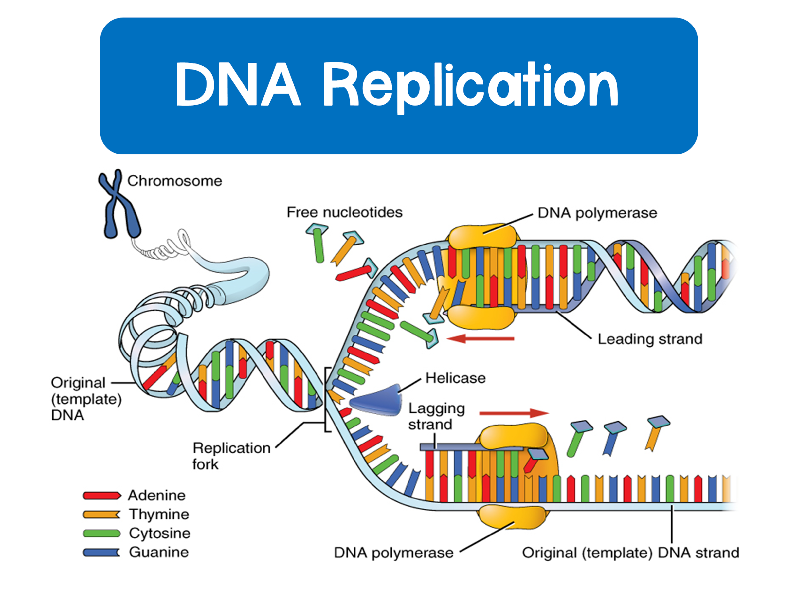

Slide 20
DNA Replication
DNA replicates during the S phase of the cell cycle
How does DNA replicate?

Slide 21
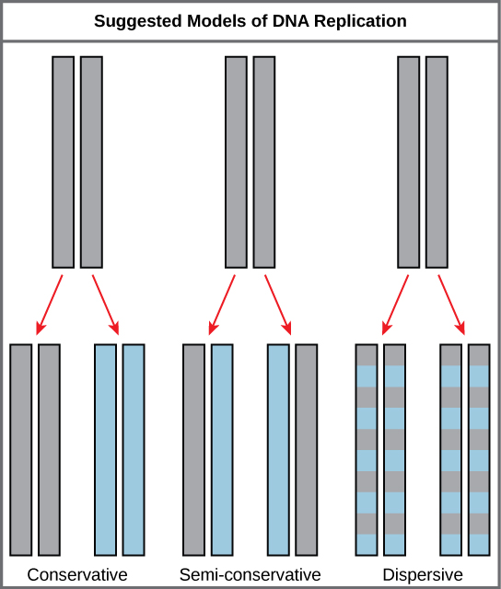
Models of DNA Replication
There were 3 alternative models for DNA replication
Conservative
Semi Conservative
Dispersive

Slide 22
Models of DNA Replication
Conservative model
  The parental strands direct synthesis of an entirely new double stranded molecule
    The parental strands are fully “conserved”
Parental strands
New strands
Parental strands
Conservative

Slide 23
Models of DNA Replication
Semi conservative model
  The two parental strands each make a copy of itself
    After one round of replication the two daughter molecules each have one parental and one new strand
Parental strands
1 parental
1 new strand
Semi Conservative

Slide 24
Models of DNA Replication
Dispersive model
  The material in the two parental strands is dispersed randomly between the two daughter molecules
    After one round of replication the daughter molecules contain a random mix of parental and new DNA
Parental strands
Mix of parental and new
Dispersive

Slide 25
Which Model Is Correct?
In 1954 Meselson and Stahl performed an experiment using bacteria
Process:
Bacteria was cultured with a heavy isotope, ¹⁵N
Bacteria was transferred to a medium with ¹⁴N, a light isotope
DNA was centrifuged and analyzed after each replication

Slide 26
Semi-Conservative Model
By analyzing samples of DNA after each generation, it was found that the parental strands were following the semi-conservative model.

Slide 27
Semi-Conservative Model
Notes:
On this slide I like to have my students discuss the right side of the image and determine how this data supports semi-conservative replication

Slide 28
Steps in DNA Replication

Slide 29
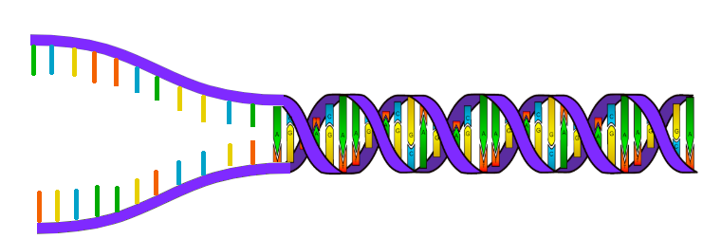
Steps in DNA Replication
1. DNA replication begins at sites called origins of replication
Various proteins attach to the origin of replication and open the DNA to form a replication fork
3’
5’

Slide 30
Steps in DNA Replication
2. Helicase will unwind the DNA strands at each replication fork
To keep the DNA from re-bonding with itself, proteins called single strand binding proteins (SSBPs) bind to the DNA to keep it open
Topoisomerase will help prevent strain ahead of the replication fork by relaxing supercoiling

Slide 31
Steps in DNA Replication
Helicase
Topoisomerase
3’
5’
SSBPs

Slide 32
Steps in DNA Replication
3. The enzyme primase initiates replication by adding short segments of RNA, called primers, to the parental DNA strand
The enzymes that synthesize DNA can only attach new DNA nucleotides to an existing strand of nucleotides
Primers serve as the foundation for DNA synthesis

Slide 33
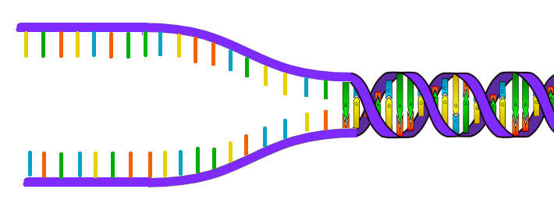
Steps in DNA Replication
RNA primer
3’
5’

Slide 34
Steps in DNA Replication
4. Antiparallel elongation
DNA Polymerase III (DNAP III) attaches to each primer on the parental strand and moves in the 3’ to 5’ direction
  As it moves, it adds nucleotides to the new strand in the 5’ to 3’ direction
  The DNAP III that follows helicase is known as the leading strand and it only requires one primer
  The DNAP III on the other parental strand that moves away from helicase is known as the lagging strand and requires many primers

Slide 35
Steps in DNA Replication
DNA Polymerase III moves 3’ to 5’ following helicase
Leading strand
3’
5’
Lagging strand
DNA Polymerase III moves 3’ to 5’ away from helicase

Slide 36
Steps in DNA Replication
5. The leading strand is synthesized in one continuous segment, but since the lagging strand moves away from the replication fork it is synthesized in chunks
Okazaki fragments: segments of the lagging strand

Slide 37


Steps in DNA Replication
Leading strand
3’
5’
3’
3’
5’
5’
Lagging strand
Okazaki fragment

Slide 38
Steps in DNA Replication
6. After DNAP III forms an okazaki fragment, DNAP I replaces RNA nucleotides with DNA nucleotides
DNA ligase: joins the okazaki fragments forming a continuous DNA strand

Slide 39



Steps in DNA Replication
Leading strand
DNAP I
3’
5’
Lagging strand
Ligase connects fragments

Slide 40
Putting it all Together
https://www.youtube.com/watch?v=2ymwAtu3rAM
Notes:
I love to show the DNA replication video by Mr Anderson as soon as we finish so students can see and hear the process once more

Slide 41
Putting it all Together
https://www.youtube.com/watch?v=TNKWgcFPHqw
Notes:
This is another great video to watch if you have the time, it shows the synthesis of DNA using a 3D model. The more they see it, the more familiar they become with the process!

Slide 42
Problems at the 5’ End
Since DNAP III can only add nucleotides to a 3’ end, there is no way to finish replication on the 5’ end of a lagging strand
  Over many replications, this would mean that the DNA would become shorter and shorter
  How are the genes on DNA protected from this?
    Telomeres: repeating units of short nucleotide sequences that do not code for genes
      Form a cap at the end of DNA to help postpone erosion
      The enzyme telomerase adds telomeres to DNA
Notes:
Here is a good video to show about telomeres
https://www.youtube.com/watch?time_continue=1&v=2NS0jBPurWQ&feature=emb_logo

Slide 43
Proofreading and Repair
As DNA polymerase adds nucleotides to the new DNA strand, it proofreads the bases added
  If errors still occur, mismatch repair will take place
    Enzymes remove and replace the incorrectly paired nucleotide
    If segments of DNA are damaged, nuclease can remove segments of nucleotides and DNA polymerase and ligase can replace the segments

Slide 44
Quick Review
If a parental DNA strand read: 5’- ACGTAC- 3’ what would a newly synthesized complementary strand read?
  Answer: 3’- TGCATG- 5’
Summarize the role of helicase, topoisomerase, and DNA Polymerase III.
  Answer: helicase unzips the DNA, topoisomerase helps reduce strain, DNAP III adds nucleotides to the new strand of DNA

Slide 45
Quick Review
What direction does DNAP III move along the parental strand?
  Answer: It moves 3’ to 5’
Why do Okazaki fragments occur on the lagging strand.
  Answer: fragments occur because DNAP III moves away from the replication fork, so it has to replicate in chunks

