Slide 1
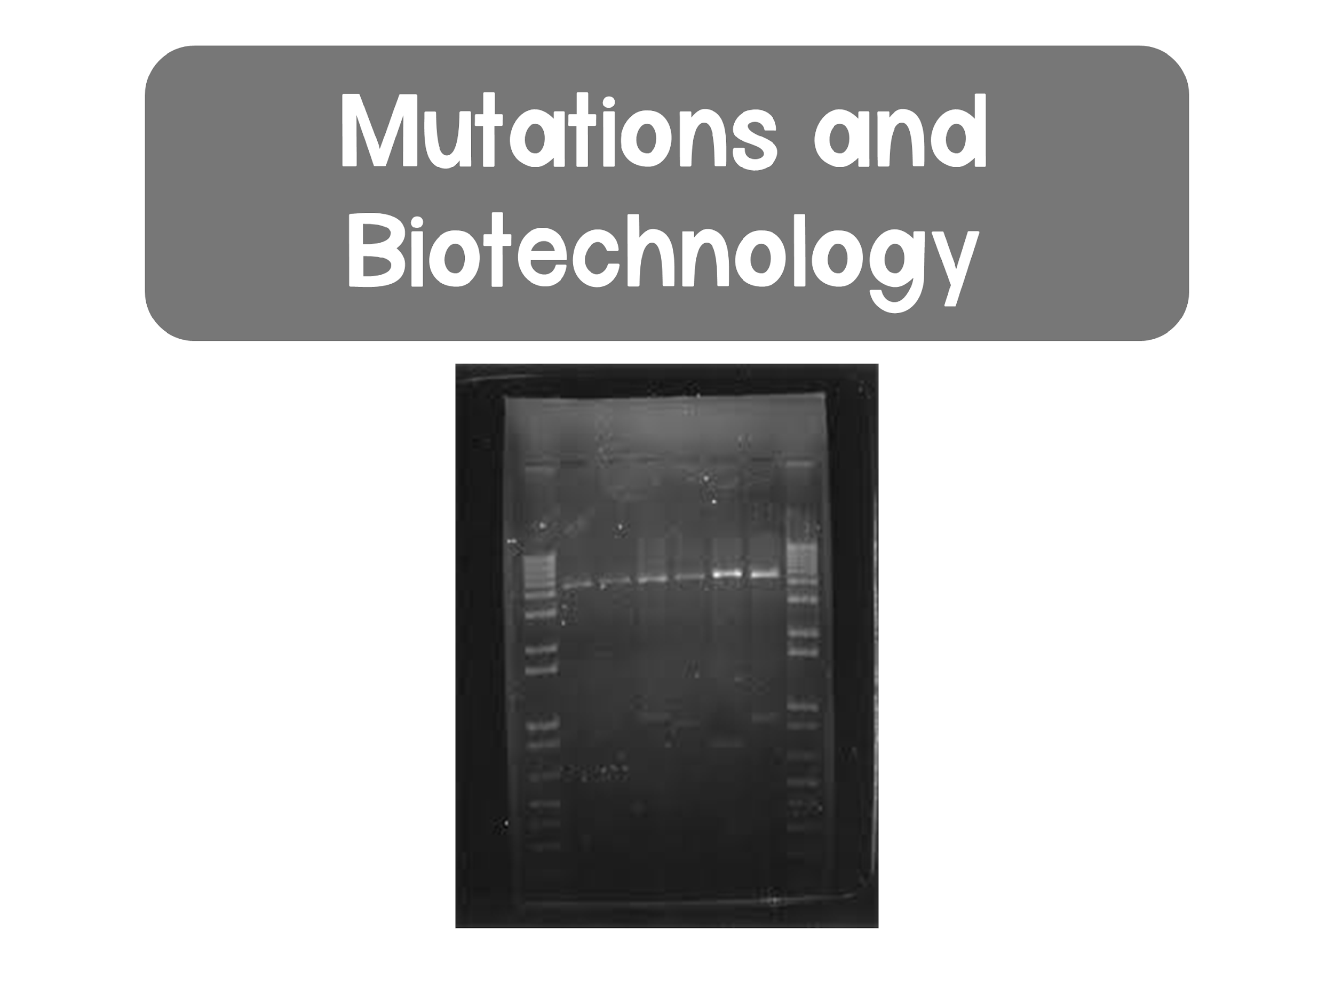

Slide 2
Mutations
Mutations: changes in the genetic material of a cell, which can alter phenotypes
  Primary source of genetic variation
  Normal function and production of cellular products is essential
    Any disruption can cause new phenotypes
  Changes can be large scale or small scale
    Large scale: chromosomal changes
    Small scale: nucleotide substitutions, insertions, or deletions

Slide 3
Small Scale Mutations
Point mutations: change a single nucleotide pair of a gene
  Substitution: the replacement of one nucleotide and its partner with another pair of nucleotides
    Silent: change still codes for the same amino acid (remember: redundancy in the genetic code)
    Missense: change results in a different amino acid
    Nonsense: change results in a stop codon

Slide 4
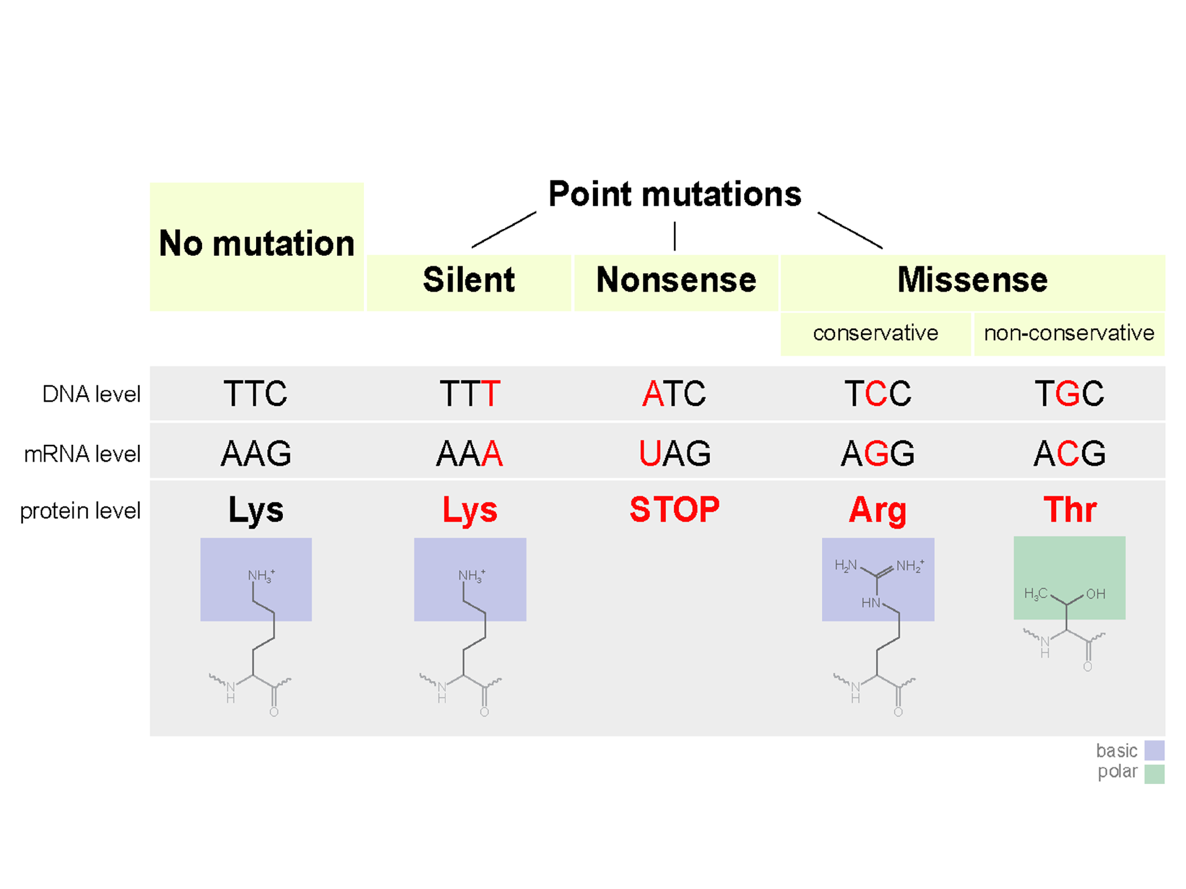
Point Mutations

Slide 5
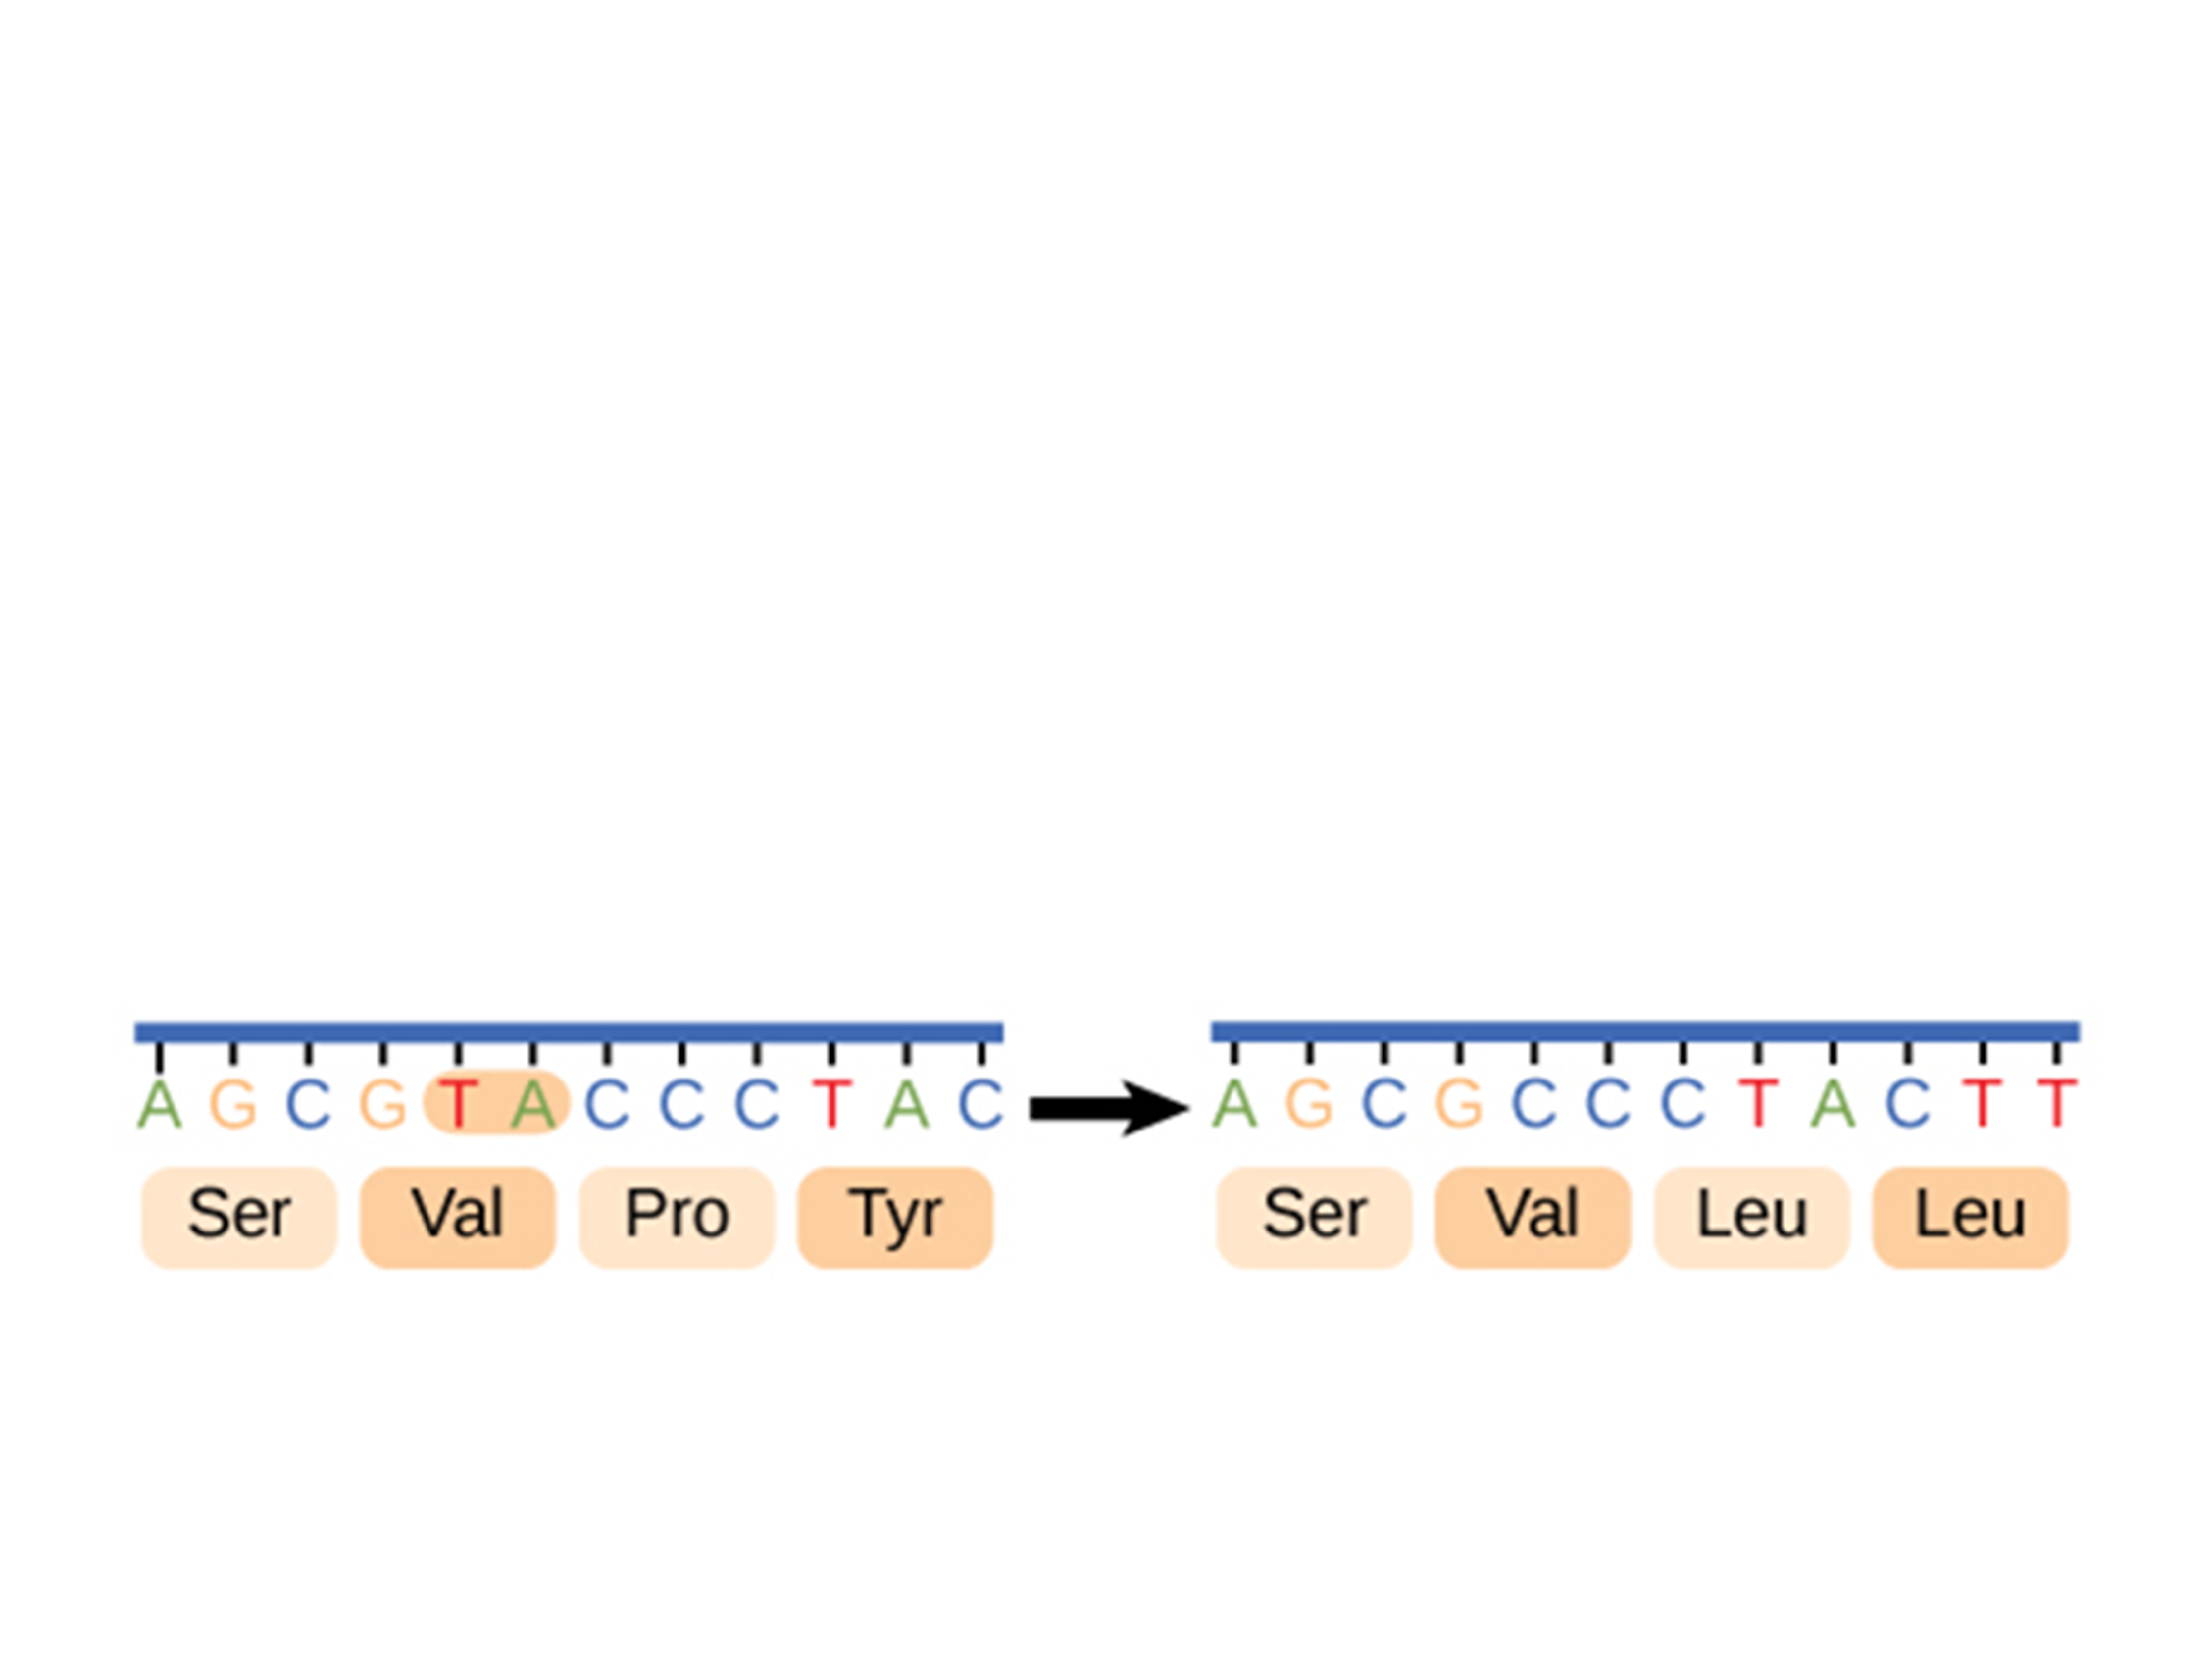
Small Scale Mutations
Frameshift mutation: when the reading frame of the genetic information is altered
  Disastrous effects to resulting proteins
    Insertion: a nucleotide is inserted
    Deletion: a nucleotide is removed

Slide 6
Large Scale Mutations
Mutations that affect chromosomes
Nondisjunction: when chromosomes do not separate properly in meiosis
  Results in the incorrect number of chromosomes
    Example: Down Syndrome- trisomy 21
Translocation: a segment of one chromosome moves to another
Inversions: a segment is reversed
Duplications: a segment is repeated
Deletions: a segment is lost

Slide 7
Natural Selection
Any time mutations occur, they are subject to natural selection
  Genetic changes can sometimes enhance the survival and reproduction of an organism

Slide 8
Increasing Genetic Variation
Prokaryotes can exchange genetic material through horizontal gene transfer
If there is a mutation that is beneficial to the survival and reproduction of that prokaryote then it can also be transferred
  Transformation: uptaking of DNA from a nearby cell
  Transduction: viral transmission of genetic material
  Conjugation: cell to cell transfer of DNA
  Transposition: movement of DNA segments within and between DNA molecules

Slide 9
Biotechnology

Slide 10
Biotechnology
Both DNA and RNA can be manipulated through genetic engineering

Slide 11
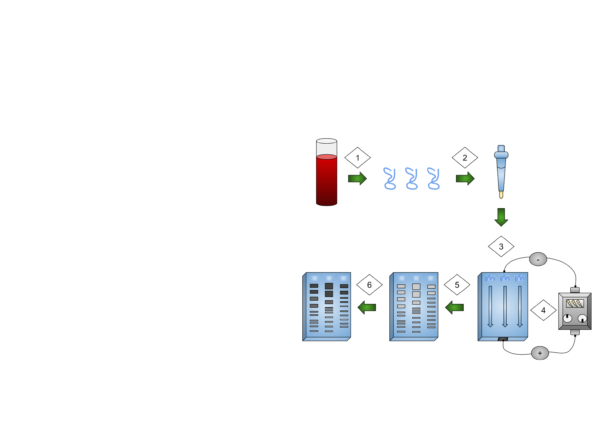
Gel Electrophoresis
Gel electrophoresis: a technique used to separate DNA fragments by size
DNA is loaded into wells on one end of a gel and an electric current is applied
  DNA fragments are negatively charged so they move towards the positive electrode

Slide 12
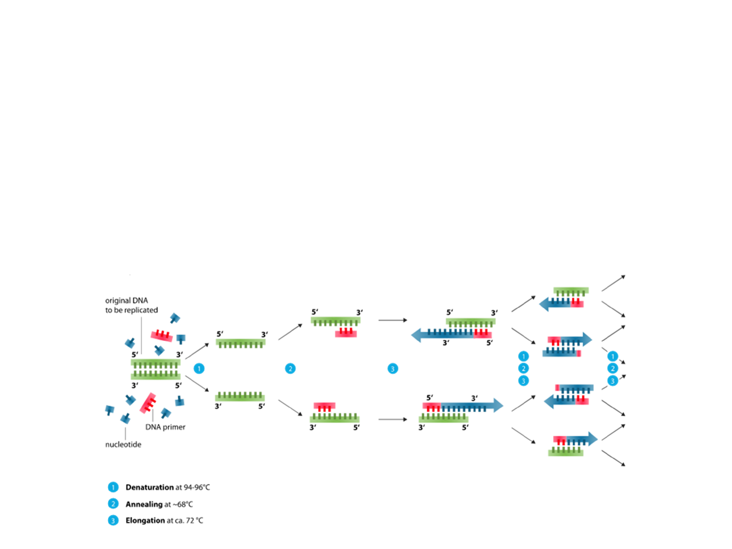
PCR
Polymerase chain reaction (PCR): a method used in molecular biology to make several copies of a specific DNA segment
Segments of DNA are amplified
Results can be analyzed using gel electrophoresis

Slide 13
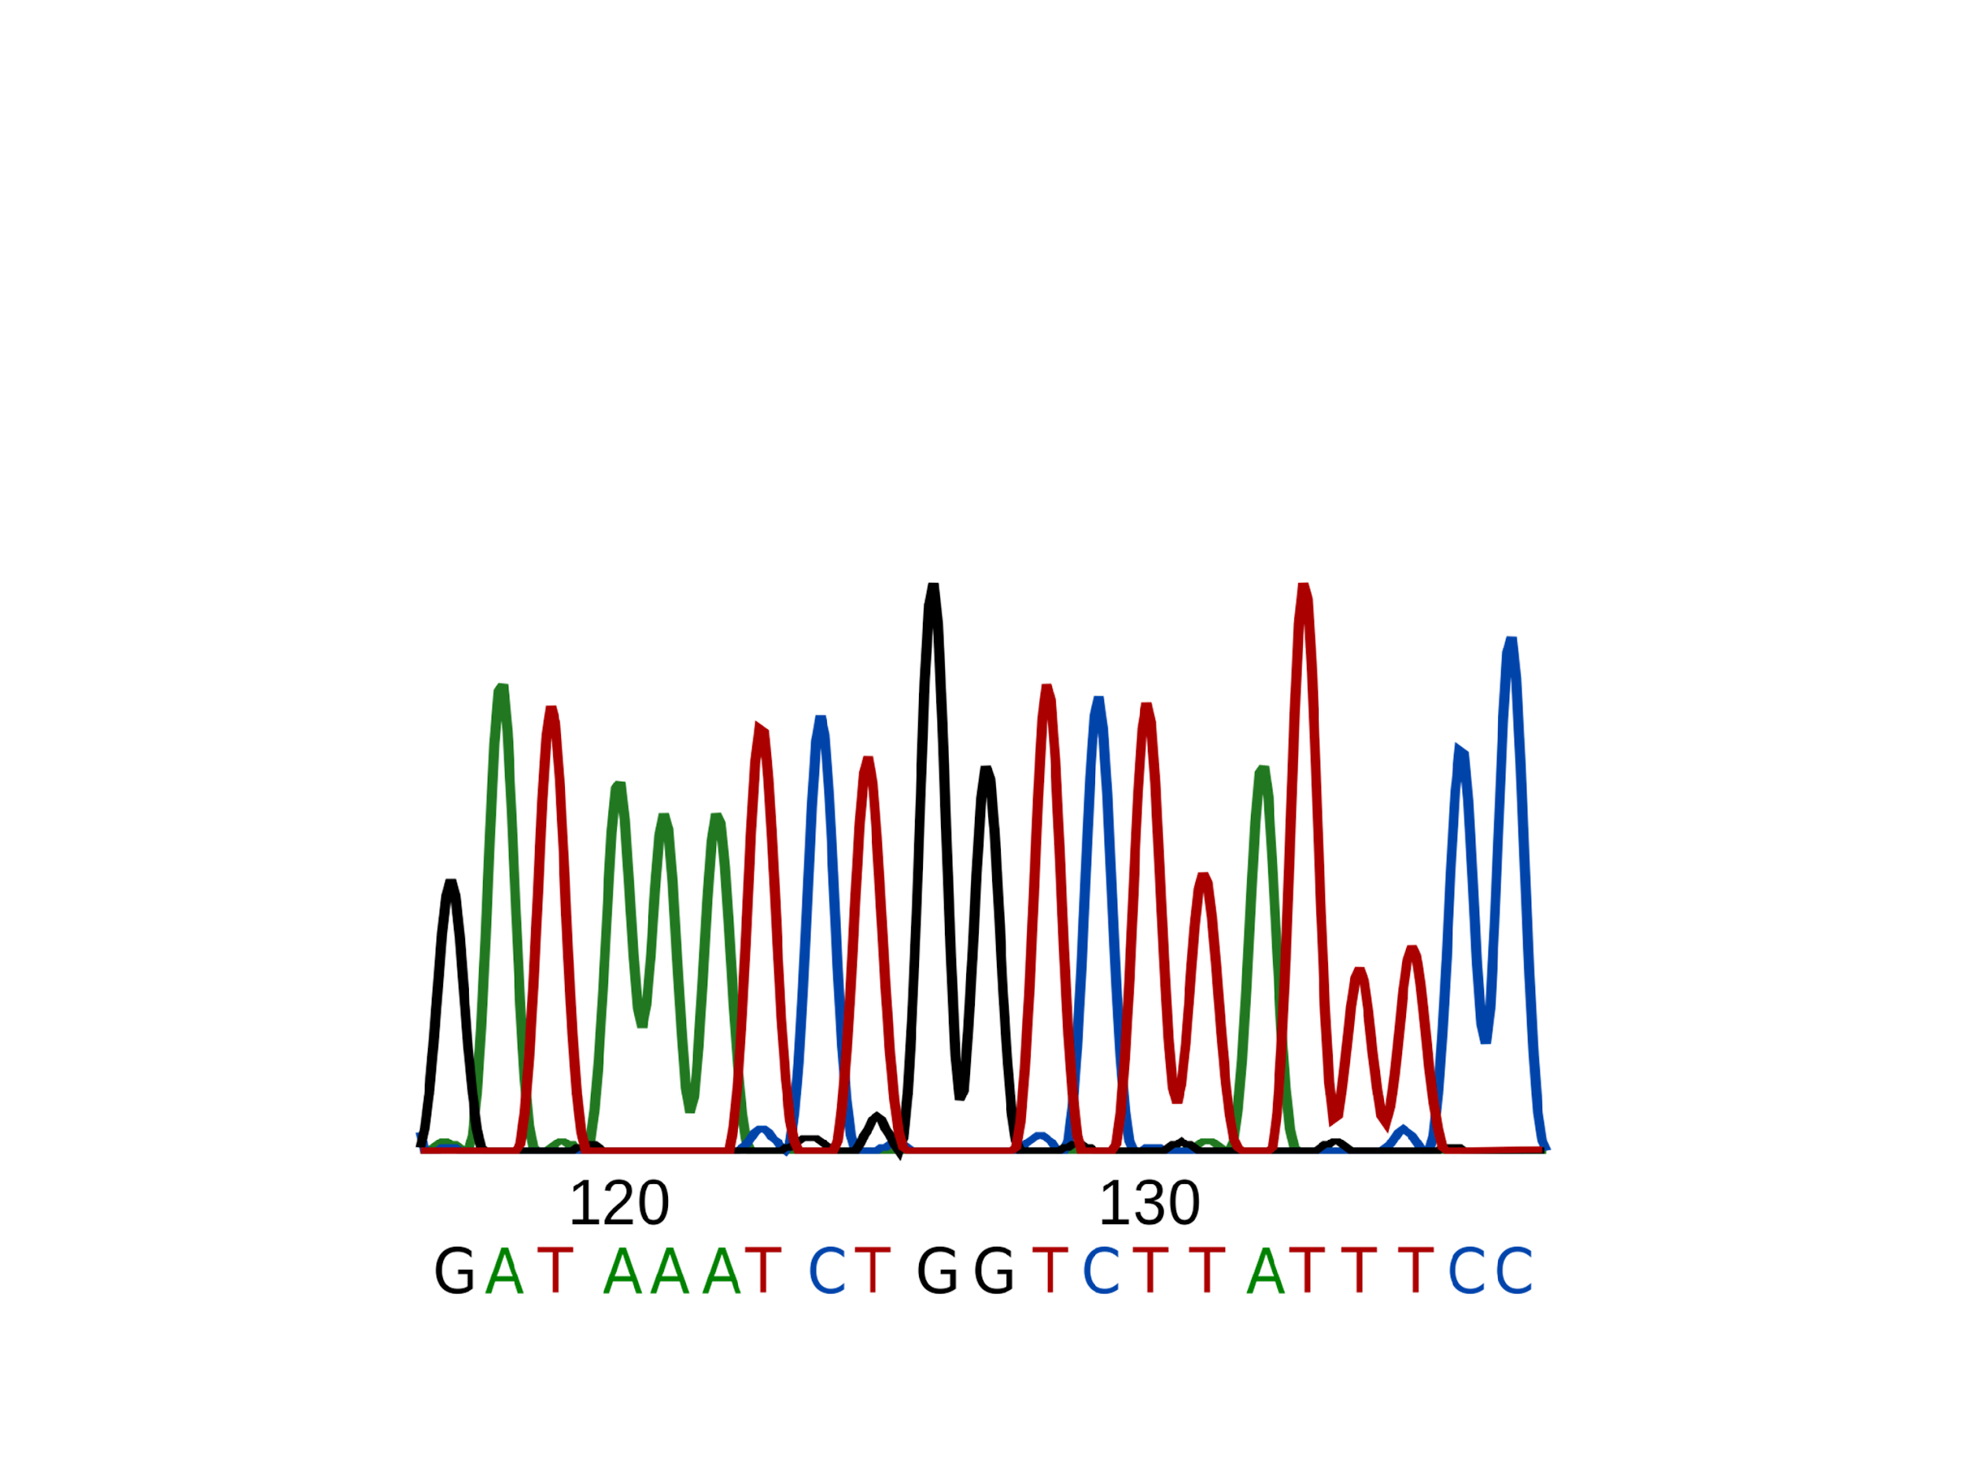
DNA Sequencing
DNA sequencing: the process of determining the order of nucleotides in DNA

