Slide 1
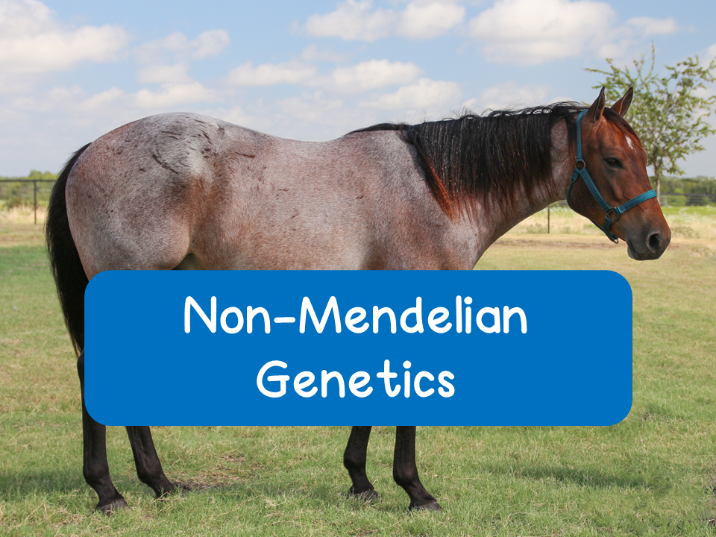
Notes:
Here are some helpful videos for non-mendelian genetics:
Amoeba Sisters: https://www.youtube.com/watch?v=YJHGfbW55l0
Bozeman: https://www.youtube.com/watch?v=YoEgUqHOcbc
Bozeman Chi-Square: https://www.youtube.com/watch?v=WXPBoFDqNVk

Slide 2
Non-Mendelian Genetics
Many traits do not follow the ratios predicted by Mendel’s laws. Why?
Varying degrees of dominance
Many traits are produced through multiple genes acting together
Some traits are determined by genes on the sex chromosomes
Some genes are adjacent or close to one another on the same chromosome and will segregate as a unit
Some traits are the result of non-nuclear inheritance (ie chloroplast and mitochondrial DNA)

Slide 3
Degrees of Dominance

Slide 4
Degrees of Dominance
Alleles can show varying degrees of dominance
In Mendel’s experiments, he worked with traits that showed complete dominance
  Homozygous dominant and heterozygous individuals are phenotypically the same
Incomplete dominance: neither allele is fully dominant
  F1 generation has a phenotype that is a mix of those of the parental generation
    Example: red flowers crossed with white flowers will produce pink offspring

Slide 5
Degrees of Dominance
Codominance: two alleles that affect phenotype are both expressed
  Example: human blood group
    Type AB blood: A and B are both expressed
Multiple Alleles: genes that exist in forms with more than two alleles
  Example: human blood group
    Alleles: I^{A}, I^{B}, i

Slide 6
Practice Problems
1. A black mouse (BB) is crossed with a white mouse (bb) and the resulting offspring are gray. What is the easiest explanation to explain this phenomenon?
Answer: incomplete dominance

Slide 7
Practice Problems
2. Cattle can be red (RR= all red hair), white (WW= all white hair), or roan (RW= red and white hair). What is the best explanation for this phenomenon?
Answer: Codominance
3. A red cow is crossed with a roan cow. What would the phenotypic ratio of the offspring be?
Cross: RR x RW
Answer:
1:1 red and roan
50% red
50% roan
 | R | R
R | RR | RR
W | RW | RW

Slide 8
Practice Problems
4. A woman with type A blood has a child with a man who has type B blood. With this limited information, what are possible genotypes for the woman? For the man?
Answer:
The woman could be either I^{A}I^{A} or I^{A}i
The man could be either I^{B}I^{B} or I^{B}i

Slide 9
Multiple Genes

Slide 10
Multiple Genes
In many cases, two or more genes are responsible in determining phenotypes.

Slide 11
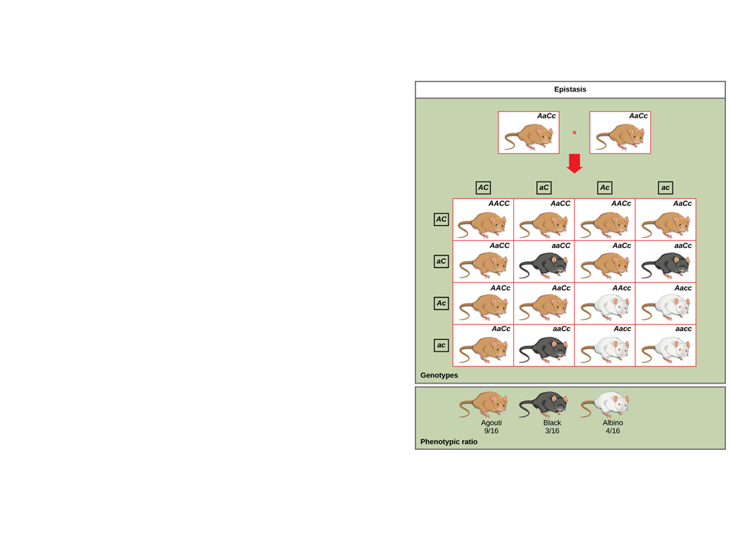
Multiple Genes
Epistasis: the phenotypic expression of a gene at one locus affects a gene at another locus
Example: coat color in labs and some mice
  One gene codes for pigment and a second gene determines whether or not that pigment will be deposited in the hair

Slide 12
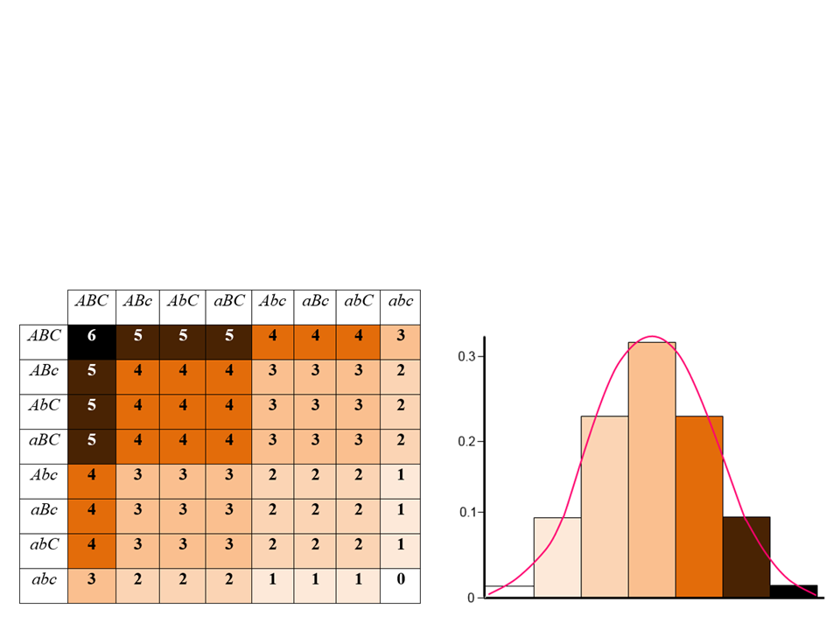
Multiple Genes
Polygenic inheritance: the effect of two or more genes acting on a single phenotype
  Example: height, human skin color

Slide 13
Sex Chromosomes

Slide 14
Sex-Linked Genes
Thomas Hunt Morgan experimented with fruit flies and determined that specific genes can be carried on sex chromosomes
Sex-linked gene: a gene located on either the X or the Y chromosome
  Y-linked genes: genes specifically found on the Y chromosome
    Very few Y-linked genes, so very few disorders
  X-linked genes: genes found on the X chromosome

Slide 15
Inheritance of X-Linked Genes
Fathers can pass X-linked alleles to all of their daughters, but none of their sons
Mothers can pass X-linked alleles to both daughters and sons
Affected father
Affected mother
N = normal
n = affected
X^{N}X^{N} x X^{n}Y
X^{N}X^{n} x X^{N}Y
 | X^{n} | Y
X^{N} | X^{N}X^{n} | X^{N}Y
X^{N} | X^{N}X^{n} | X^{N}Y
 | X^{N} | Y
X^{N} | X^{N}X^{N} | X^{N}Y
X^{n} | X^{N}X^{n} | X^{n}Y

Slide 16
Inheritance of X-Linked Genes
If an X-linked trait is due to a recessive allele:
  Females will only express trait if they are homozygous
  Because males only have one X chromosome, they will express the trait if they inherit it from their mother
    They are called hemizygous (since the term heterozygous does not apply)
    Due to this males are much more likely to have an X-linked disorder

Slide 17
X-Linked Disorders
Duchenne muscular dystrophy
  Progressive weakening of muscles
Hemophilia
  Inability to properly clot blood
Color blindness
  Inability to correctly see colors

Slide 18
X-Inactivation
Females inherit two X chromosomes, which is double than males!
During development, most of the X chromosome in each cell becomes inactive
  The inactive X in each cell of a female condenses into a Barr body
    Helps to regulate gene dosage in females

Slide 19
Linked Genes

Slide 20
Genetic Recombination
Genetic recombination: production of offspring with a new combination of genes from parents
Parental types: offspring with the parental phenotype
Recombinants: offspring with phenotypes that are different from the parents

Slide 21
Genetic Recombination
Mendel also observed recombinants during his crosses
Example: green wrinkled plant crossed with a yellow-round plant
  yyrr x YyRr
 | YR | yr | Yr | yR
yr | YyRr | yyrr | Yyrr | yyRr
50% Parental phenotypes
50% Recombinant phenotypes
50% recombination, however, indicates that genes are unlinked, or on different chromosomes

Slide 22
Linked Genes
Linked genes: genes located near each other on the same chromosome that tend to be inherited together
Meiosis and random fertilization generate genetic variation in offspring due to:
  Independent assortment of chromosomes
  Crossing over in Meiosis I
  Any sperm can fertilize any egg

Slide 23
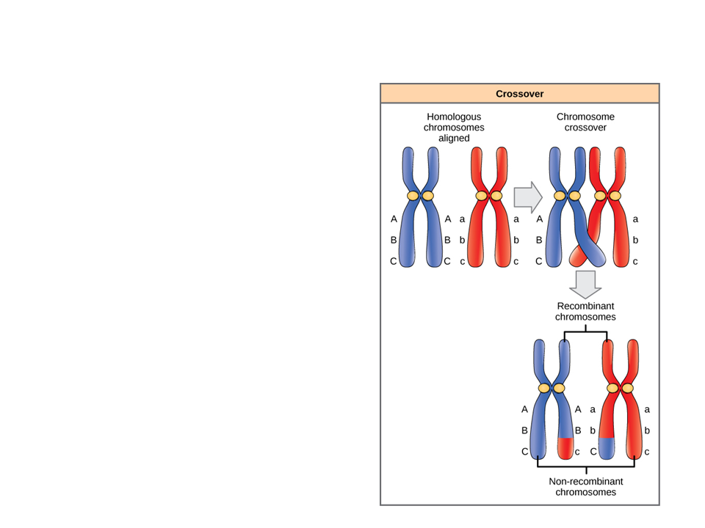
Linked Genes: Crossing Over
Linked genes show parental phenotypes in offspring at higher than 50%
During crossing over chromosomes from one paternal chromatid and one maternal chromatid exchange corresponding segments

Slide 24
Linked Genes: Crossing Over
Crossing over helps to explain why some linked genes become separated during meiosis
The further apart two genes are on the same chromosome, the higher the probability that a crossing over event will occur between them and the higher the recombination frequency

Slide 25
Mapping Distance
Experiments performed by Sturtevant, allowed scientists to map genes and their locations on chromosomes
Linkage map: genetic map that is based on recombination frequencies
  The distance between genes are map units
    One map unit is equivalent to a 1% recombination frequency
      Express the relative distances along chromosomes
      50% recombination means that the genes are far apart on the same chromosome or on two different chromosomes

Slide 26
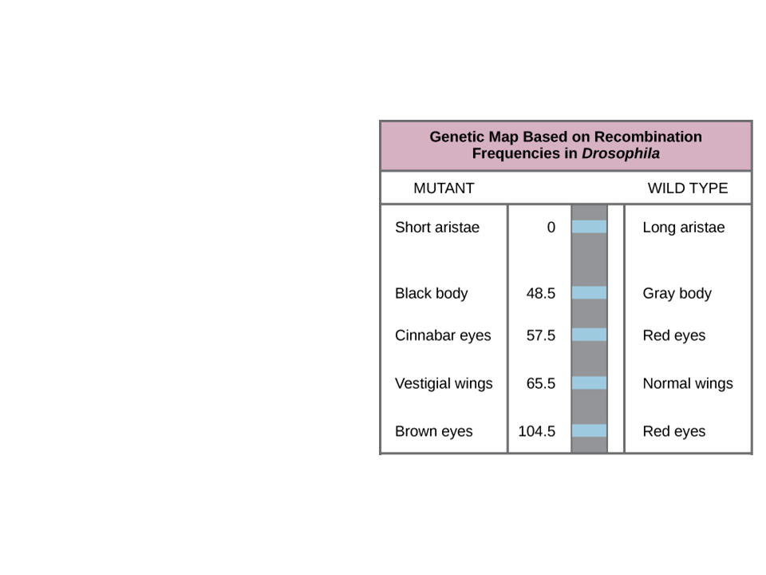
Mapping Distance
Numbers represent their distance from the “aristae” trait

Slide 27
Non-Nuclear DNA

Slide 28
Non-Nuclear DNA
Some traits are located on DNA found in the mitochondria or chloroplasts
Both chloroplasts and mitochondria are randomly assorted to gametes and daughter cells
  In animals, mitochondria are transmitted by the egg, NOT the sperm
    Therefore, ALL mitochondrial DNA is maternally inherited
  In plants, mitochondria and chloroplasts are transmitted in the ovule, NOT the pollen
    Therefore, both mitochondrial and chloroplast determined traits are maternally inherited

Slide 29
Statistical Analysis:
Chi Square

Slide 30
Goodness of Fit Test
Chi-square: a form of statistical analysis used to compare the actual results (observed) with the expected results
Helps to:
  Determine whether the data obtained experimentally provides a “good fit” to the expected data
  Determine if any deviations from the expected results are due to random chance alone or to other circumstances (ie data collection error)
Designed to analyze categorical data

Slide 31
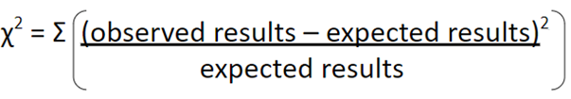
Chi Square (X²)
Use the equation to test the “null” hypothesis
  The prediction that data from the experiment will match the expected results
Formula:
Symbol means “sum”

Slide 32
Example
You are interested in examining the trait that allows people to roll their tongue.
Tongue rolling is dominant to non tongue rolling
You survey 100 people and you find:
  90 people were able to roll their tongue
  10 people could not roll their tongue
You also took genetic data from the parents of all 100 people
  The parental genotypes for all 100 people was Rr
Null: any difference between the observed and expected data is due to chance

Slide 33
Example: How to Solve
Step 1: Determine what your expected and observed values are.
  Observed (Actual) values: the numbers that you get in your data
    Usually no calculations
  Expected values: based on probability
    Need to do calculations
    In this example, you know that all parents are Rr for the trait. So, set up a Punnett square to determine the expected numbers of people who can and cannot roll their tongue
Notes:
Students should find that ¾ can roll their tongue (or 75 people out of the 100 surveyed) and ¼ cannot (25 people of the 100 surveyed)

Slide 34
Example: How to Solve
Step 2: Make a table
The table you make should always follow this general format:
 |  |  | Total
Observed- O
Expected- E
O-E
(O-E)²
(O-E)²/E

Slide 35
Example: How to Solve
Fill in the table with the trait you are looking at
Trait | Tongue Roller | Non Tongue Roller | Total
Observed- O
Expected- E
O-E
(O-E)²
(O-E)²/E

Slide 36
Example: How to Solve
Step 3: Plug in your data to the table and solve
Trait | Tongue Roller | Non Tongue Roller | Total
Observed--O
Expected--E
O-E
(O-E)²
(O-E)²/E

Slide 37
Example: How to Solve
If you performed the calculations correctly, your table should look like this:
Trait | Tongue Roller | Non Tongue Roller | Total
Observed--O | 90 | 10 | 100
Expected--E | 75 | 25 | 100
O-E | (90-75) = 15 | (10-25) = -15 | 0
(O-E)² | 225 | 225 | 450
(O-E)²/E | 225/75=3 | 225/25=9 | 12= X²
Notes:
Negative numbers in the chart are fine!

Slide 38
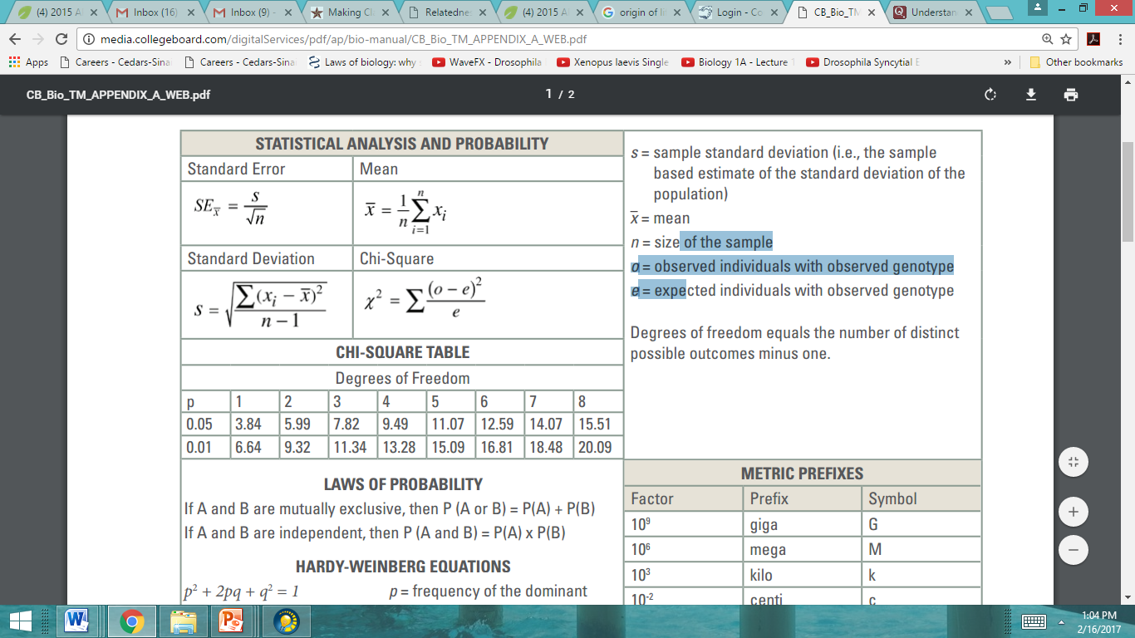
Example: How to Solve
Step 4: Determine the degrees of freedom for your experiment
  With X², you must determine the probability that the difference between the observed and expected values occurred simply by chance
  You need to compare your calculated value to the appropriate value in a “degrees of freedom” table

Slide 39
Example: How to Solve
Step 4 Continued:
  To calculate the degrees of freedom:
  Degrees of freedom = # of categories – 1
    For this problem, there are two categories (tongue rollers and non-tongue rollers)
      Degrees of freedom = 2 – 1
        Degrees of freedom = 1
Notes:
Since we determined the degrees of freedom for this experiment to be one, we only look at the column for 1

Slide 40
Example: How to Solve
P represents the confidence
0.05 means that you are 95% confident that your observed data fits your expected data extremely well
0.01 means that you are 99% confident that your observed data fits your expected data extremely well
As a general rule of thumb, you look at the p = 0.05 row, unless instructed otherwise

Slide 41
Example: How to Solve
These values are the critical values for the degrees of freedom

Slide 42
Example: How to Solve
Interpreting results and degrees of freedom chart:
If Χ² > critical value: there is a statistically significant difference between the actual and expected values.
  REJECT null hypothesis
If Χ² < critical value: there is NOT a statistically significant difference between the actual and expected values
  ACCEPT null hypothesis

Slide 43
Example: How to Solve
For this example, Χ² = 12
12 > 3.84
Therefore, there is a statistically significant difference between the observed and expected population
  What does this mean? Reject the null hypothesis
    Differences are not due to chance so there must be another explanation

Slide 44
Practice Problem
In peas, yellow seeds (A) are dominant over green (a) seeds. In a cross between two plants both heterozygous for seed color, the following was observed:
Yellow= 4400
Green= 1624
Does the data fit the predicted phenotypic ratio?

Slide 45
Practice Problem
Seed color (phenotype) | Green | Yellow | Total
Observed--O
Expected--E
O-E
(O-E)²
(O-E)²/E

Slide 46
Seed color (phenotype) | Green | Yellow | Total
Observed--O | 1624 | 4400 | 6024
Expected--E | 6024 (.25) = 1506 | 6024 (.75) = 4518 | 6024
O-E | 118 | -118 | 0
(O-E)² | 13924 | 13924 | 27848
(O-E)²/E | 3.08 | 9.24 | 12.32=x²
Data does not fit the expected phenotypes, we reject the null hypothesis, results are not due to chance

Slide 47
Environmental Effects on Phenotype

Slide 48
Environmental Factors
Various environmental factors can influence gene expression and lead to phenotypic plasticity
  Individuals with the same genotype exhibit different phenotypes in different environments
    Examples:
      Temperature can change coat color in rabbits and Siamese cats
      Soil pH can affect flower color
      UV exposure can increase melanin production in the skin

Slide 49
Chromosomal Inheritance and Disorders

Slide 50
Genetic Disorders
Some genetic disorders can be linked to affected or mutated alleles or chromosomal changes

Slide 51
Mutated Alleles
Tay-Sachs disease
  Autosomal recessive disease
    Mutated HEXA gene
      Body fails to produce an enzyme that breaks down a particular lipid
    Affects central nervous system and results in blindness
Sickle cell anemia
  Autosomal recessive disease
    Mutated HBB gene
      Sickled cells contain abnormal hemoglobin molecules

Slide 52
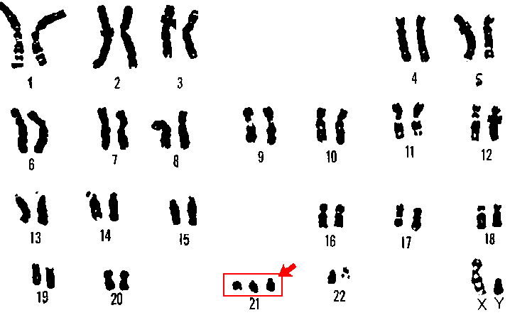
Chromosomal Changes
Nondisjunction: chromosomes fail to separate properly in meiosis I or meiosis II
    Karyotyping can detect nondisjunction
      Example: Down Syndrome
        Three copies of chromosome 21

