Slide 1
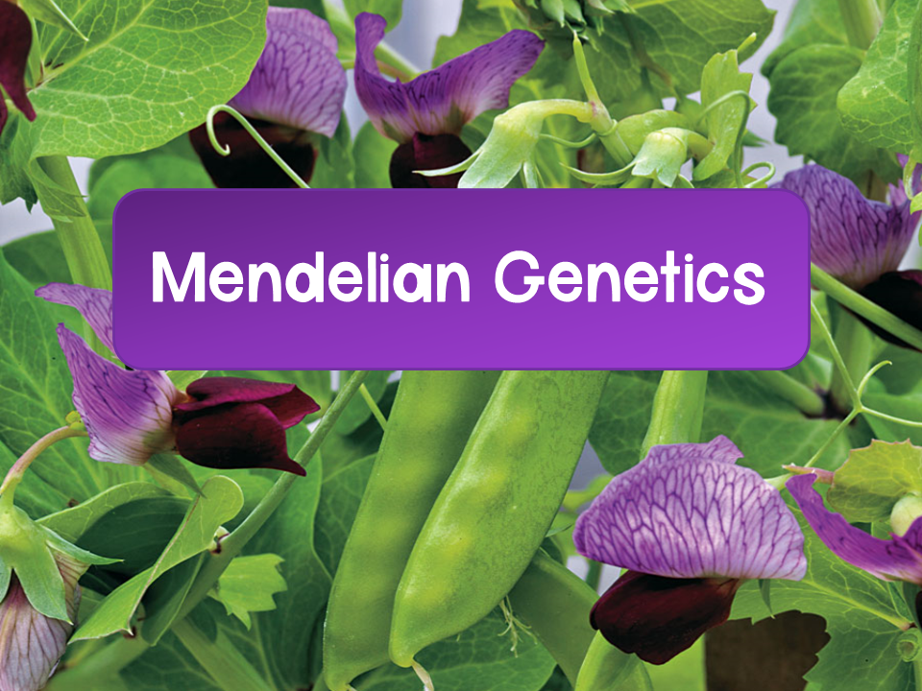
Notes:
Here are some helpful videos for mendelian genetics:
Professor Dave: https://www.youtube.com/watch?v=3f_eisNPpnc
Bozeman https://www.youtube.com/watch?v=NWqgZUnJdAY
Bozeman Probability https://www.youtube.com/watch?v=y4Ne9DXk_Jc

Slide 2
Common Ancestry
DNA and RNA carry genetic information
The genetic code is shared by all living systems
Gregor Mendel studied inheritance and created two laws that can be applied to the study of genetics

Slide 3
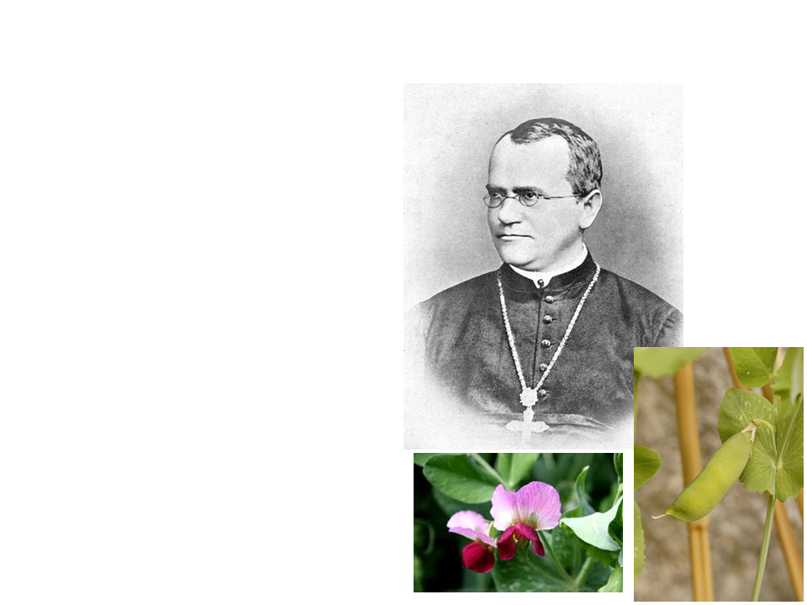
Gregor Mendel
Mendel was an Austrian monk who experimented on pea plants and discovered the basic principles of heredity
Why pea plants?
  Many varieties
  Controlled mating
  Relatively short generation time

Slide 4
Pea Plant Traits
Mendel only tracked characteristics that came in two distinct forms:
  Examples:
    Color (purple or white)
    Seed shape (round or wrinkled)
To help control his experiments, he used true breeding plants
  True breeding: organisms that produce offspring of the same variety over many generations of self pollination
    Example: true breeding purple pea plants will only produce purple offspring with self pollination

Slide 5
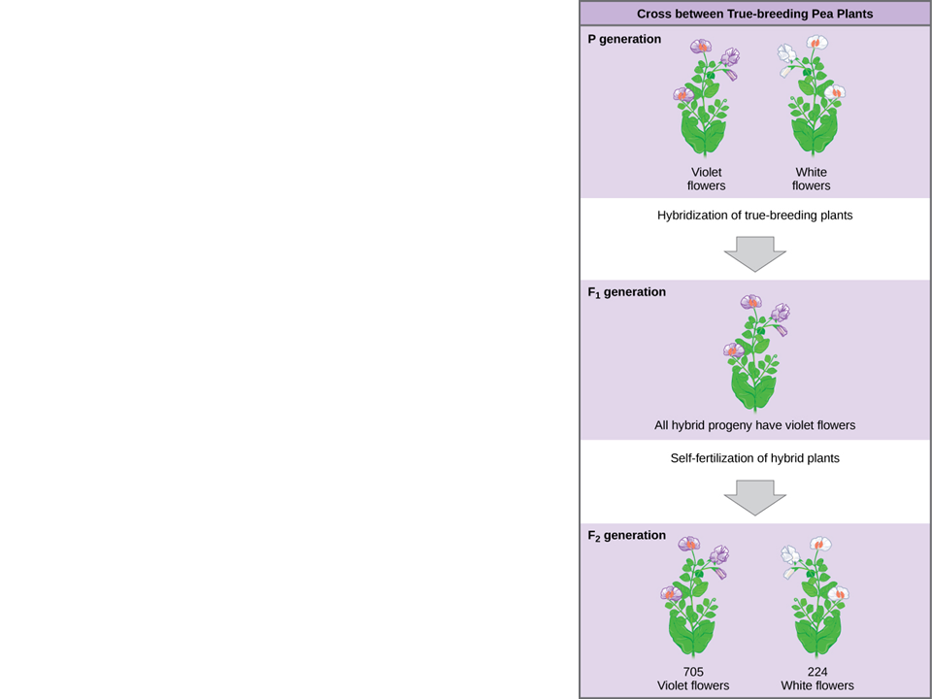
Generations
P generation: true-breeding parental generation
F₁ generation: (first filial) hybrid offspring of P generation
F₂ generation: (second filial) offspring of the F₁ generation
Notes:
Filial means “son” in Latin

Slide 6
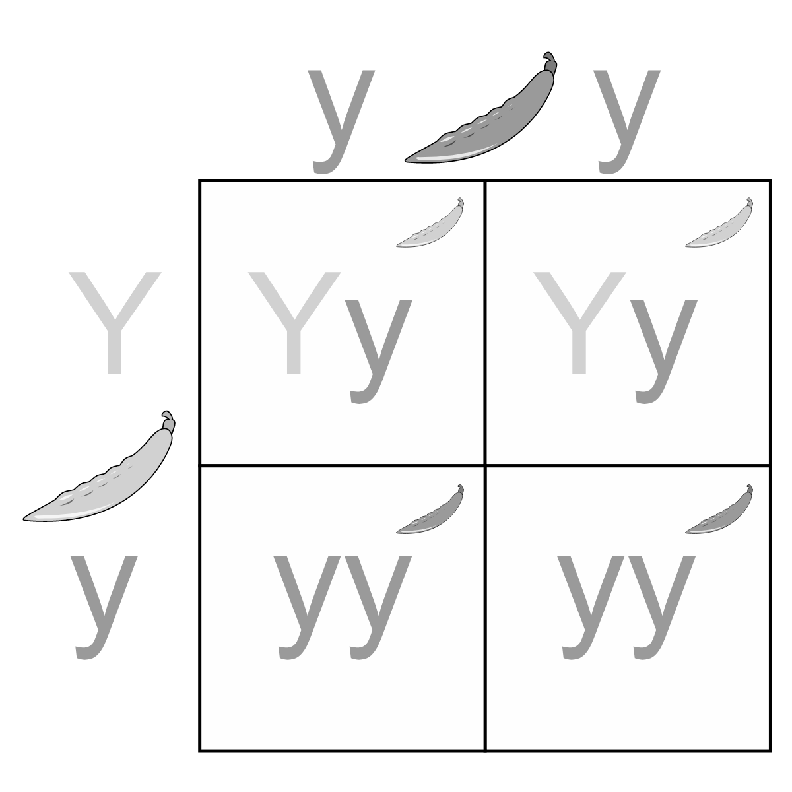
Punnett Squares
Punnett squares: diagrams used to predict the allele combinations of offspring from a cross with known genetic compositions
Note:
Capital letters denote dominant traits
Lower case letters denote recessive traits

Slide 7
Genetics Vocabulary
Homozygous: an organism that has a pair of identical alleles for a character
  Example:
    Homozygous dominant: AA
    Homozygous recessive: aa
Heterozygous: an organism has two different alleles for a gene
  Example: Aa
Genotype: the genetic makeup (alleles) of an organism
Phenotype: an organism’s appearance, which is determined by the genotype

Slide 8
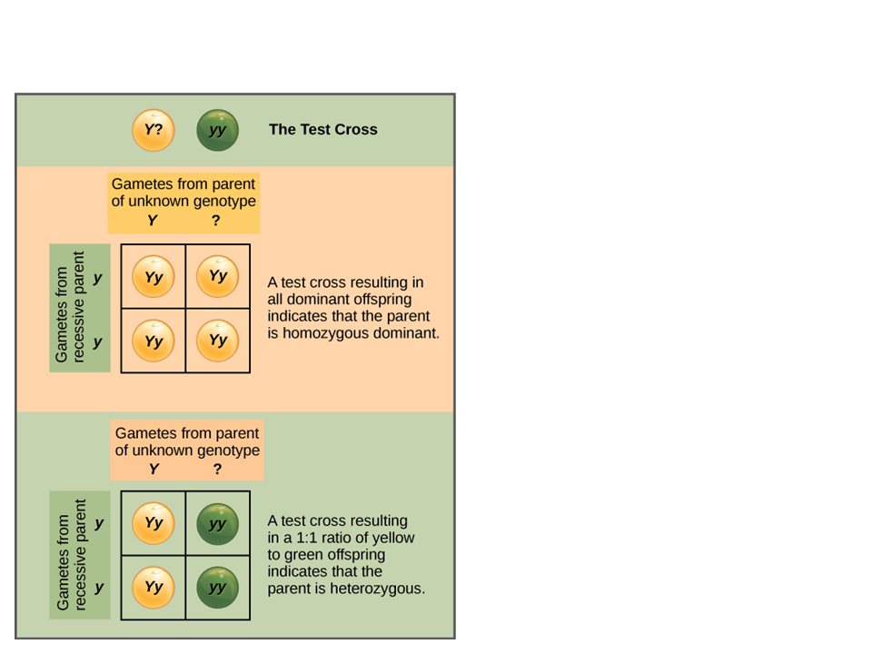
Testcross
Testcrosses help to determine if the dominant trait is homozygous dominant or heterozygous

Slide 9
Principles of Heredity
Mendel’s experiments allowed him to develop two fundamental principles of heredity:
The law of segregation
The law of independent assortment
These will be discussed in more depth as we go through his experiments

Slide 10
Discoveries
Mendel noticed that the cross between purple and white true breeding pea plants produced only purple F₁ offspring
  Did the white characteristic disappear?
    No, because the white pea flower characteristic came back in the F₂ generation
    How is this possible?

Slide 11
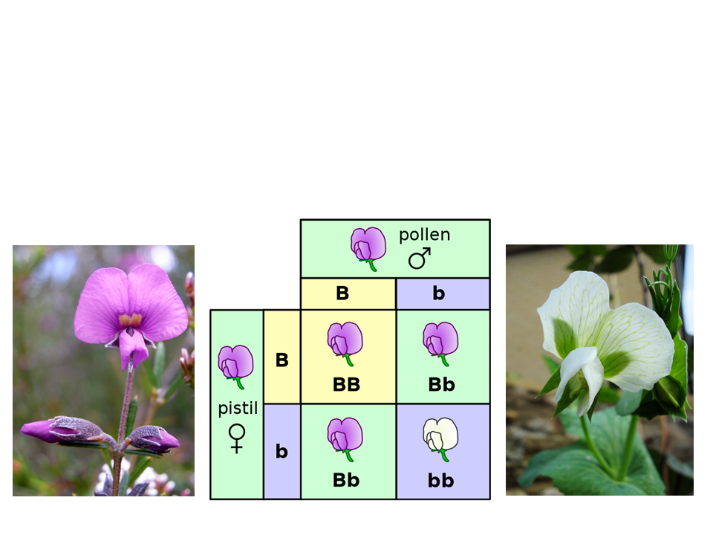
Dominant vs Recessive
Mendel hypothesized that the purple flower must be a dominant trait to the white flower, which is a recessive trait

Slide 12
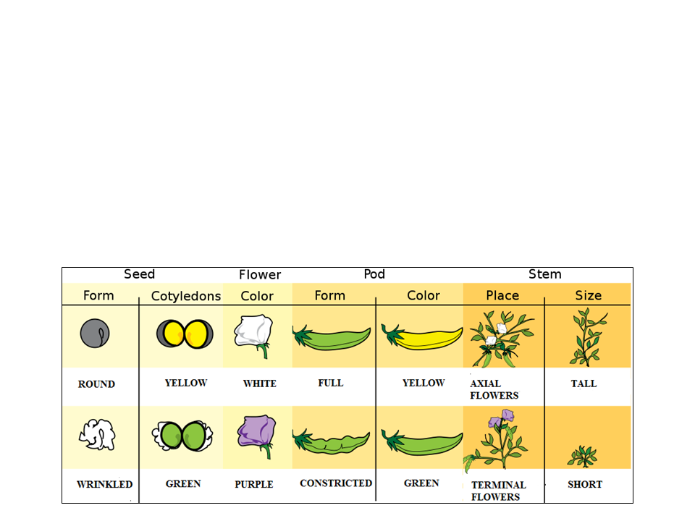
Dominant vs Recessive
Mendel performed the same crosses for each of the seven characteristics of pea plants and found the same results
  He found that the F₂ generation was always a 3:1 ratio

Slide 13
Mendel’s Model
To explain the 3:1 ratio he observed in the F₂ generation, Mendel created a model with four concepts:
Alternative versions of genes (alleles) account for variations in inherited characteristics
For each character, an organism inherits two copies (two alleles) of a gene, one from each parent.
If two alleles at a locus differ, then the dominant allele determines the appearance and the recessive allele has no noticeable effect
Law of segregation: the two alleles for the same trait separate during gamete formation and end up in different gametes

Slide 14
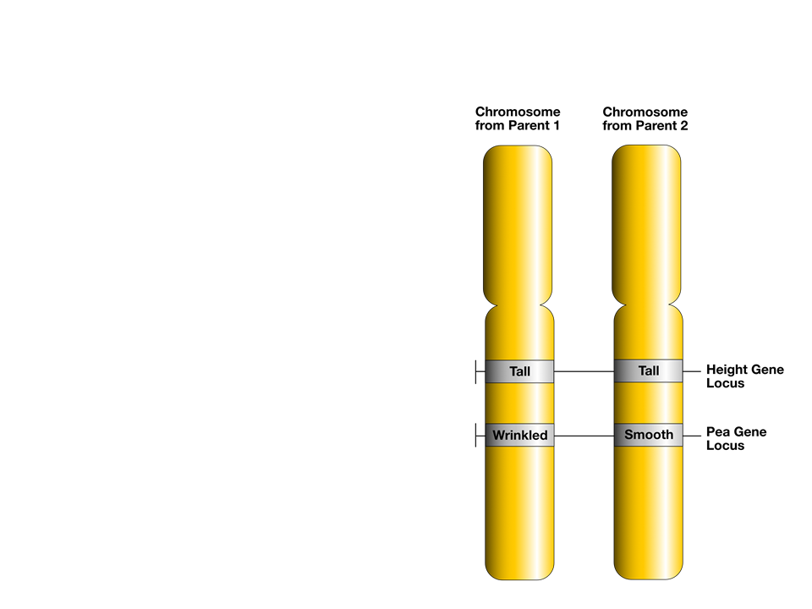
Alleles: A Closer Look
Somatic cells are diploid
  They contain two copies of each chromosome
  Alleles: alternative versions of a gene

Slide 15
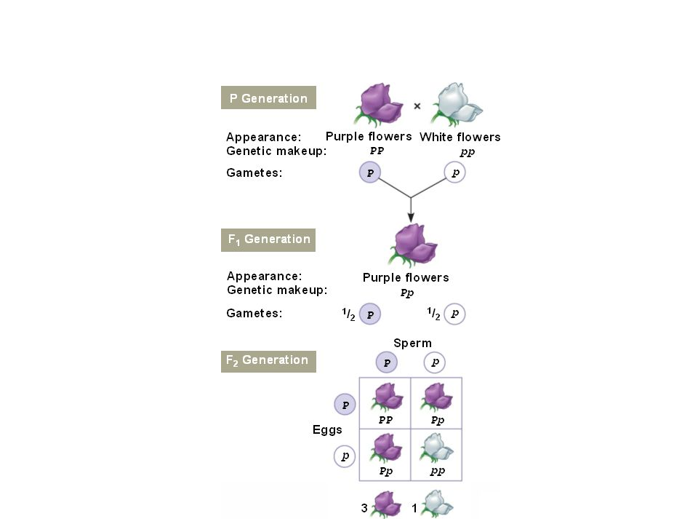
The Law of Segregation
Each gamete for P generation will contain one allele for flower color (in this case they are true breeding so every gamete has the same allele)
True-breeding plants will have two identical alleles
F1 generation are all hybrids: Pp
F2 generation:
Pp x Pp produces 3:1 ratio

Slide 16
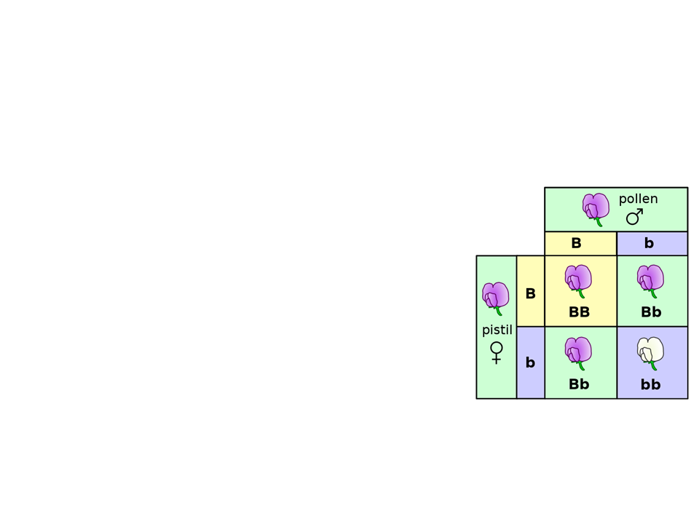
Monohybrid Crosses
The law of segregation was determined by doing crosses between true-breeding plants which produced F₁ hybrids, known as monohybrids
  Example: BB x bb produce F₁ that are all Bb
  Monohybrid crosses: a cross between the F₁ hybrids
    Bb x Bb

Slide 17
The Law of Independent Assortment
Mendel’s second principle is the law of independent assortment: genes for one trait are not inherited with genes of another trait
  Instead of following one trait in his crosses, this time Mendel followed two traits (i.e. pea pod color and pea pod shape)
This law only applies to: genes that are located on different chromosomes (not homologous) OR genes that are very far apart on the same chromosome

Slide 18
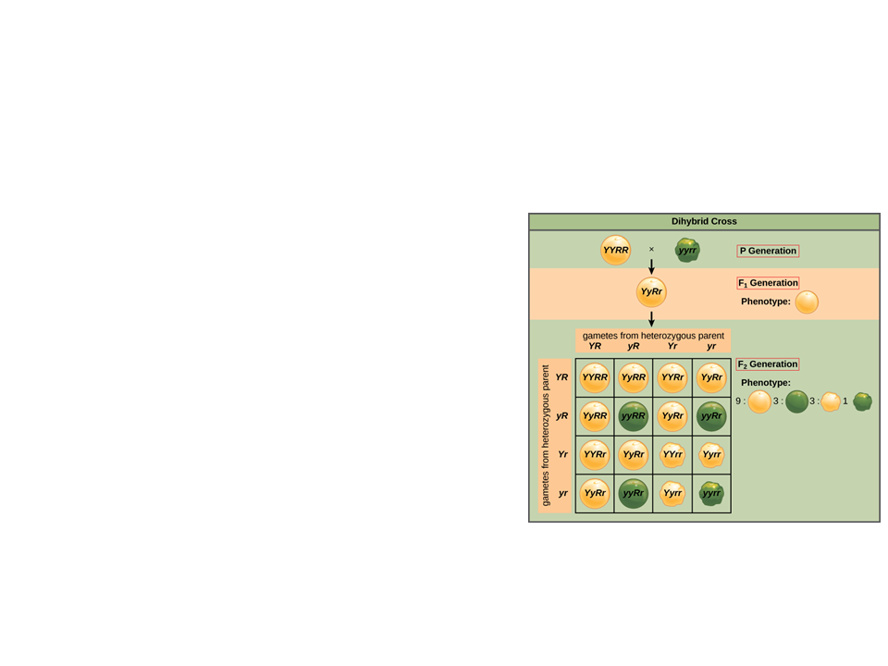
Dihybrid Crosses
The law of independent assortment was determined by doing crosses between plants that were true breeding for two traits, which produced F₁ hybrids known as dihybrids
Example: YYRR x yyrr
  All F₁ dihybrids would be YyRr
Dihybrid cross: a cross between F₁ dihybrids
  YyRr x YyRr
Produces a 9:3:3:1 phenotypic ratio

Slide 19
How to Solve Genetics Problems
Write down the symbols for the alleles (sometimes they are given to you)
Write down the genotypes given
  If phenotypes are given, then write down the possible genotypes
Determine what the problem is asking, and write out the cross as: [genotype] x [genotype]
Set up the Punnett square

Slide 20
Practice Problems
A tall plant (TT) is crossed with a short plant (tt). What percentage of the offspring will be tall?
How to solve:
1. Write out the symbols for the alleles:
T = tall, t = short
T
T
2. Write out the genotypes given:
TT, tt
t
Tt
Tt
t
Tt
Tt
3. Write out the cross:
TT x tt
Answer: 100% of the offspring will be tall
4. Set up the Punnett square

Slide 21
Practice Problems
2. Round seed shape is dominant to wrinkled seed shape. A plant that is heterozygous for the round seed shape is crossed with a plant that is homozygous for round seed shape. What percent of the offspring will be homozygous dominant?
R = round
r = wrinkled
R
r
R
RR
Rr
Answer: 50% of the offspring will be homozygous dominant
R
RR
Rr

Slide 22
Practice Problems
3. In cats, short hair is dominant to long hair. A true-breeding short haired cat is crossed with a cat that is heterozygous for the trait. What percentage of the offspring will have long hair?
H = short hair
h = long hair
H
h
H
HH
Hh
Answer: 0% of the offspring will have long hair
H
HH
Hh

Slide 23
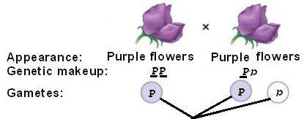
Practice Problems
4. Purple (P) is dominant to white (p) flowers. In a homozygous dominant purple plant, what gametes would be produced? What about in a plant that is heterozygous?
Answer: the homozygous dominant plants gametes would all be P. The heterozygous plants gametes would be P or p.

Slide 24
Practice Problems
5. In pea plants, purple flower color is dominant to white flower color, and round pods are dominant to wrinkled pods. If a true breeding purple flowered round pod plant is crossed with a true breeding white flowered wrinkled pod plant, what will the resulting F1 generation be? Hint: don’t do a punnett square
P = purple
p = white
R = round
r = wrinkled
Cross: PPRR x pprr
Gametes:
PR
pr
All offspring: PpRr

Slide 25
Practice Problems
6. In pea plants, purple flower color is dominant to white flower color, and round pods are dominant to wrinkled pods. If a plant that is heterozygous for both traits is self crossed, what will the phenotypic ratios of the F1 generation be?
P = purple
p = white
R = round
r = wrinkled
Cross: PpRr x PpRr
How do you find the gametes? FOIL
PpRr x PpRr
PR
Pr
pR
pr
x
PR
Pr
pR
pr

Slide 26
Practice Problems
Now set up the Punnett square with the gametes and perform the cross
Cross: PpRr x PpRr
P = purple
p = white
R = round
r = wrinkled
 | PR | Pr | pR | pr
PR
Pr
pR
pr

Slide 27
Practice Problems
Go through and determine the phenotypes
Cross: PpRr x PpRr
P = purple
p = white
R = round
r = wrinkled
 | PR | Pr | pR | pr
PR | PPRR | PPRr | PpRR | PpRr
Pr | PPRr | PPrr | PpRr | Pprr
pR | PpRR | PpRr | ppRR | ppRr
pr | PpRr | Pprr | ppRr | pprr
Purple/round: 9/16
Purple/wrinkled: 3/16
White/round: 3/16
White/wrinkled: 1/16
Phenotypic ratio 9:3:3:1

Slide 28
Laws of Probability
The laws of segregation and independent assortment reflect rules of probability
The multiplication rule: the probability that two or more independent events will occur together in some specific combination
Example: If you flip a coin twice, what is the probability that it will land heads up both times?
  ½ x ½ = ¼
Example: What is the probability of having 3 girls in a row?
  ½ x ½ x ½ = ⅛

Slide 29
Practice Problems
Tallness is dominant to dwarfism in pea plants. Plants that are heterozygous for height are crossed. What is the probability that the offspring will be homozygous dominant?
T = tall
t = dwarf
Cross:Tt x Tt
½ chance of inheriting T
½ chance of inheriting T
½ x ½ = ¼

Slide 30
Practice Problems
2. In a cross between AABBCc x AaBbCc what is the probability that the offspring will be AaBbcc?
The rule of multiplication allows you to not do a massive Punnett square! Instead, work through each letter at a time in the initial cross.
 | A | A
A | AA | AA
a | Aa | Aa
 | B | B
B | BB | BB
b | Bb | Bb
 | C | c
C | CC | Cc
c | Cc | cc
Aa: 1/2
Bb: 1/2
cc: 1/4
Probability of offspring being AaBbcc: ½ x ½ x ¼ = 1/16

Slide 31
Laws of Probability
The addition rule: the probability that two or more mutually exclusive events will occur
Example: what is the chance of rolling a dice and it lands on a 1 or 6?
  1/6 + 1/6 = 1/3

Slide 32
Practice Problems
1. In a cross between AABBCc x AaBbCc what is the probability that the offspring will be AaBbcc or AABBCC?
 | A | A
A | AA | AA
a | Aa | Aa
 | B | B
B | BB | BB
b | Bb | Bb
 | C | c
C | CC | Cc
c | Cc | cc
Option 1:
Aa: 1/2
x
Bb: 1/2
x
cc: 1/4
= 1/16
+
Option 2:
AA: 1/2
x
BB: 1/2
x
CC: 1/4
= 1/16
Probability of offspring being AaBbcc or AABBCC:
1/16 + 1/16 = 1/8

Slide 33
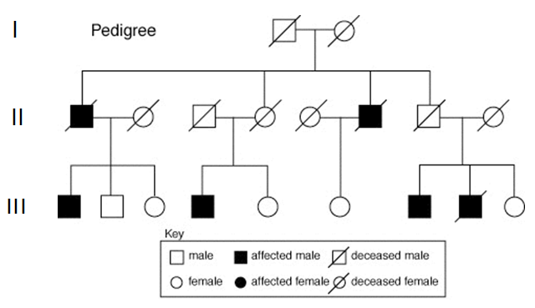
Pedigrees
Many human traits follow Mendelian patterns of genetics
Pedigrees: family trees that give a visual of inheritance patterns of particular traits

Slide 34
Reading Pedigrees
Horizontal line connects parents
Generation
Vertical line connects to children

Slide 35
Reading Pedigrees
If a trait is dominant, one parent must have the trait
  Dominant traits do not skip a generation
If a trait is X-linked, then males are more commonly affected than females

