Slide 1
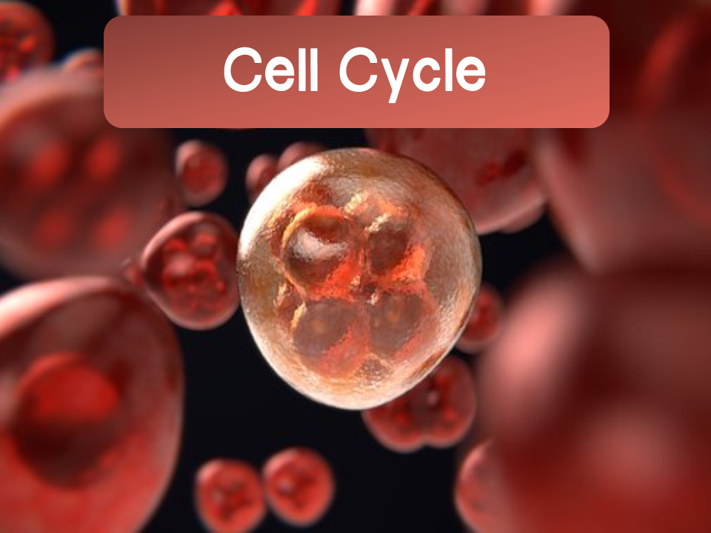
Notes:
Helpful videos:
Bozeman: Cell Cycle https://www.youtube.com/watch?v=1cVZBV9tD-A&t=38s
Amoeba Sisters: Cell Cycle and Cancer https://www.youtube.com/watch?v=QVCjdNxJreE

Slide 2
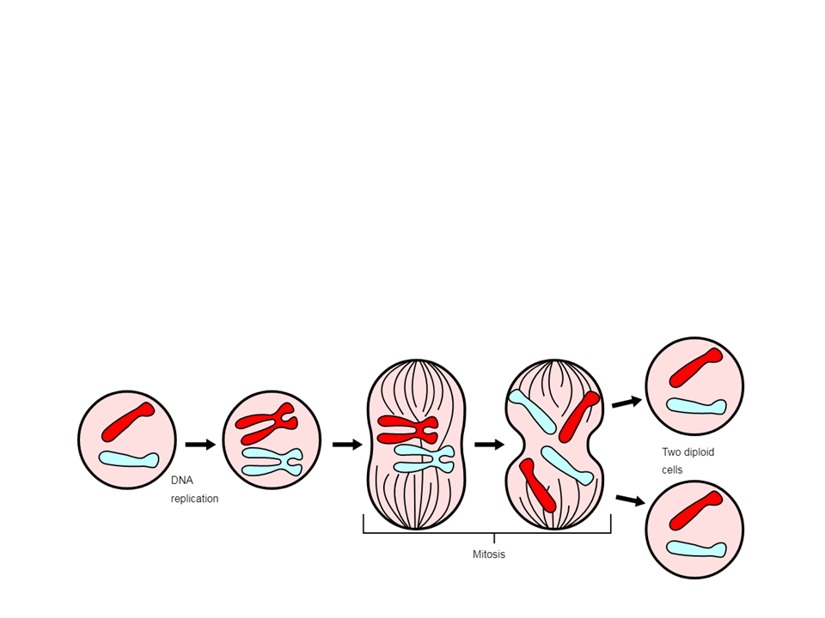
Cell Cycle
The cell division process is an integral part of life
  Allows for the reproduction of cells, growth of cells, and tissue repair
Cell cycle: the life of a cell from its formation until it divides

Slide 3
Organization of DNA
Cells must organize and package their DNA before division
DNA associates with and wraps around proteins known as histones to form nucleosomes
  Strings of nucleosomes form chromatin
    When a cell is not actively dividing, chromatin is in a non-condensed form
    After DNA replication, chromatin condenses to form a chromosome
      Chromosomes are densely packed to allow for easier division

Slide 4
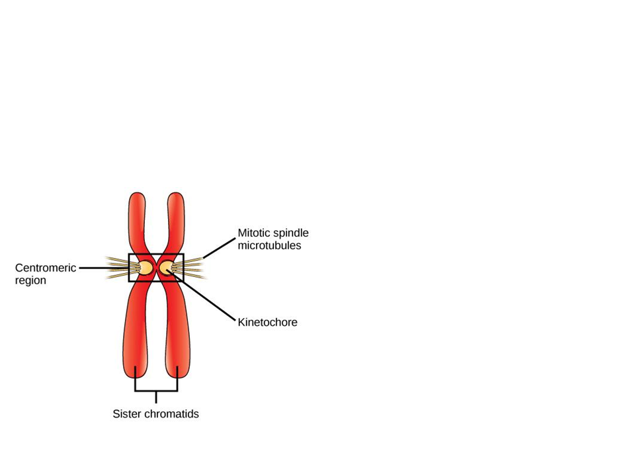
Organization of DNA
Since the DNA was replicated, each chromosome has a duplicated copy
      The copies join together to form sister chromatids
        Centromere: the region on each sister chromatid where they are most closely attached
        Kinetochore: proteins attached to the centromere that link each sister chromatid to the mitotic spindle

Slide 5
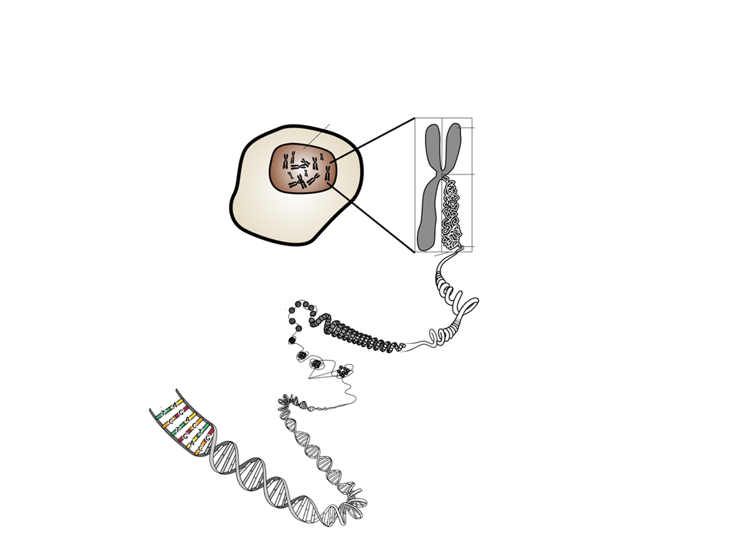
Organization of DNA
Nucleus
Sister chromatids
Chromosome
Nucleosomes
DNA (double helix)
Chromatin

Slide 6
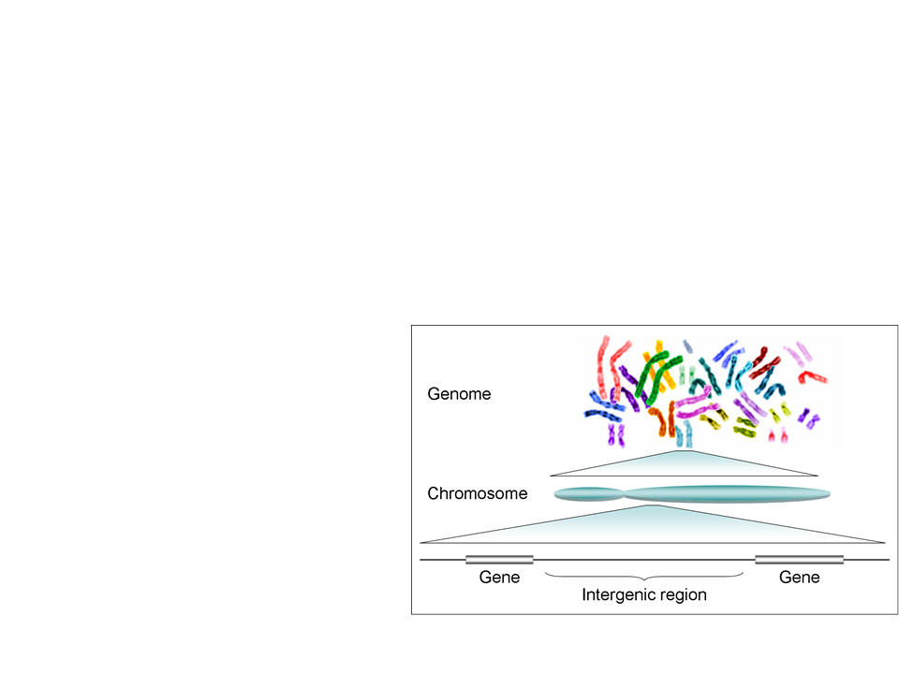
Genome
Genome: all of a cell’s genetic information (DNA)
Prokaryotes: singular, circular DNA
Eukaryotes: one or more linear chromosomes
  Every eukaryote has a specific number of chromosomes
    Humans: 46
    Chimps: 48
    Elephants: 56

Slide 7
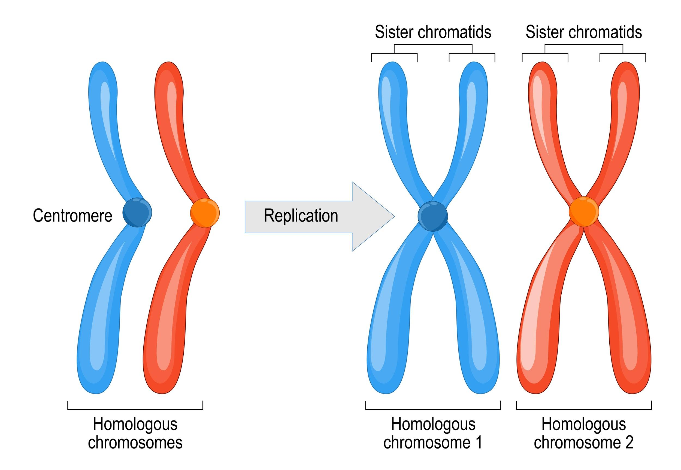
Genome
Homologous chromosomes: two chromosomes (one from mom and one from dad) that are the same length, have the same centromere position, and carry genes controlling the same characteristics

Slide 8
Practice FRQ
Biological structures tend to be composed of smaller units that assemble into more complex structures. Using eukaryotic chromosomes as an example, a) describe the smaller units and their assembly that leads to the larger, more complex structure of a chromosome. b) Identify one major function of chromosomes.
Notes:
Student responses should follow this general format: DNA→ wraps around histones-->nucleosomes--> forms chromatin--> condenses to form chromosomes
Any one of these would be acceptable: packages DNA, allows for cell division to occur more efficiently, contains genetic information, protects genetic information

Slide 9
Types of Cells
Somatic Cells
Gametes
Body cells
Diploid (2n): two sets of chromosomes, one set from each parent
Divide by mitosis
Humans: 2n=46
  23 from mom
  23 from dad
Reproductive cells (eggs/sperm)
Haploid (n): one set of chromosomes
Divide by meiosis
Humans: n=23
Note: This unit will focus on mitosis

Slide 10
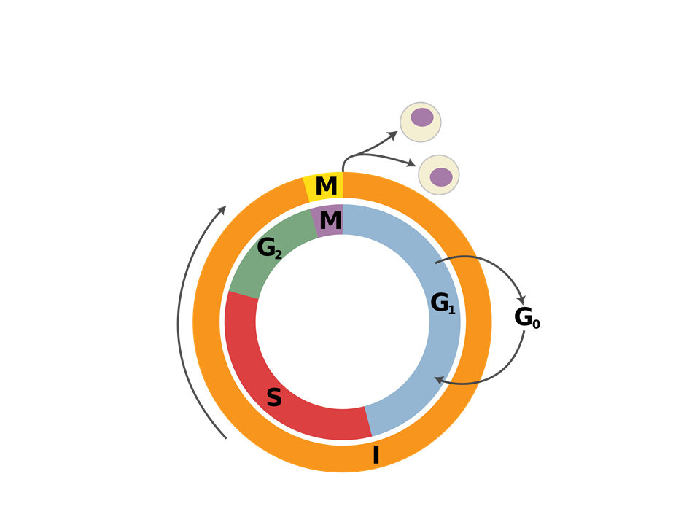
Cell Cycle

Slide 11
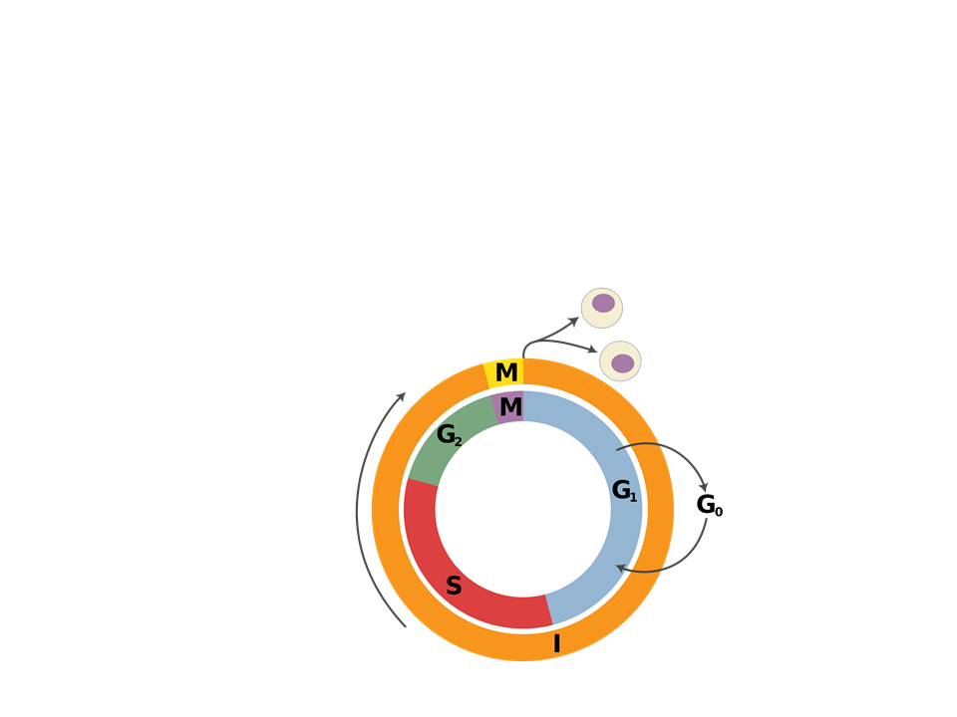
Cell Cycle
The cell cycle consists of alternating phases of interphase and mitosis
  G₁→ S→ G₂ → mitosis → cytokinesis
Interphase

Slide 12
Cell Cycle
Interphase
The longest portion of the cell cycle (90%)
  G1 “first gap” phase
    The cell grows and carries out normal functions
  S “synthesis” phase
    DNA replication and chromosome duplication occurs
  G2 “second gap” phase
    Final growth and preparation for mitosis
M Phase
Mitosis: nucleus divides
Cytokinesis: cytoplasm divides
Mitosis results in 2 identical diploid daughter cells

Slide 13
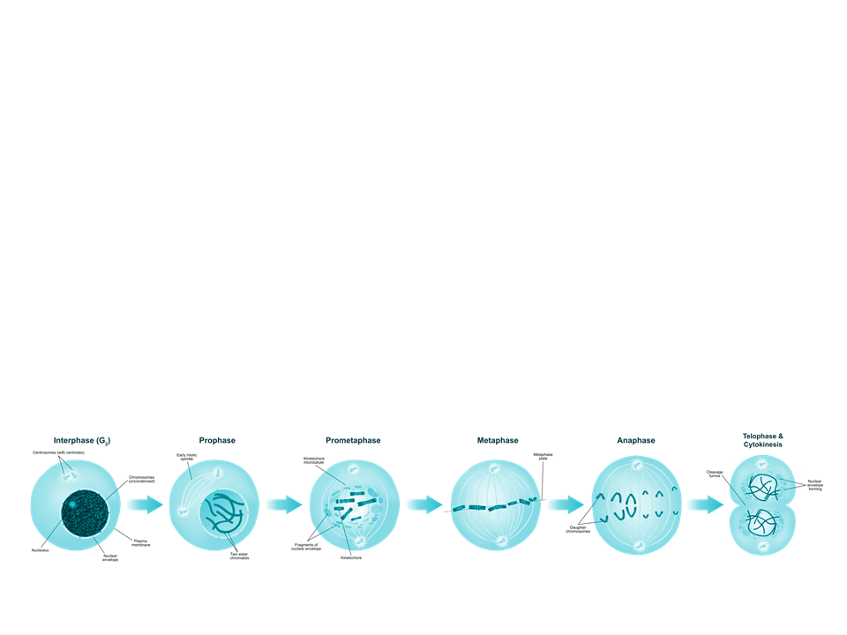
Phases of Mitosis
Mitosis is broken down into 5 stages:
Prophase
Prometaphase
Metaphase
Anaphase
Telophase and cytokinesis

Slide 14
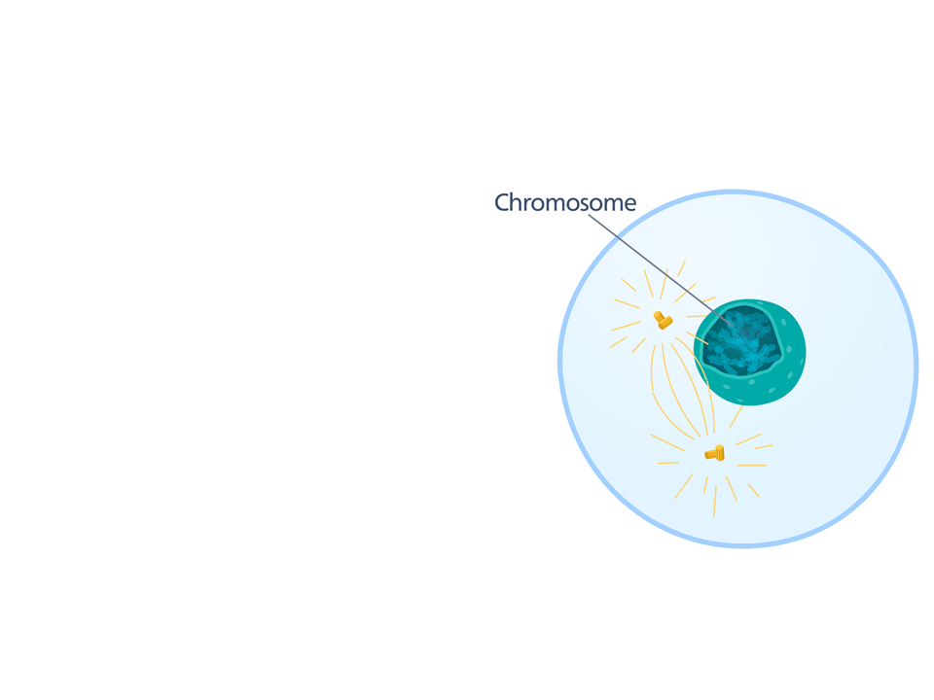
Prophase
Key events:
Chromatin condenses
Nucleoli disappear
Duplicated chromosomes appear as sister chromatids
Mitotic spindle begins to form
Centrosomes move away from each other

Slide 15
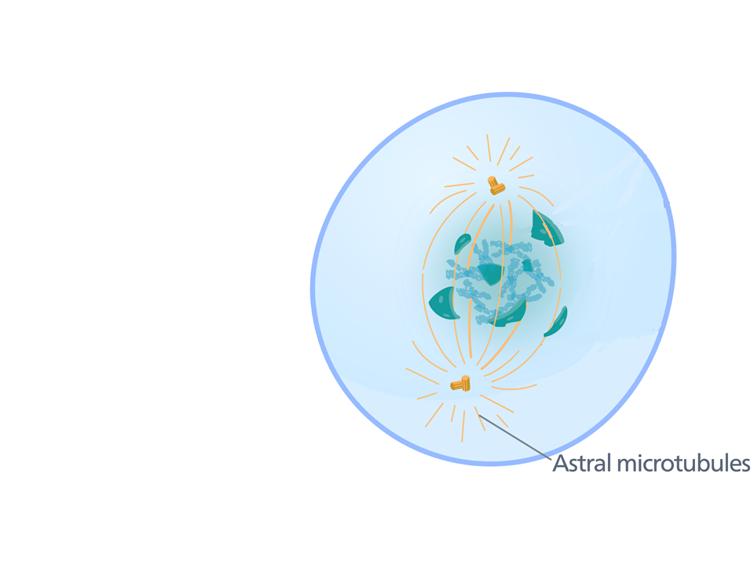
Prometaphase
Key events:
Nuclear envelope fragments
Microtubules enter nuclear area and some attach to kinetochores

Slide 16
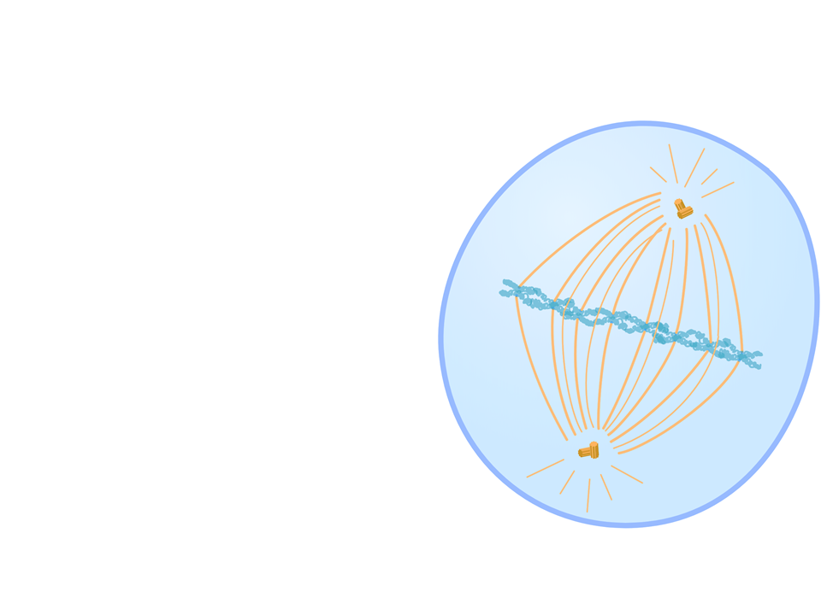
Metaphase
Key events:
Centrosomes are at opposite poles
Chromosomes line up at the metaphase plate
Microtubules are attached to each kinetochore

Slide 17
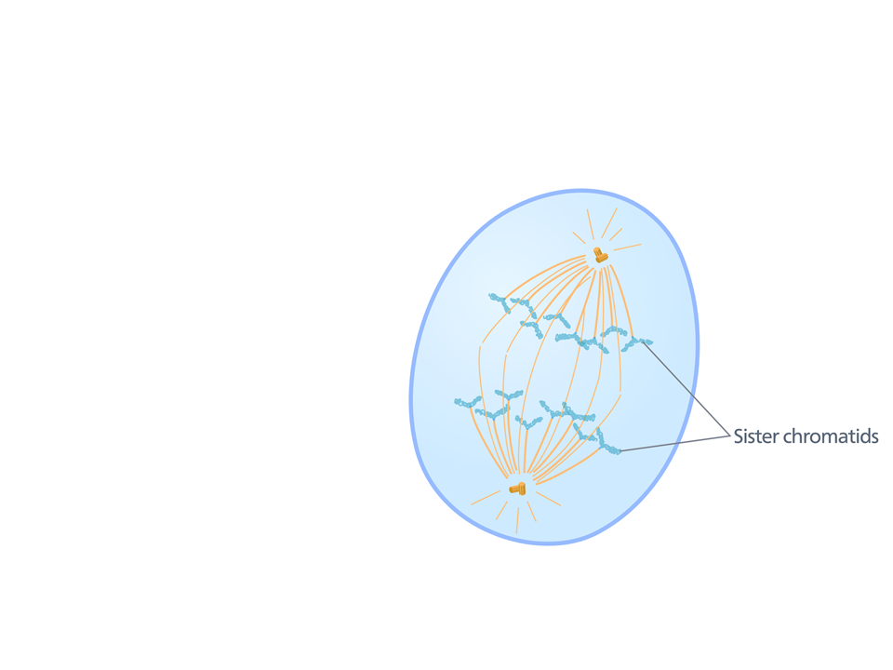
Anaphase
Key events:
Sister chromatids separate and move to opposite ends of the cell due to the microtubules shortening
Cell elongates

Slide 18
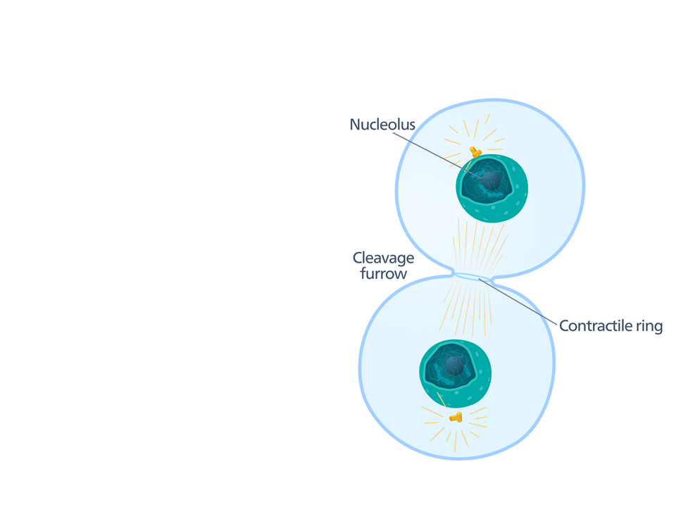
Telophase and Cytokinesis
Key events:
Two daughter nuclei form
Nucleoli reappear
Chromosomes become less condensed

Slide 19
Telophase and Cytokinesis
Cytokinesis occurs
  Animals: a cleavage furrow appears due to a contractile ring of actin filaments
  Plants: vesicles produced by the Golgi travel to the middle of the cell and form a cell plate

Slide 20
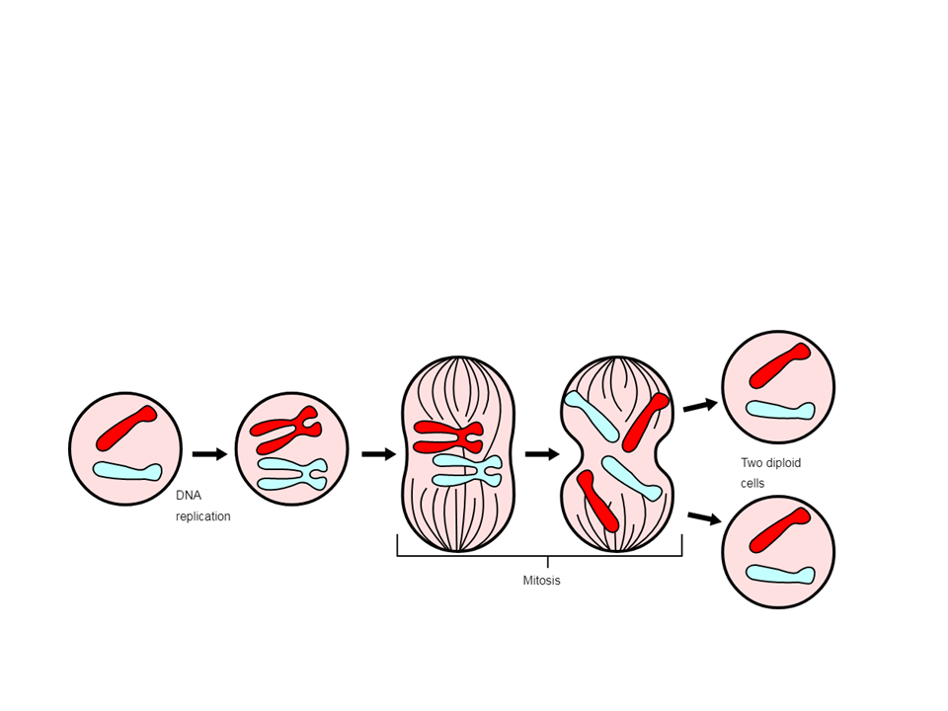
Tracking Chromosomes
Maternal chromosomes
Paternal chromosomes
2n=2 daughter cells
2 chromosomes
Parent cell 2n=2
2 chromosomes
After S phase
2 chromosomes
4 chromatids
Anaphase
4 chromosomes
Notes:
After S phase, the sister chromatids are considered to still be chromosomes because they are identical copies
During anaphase, the separated sister chromatids are now considered to each be their own chromosome

Slide 21
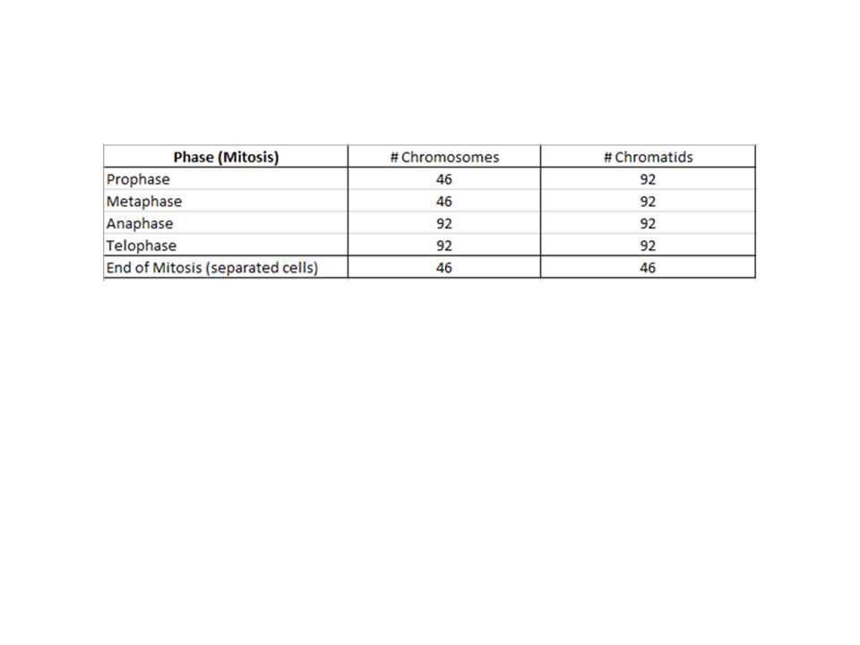
Human Cells: Tracking Chromosomes

Slide 22
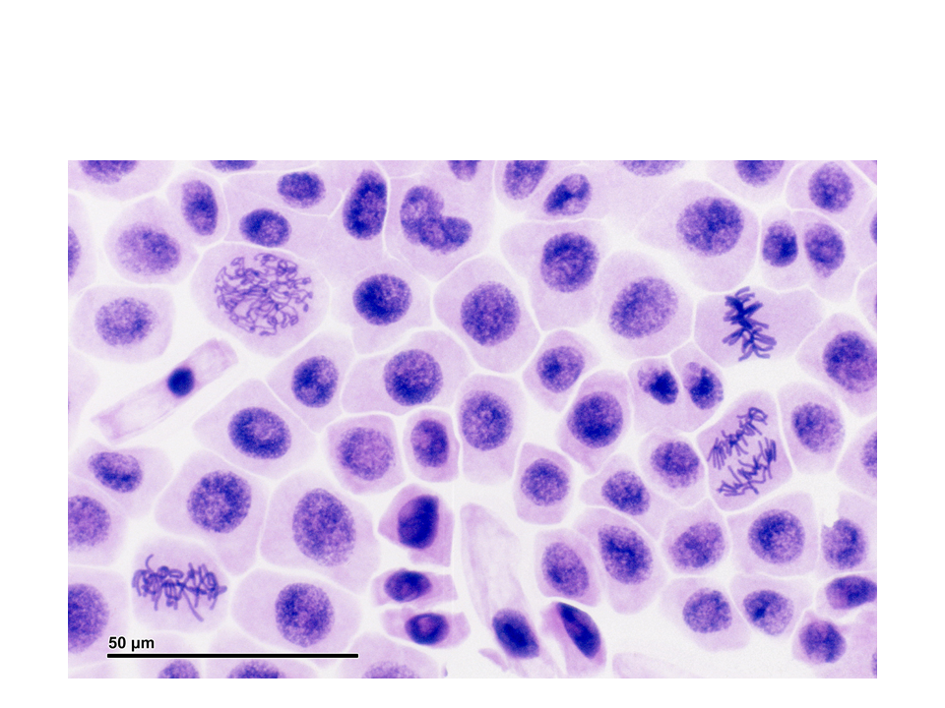
Can you identify stages of mitosis in the image below?
Notes:
I allow students a couple of minutes to talk to a partner and try to pinpoint various stages of mitosis

Slide 23
Practice Multiple Choice
Movement of the chromosomes during anaphase would be most affected by a drug that prevents
A) nuclear envelope breakdown.
B) cell wall formation
C) elongation of microtubules.
D) shortening of microtubules.
E) formation of a cleavage furrow

Slide 24
Practice Multiple Choice
Eukaryotic chromatin is composed of
condensed DNA only
DNA and RNA
DNA and carbohydrates
DNA and proteins
DNA and ribosomes

Slide 25
Practice Multiple Choice
If a sperm cell contains 12 chromosomes, it comes from an animal that has ______ chromosomes.
4
8
12
16
24

Slide 26
Practice FRQ
A cell has 50 chromosomes. After mitosis and cell division, you find that one daughter cell has 49 chromosomes and the other daughter cell has 51 chromosomes. Predict one way that this could have happened.
Notes:
Possible answers: microtubules failed to separate sister chromatids in anaphase, microtubules failed to attach to sister chromatids during prometaphase/metaphase.

Slide 27
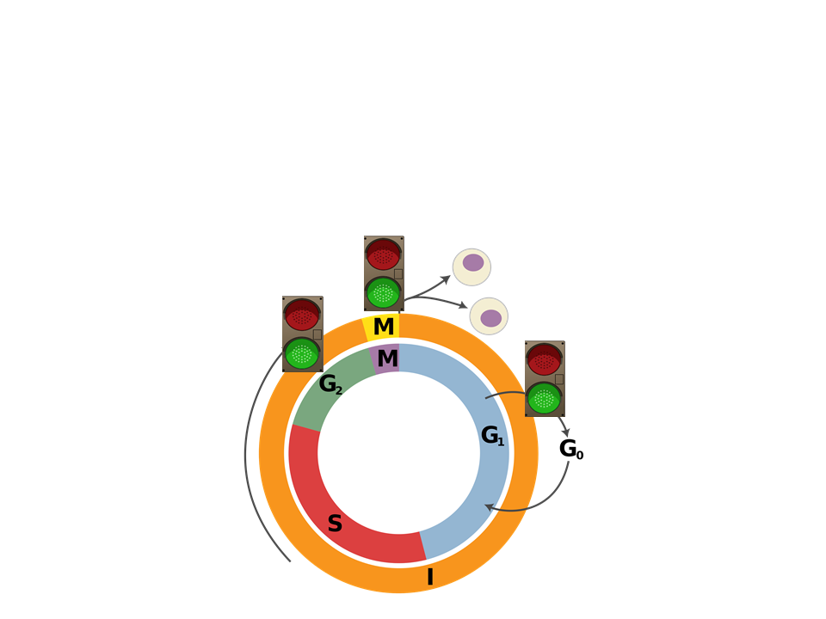
Regulation of the Cell Cycle
Throughout the cell cycle there are checkpoints
  Control points that regulate the cell cycle
    Cells receive stop/go signals

Slide 28
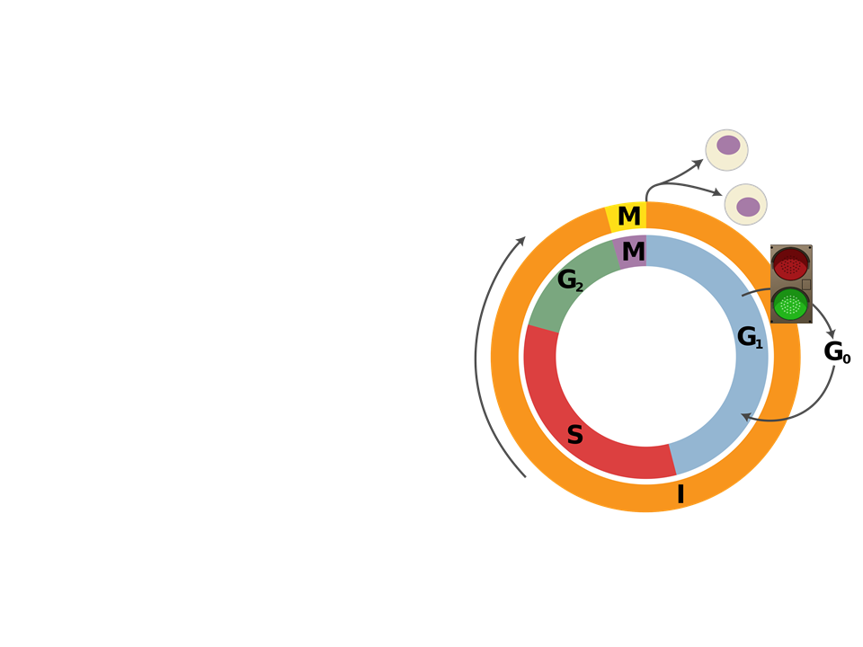
Major Checkpoints
G₁ Checkpoint
Most important checkpoint
Checks for cell size, growth factors, and DNA damage
Stop/Go signals
  “Go”- cell completes the whole cell cycle
  “Stop”- cell enters a nondividing (quiescent) state known as G₀ phase

Slide 29
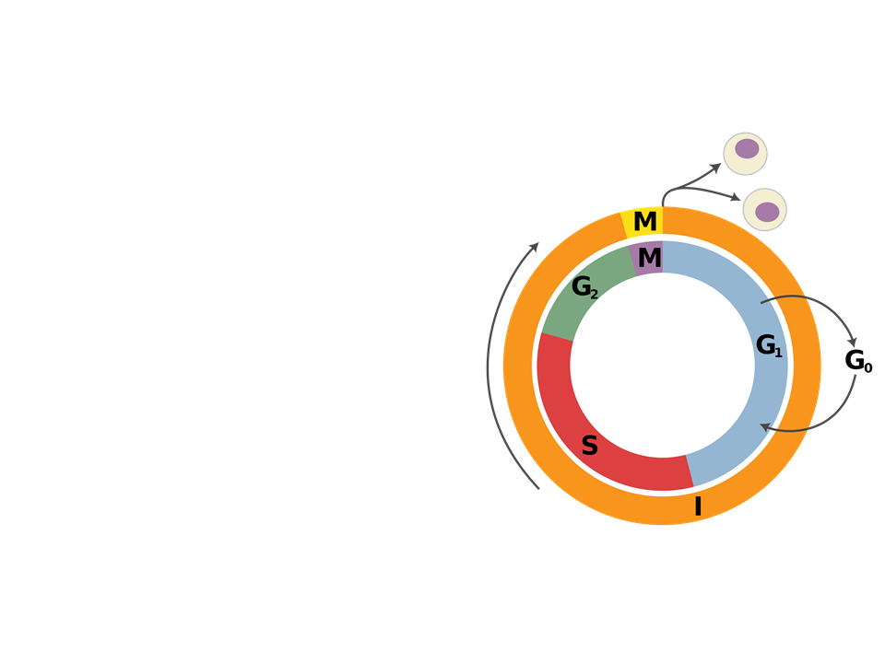
Major Checkpoints
G₀
Some cells stay in G₀ forever (muscle/nerve cells)
Some cells can be called back into the cell cycle

Slide 30
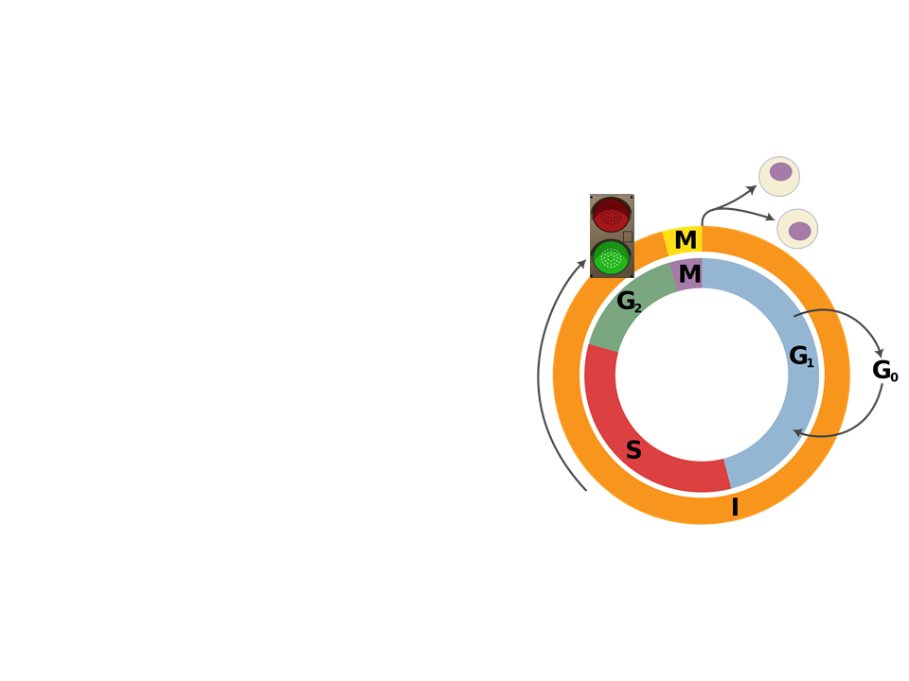
Major Checkpoints
G₂ Checkpoint
Checks for completion of DNA replication and DNA damage
“Go”--cell proceeds to mitosis
“Stop”-- cell cycle stops and the cell will attempt to repair damage
  If damage cannot be repaired the cell will undergo apoptosis
    Programmed cell death

Slide 31
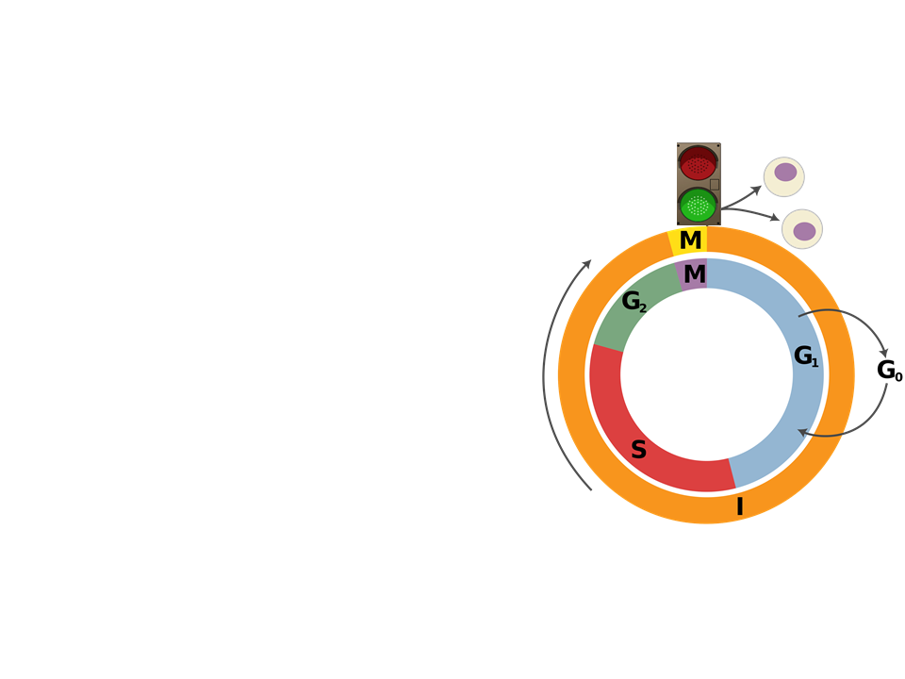
Major Checkpoints
M (Spindle) Checkpoint
Checks for microtubule attachment to chromosomes at the kinetochores at metaphase
“Go”--cell proceeds to anaphase and completes mitosis
“Stop”-- cell will pause mitosis to allow for spindles to finish attaching to chromosomes

Slide 32
Internal Cell Cycle Regulators
Regulation of the cell cycle involves an internal control system that consists of:
Proteins known as cyclins
  Concentration of cyclins varies
    Cyclins are synthesized and degraded at specific stages of the cell cycle
Enzymes known as cyclin-dependent kinases (CDKs)
  Concentration remains constant through each phase of the cell cycle
    Active only when its specific cyclin is present

Slide 33
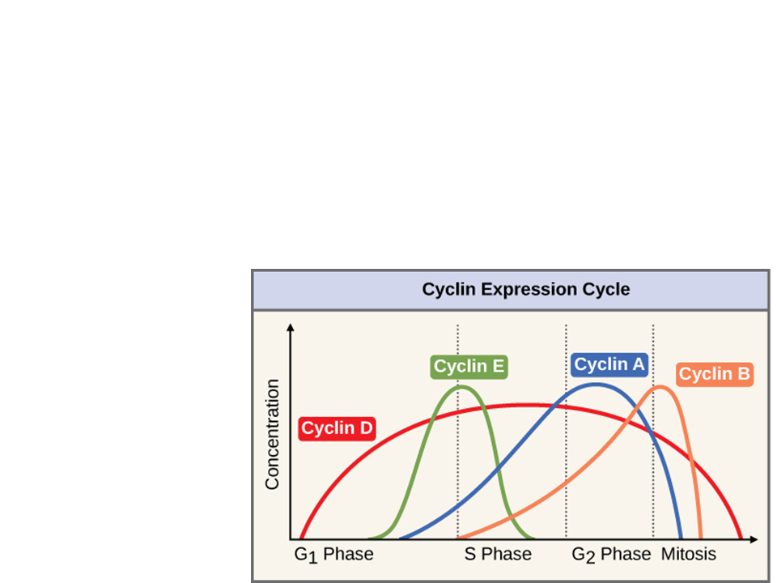
Internal Cell Cycle Regulators
Each cyclin-CDK complex has a specific regulatory effect
  Active CDK complexes phosphorylate target proteins, which help regulate key events in the cell cycle
Notice: varying levels of different cyclins in each stage

Slide 34
External Cell Cycle Regulators
Growth factors: hormones released by cells that stimulate cell growth
  Signal transduction pathway is initiated
    CDKs are activated leading to progression through the cell cycle
Contact (or density) inhibition: Cell surface receptors recognize contact with other cells
  Initiates signal transduction pathway that stops the cell cycle in G₁ phase
Anchorage dependence: cells rely on attachment to other cells or the extracellular matrix to divide

Slide 35
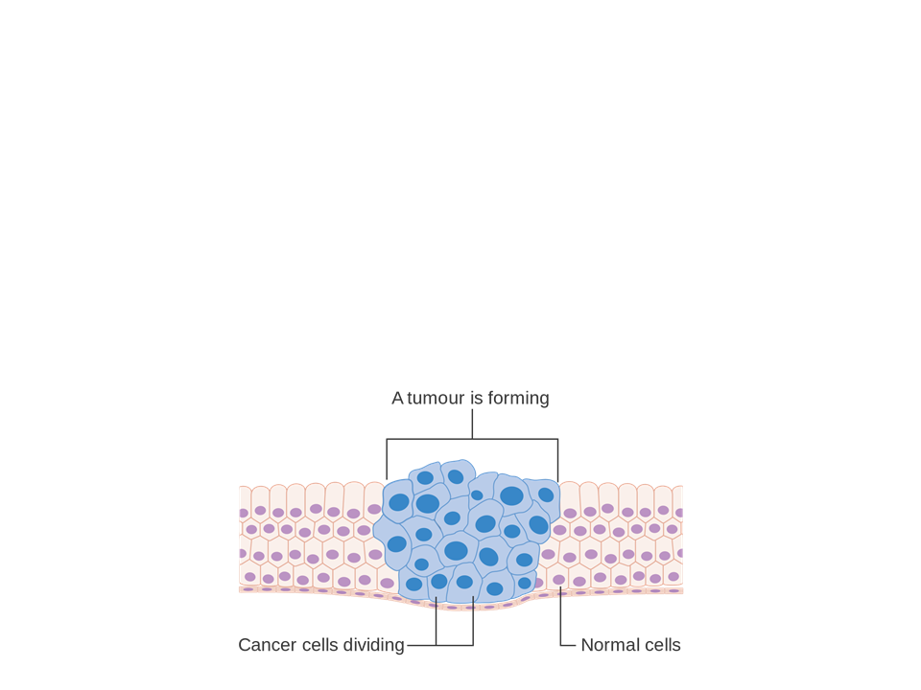
Cancer: Evasion of the Cell Cycle
Normal cells become cancerous through DNA mutations
  DNA mutations: changes in the DNA
    Cancer cells on average have accumulated 60 or more mutations on genes that regulate cell growth

Slide 36
Normal Cells vs Cancer Cells
Normal Cells
Cancer Cells
Follow checkpoints
Divide on average 20-50 times in culture (in petri dishes)
Go through apoptosis when there are significant errors
Do not follow checkpoints
Divide infinitely when in culture
  Considered to be “immortal”
Evade apoptosis and continue dividing even with errors

Slide 37
Cancer Cells
The uncontrollable growth of cancer cells can lead to a tumor
  A mass of tissue formed by abnormal cells
    Benign tumor: cells are abnormal, but not considered to be cancerous (yet)
      Cells remain at only the tumor site and are unable to spread elsewhere in the body
    Malignant tumor: mass of cancerous cells that lose their anchorage dependency and can leave the tumor site
      Metastasis: when cells separate from the tumor and spread elsewhere in the body

Slide 38
Cancer Prevention
Unfortunately, cancer can affect anyone. However, there are various things that you can do that will minimize your risk of developing cancer:
  Do not smoke (cigarettes, vape products)
    Nicotine causes mutations in cells at high rates
  Eat healthy and drink water
    Fatty foods and dehydration can affect the functions of cells
  Protect your skin from the sun by using SPF
    Sun is damaging to skin cells and can cause mutations to occur after exposure
If possible, ask your family about any history of cancer and receive regular cancer screenings

Slide 39
Practice FRQ
Vinblastine is a chemotherapeutic drug often administered to patients suffering from Hodgkin’s lymphoma, lung cancer, and bladder cancer. Vinblastine works by entering cancer cells and binding to tubulin, which is a protein that forms microtubules. Once Vinblastine has bound to tubulin, it inhibits the assembly of microtubules and proper formation of the mitotic spindle. This causes the cell cycle to arrest. a) Identify and explain two phases of the cell cycle most affected by Vinblastine. b) Identify the checkpoint that is most likely responsible for arresting the cell cycle.
Notes:
a)Metaphase: microtubule attachment to the kinetochore would not happen
Anaphase: since microtubule attachment did not occur, the sister chromatids would not separate
b) M (spindle) checkpoint

