Slide 1
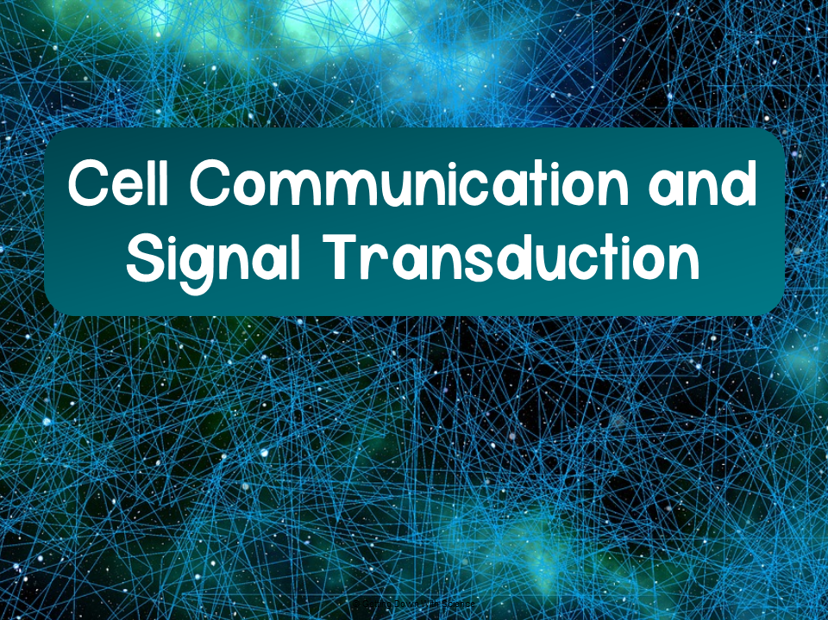
Notes:
Helpful videos:
Khan Academy: Cell Signaling https://www.youtube.com/watch?v=FQFBygnIONU
Bozeman: Cell Signaling https://www.youtube.com/watch?v=qOVkedxDqQo&t=224s

Slide 2

Cell Communication
Cell-to-cell communication is critical for the function and survival of cells
Responsible for the growth and development of multicellular organisms

Slide 3
How Do Cells Communicate?
Cells communicate through three general ways
Direct Contact
Local Signaling
Long-distance signaling

Slide 4
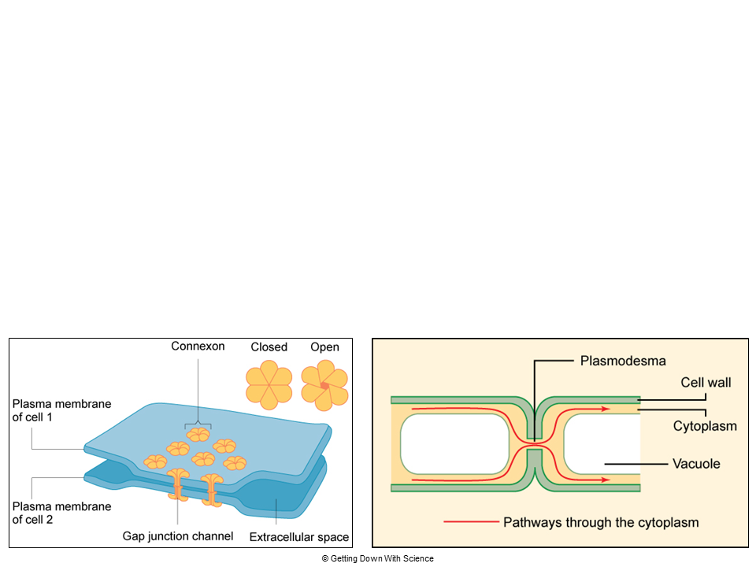
Direct Contact
Direct contact: communication through cell junctions
  Signaling substances and other material dissolved in the cytoplasm can pass freely between adjacent cells
    Animal cells: gap junctions
    Plant cells: plasmodesmata

Slide 5
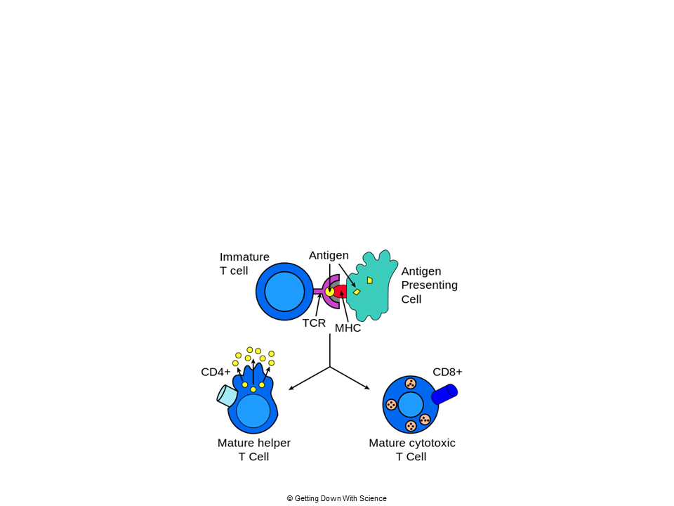
Direct Contact
Example:
  Immune cells
    Antigen presenting cells (APCs) communicate to T cells through direct contact

Slide 6
Local Regulators
Local regulators: a secreting cell will release chemical messages (local regulators/ligands) that travel a short distance through the extracellular fluid
  The chemical messages will cause a response in a target cell
  Examples:
    Paracrine signaling
    Synaptic signaling

Slide 7
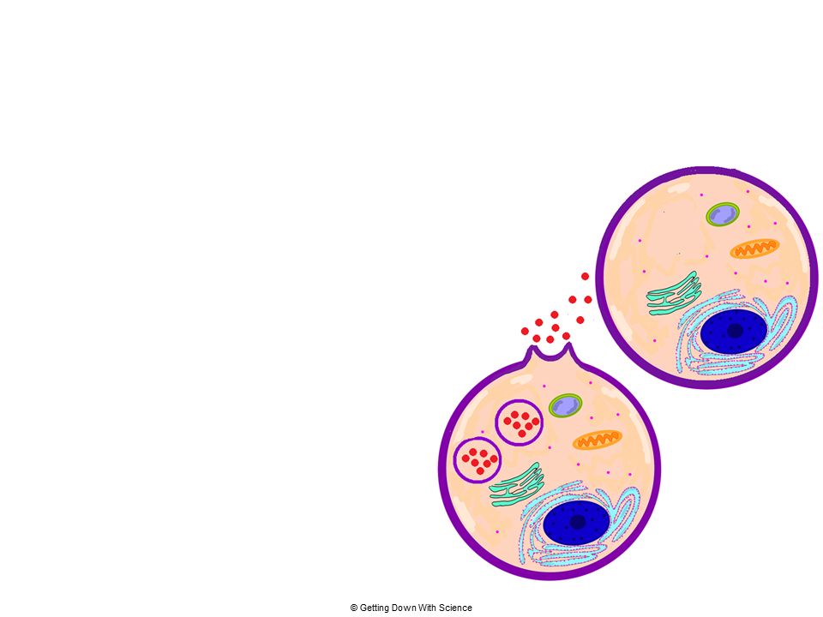
Local Regulators
Paracrine signaling: secretory cells release local regulators (ie growth factors) via exocytosis to an adjacent cell
Target cell
Local regulator
Secretory cell that acts on nearby cells

Slide 8
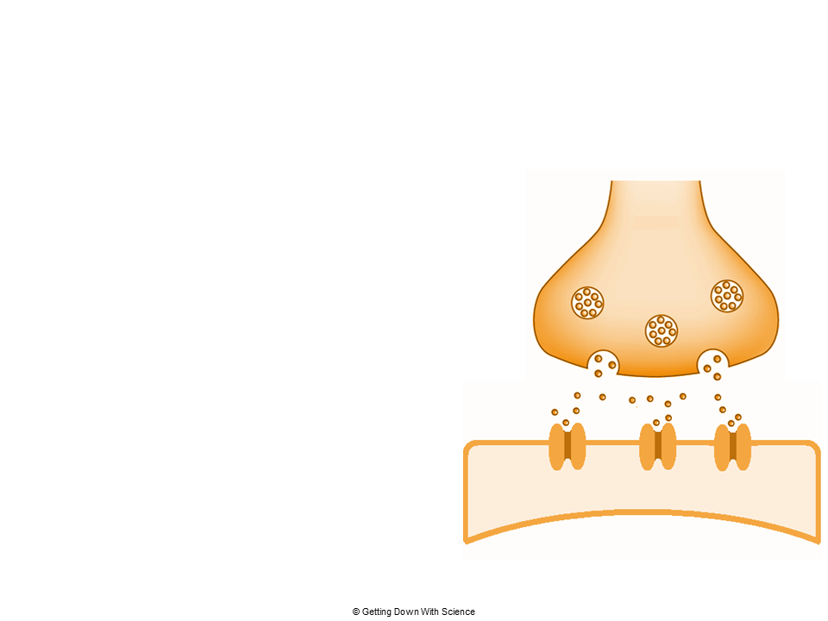
Local Regulators
Synaptic signaling: Occurs in animal nervous systems
Neurons secrete neurotransmitters
  Diffuse across the synaptic cleft- space between the nerve cell and target cell
Axon
Neurotransmitters
Synaptic
cleft
Target cell
Notes:
Note: Can be considered long distance signaling depending upon the length of the neuron

Slide 9
Long Distance Signaling
Animals and plants use hormones for long distance signaling
  Plants release hormones that travel in the plant vascular tissue (xylem and phloem) or through the air to reach target tissues
  Animals use endocrine signaling
    Specialized cells release hormones into the circulatory system where they reach target cells

Slide 10
Long Distance Signaling
Example:
  Insulin
    Insulin is released by the pancreas into the bloodstream where it circulates through the body and binds to target cells

Slide 11
Quick Check
What type of communication involves a cell secreting a substance to an adjacent target cell?
  Answer: paracrine signaling
Plant cells in direct contact with each other can diffuse substances through these structures to communicate. What are they?
  Answer: plasmodesmata

Slide 12
Practice Problems
Work on practice problems 1-7 in your packet

Slide 13
Think, Pair, Share
How do you think cells process signals?

Slide 14
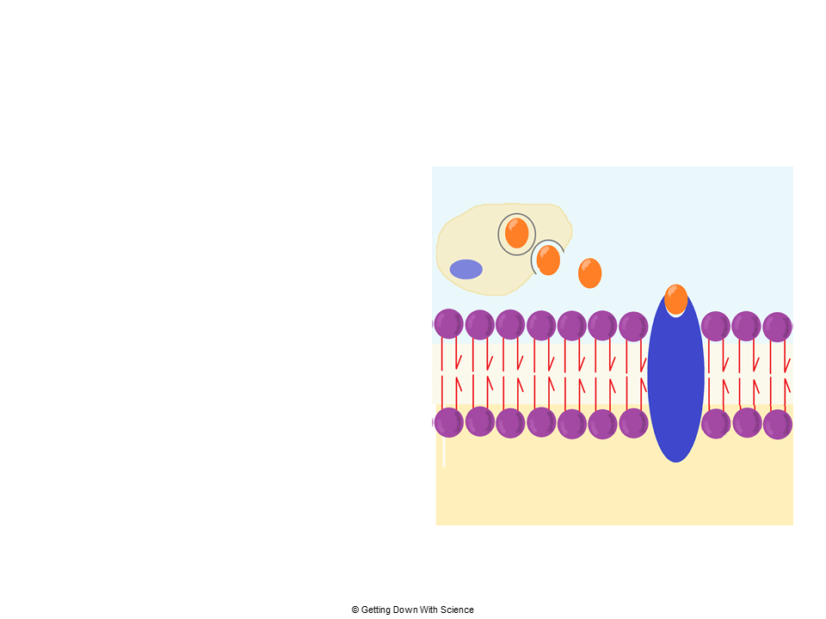
Cell Signaling: Overview
Cell-to-cell messages can be divided into three stages
Reception
  Ligand binds to receptor

Slide 15
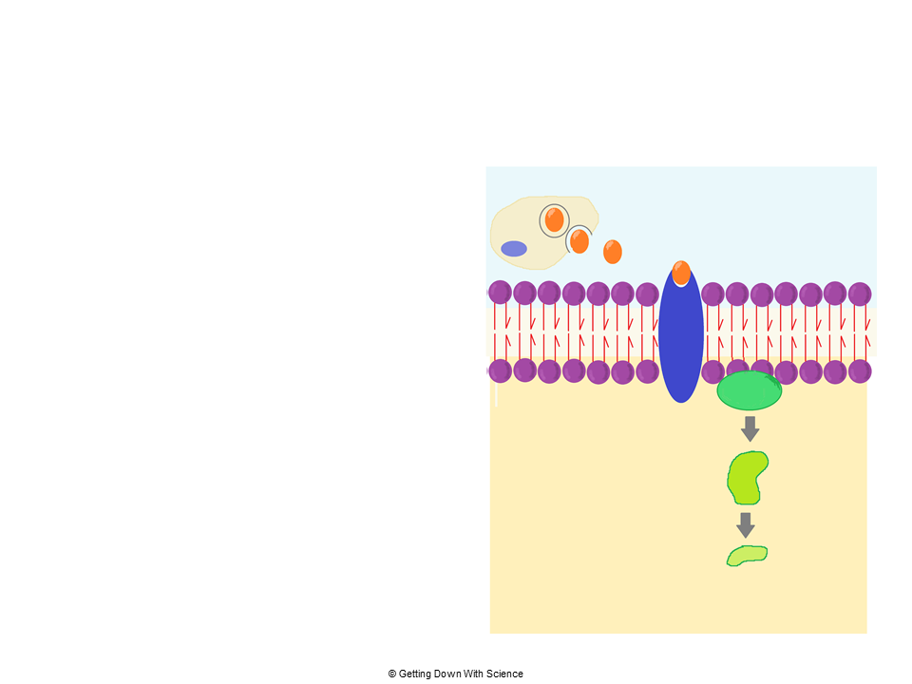
Cell Signaling: Overview
Cell-to-cell messages can be divided into three stages
Reception
  Ligand binds to receptor
Transduction
  Signal is converted

Slide 16
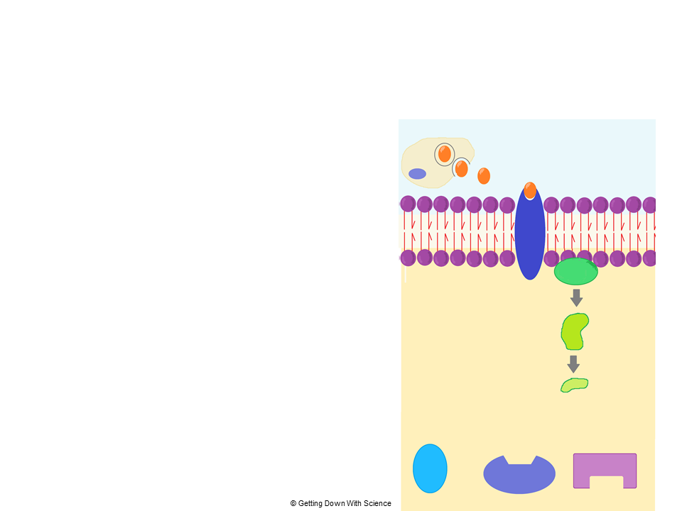
Cell Signaling: Overview
Cell-to-cell messages can be divided into three stages
Reception
  Ligand binds to receptor
Transduction
  Signal is converted
Response
  A cell process is altered
A
B
C

Slide 17
Stage 1: Reception
Reception: the detection and receiving of a ligand by a receptor in the target cell
Receptor: macromolecule that binds to a signal molecule (ligand)
  All receptors have an area that interacts with the ligand and an area that transmits a signal to another protein
    Binding between ligand and receptor is highly specific

Slide 18
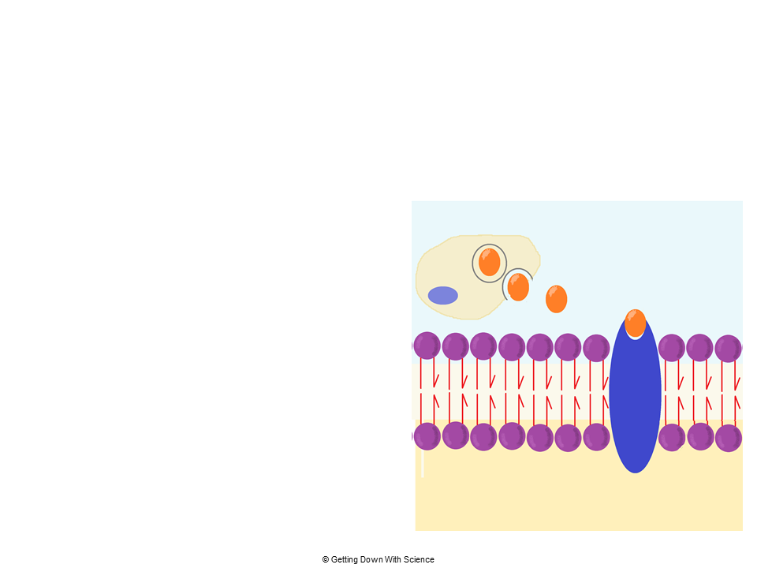
Stage 1: Reception
When the ligand binds to the receptor, the receptor activates (via a conformational change)
Allows the receptor to interact with other cellular molecules
  Initiates transduction signal
Receptors can be in the plasma membrane or intracellular

Slide 19
Stage 1: Reception
Plasma Membrane Receptors
Intracellular Receptors
Most common type of receptor involved in signal pathways
Bind to ligands that are:
  Polar, water-soluble
  Large
Examples:
  G protein coupled receptors (GPCRs)
  Ligand-gated ion channels
Found in the cytoplasm or nucleus of target cell
Bind to ligands that can pass through the plasma membrane
  Ie hydrophobic molecules
    Steroid and thyroid hormones
    Gasses like nitric oxide

Slide 20
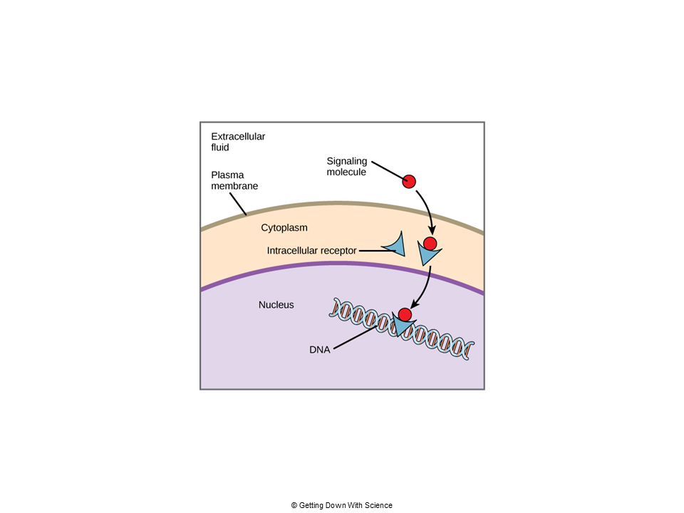
Stage 1: Reception
Intracellular receptors
Note: the AP exam will not expect you to be able to classify any given molecule as hydrophobic, usually they will either tell you it is hydrophobic, or they will say the molecule is a steroid hormone

Slide 21
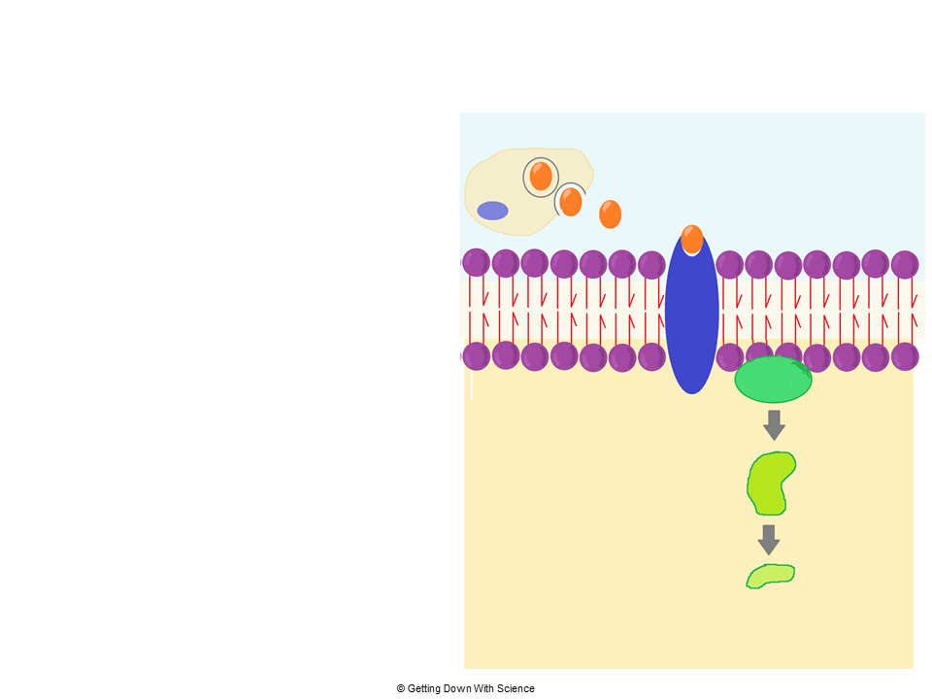
Stage 2: Transduction
Transduction: the conversion of an extracellular signal to an intracellular signal that will bring about a cellular response
Requires a sequence of changes in a series of molecules known as a signal transduction pathway
Intracellular signaling molecules

Slide 22
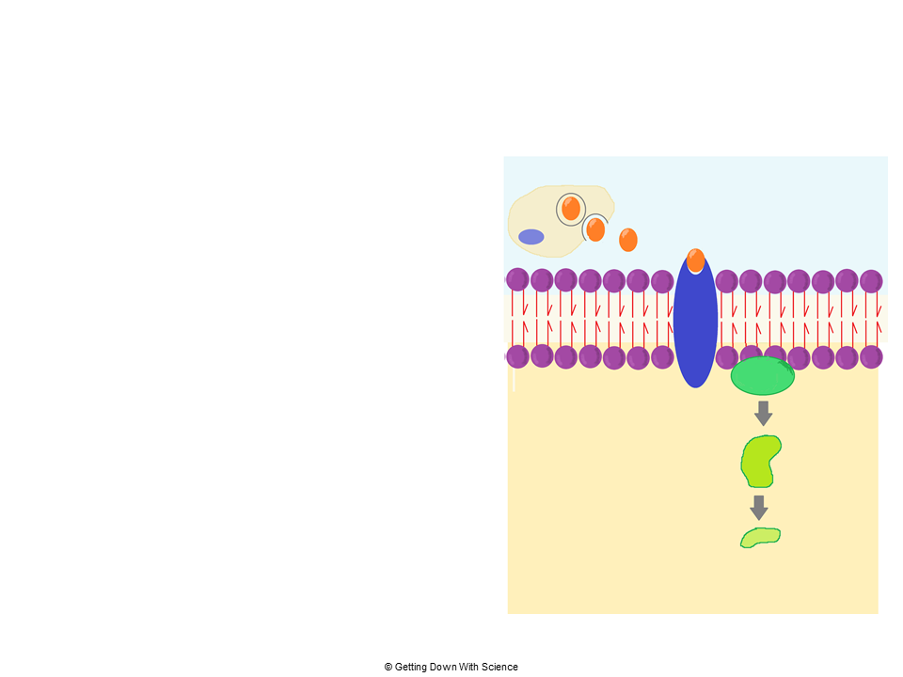
Stage 2: Transduction
The signal transduction pathway regulates protein activity through:
  Phosphorylation by the enzyme protein kinase
    Relays signal inside cell
  Dephosphorylation by the enzyme protein phosphatase
    Shuts off pathways
*Remember: a change in shape means a change in function
Intracellular signaling molecules

Slide 23
Stage 2: Transduction
During transduction the signal is amplified
Second messengers: small, non-protein molecules and ions help relay the message and amplify the response
  Cyclic AMP (cAMP) is a common second messenger
Intracellular signaling molecules

Slide 24
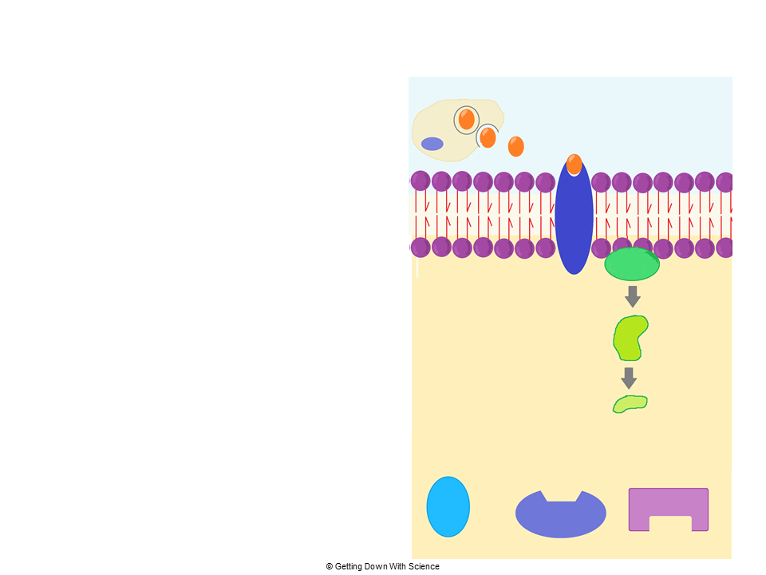
Stage 3: Response
Response: the final molecule in the signaling pathway converts the signal to a response that will alter a cellular process
Examples:
Protein that can alter membrane permeability
Enzyme that will change a metabolic process
Protein that turns genes on or off
A
B
C

Slide 25
Quick Review
What are the three stages of cell signaling?
  Answer: reception, transduction, reponse
What is the actual “signal” being transduced in a signal transduction pathway?
  Answer: a ligand
How is this “signal” passed from outside to inside the cell?
  Answer: through transduction. During transduction the signal is relayed by protein kinases and amplified by second messengers

Slide 26
Signal Transduction Pathways
Signal transduction pathways can influence how a cell responds to its environment
  They can result in changes in gene expression and cell function
    Can alter phenotypes or result in cell death

Slide 27
Changes in Signal Transduction Pathways
Mutations to receptor proteins or to any component of the signaling pathway will result in a change to the transduction of the signal

Slide 28
Practice FRQ
Some diseases, such as cancer and diabetes, are caused by defective protein phosphatases. Explain how such a defective protein would affect a signal transduction pathway.
Notes:
Protein phosphatases are responsible for dephosphorylation of molecules. If they are defective, then they will not be able to perform their function, which would result in an alteration to the signaling pathway.They are also partially responsible for stopping signal pathways, if they are defective the signal pathway would continue.

Slide 29
Important Receptors
In eukaryotic organisms there are two main categories of cell membrane receptors:
G protein coupled receptors (GPCRs)
Ion channels

Slide 30
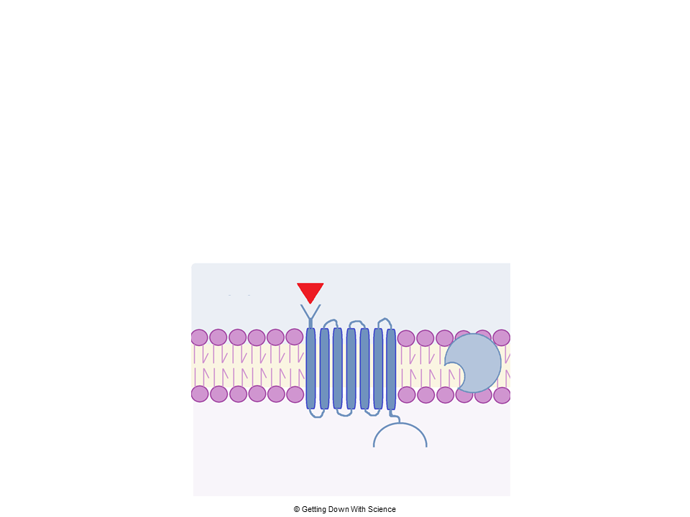
GPCRs
G protein coupled receptors (GPCRs):
Largest category of cell surface receptors
Important in animal sensory systems
Binds to a G protein that can bind to GTP, which is an energy molecule similar to ATP
GPCR

Slide 31
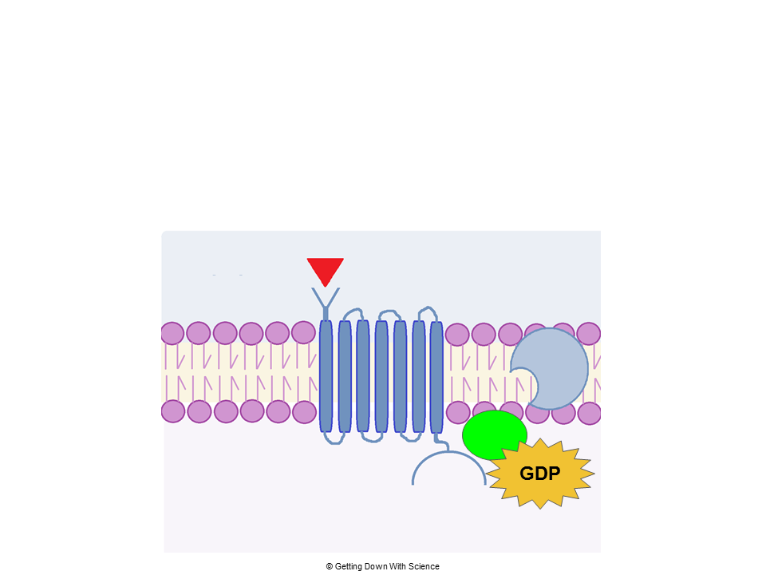
GPCRs
The GPCR, enzyme, and G protein are inactive until ligand binding to GPCR on the extracellular side
Inactive enzyme
ligand
Inactive G protein
Inativate
GPCR

Slide 32
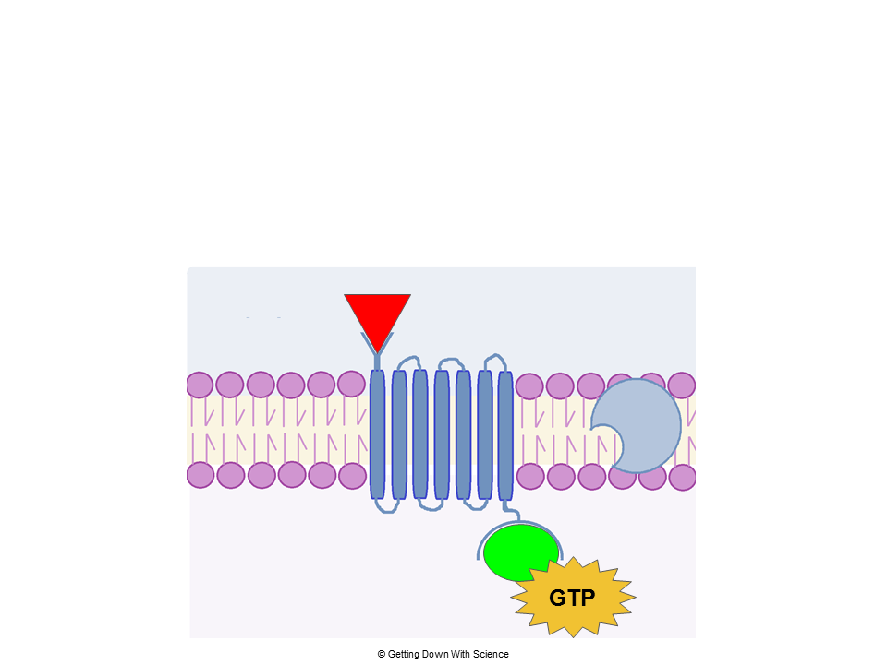
GPCRs
Ligand binding causes cytoplasmic side to change shape
  Allows for the G protein to bind to GPCR
    Activates the GPCR and G protein
      GDP becomes GTP
Inactive enzyme
Ligand
binds
Active G protein
Active
GPCR
GDP becomes GTP

Slide 33
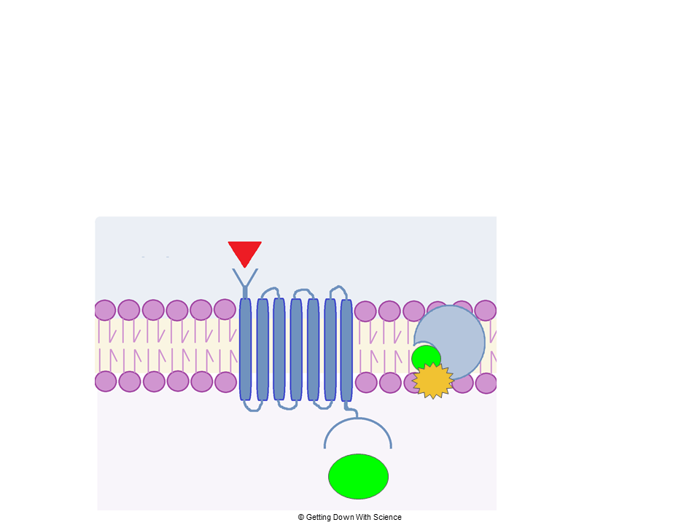
GPCRs
Part of the activated G protein can then bind to the enzyme
  Activates enzyme
  Amplifies signal and leads to a cellular response
Active enzyme
Signaling pathway

Slide 34
Ion Channels
Ligand gated ion channels:
Located in the plasma membrane
Important in the nervous system
Receptors that act as a “gate” for ions
  When a ligand binds to the receptor, the “gate” opens or closes allowing the diffusion of specific ions
    Initiates a series of events that lead to a cellular response

Slide 35
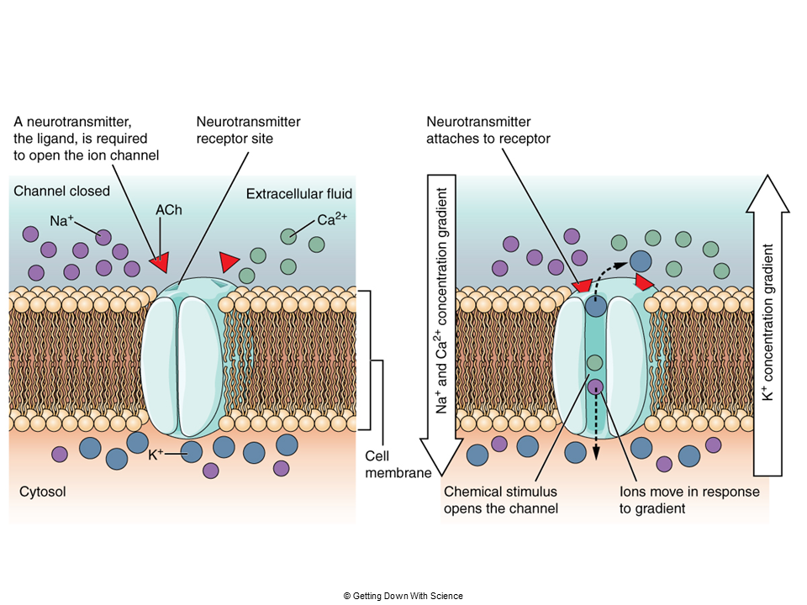
Ion Channels

