Slide 1
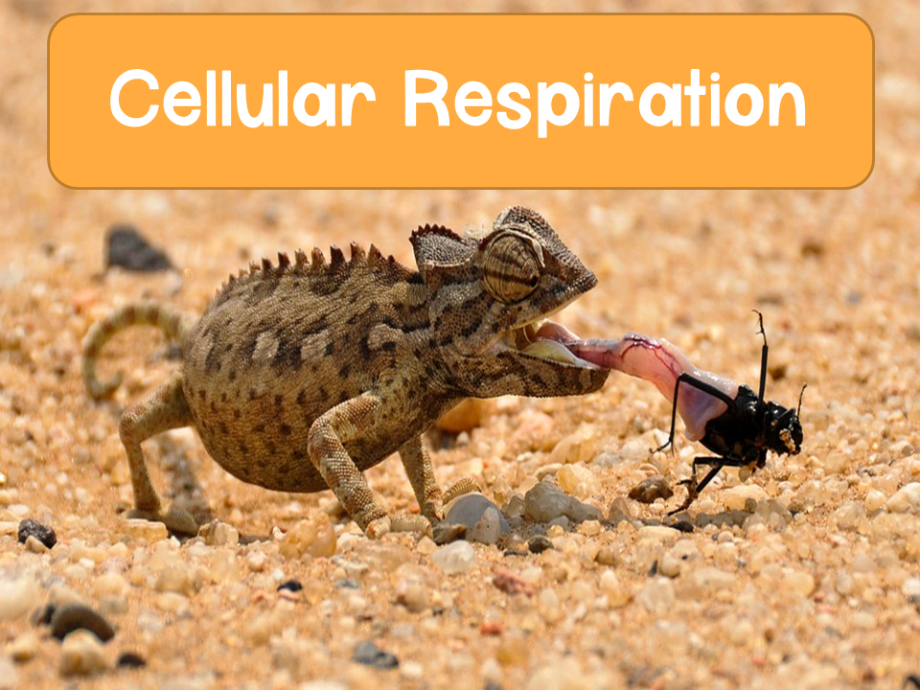

Slide 2
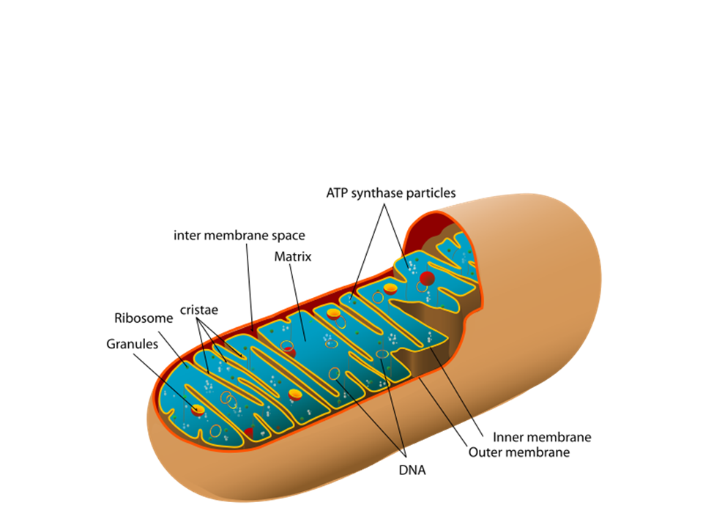
Review: Mitochondria
Take a minute to review your notes and/or text for the structures of the mitochondria

Slide 3
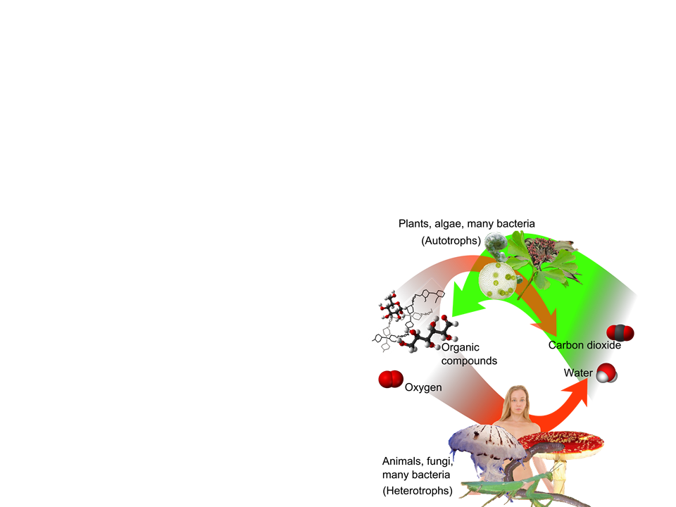
Cellular Respiration
Cells harvest chemical energy stored in organic molecules and use it to generate ATP
Organic molecules + oxygen
CO₂ + H₂O + energy
Starch is the major source of fuel for animals
Breaks down into glucose

Slide 4
Cellular Respiration
Catabolic breakdown of glucose:
Remember:
OIL RIG or
LEO goes GER
Oxidized
C₆H₁₂O₆ + 6O₂
6CO₂ + 6H₂O + energy (ATP and heat)
Reduced
The oxidation of glucose transfers e- to a lower energy state, releasing energy to be used in ATP synthesis

Slide 5
Path of Electrons in Energy Harvest
During cellular respiration, most electrons will follow this “downhill” exergonic path:
glucose
NADH
ETC
oxygen

Slide 6
Energy Harvest
Glucose is broken down in steps to harvest energy
Electrons are taken from glucose at different steps
Each e⁻ taken travels with a proton (H⁺)
  Dehydrogenases take 2 e⁻ and 2 protons from glucose
    Oxidizing agent for glucose
  Transfers 2e- and 1 proton to the coenzyme NAD⁺. Reduces to NADH (stores the energy)
    Other proton is released into surrounding solution as H⁺
  NADH carries e⁻ to the electron transport chain

Slide 7
Energy Harvest
Electron transport chain (ETC): a sequence of membrane proteins that shuttle electrons down a series of redox reactions
  Releases energy used to make ATP
  ETC transfers e⁻ to O₂ (the final e⁻ acceptor) to make H₂O
    Releases energy

Slide 8
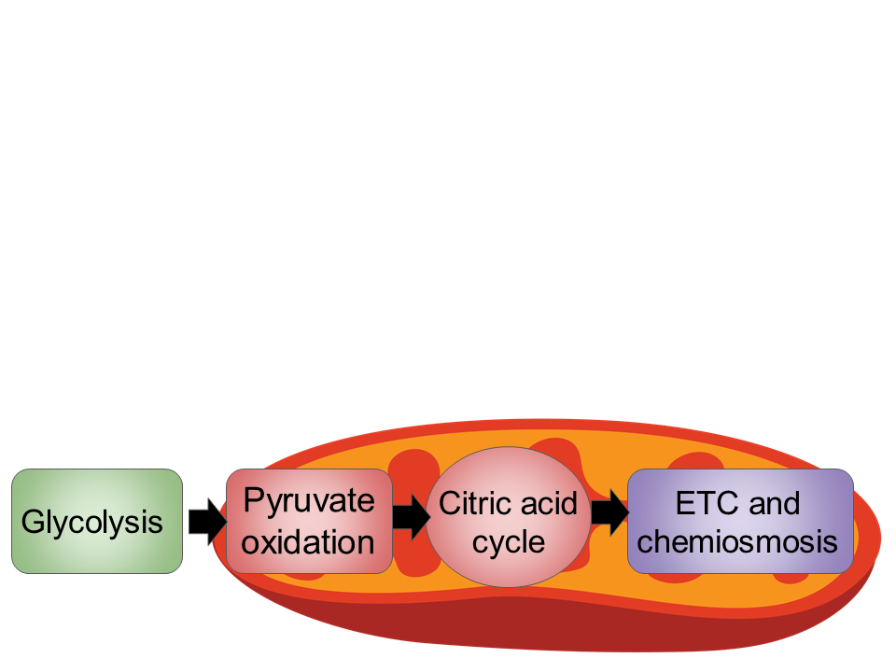
Stages of Cellular Respiration
There are three stages of cellular respiration:
Glycolysis
Pyruvate oxidation and the citric acid cycle
Oxidative phosphorylation (ETC and chemiosmosis)

Slide 9

Glycolysis
Starting point of cellular respiration
Occurs in the cytosol
Splits glucose (6C) into 2 pyruvates (3C)

Slide 10
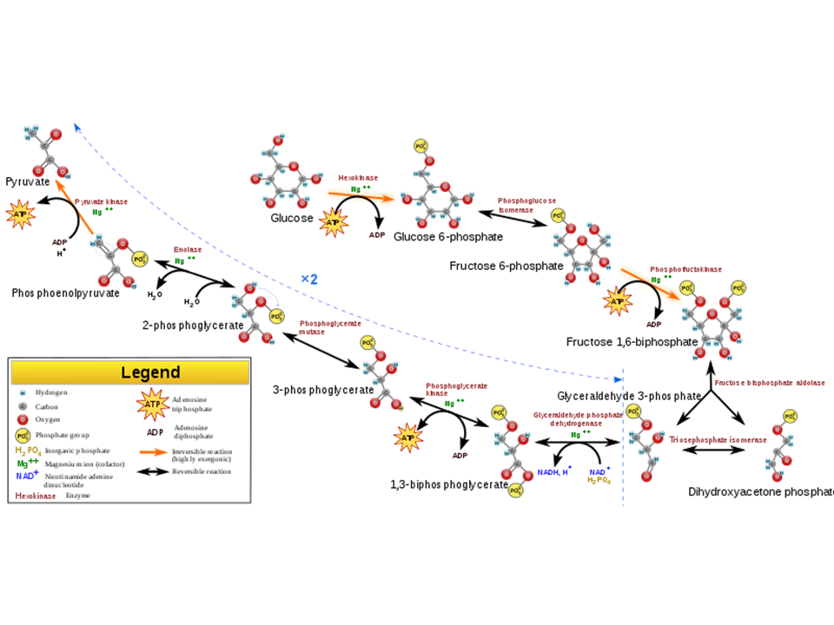
Glycolysis
For those who want to see the entire process in all its glory. Don’t worry you don’t need to know ALL of this ☺

Slide 11
Glycolysis
Summarized pathway:
Glucose
ADP + P
2 NAD⁺
2 ATP
2 NADH + 2H⁺
2 H₂O
2 pyruvate

Slide 12
Glycolysis
Two stages
  Energy investment stage: the cell uses ATP to phosphorylate compounds of glucose
  Energy payoff stage: energy is produced by substrate level phosphorylation
    The net energy yield per 1 glucose:
      2 ATP
      2 NADH

Slide 13
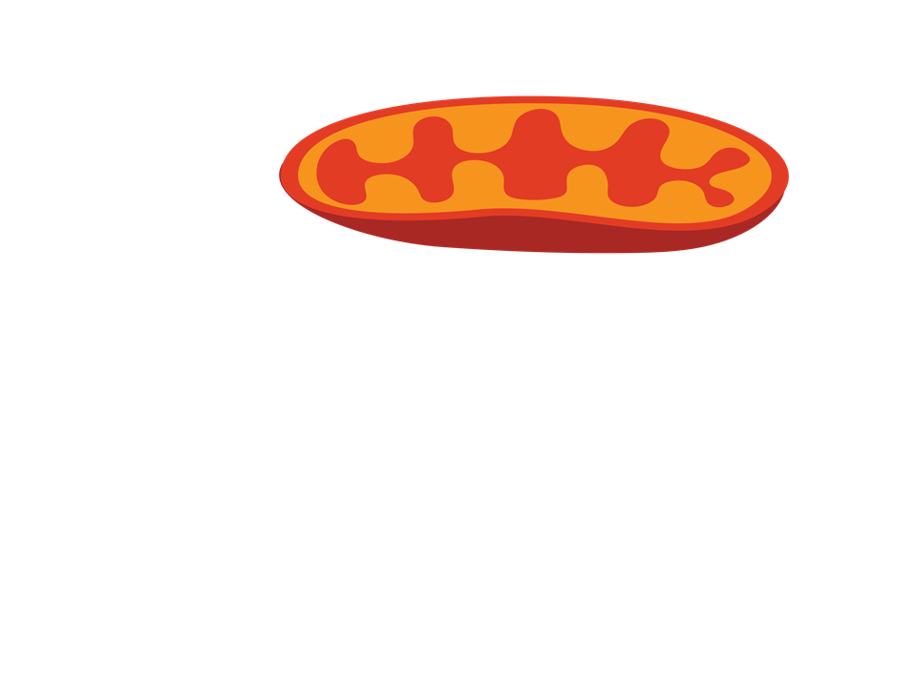
Glycolysis Summary
Pyruvate oxidation
Citric acid cycle
ETC and chemiosmosis
Glycolysis
Energy Investment
2 ATP
2 ADP + P
Energy Payoff
4 ADP + P
4 ATP
2 NAD⁺ + 4e⁻ + 4H⁺
2 NADH + 2H⁺
Net
2 Pyruvate + 2 H₂O
2 ATP
2 NADH + 2H⁺

Slide 14
Quick Check
Where does glycolysis occur?
  Answer: cytosol
What is produced through glycolysis?
  Answer: pyruvate
What is the net production of ATP?
  Answer: 2 ATP

Slide 15

Pyruvate Oxidation and Citric Acid Cycle
If oxygen is present, the pyruvate enters the mitochondria (eukaryotic cells)
Pyruvate is oxidized into acetyl coA
  Acetyl coA is used to make citrate in the citric acid cycle
2 CO₂ and 2 NADH are produced

Slide 16
Pyruvate Oxidation
CoA
Pyruvate
Acetyl CoA
CO₂
NAD⁺
NADH + CO₂

Slide 17
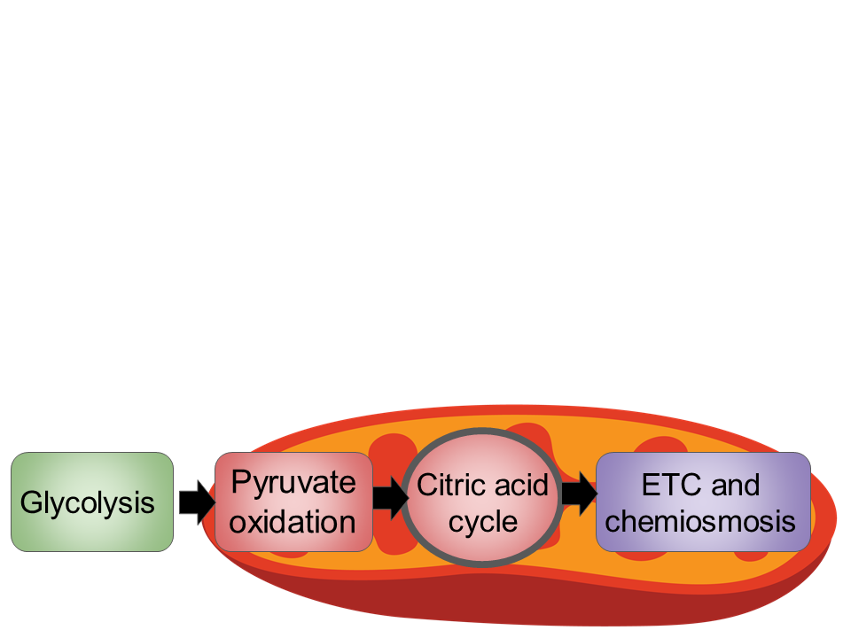
Citric Acid Cycle
Also known as the Krebs cycle
Occurs in the mitochondrial matrix
Turns acetyl CoA into citrate
  Releases CO₂
  ATP synthesized
  Electrons transferred to NADH and FADH₂

Slide 18
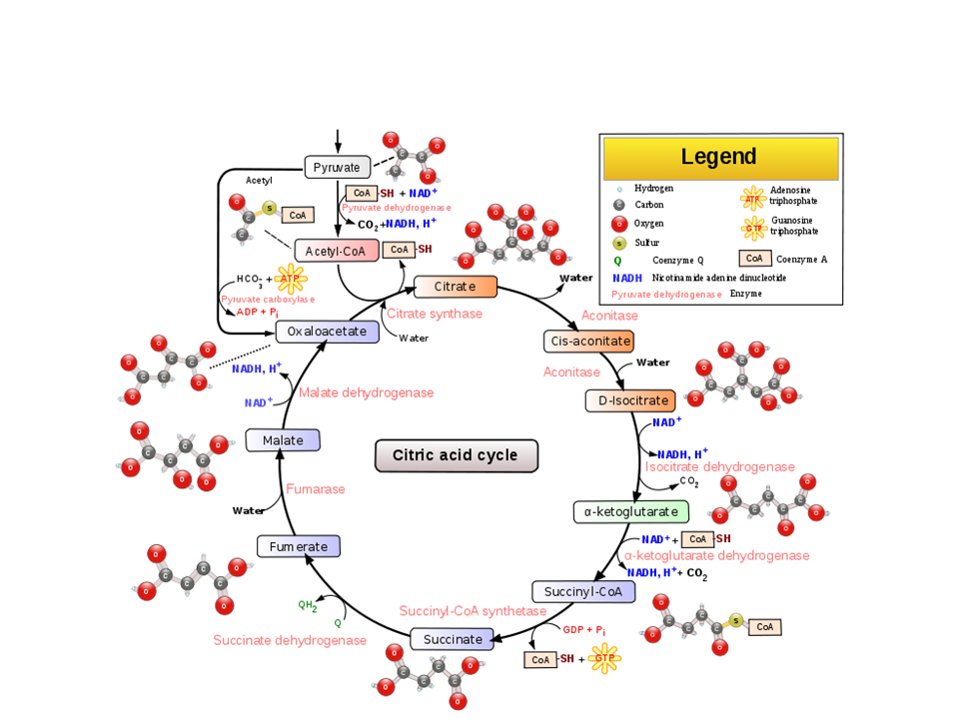
Citric Acid Cycle
Don’t worry you don’t need to know ALL of this ☺

Slide 19
Citric Acid Cycle
Summarized pathway (per glucose molecule):
Inputs
Outputs
2 acetyl CoA
2 ATP
6 NADH
4 CO₂
2 FADH₂
Citric acid cycle

Slide 20
Quick Check
Where does the citric acid cycle occur?
  Answer: mitochondrial matrix
What is the net production of ATP in the citric acid cycle?
  Answer: 2 ATP

Slide 21

Oxidative Phosphorylation
Oxidative phosphorylation consists of:
  Electron transport chain
  Chemiosmosis

Slide 22
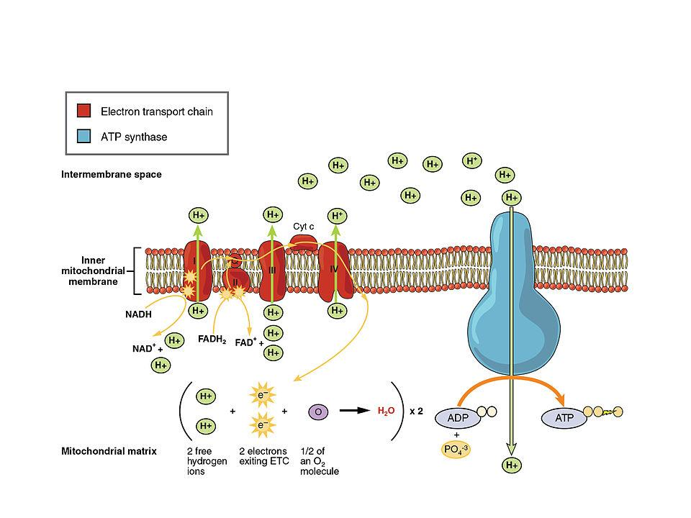
Electron Transport Chain

Slide 23
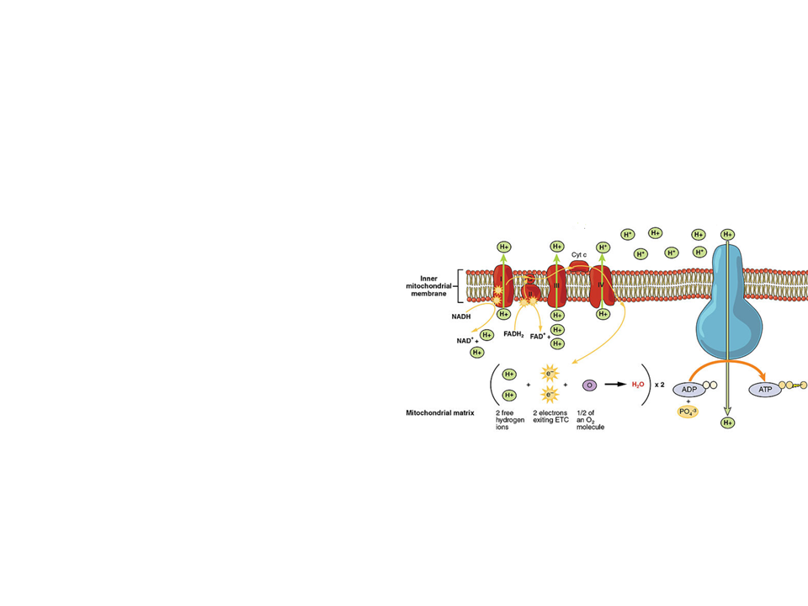
Electron Transport Chain
The ETC is located in the inner membrane of the mitochondria
  Collection of proteins
  As the electrons “fall” proteins alternate between reduced (accepts e⁻) and oxidized (donates e⁻) state

Slide 24
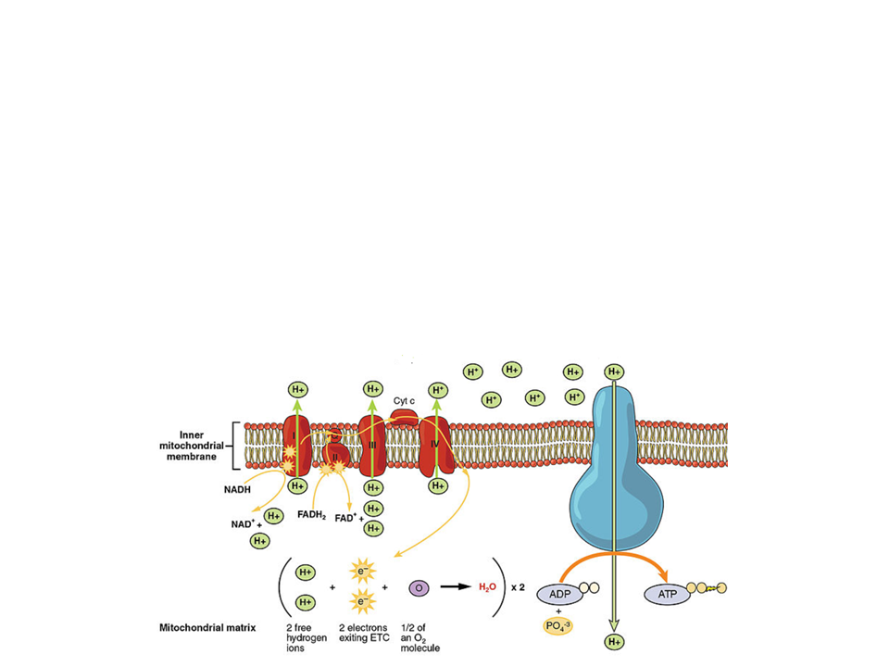
Electron Transport Chain
The cristae increase the surface area for the reactions to occur
Does not produce ATP directly
  Helps manage the release of energy by creating several small steps for “fall” of electrons

Slide 25
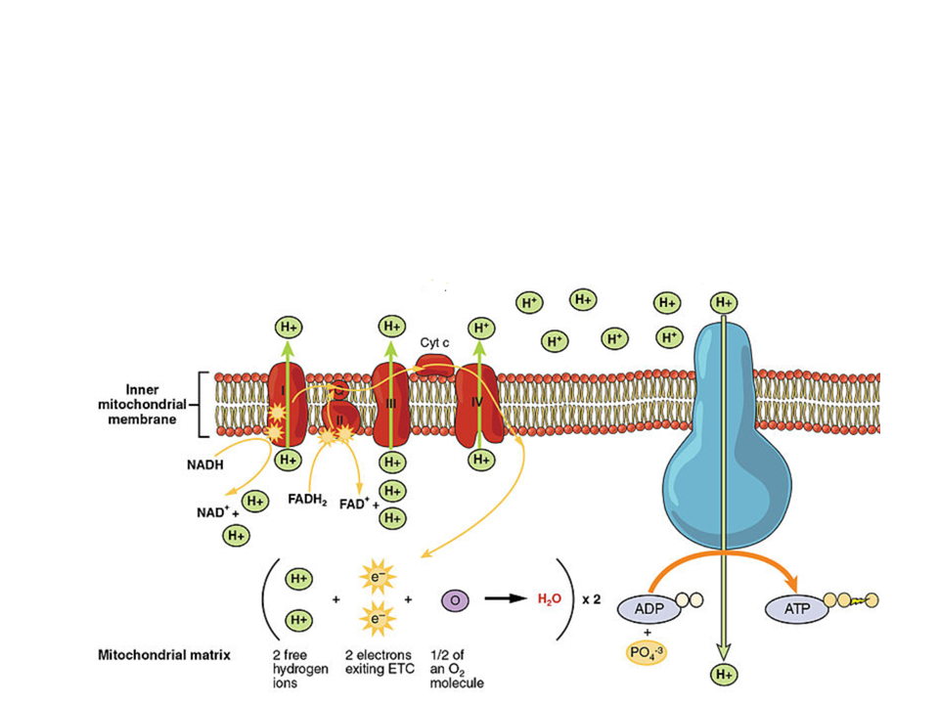
Electron Transport Chain
The final electron acceptor is oxygen
  Each oxygen pairs with 2 H⁺ and 2 e⁻ to form H₂O

Slide 26
Electron Transport Chain
One major function of the ETC is to create a proton (H⁺) gradient across the membrane
  As proteins shuttle electrons along the ETC, they also pump H⁺ into the intermembrane space
    Use the exergonic flow of electrons from NADH and FADH₂
  This gradient will power chemiosmosis
    Uses hydrogen ions to power cellular work

Slide 27
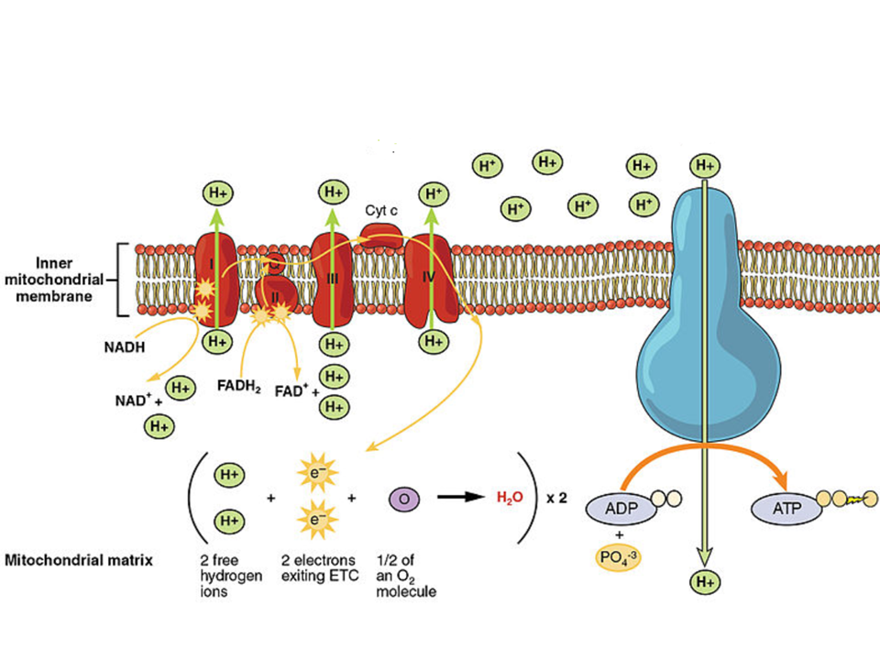
Pumping H+

Slide 28
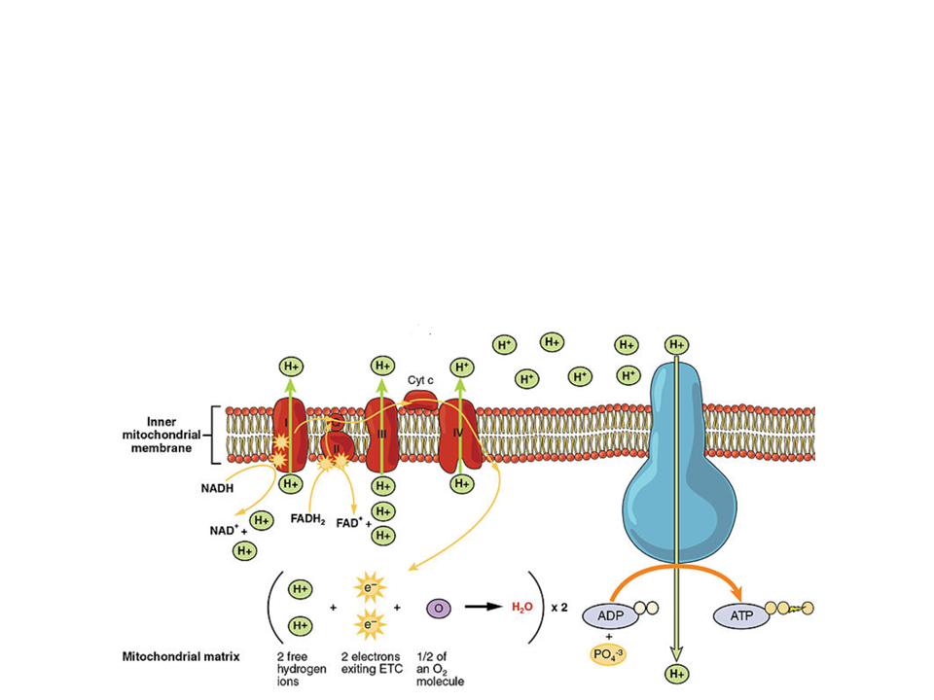
Chemiosmosis
ATP synthase: the enzyme that makes ATP from ADP + P
  Uses energy from the H⁺ gradient across the membrane

Slide 29
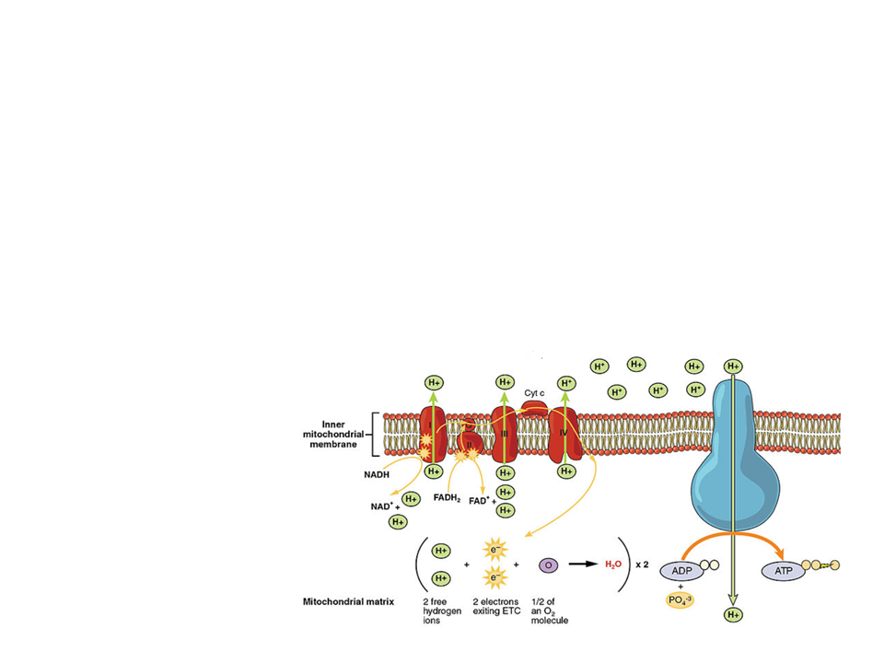
Chemiosmosis
H⁺ ions flow down their gradient through ATP synthase
  ATP synthase acts like a rotor
    When H+ binds the rotor spins
      Activates catalytic sites to turn ADP + P into ATP

Slide 30
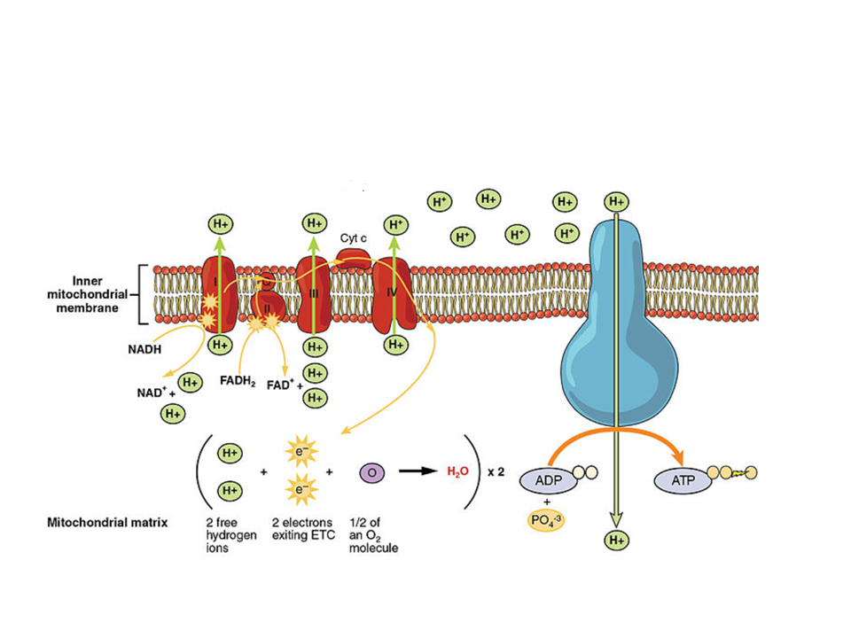
Chemiosmosis
Produces about 26-28 ATP per glucose

Slide 31
Quick Check
How is a proton gradient formed across the inner mitochondrial membrane?
  Answer: the exergonic flow of electrons from NADH and FADH₂ powers the complexes in the ETC to pump H+ into the intermembrane space
What is the final electron acceptor in the ETC?
  Answer: oxygen
How does ATP synthase obtain energy to convert ADP + P to ATP?
  Anwer: from the proton gradient.

Slide 32
Summary | Inputs | Outputs
Glycolysis | 1 glucose | 2 pyruvate 2 ATP 2 NADH
Pyruvate oxidation | 2 pyruvate | 2 acetyl CoA 2 CO₂ 2 NADH
Citric acid cycle | 2 acetyl CoA | 4 CO₂ 2 ATP 6 NADH 2 FADH₂
Oxidative phosphorylation | 10 NADH 2 FADH₂ | 26-28 ATP
Total ATP |  | 30-32 ATP

Slide 33
Respiration without Oxygen

Slide 34
Respiration
Remember: in cellular respiration, oxygen is the final electron acceptor- it drives electrons down the ETC. So how do organisms produce ATP in the absence of oxygen?
Anaerobic respiration
Fermentation

Slide 35
Anaerobic Respiration
Anaerobic respiration: generates ATP using an ETC in the absence of oxygen
Takes place in prokaryotic organisms that live in environments with no oxygen
The final electron acceptors: sulfates or nitrates

Slide 36
Fermentation
Fermentation: generates ATP without an ETC
Extension of glycolysis
  Recycles NAD+
  Occurs in the cytosol
  NO oxygen
  Two types:
    Alcohol fermentation
    Lactic acid fermentation

Slide 37
Alcohol Fermentation
Alcohol fermentation: pyruvate is converted into ethanol
Examples: bacteria, yeast
2 ADP + P
2 ATP
Glucose
Glycolysis
2 Pyruvate
2 NAD⁺
2 NADH + 2H⁺
2 CO₂
2 Ethanol
2 Acetaldehyde

Slide 38
Lactic Acid Fermentation
Lactic acid fermentation: pyruvate is reduced directly by NADH to form lactate
2 ADP + P
2 ATP
Glucose
Glycolysis
2 Pyruvate
2 NAD⁺
2 NADH + 2H⁺
2 Lactate

Slide 39
Lactic Acid Fermentation
Example: muscle cells
When muscles run out of oxygen, they can go through lactic acid fermentation to produce ATP
  Causes the burning sensation you may feel when performing strenuous exercise

Slide 40
Lactic Acid Fermentation
Breakdown of lactate:
Muscles produce lactate, which goes into the blood, and is broken down back to glucose in the liver
  When lactate is in the blood, it lowers the pH
  If lactate builds up and is unable to be broken down it can lead to lactic acidosis
    Excessively low blood pH

Slide 41
Respiration: Putting it all Together
Glycolysis
(cytosol)
With oxygen
NO oxygen
Pyruvate
oxidation
Fermentation
30-32 ATP
Citric acid cycle
Lactic acid
Alcohol
Oxidative phosphorylation
(ETC and chemiosmosis)
2 ATP
2 ATP

Slide 42
Practice FRQ
The catch and release method of fishing was once thought to be a beneficial way to conserve fish populations in a body of water. However, it is now known to be potentially deadly for up to 72 hours after a fish has been caught. When a fish is caught and pulled out of the water, it cannot take in oxygen. The fish experiences extreme stress during this time, which triggers “shimmying,” a condition where the fish uses its muscles to vigorously shake back and forth. (a) Identify the stage of cellular respiration that is directly affected by the lack of oxygen. (b) Explain the role of oxygen in cellular respiration. (c) Describe how the fish is most likely able to generate energy to “shimmy” in the absence of oxygen.
Notes:
The ETC is affected.
Oxygen is the final electron acceptor. It attracts electrons as they “fall” down the ETC. Without oxygen, there would be no final electron acceptor, so the ETC would effectively shut down.
The fish must go through anaerobic respiration to “shimmy.” The muscle cells are going through lactic acid fermentation.

Slide 43
Practice FRQ
Examining the permeability of mitochondria revealed that the outer membrane was permeable to H⁺ ions. After discovering this, a researcher wanted to study the effects of pH on the activity of mitochondria. Mitochondria from liver cells were isolated and exposed to solutions at pH 9, 8, 7, 6, and 5. The results indicated that mitochondria were most active at pH 5. (a) Explain how pH may affect the relative concentration of ions in the mitochondria. (b) Propose a model to explain how a low pH could increase the productivity of mitochondria.
Notes:
If mitochondria are placed in low pH solutions, they are being exposed to H+ ions. This could then increase the relative concentrations of H+ in the intermembrane space since it can diffuse through the outer membrane.
With a higher amount of H+ in the intermembrane space, the gradient is increased, and ATP synthase will be able to generate ATP more rapidly

